Slide 1
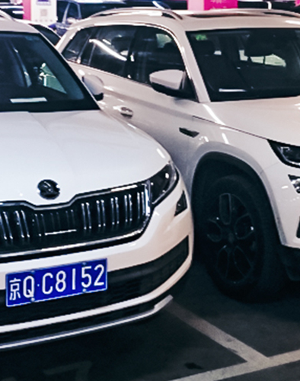
Car Plate Recognition and Reconstruction with Deep Learning
Project for the Computer Vision course La Sapienza, A.Y. 2024/2025 Authors: Onorio Iacobelli, Alessandro Rocchi
1/17

Slide 2
Outline
Problem Statement
State of the Art
Proposed Method
Dataset
Experimental Setup
Model Evaluation
Conclusions
Future Works
References
2/17

Slide 3
Problem Statement
Detecting and recognizing license plates is a crucial task in computer vision.
It involves two key computer vision steps:
locating license plates within images (detection) and
extracting the alphanumeric characters from them (recognition).
This task is widely used in intelligent transportation systems, such as automated toll collection, traffic law enforcement, and vehicle tracking.
3/17

Slide 4
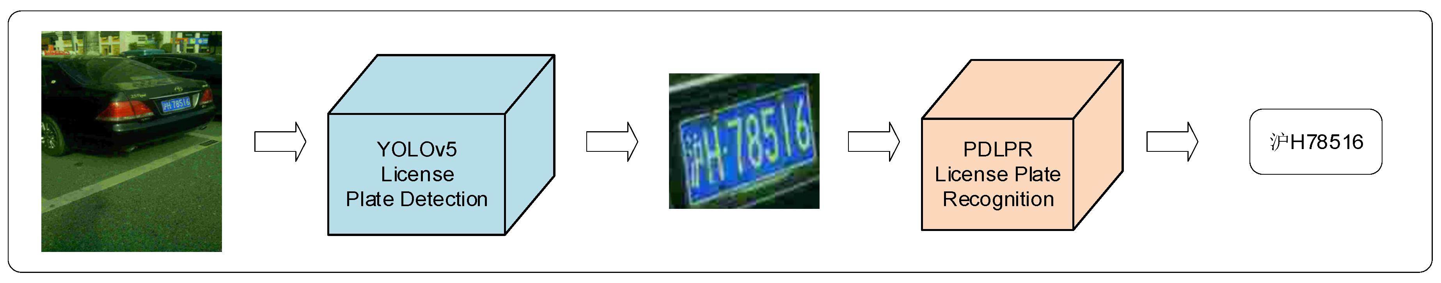
State of the Art
The state-of-the-art approach we’ve looked at consists in a YOLOv5-PDLPR model which employs the YOLOv5 detection algorithm and a PDLPR algorithm for the recognition part.
The PDLPR algorithm is described and proposed in the reference paper [1] for the project and is responsible for recognizing the characters in the cropped license plate images.
4/17

Slide 5
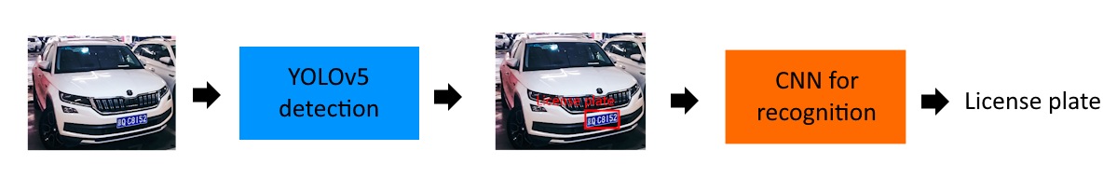
Proposed Method
We propose a baseline model composed of:
the YOLOv5 model [2], trained by us, for detection
a multi-head CNN, also trained by us, for recognition
The YOLOv5 model detects the bounding boxes for the license plates and classifies them as such.
5/17

Slide 6
Proposed Method
The recognition model was created by us and works as follows.
It takes an RGB image in input and crops it according to the bounding box obtained from detection.
Features are extracted from the image by using stacked convolutional layers, followed by ReLU and MaxPooling.
The feature map is flattened into a single vector per image.
7 output heads predict a part of the license plate (province, letters, numbers)
6/17
Notes:
6

Slide 7
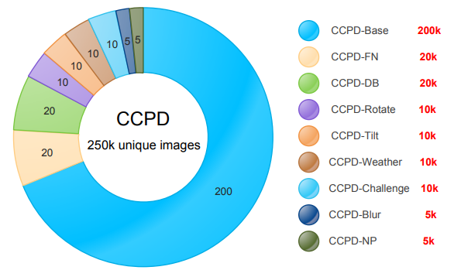
Dataset
The dataset we used for training is the CCPD2019 dataset [3], containing a large quantity of images depicting Chinese cars with their license plates.
Specifically, we used the «CCPD-Base» subset, containing 200000 images, from which we further took other smaller subsamples.
7/17
Notes:
77

Slide 8
Experimental Setup
We’ve developed our code in a Colab notebook containing:
download and decompression of the dataset
implementation, training and evaluation of the models for detection and recognition
evaluation of the full pipeline
implementation and evaluation of a pretrained model representing the state-of-the-art approach
For the state-of-the-art implementation we used a YOLOv5 model [4] pretrained on license plates for detection and the PaddleOCR model [5] for recognition.
8/17

Slide 9
Detection Evaluation
Model | Samples | Precision | Recall | AVG IoU
YOLOv5s | 20’000 | 99.3% | 99.2% | 0.643
YOLOv5m | 10’000 | 99.8% | 99.0% | 0.645
YOLOv5m | 20’000 | 99.0% | 99.0% | 0.649
YOLO models trained on 20 epochs
9/17

Slide 10
Recognition Evaluation
Model | Samples | Epochs | Full Plate Accuracy
Baseline CNN | 10’000 | 30 | 64.6%
Baseline CNN | 20’000 | 10 | 75.9%
Baseline CNN | 20’000 | 30 | 80.2%
Performance scales directly with more data and longer training
10/17

Slide 11
Pipeline Evaluation
Models | Detection |  |  | Recognition
 | Precision | Recall | F1 | Plate Accuracy | F1
YOLOv5m + Baseline | 99.4% | 53.4% | 69.5% | 74.2 % | 93.9%
YOLO + Baseline OCR | 92.4% | 96.7% | 94.5% | 81.8% | 96.5%
YOLO + PDLPR | 93.0% | 98.3% | 95.6% | 85.1% | 86.9%
All pipeline evaluations run on 20’000 samples
11/17

Slide 12
Pipeline Evaluation
Models | Detection |  |  | Recognition
 | Precision | Recall | F1 | Plate Accuracy | F1
YOLOv5m + Baseline | 99.4% | 53.4% | 69.5% | 74.2 % | 93.9%
YOLO + Baseline OCR | 92.4% | 96.7% | 94.5% | 81.8% | 96.5%
YOLO + PDLPR | 93.0% | 98.3% | 95.6% | 85.1% | 86.9%
Our baseline detector's poor recall (53.4%) was the primary bottleneck
in our custom pipeline
12/17

Slide 13
Pipeline Evaluation
Models | Detection |  |  | Recognition
 | Precision | Recall | F1 | Plate Accuracy | F1
YOLOv5m + Baseline | 99.4% | 53.4% | 69.5% | 74.2 % | 93.9%
YOLO + Baseline OCR | 92.4% | 96.7% | 94.5% | 81.8% | 96.5%
YOLO + PDLPR | 93.0% | 98.3% | 95.6% | 85.1% | 86.9%
Ablation Insight: Swapping to a pre-trained detector boosted recall to 96.7%,
proving our recognition model was effective when given good inputs
13/17
Notes:
3

Slide 14
Pipeline Evaluation
Models | Detection |  |  | Recognition
 | Precision | Recall | F1 | Plate Accuracy | F1
YOLOv5m + Baseline | 99.4% | 53.4% | 69.5% | 74.2 % | 93.9%
YOLO + Baseline OCR | 92.4% | 96.7% | 94.5% | 81.8% | 96.5%
YOLO + PDLPR | 93.0% | 98.3% | 95.6% | 85.1% | 86.9%
The PDLPR model provides a final ~3% accuracy improvement,
highlighting the superior robustness of its advanced recognition architecture.
14/17
Notes:
4

Slide 15
Conclusions
A good plate detector is the key for the pipeline performance
Simple baseline can perform well on the right input from detection output
Baseline OCR results are not far from PDLPR results, although PDLRP shows more consistency in difficult scenarios
15/17
Notes:
5

Slide 16
Future Works
Take advantage of all the available samples for training phase
Increase complexity to achieve better results for the baseline recognition model
Extend the dataset to other license plates from other countries to generalize more
16/17

Slide 17
References
Tao, L.; Hong, S.; Lin, Y.; Chen, Y.; He, P.; Tie, Z. A Real-Time License Plate Detection and Recognition Model in Unconstrained Scenarios. Sensors 2024, 24, 2791. https://doi.org/10.3390/s24092791
https://github.com/ultralytics/yolov5
Zhenbo Xu, Wei Yang, Ajin Meng, Nanxue Lu, Huan Huang, Changchun Ying, Liusheng Huang; Proceedings of the European Conference on Computer Vision (ECCV), 2018, pp. 255-271
https://huggingface.co/keremberke/yolov5m-license-plate
https://github.com/PaddlePaddle/PaddleOCR
17/17

