Slide 1
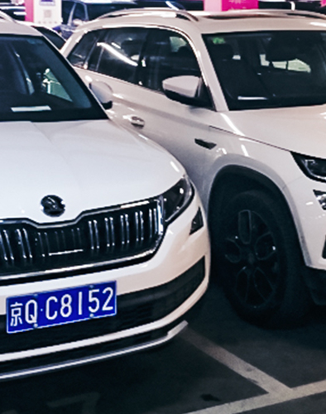
Car Plate Recognition and Recostruction with Deep Learning
Project for the Computer Vision course Sapienza, A.Y. 2024/2025 Authors: Onorio Iacobelli, Alessandro Rocchi

Slide 2
Outline
Problem statement
State of the Art
Proposed Method
Dataset
Experimental Setup
Model Evaluation
Conlusions

Slide 3
Problem Statement

Slide 4
State of the Art

Slide 5
Proposed Method

Slide 6
Dataset

Slide 7
Experimental Setup

Slide 8
Model Evaluation

Slide 9
Conclusions

Slide 10
References
Tao, L.; Hong, S.; Lin, Y.; Chen, Y.; He, P.; Tie, Z. A Real-Time License Plate Detection and Recognition Model in Unconstrained Scenarios. Sensors 2024, 24, 2791. https://doi.org/10.3390/s24092791

