Slide 1
NPHCDA · UNICEF · GAVI
Predictive Modelling of Zero-Dose and
Under-Immunized Children for Improved Immunization Decision Making in Nigeria
Findings and programme use for the National Routine Immunization (RI) team
Prepared by the CIDRE and Quantium Insights LLC consortium, in technical support of NPHCDA, with UNICEF and Gavi (the global vaccine partnership).

Slide 2
Closing the loop on the Executive Director's three requests
All three are complete. Each is answered by slides added or rebuilt since the last review, tagged so they can be checked off one by one.
1
COMPLETE
2
COMPLETE
3
COMPLETE
Nine more antigens,
beyond the original four
Archetyping rebuilt
at local government level
The priority states and
LGAs, named and ranked
WHAT YOU ASKED
WHAT YOU ASKED
WHAT YOU ASKED
Add indicators beyond BCG, Penta1, Penta3 and Measles1.
The unsupervised model was at state level. Take archetyping down to LGA.
Give the priority states and LGAs for zero-dose focus.
WHAT WAS DELIVERED
WHAT WAS DELIVERED
WHAT WAS DELIVERED
Nine antigens added: OPV3, IPV1, PCV3, Yellow Fever, Meningitis A, IPV2, and Rotavirus 1 to 3.
All 774 LGAs grouped into five contextual profiles from 15 local indicators, using no zero-dose or coverage estimate, with candidate packages from each LGA's measured barriers. Two profiles hold 1.52 million missed children.
All 773 modelled LGAs ranked by burden, each carrying its rate, cumulative share, priority band, equity tier and archetype. 151 LGAs cover half of the burden; 342 cover 80 percent.
New slide 11
New slides 20 to 23
New slide 19
How to verify. The six slides answering these requests carry a green tag in the top-right corner: 11, 19, 20, 21, 22 and 23.
Requests recorded at the Executive Director's review of the first presentation. Prepared by the CIDRE and Quantium Insights LLC consortium, in technical support of NPHCDA.

Slide 3
Outline
1
Project summary: project journey, outputs and handover
2
Key results and programme messages
3
Modelling approach: two Bayesian methods, from state estimates to every LGA
4
External benchmarks and an independent Concordant check
5
Practical use and use cases for decision-making
6
Methodological considerations: data quality, model transparency, archetype robustness
7
The Hugging Face application: filtering, outputs, programme support and limits
Recommendations
8
2
Notes:
Outline of the modelling check-in (your portion, after the three project-summary slides). Page references match the numbers printed on each slide. Five main-deck areas plus the Hugging Face application. If you prefer the printed page numbers to match each slide's physical position, the whole deck can be renumbered so this outline becomes slide 4 with content running 5 to 26.

Slide 4
Project journey: inception to handover
One integrated cycle over six months, from assessment to handover.
M1
M1-M2
M3
M4-M5
M6
Inception and governance
Baseline and modelling questions
Capacity building
Applied modelling
Endline, Integration and handover
Self-learning, virtual class, in-person fellowship, tests
Group mentorship, abstracts, model validation, domain outputs
Kickoff, workplan, data inventory, stakeholder alignment
Readiness review, decision-use questions, use-case matrix
No-code app, ZARA, procedures, user guides, endline, closeout
Delivery stream
Evidence of implementation
Baseline assessment - documented status, infrastructure, staff capacity and governance.
Abstract presentations turned model outputs into policy-facing products.
Modelling questions refined into eight domains aligned to NPHCDA decision needs.
Endline assessment - measured uptake, readiness gains and remaining barriers.
The fellowship combined virtual learning, in-person modelling, and supervised group work.
Handover packaged models, documentation, dashboards and recommendations.
Key achievement: from one-off training to a modelling workflow NPHCDA now runs in-house.
Source: consortium project record, January to June 2026. DIH = Digital Innovation Hub, the agency's in-house data team; ZARA = Zero-dose Analytics and Risk Assistant.

Slide 5
The seven research questions
Agreed with NPHCDA as the scope of work. Seven domains, one shared question: who is missed, where, and why.
Domain 1
Domain 5
Which antigens are at risk of falling below the 80 percent coverage target in the next 6 to 12 months?
Where do zero-dose children concentrate, who are they, and where do we act first?
Domain 2
Domain 6
What are the dropout rates across antigen pairs, and what drives incomplete vaccination?
Where is polio-detection and transmission risk highest on the path to certification?
Domain 3
Domain 7
How does zero-dose risk vary by place, wealth, education and access?
Where is outbreak risk highest, and how does it link to child deaths?
Domain 4
All seven domains are complete, validated and handed over.
How far does vaccine hesitancy explain coverage shortfalls?
Source: scope of work agreed with NPHCDA, 2026. LGA = local government area; RI = routine immunization.

Slide 6
The modelling journey, end to end
We brought many data sources together, checked them, and turned the results into a priority list and simple web tool.
1 · PREPARE
Data retrieval
Harmonization and triangulation
Pre-processing
Feature engineering
Routine immunization records, household surveys, population data, maps, travel-time data and surveillance records
Check missing records, reporting gaps and population figures
Missed children, dropout, child population and local barriers
Make sure state and local government names match across files
2 · ANALYSE
Statistical analysis
Machine learning
Spatial analysis
Time-series forecasting
Bayesian regression
MGWR
Spatial scan statistics
Create five easy-to-use community types
Show where the problem is concentrated
Show why different areas need different responses
LASSO driver selection
Estimate where coverage or completion may fall
Estimate how many children are being missed
Identify where surveillance should remain strong
Seven methods run in parallel on the same engineered features
3 · VALIDATE
AND USE
Convergent validation
Priority list development
Programme use
Compare with newer surveys, independent maps and child-death patterns
Rank local governments and match them with practical response packages
NPHCDA microplanning; the Hugging Face web application and the ZARA analyst
Source: consortium modelling pipeline, 2026. Every acronym is spelled out on the methods, datasets and reference slides.

Slide 7
Methods at a glance
One method per question. Every finding is reproducible from the consortium notebooks.
Domain 1
Showed which vaccines may need attention soon.
Domain 2
Showed where children start vaccination but do not complete it.
Domain 3
Showed where poverty, distance, education and access barriers are strongest.
Domain 4
Checked whether vaccine concerns explain missed children.
Domain 5
Estimated where missed children are (two methods) and grouped areas by barrier.
Domain 6
Showed where polio surveillance and response should remain strong.
Domain 7
Showed where low coverage is linked with higher child-survival risk.
Validation: Independent testing showed the model was highly accurate (3 to 4% error)
Source: consortium methods, 2026. Model estimates reported with their uncertainty; clean convergence, maximum R-hat below 1.01.

Slide 8
The datasets behind every estimate
Eleven sources, mapped to the domains they feed. Nothing is modelled from a single data stream.
Dataset
What it provides
Domains
DHIS2 routine RI reports
Monthly administrative dose counts, all states, 2021 to 2025
1, 2, 5
NDHS 2008 to 2024 (verified)
Survey DTP1 coverage and zero-dose, 12-to-23-month cohort
1, 3, 4, 5
NmDHS 2025-26
New national survey, released after this work: out-of-sample check
Validation
Zero-dose master dataset
37-state file: survey coverage plus 30+ predictors
2, 3, 4, 5
Equity indicators file
Wealth, education, distance to care, urbanicity, fertility
3, 5
GRID3 admin boundaries
Admin-1 and admin-2 layers for maps and contiguity
3, 5, 6
AFP national line list
Case-level surveillance, about 103,000 records, 2015 to 2025
6
IHME GBD 2023 (Nigeria)
State cause-of-death fractions; independent mortality record
7
NPHCDA ACSM register
2,593 advocacy and social-mobilization activities, 36 states
4
Population: NPC 2022 and WorldPop
Local-government denominators for absolute-burden conversion
1, 4, 5, 7
Meta Relative Wealth Index; Weiss travel time; ACLED
Wealth, remoteness and political-violence covariates
3, 5
All acronyms are spelled out in the reference slides.

Slide 9
Local government coverage of the zero-dose estimates
Method 1 estimates 773 of the 774 local government areas; Method 2 estimates all 774.
Zone | LGAs | Method 1 | Method 2
North Central | 121 | 121 | 121
North East | 112 | 111 | 112
North West | 186 | 186 | 186
South East | 95 | 95 | 95
South South | 123 | 123 | 123
South West | 137 | 137 | 137
Nigeria | 774 | 773 | 774
773 / 774
774 / 774
LGAs estimated by Method 1
LGAs estimated by Method 2 (SAE)
Guzamala (Borno). No Penta1 doses were reported in DHIS2 for 2021 to 2024, and only partially in 2025. Method 1 distributes each state's children using the LGA's share of reported Penta1 doses, so it cannot place Guzamala. Method 2 estimates it from the Borno survey anchor, local conditions and neighbouring LGAs.
What the data team can do. Restore routine Penta1 reporting for Guzamala, and review LGAs whose reported doses are far above or below their estimated child population in the monthly data-quality checks; these are the LGAs where the two methods differ most.
Source: DHIS2 routine antigen export by local government area and month, 2021 to 2025; GRID3 boundaries (774 LGAs). LGA = local government area; SAE = small-area estimation.

Slide 10
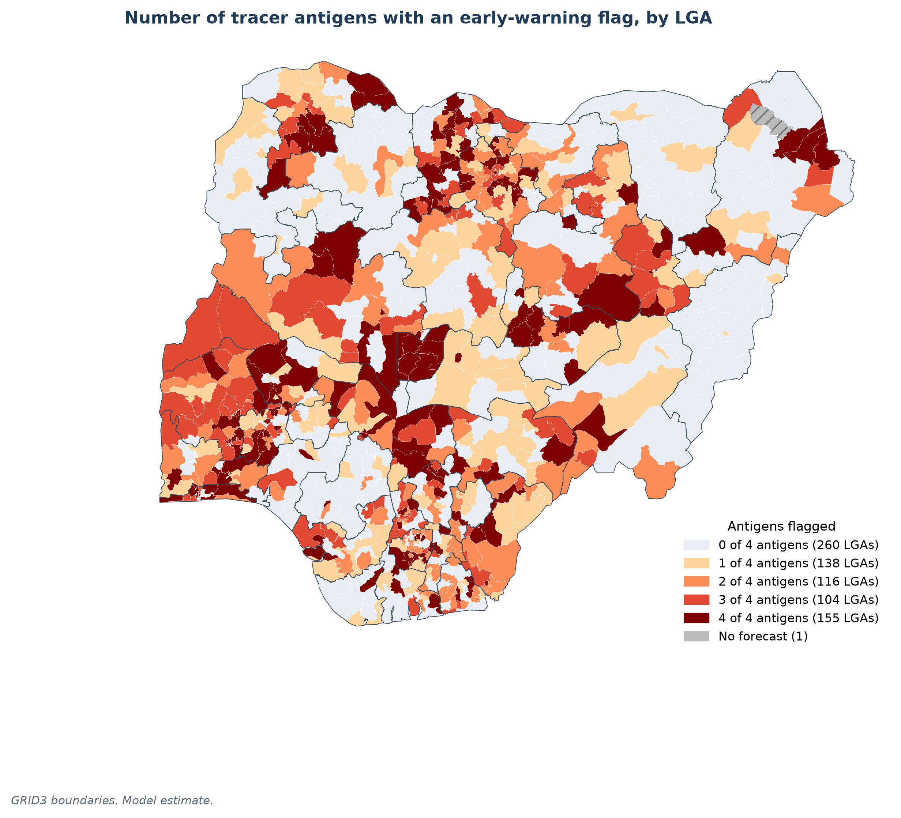
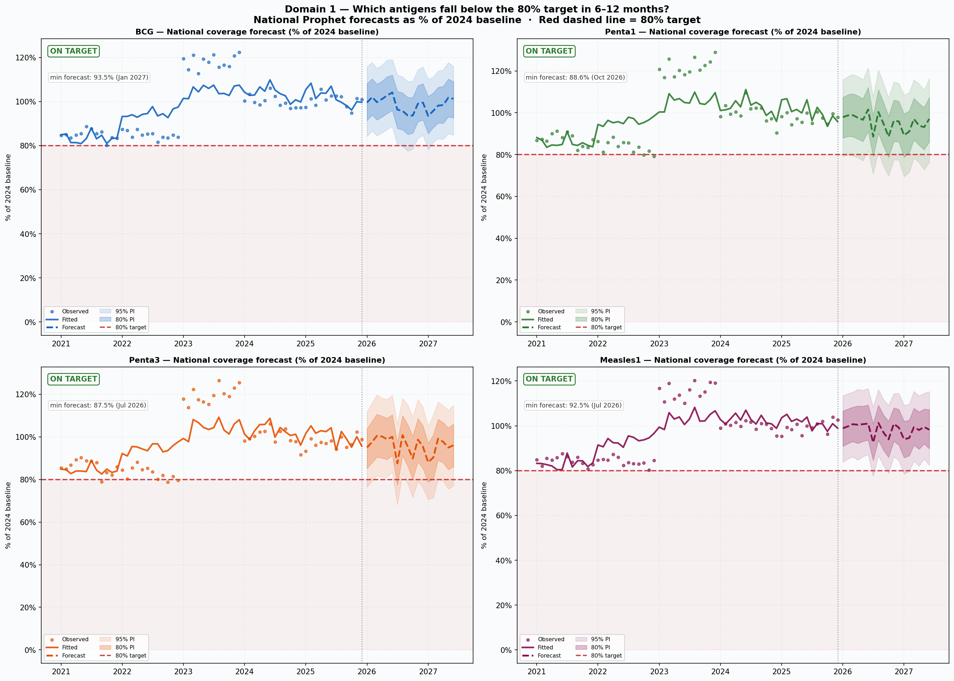
Domain 1: which antigens are at risk of falling below target?
An early-warning signal that delivery is falling. It is not a count of children vaccinated.
1,302
early-warning flags, in 513 of the 773 LGAs
3,092 forecasts, one per LGA and tracer vaccine. For 195 flags the fall is already visible in 2025. Nationally, all four stay above their 2024 level.
What below 80 percent means. Doses delivered have dropped below four-fifths of what that area managed in 2024. It does not mean only 80 percent of children were reached.
What to do. Follow up first where the fall is already visible, then watch the projected dips, by vaccine and by LGA.
Model estimate. The 80 percent mark compares each LGA with its own 2024 level of doses delivered. It is a decline tripwire, not coverage of the eligible child population. Map: number of the four tracer vaccines flagged in each LGA. Source: Domain 1 Prophet forecasts on DHIS2 routine data, 2021 to 2025 (Guzamala, Borno, has no 2024 data and no forecast).

Slide 11
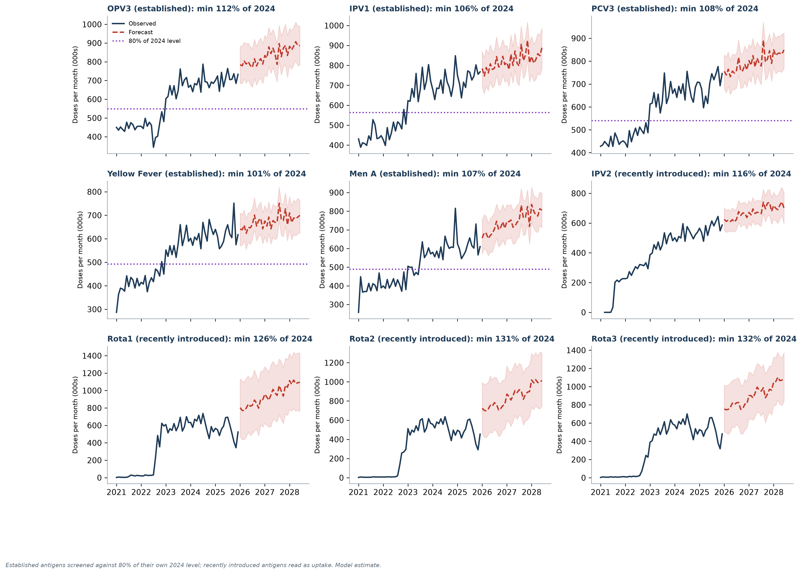
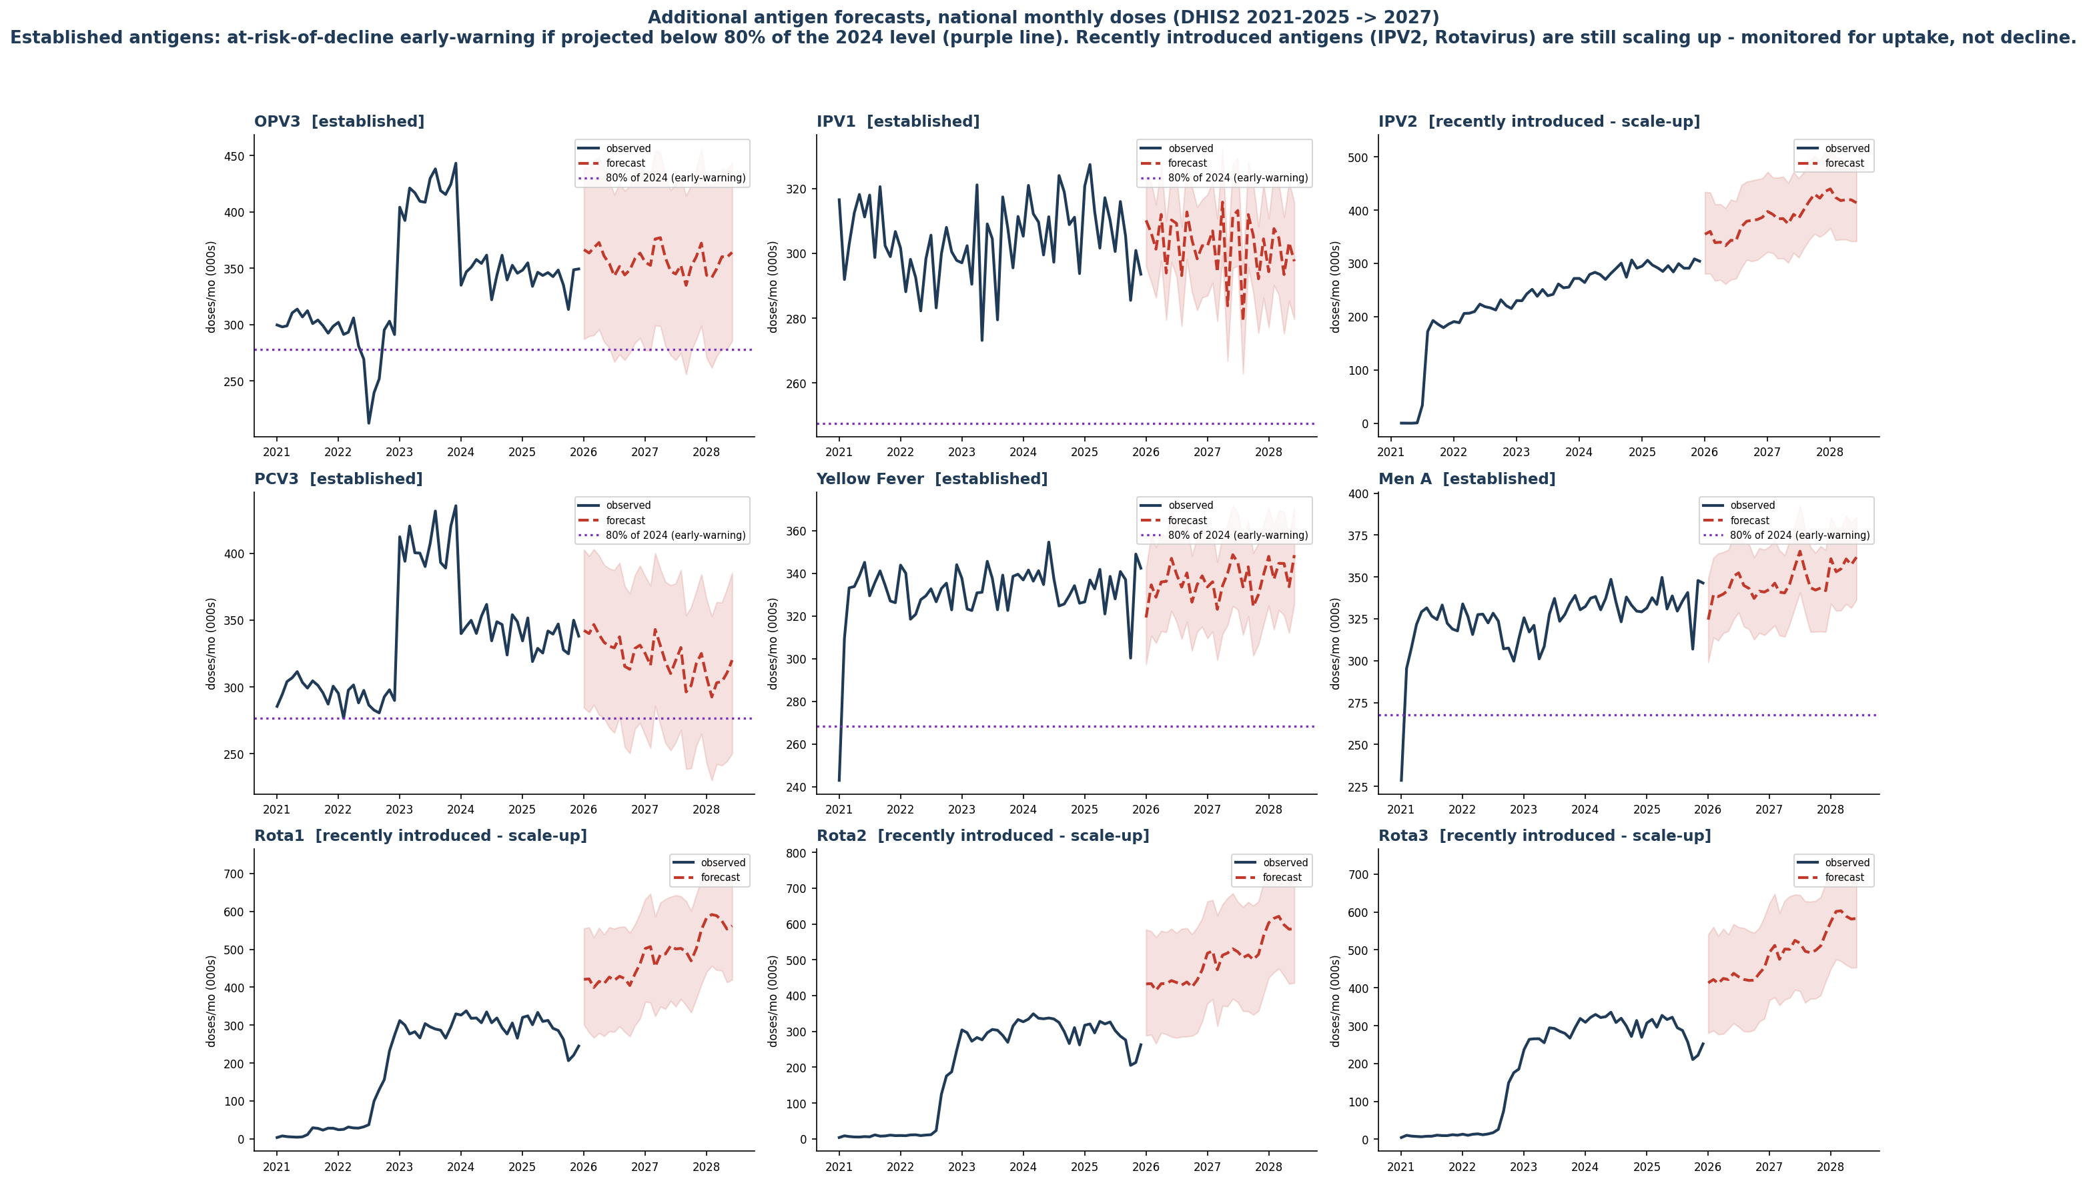
No decline warning for the nine additional antigens
NEW · ED REQUEST 1
Same method, nine more vaccines. The established five hold; rotavirus uptake dipped in 2025 and needs watching.
5 of 5
established antigens added - OPV3, IPV1, PCV3, Yellow Fever and Meningitis A - are projected to stay above 80 percent of their own 2024 level. None is flagged.
4 of 4
new series - IPV2 and Rotavirus 1 to 3 - are tracked for uptake. IPV2 is rising; rotavirus was 89-91 percent of 2024 in 2025.
How to read the chart
The purple dotted line is 80 percent of that antigen's own 2024 doses - the at-risk-of-decline early-warning mark. Rising series carry no line, because they should not be screened for decline.
Model estimate. Source: Domain 1 Prophet forecasts on DHIS2 (District Health Information System, version 2) routine data, 2021 to 2025, projected to 2028. OPV = oral polio vaccine; IPV = inactivated polio vaccine; PCV3 = third dose of pneumococcal conjugate vaccine.
Notes:
NEW - added on the Executive Director's request. Nine antigens beyond the original four tracer vaccines: OPV3, IPV1, PCV3, Yellow Fever and Meningitis A are screened for decline; IPV2 and Rotavirus 1 to 3 are tracked for uptake. None flagged.

Slide 12
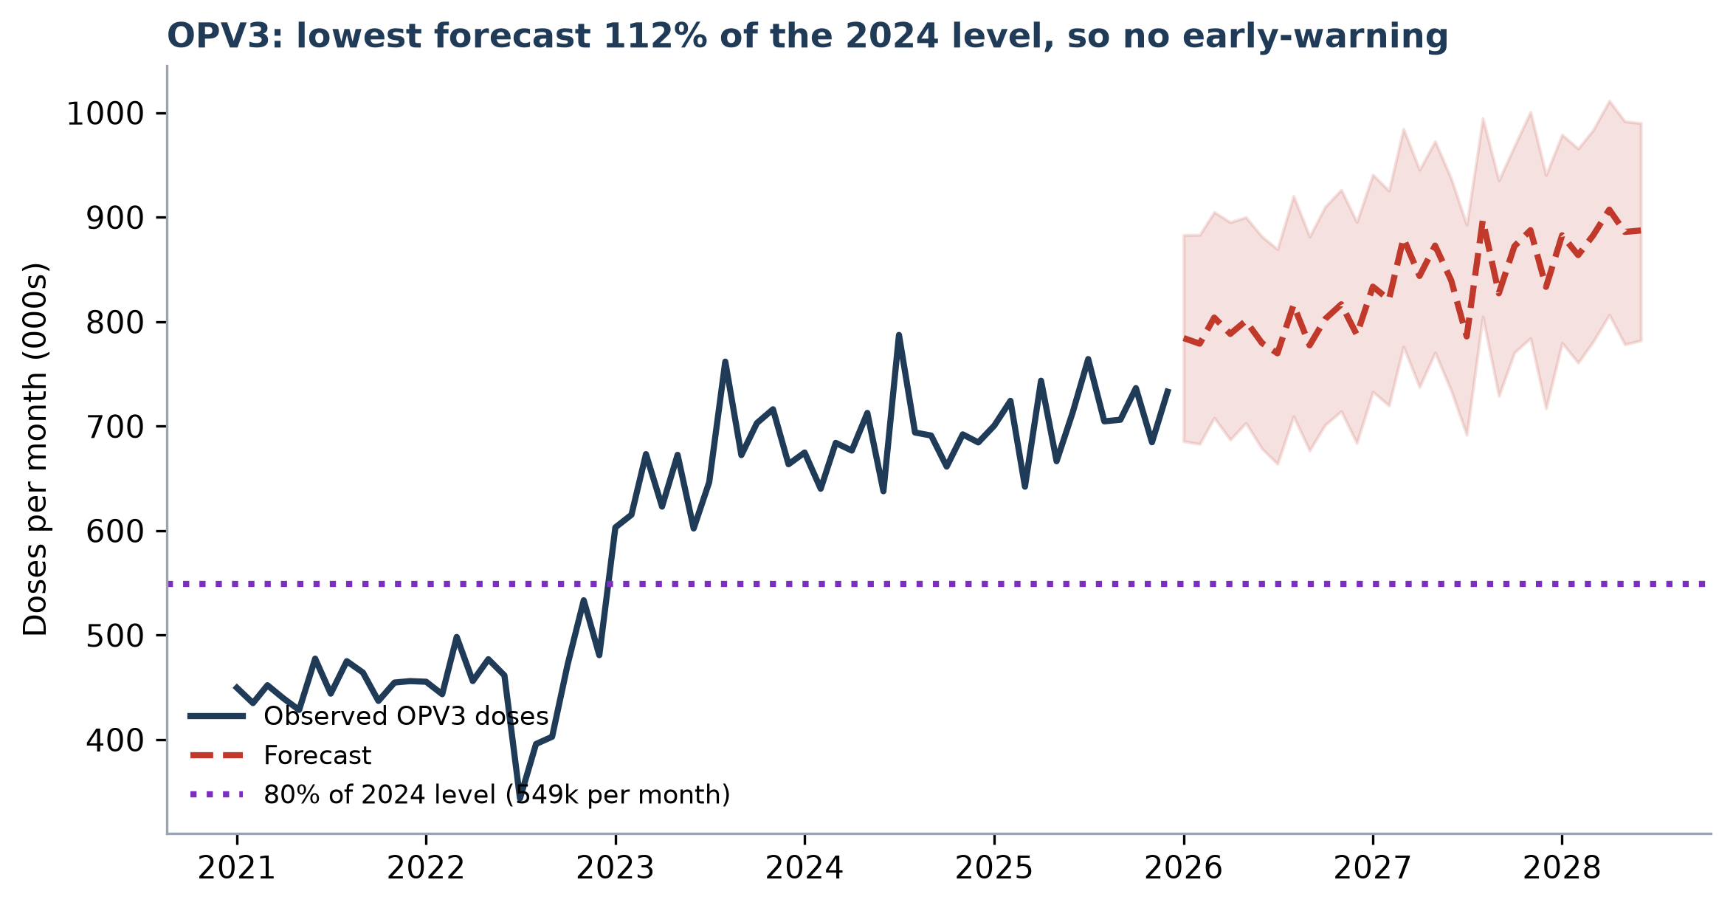
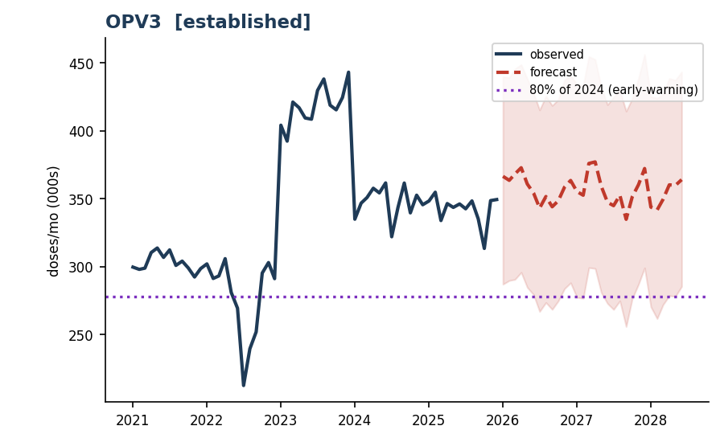
What the at-risk-of-decline early-warning measures
It tells you when delivery is slipping against a settled benchmark. It is not a coverage figure.
THE FLAG, IN FOUR LINES
At-risk-of-decline early-warning
What it measures. Projected monthly doses for an antigen, expressed as a percent of that antigen's own 2024 level.
The mark. Below 80 percent means doses are slipping against the settled 2024 benchmark. That is what raises the flag.
It is denominator-free. It does not say what share of children were reached, because no child population enters the calculation.
What to do with it. Catch the decline early, and route supervision to the exact antigen, month and local government area.
Reading one panel. The purple dotted line is 80 percent of OPV3's 2024 doses; the forecast stays clear of it, so OPV3 is not flagged.
Why the benchmark is 2024, not 2025
Not to be confused with true coverage
2024 is the last complete, fully-reported year, so it holds still. 2025 is partial and keeps shifting as late reports arrive, which would raise alerts that are really reporting lag.
True coverage divides doses by the eligible child population, the 12-to-23-month cohort. It answers a different question and is shown separately in the application as "Estimated coverage (eligible cohort)".
The early-warning tells you when delivery is falling. Coverage tells you how many children you reached. Different questions, different denominators.
Source: Domain 1 methods, consortium documentation, 2026. WHO = World Health Organization; Gavi = the global vaccine partnership. Projected values are model estimates.

Slide 13
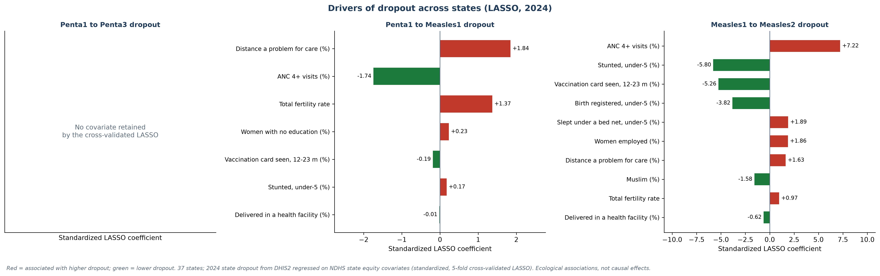
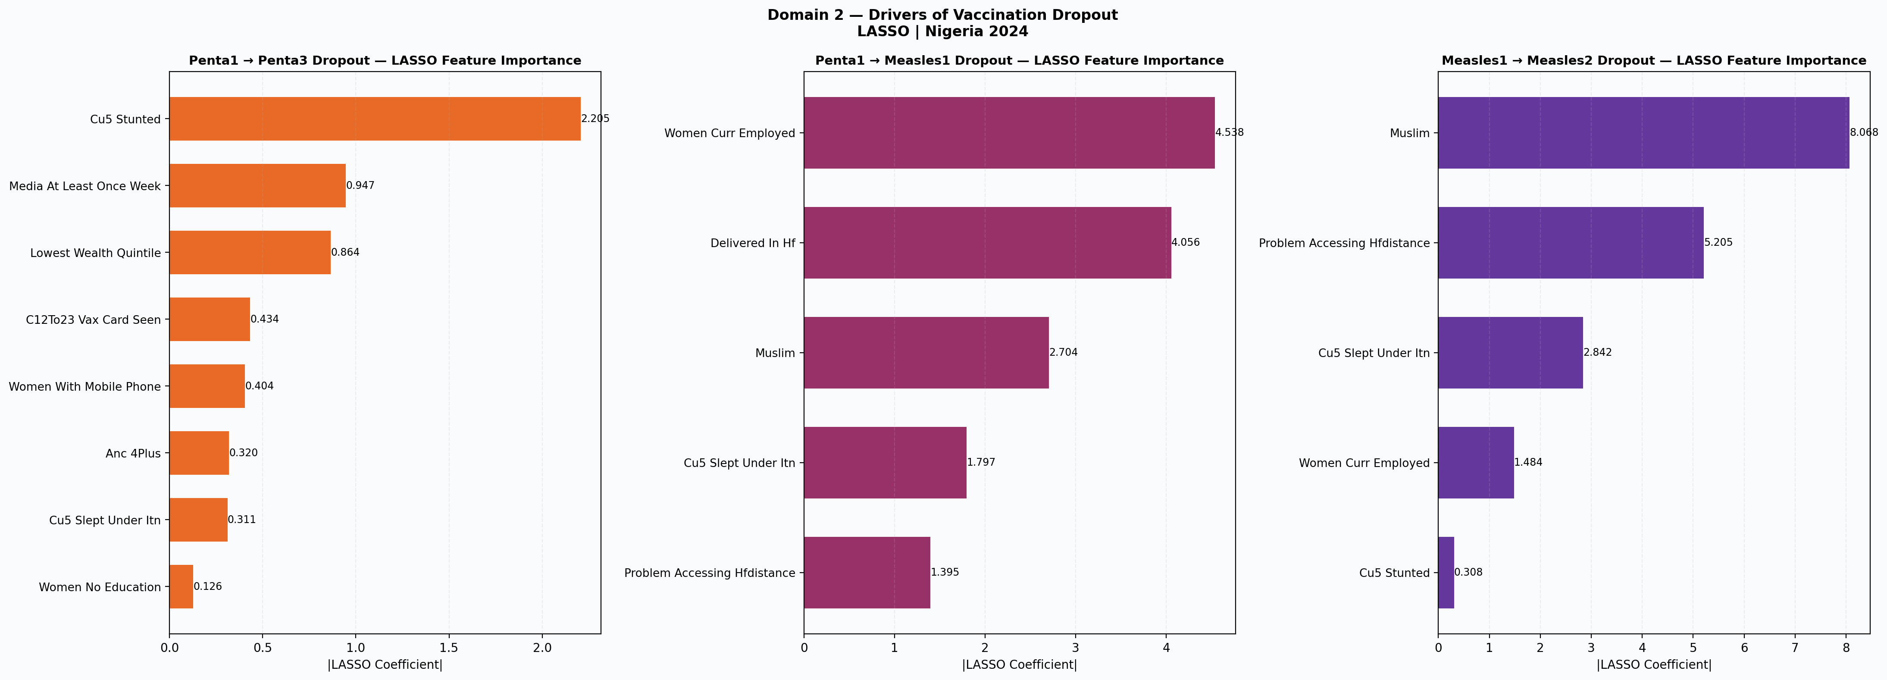
Domain 2: what drives incomplete vaccination?
Dropout differs by transition: the second measles dose is still the largest gap, and each transition has different drivers.
The biggest gap is between Measles1 and Measles2: national dropout fell from 60% in 2021 to 34% in 2025, still far above Penta1 to Penta3 (about 5%) and Penta1 to Measles1 (about 11%).
Penta1 to Penta3
Penta1 to Measles1
Measles1 to Measles2
Higher with conflict deaths; lower with ORS use (LGAs).
Distance to care; high fertility; less antenatal care.
Few vaccination cards seen; births unregistered.
Defaulter tracing and security-sensitive outreach in conflict-affected LGAs.
Link the 9-month visit to outreach and nutrition contacts.
Home-based records, card retention and second-year reminders.
Model estimate. DHIS2 2021-2025 (counts read with thousands separators). Cross-validated LASSO: 37 states (2024; chart) and 743 LGAs (2021-2024). Ecological associations: directional, not causal. ORS = oral rehydration salts.

Slide 14
Domain 2: where dropout is highest, by state
Observed 2021-2025 and Prophet forecast 2026-2027, the same view as the web application's heatmap.
34%
Measles1 to Measles2 dropout nationally in 2025 (60% in 2021)
34 of 37
states lost more than 10% of children between the two measles doses in 2025
about 5%
Penta1 to Penta3 dropout in 2025; low and stable since 2021
Act first in Anambra, Akwa Ibom, Imo, Abia and Oyo, where 48-60% of children who receive Measles1 miss Measles2.
Model estimate. DHIS2 monthly counts read with thousands separators; grey = no records for the state that year; negative dropout = later dose recorded at or above the earlier dose.

Slide 15
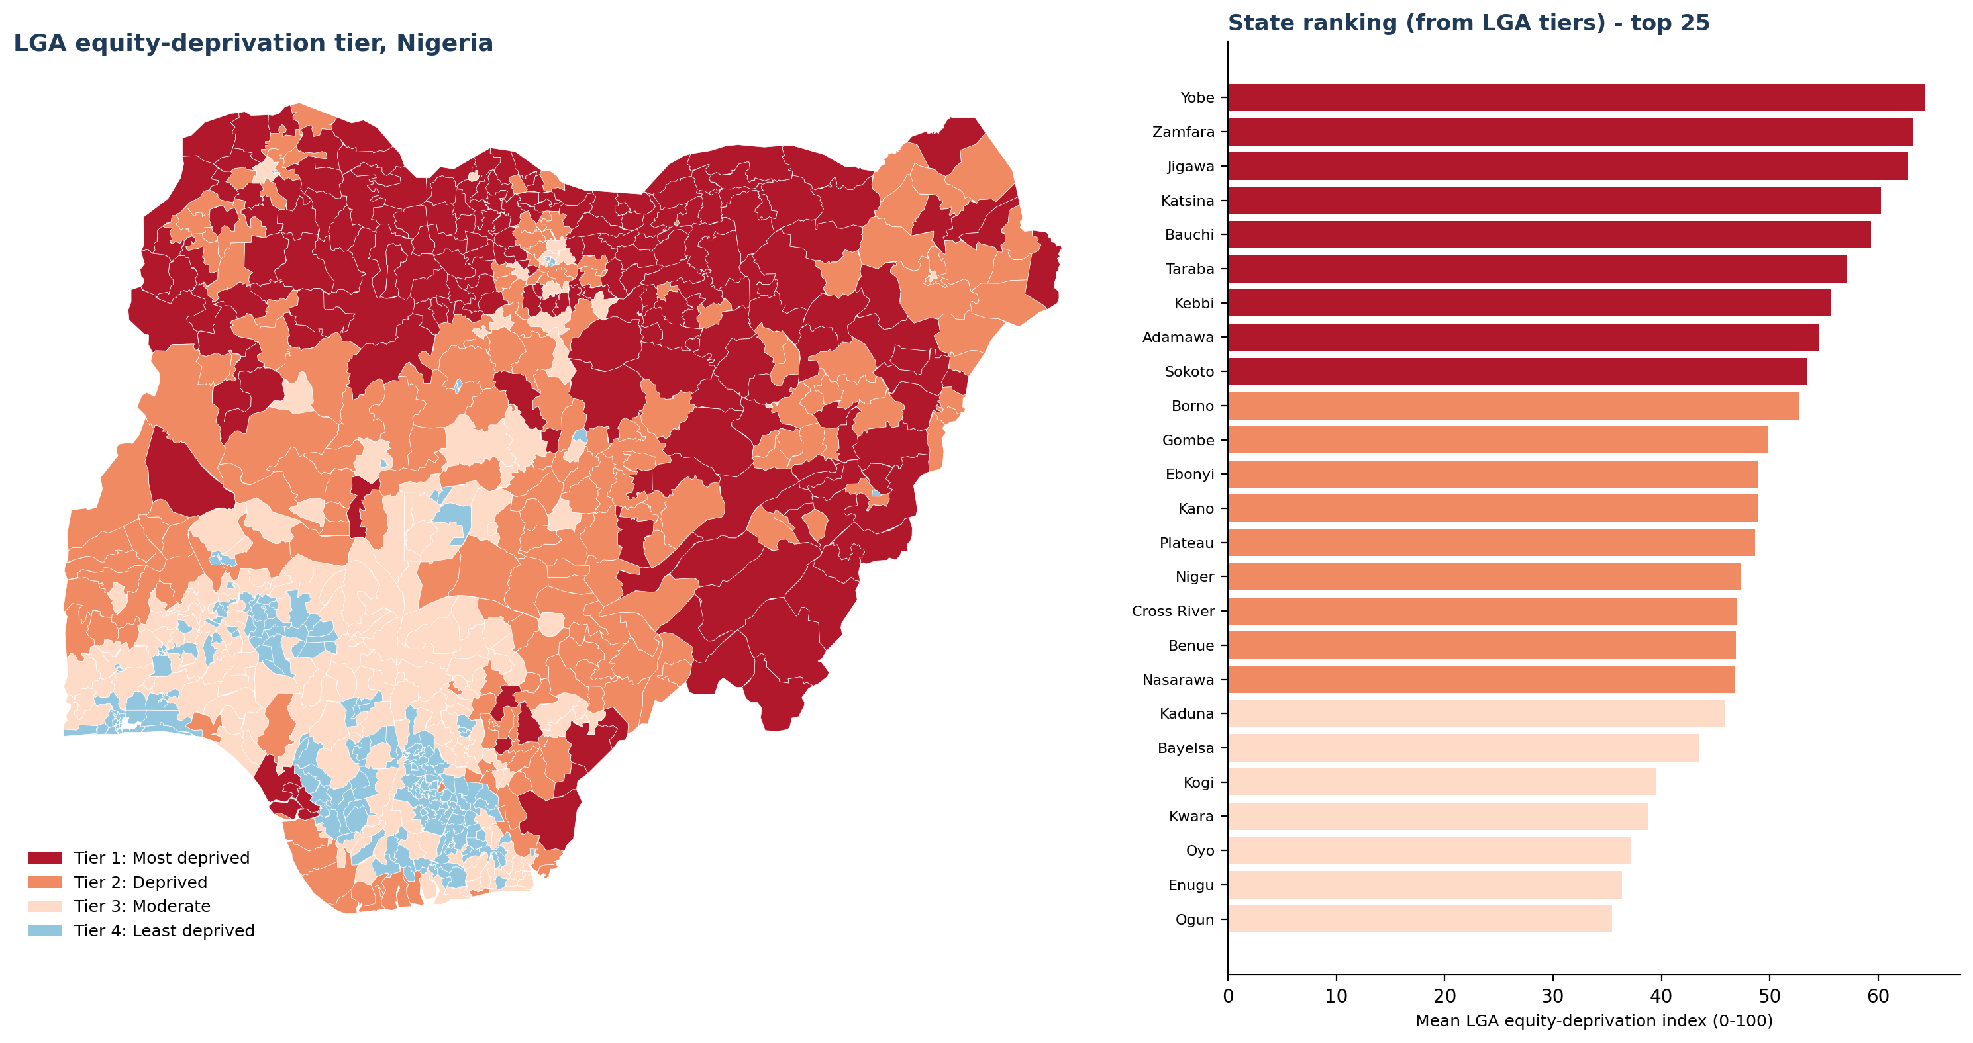
Domain 3: where children are hardest to reach
Model estimate. The index combines travel time, education, poverty and wealth.
Tier 1 Most deprived
Tier 2 Deprived
Tier 3 Moderate
Tier 4 Least deprived
Darker areas have stronger barriers: longer travel, lower education and more poverty.
Many of the hardest-to-reach LGAs are in the North-East and North-West.
Use this with the burden ranking. Burden shows where the most children are; this tier shows where barriers are deepest. Areas with both high burden and high deprivation should be prioritized..
Model estimate. Composite equity-deprivation index (0 to 100) built from Weiss travel time, education, poverty and the Meta Relative Wealth Index, grouped into four equal bands; GRID3 boundaries.
Notes:
REBUILT at local government level on the Executive Director's request. The equity deprivation index was previously state level; it now resolves to all 774 LGAs and ships as a column in the priority workbook.

Slide 16
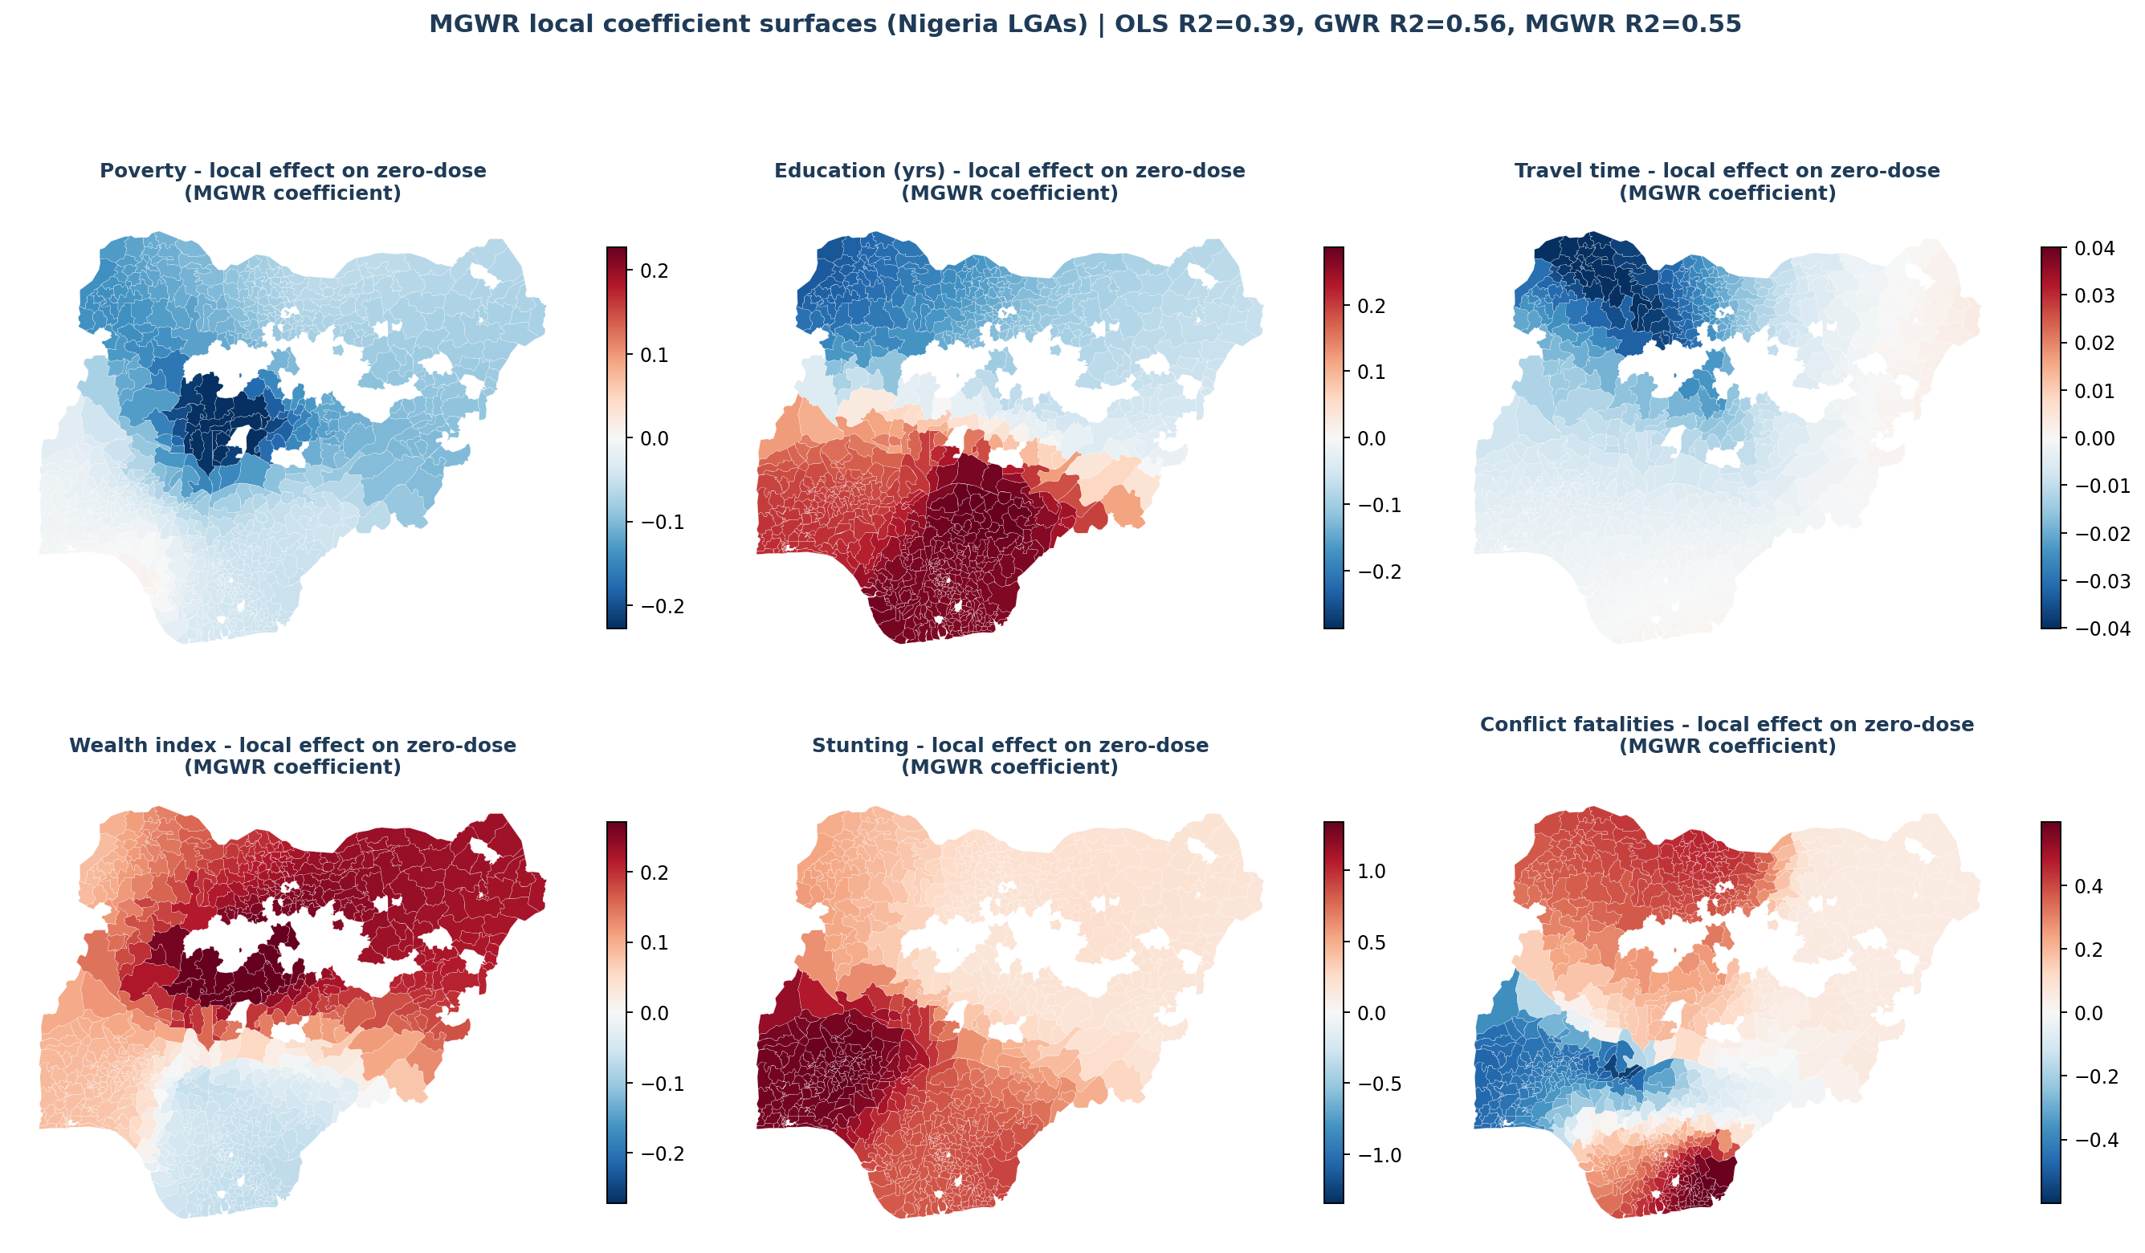
The causes act locally
The previous slide showed where disadvantage is deepest. These maps show which barrier appears strongest in each place.
39% → 55%
of the variation explained, once drivers can act differently in different places
Each map shows one possible barrier to vaccination.
Red means the factor is linked with more zero-dose children. Blue means the opposite. Darker colour means stronger effect.
Model estimate across the 774 local government areas. MGWR = multiscale geographically weighted regression, which lets each driver's effect vary from place to place. These are local, standardised, partial associations, not causal effects. White areas are not modelled because they have no DTP1 reporting, so they carry no estimate rather than a zero.
Notes:
NEW at local government level. Shows which barrier is strongest in each LGA, so the priority list carries a reason as well as a rank.

Slide 17
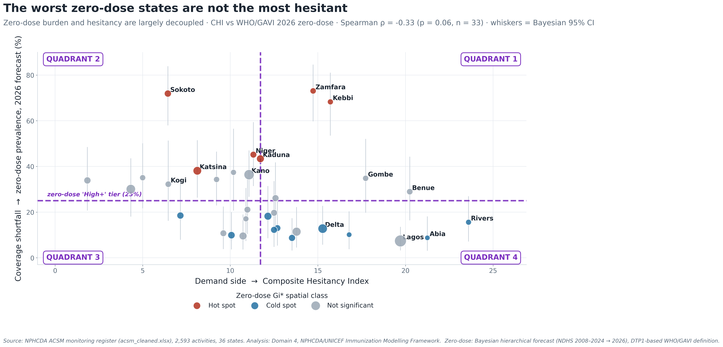
Domain 4: does hesitancy explain the shortfall?
Hesitancy is real, but it does not sit where the missed children are.
rho = -0.33
The states with the most recorded doubt are not the states missing the most children.
Each bubble is a state. Bubble size is the under-five population.
What to do. In high zero-dose but low-hesitancy areas, focus on access, outreach and service availability. Use trust-building where hesitancy is actually high.
Model estimate. Domain 4 Composite Hesitancy Index against the Domain 5 zero-dose forecast. rho = Spearman rank correlation; full provenance on the figure.

Slide 18
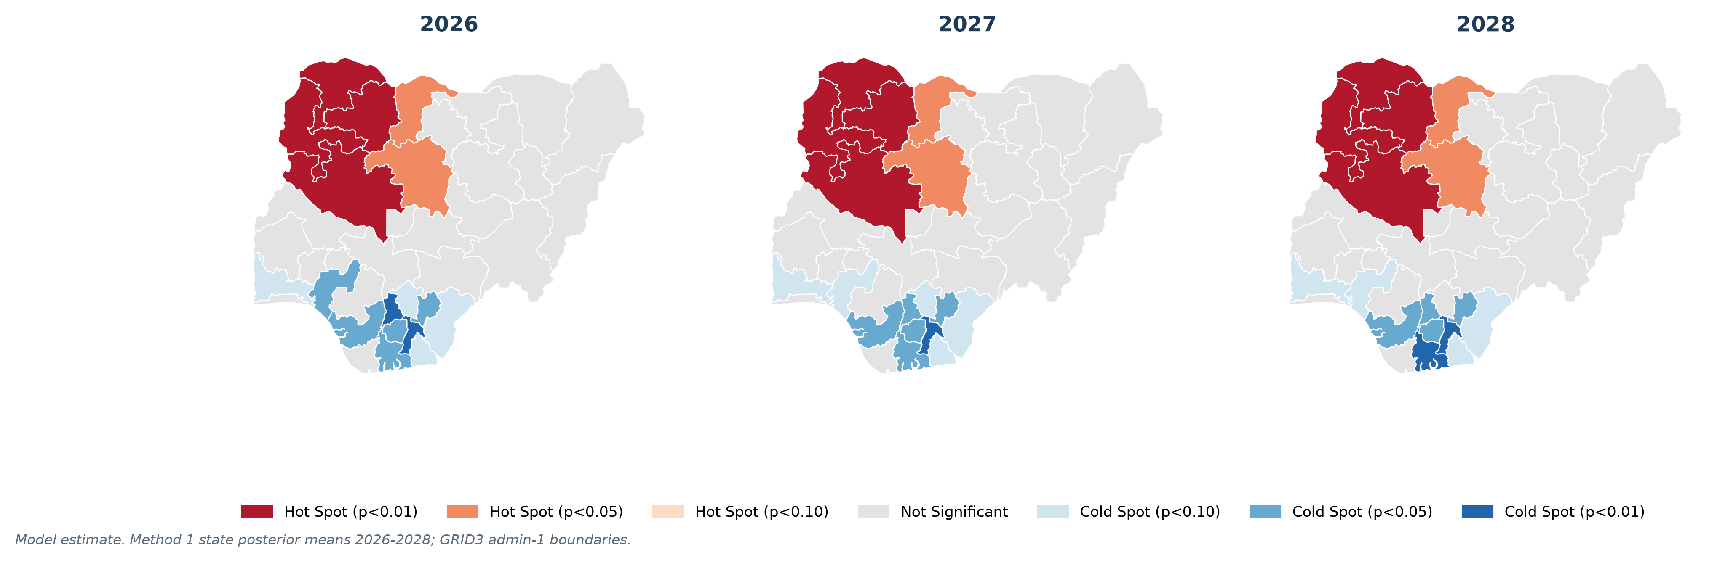
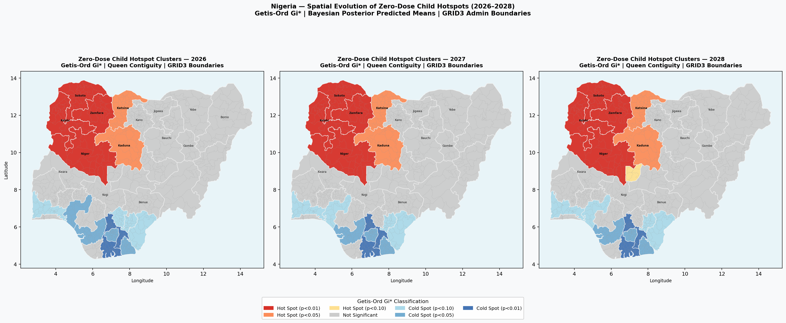
Domain 5: where do zero-dose children concentrate?
A North-West hotspot that stays fixed from 2026 to 2028, held in place by structural conditions.
2.10 million
zero-dose children in 2026 (95% interval 1.90 to 2.31 million), across 773 modelled LGAs
51%
of the burden is in the top 20% of LGAs (155 LGAs)
The maps show the modelled zero-dose surface for 2026, 2027 and 2028. The hot area sits over the North-West in every year.
Sokoto, Kebbi and Zamfara remain high-priority throughout the forecast period. They require a multi-year plan, not a one-off activity.
342 local government areas hold 80 percent - concentrated, but not the textbook 80/20.
Model estimate. Source: Method 1: Bayesian hierarchical model with DHIS2-calibrated LGA allocation (Bayesian hierarchical Beta regression on NDHS 2008 to 2024 with a DHIS2 trend term; LGA allocation by DHIS2 Penta1 share and NPC 2022 population); GRID3 boundaries; Getis-Ord Gi* state hotspots (Queen contiguity).

Slide 19
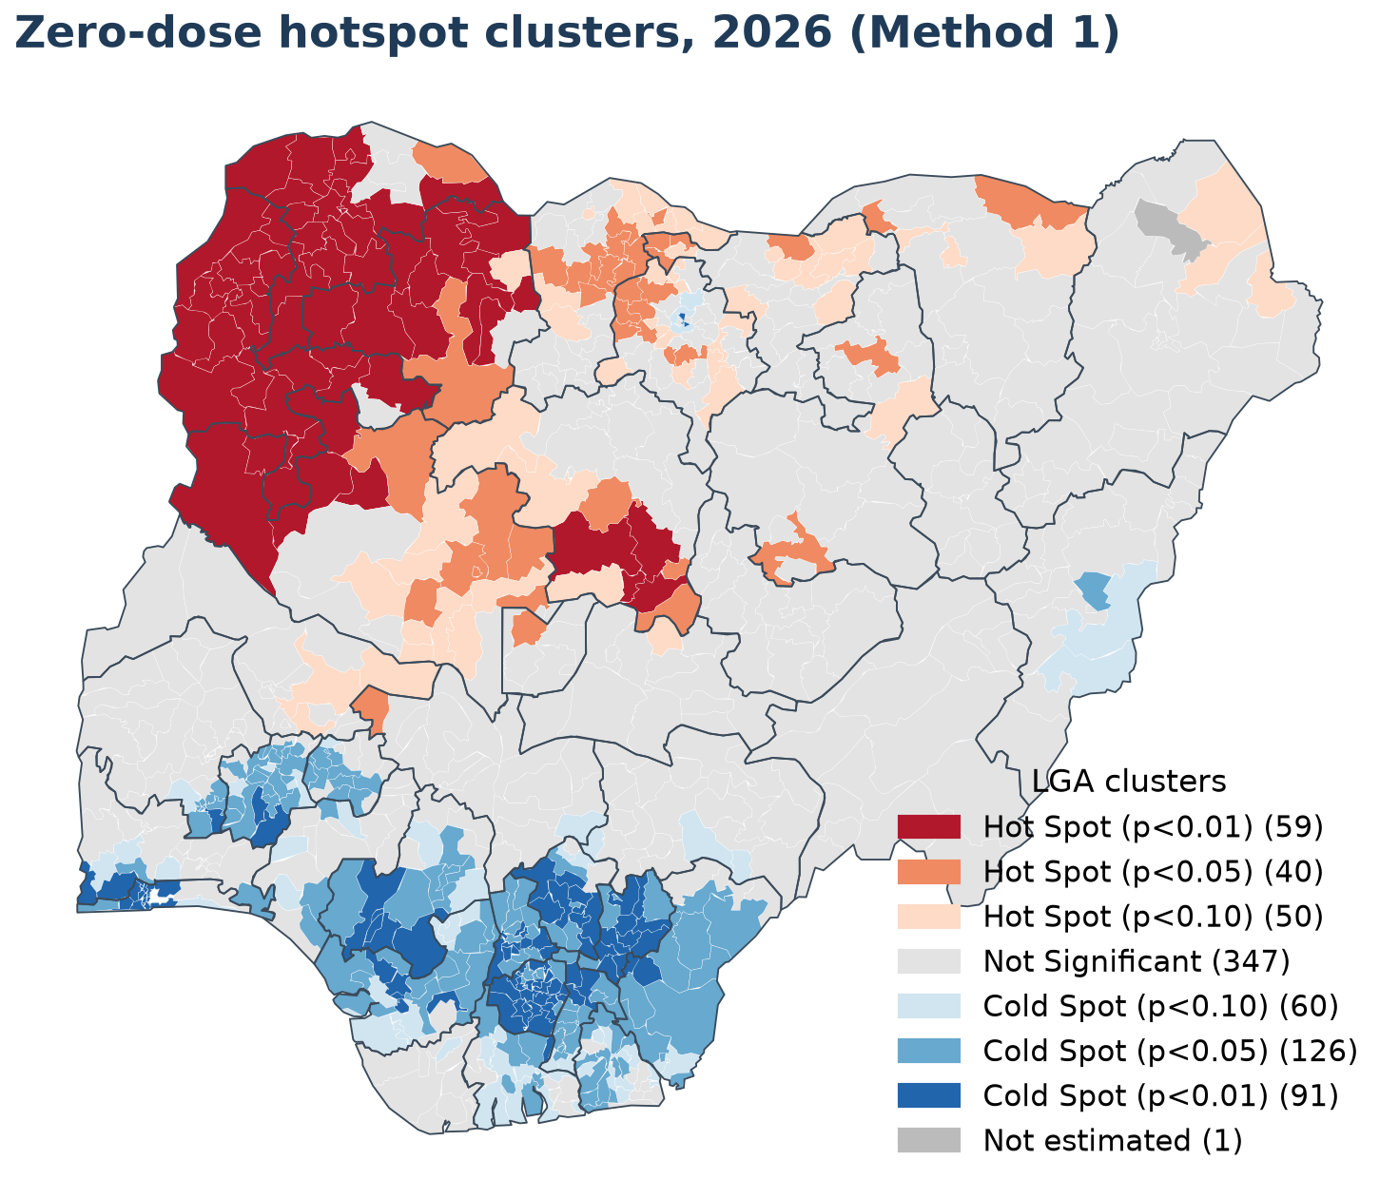
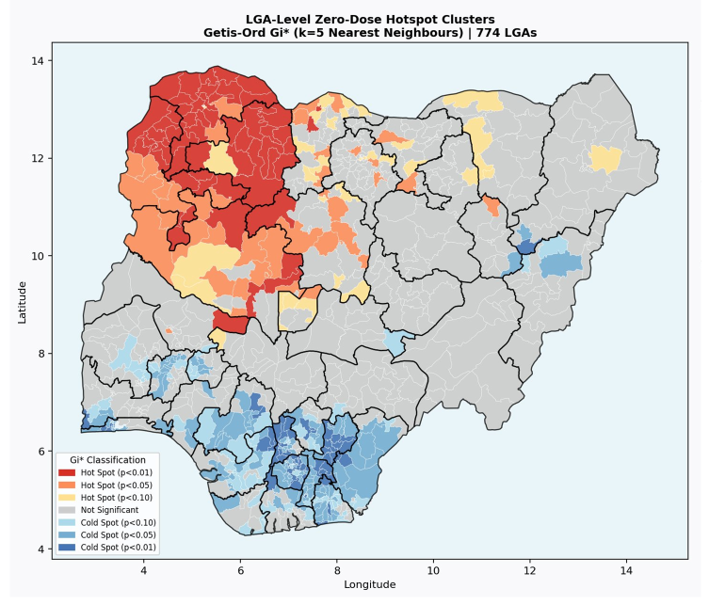
NEW · ED REQUEST 3
Every local government area, ranked by burden
The top 151 reach half of zero-dose children; the top 342 reach 80 percent.
Rank
State
LGA
Zone
Burden
Rate %
1
Zamfara
Bukkuyum
North West
13,589
87.8
2
Zamfara
Bakura
North West
13,253
99.0
3
Sokoto
Tambuwal
North West
12,738
83.2
4
Zamfara
Birnin Magaji
North West
12,223
92.8
5
Zamfara
Maradun
North West
12,057
81.2
6
Zamfara
Maru
North West
12,052
57.5
7
Zamfara
Zurmi
North West
11,913
56.6
8
Sokoto
Sokoto North
North West
11,869
75.2
9
Zamfara
Talata Mafara
North West
11,666
75.6
10
Zamfara
Kaura Namoda
North West
11,282
55.3
Red marks clusters of high zero-dose burden; blue marks low-burden clusters.
Top 10 shown here (Method 1). The full ranked list for both methods is in the government workbook and can be filtered by state or priority level in the web app.
Model estimate. Source: Method 1: Bayesian hierarchical model with DHIS2-calibrated LGA allocation, 2026; GRID3 boundaries. Hotspot method: Getis-Ord Gi* (spatial clustering), k = 5 nearest neighbours. Rates are capped at 99%.
Notes:
NEW - the priority list the Executive Director asked for. All 730 reporting LGAs ranked by modelled zero-dose burden. The full list ships as the NPHCDA LGA Priority Lists workbook, carrying rate, cumulative share, priority band, equity tier and archetype.

Slide 20
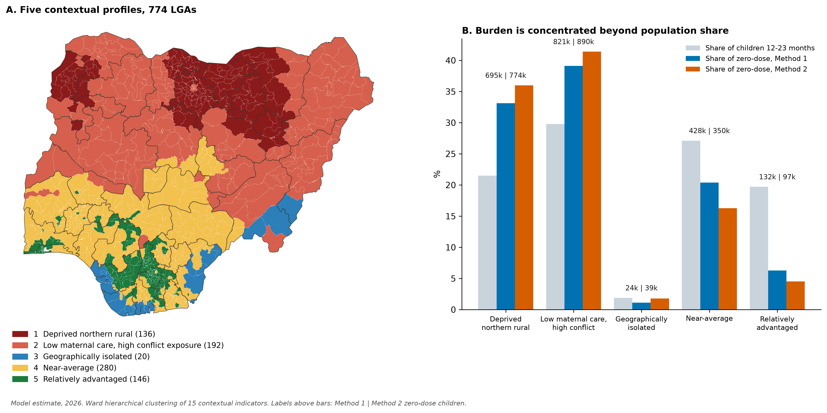
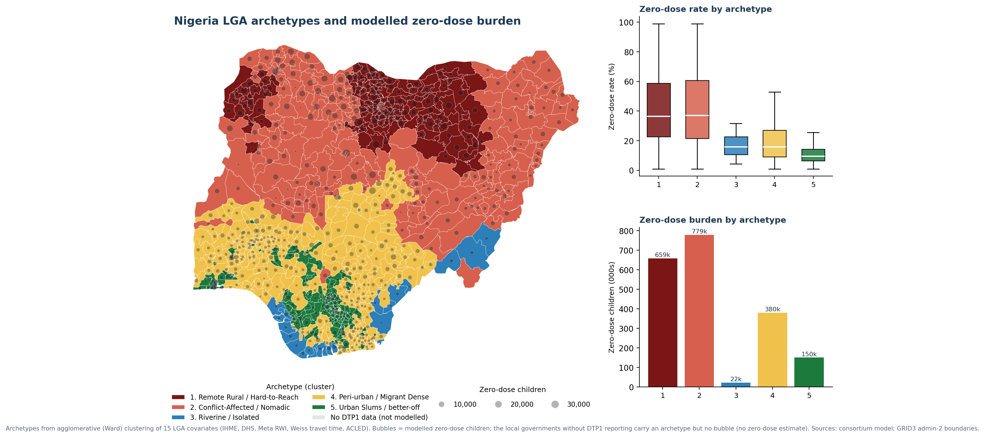
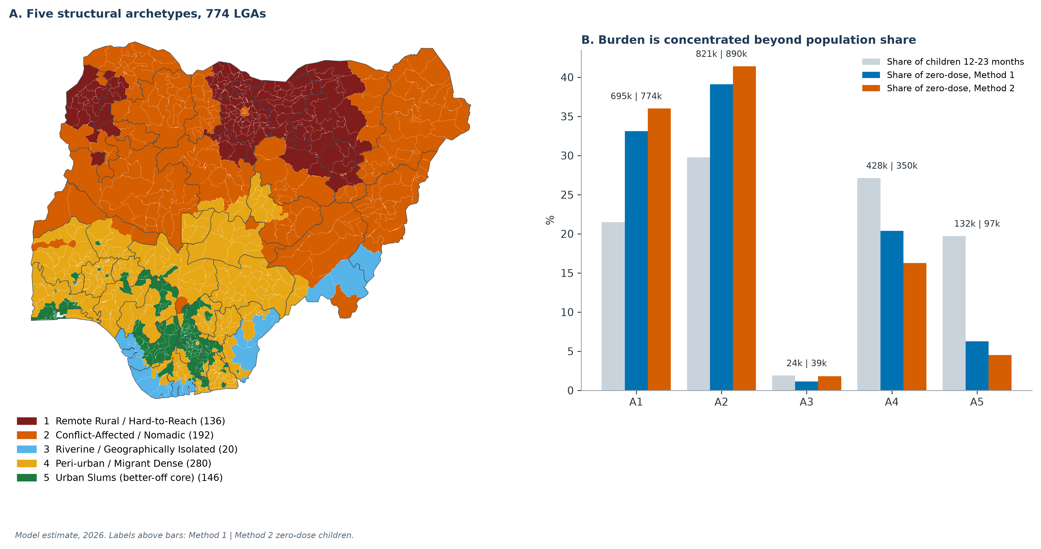
NEW · ED REQUEST 2
Archetype profiles and modelled zero-dose burden
Built from 15 contextual indicators (education, nutrition, poverty, wealth, travel time, water, maternal care, conflict and DTP1-3 dropout), the profiles use no zero-dose or coverage estimate. Yet they reproduce where the children are: profiles 1 and 2 hold 1.52 million of 2.10 million zero-dose children (72 percent; 77 percent under Method 2).
Colour shows the contextual profile. Bars compare each profile's share of children with its share of zero-dose children under both methods. Labels describe only what the indicators measure.
Model estimate. Profiles (community archetypes) from agglomerative (Ward) clustering of 15 LGA indicators (IHME, DHS, Meta Relative Wealth Index, Weiss travel time, ACLED); bars are modelled zero-dose children under both methods; GRID3 admin-2 boundaries.
Notes:
NEW - archetyping rebuilt at local government level on the Executive Director's request. The earlier unsupervised model was state level. All 774 LGAs are clustered on 15 social and structural measures, using no vaccination data.

Slide 21
NEW · ED REQUEST 2
Five contextual profiles and candidate responses
Profiles 1 and 2 hold about 72 percent of all zero-dose children (77 percent under Method 2).
#
Profile
LGAs
Zero-dose children
Mean rate
Defining signature
Priority intervention
1
Deprived northern rural
136
695,337
(33%)
44.2%
Highest child undernutrition; lowest maternal education (about 2.5 years) and facility delivery (about 10%)
Reaching-Every-Community microplanning, BHCPF outreach and community health workers; co-deliver with nutrition and antenatal care
Kano, Jigawa, Katsina
2
Low maternal care, high conflict exposure
192
820,871
(39%)
39.0%
Highest political-violence fatalities; high antigen dropout; weak antenatal care and delivery
Security-integrated microplanning, negotiated access, mobile outreach teams and defaulter tracing
Borno, Niger, Adamawa
3
Geographically isolated
20
23,514
(1%)
17.7%
Extreme travel time to care (about 108 minutes); low improved-water access
Outreach and mobile sessions (boat-based where waterways apply), community health workers, multi-antigen bundling
Cross River, Bayelsa, Delta
4
Near-average
280
427,791
(20%)
20.6%
Near the national average on every indicator; fair care-seeking (antenatal care 72%, delivery 61%)
Core fixed-site and outreach services, ward enumeration, and Periodic Intensification of Routine Immunization
Osun, Akwa Ibom, Oyo
5
Relatively advantaged
146
131,691
(6%)
9.9%
Highest wealth and education (about 9.6 years) and facility delivery (78%); moderate conflict events
Targeted social mobilisation, a fixed-plus-outreach hybrid, and private-sector last-mile reach
Imo, Anambra, Lagos
Model estimate. Ward clustering of 15 indicators across all 774 LGAs; labels describe measured indicators only. Zero-dose children and mean LGA rate from Method 1 (total 2.10 million). Grey text names example states. BHCPF = Basic Health Care Provision Fund.
Notes:
NEW - the five LGA archetypes, each with the response package matched to it.

Slide 22
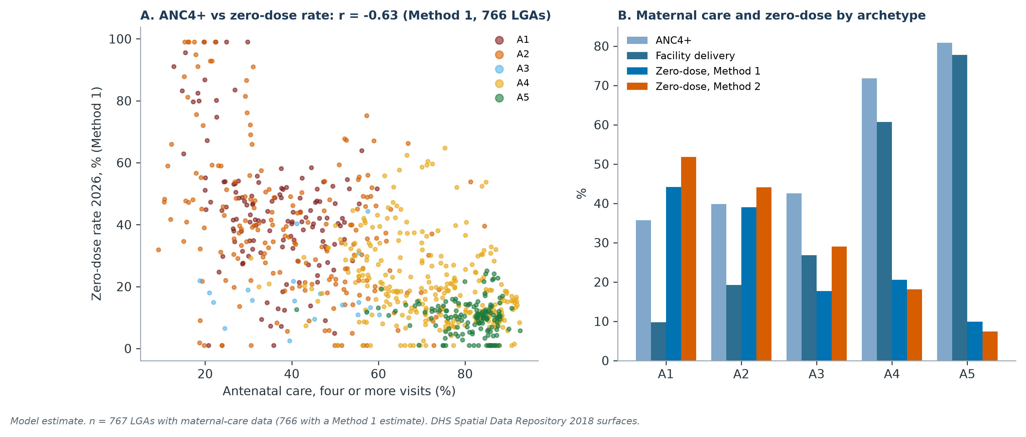
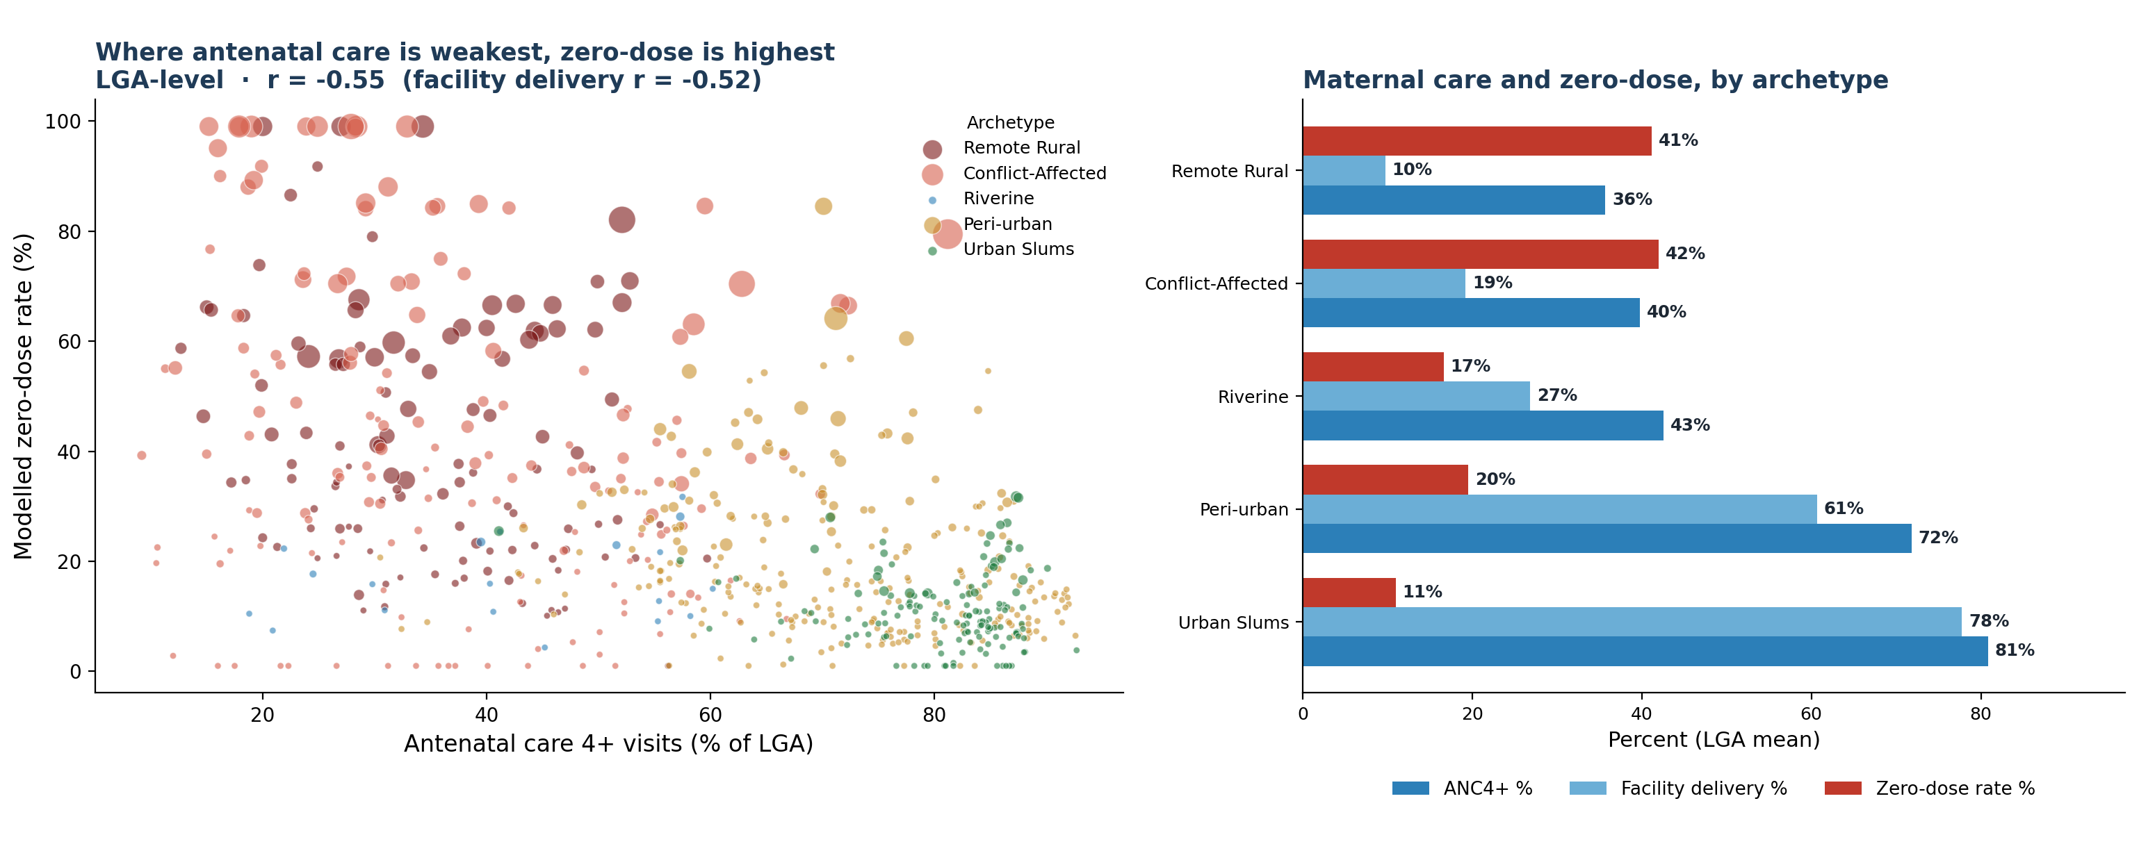
NEW · ED REQUEST 2
Maternal and immunization gaps sit in the same places
The local governments with the weakest antenatal care and facility delivery are the same ones missing the most zero-dose children, so an existing maternal contact is a ready entry point to reach them.
1.5 million
of the 2.10 million modelled zero-dose children (Method 1) are in the two profiles with the weakest maternal care.
r = -0.63
antenatal care, four or more visits, against the Method 1 zero-dose rate across local governments. Facility delivery is r = -0.59.
The link. Weaker antenatal care goes with higher zero-dose across the local governments with antenatal-care data (ANC4+ r = -0.63; facility delivery r = -0.59). The link is strong and consistent.
The burden. The deprived northern rural and low maternal care, high conflict exposure profiles hold about 1.5 million zero-dose children, on the lowest antenatal care (36 to 40%) and facility delivery (10 to 19%).
The action. Co-deliver immunization with antenatal and delivery contacts in these profiles: one visit, several services, rather than immunization outreach on its own.
Model estimate. Source: LGA profile master (IHME and DHS antenatal-care and facility-delivery covariates; modelled zero-dose). RMNCH = reproductive, maternal, newborn and child health; EPI = Expanded Programme on Immunization; ANC4+ = antenatal care, four or more visits; LGA = local government area.
Notes:
NEW - maternal and immunization convergence at LGA level, derived from the archetypes.

Slide 23
NEW · ED REQUEST 2
From profile to action: the RMNCH-EPI operational list
Five contextual profiles, the maternal-care numbers behind each, and the candidate package.
Profile
LGAs
ANC4+ (%)
Facility delivery (%)
Zero-dose rate (%)
Zero-dose children
RMNCH-EPI intervention, matched to the profile
Deprived northern rural
136
35.7
9.8
44.2
695,337
Reaching-Every-Community microplanning, BHCPF outreach and community health workers; co-deliver immunization with antenatal and nutrition contacts
Low maternal care, high conflict exposure
192
39.8
19.2
39.0
820,871
Security-integrated microplanning, negotiated access, and mobile outreach teams delivering immunization and antenatal care together
Geographically isolated
20
42.6
26.8
17.7
23,514
Outreach and mobile sessions (boat-based where waterways apply), community health workers, and multi-antigen and antenatal bundling per visit
Near-average
280
71.8
60.7
20.6
427,791
Ward enumeration and Periodic Intensification of Routine Immunization linked to antenatal clinics
Relatively advantaged
146
80.9
77.8
9.9
131,691
Targeted social mobilization, a fixed-plus-outreach hybrid, and private-sector last-mile reach for immunization and antenatal care
The full list. All 774 local government areas are ranked worst-to-best by modelled zero-dose burden in the operational workbook, each carrying its profile, maternal-care figures and candidate package, ready for microplanning.
Model estimate. Source: LGA archetype master and the RMNCH-EPI operational workbook (IHME and DHS antenatal-care and facility-delivery covariates; Method 1 modelled zero-dose). BHCPF = Basic Health Care Provision Fund. Facility-level primary health care lists and facility density are not included; those need a GRID3 or National Health Facility Registry dataset.
Notes:
NEW - the archetype to action operational list, ready for microplanning.

Slide 24
Five contextual profiles: what sets them apart
Mean domain scores (higher = more disadvantaged); labels describe only what the indicators measure.
An operational choice. Four profiles fit slightly better (silhouette 0.31 vs 0.18); five are kept because near-average and relatively advantaged LGAs differ in burden (16.3% vs 4.5%).
Coherent. 79% of neighbouring LGAs share a profile (26% by chance); bootstrap stability ARI 0.54 (0.42 to 0.72).
Membership. Clear for 46% of LGAs (60% of modelled zero-dose children), intermediate for 31%, mixed for 23%.
Labels retired. Earlier names for nomadic, migrant, riverine and urban-slum areas were dropped because no indicator measures those attributes. Population mobility must be confirmed locally before transit-point strategies are used. The two highest-burden profiles hold 77.4% of Method 2 modelled zero-dose children but 51.3% of the birth cohort.
Model estimate. Ward hierarchical clustering of 15 indicators in six domains (socioeconomic, maternal care, nutrition, access, insecurity, DTP1-3 dropout), 774 LGAs. ARI = adjusted Rand index; SD = standard deviation.

Slide 25
Barriers differ within states and at the same zero-dose rate
Dominant barrier by LGA, and how clearly each LGA fits its profile.
35 of 37
states contain LGAs with different dominant barriers
56% / 59%
of access and insecurity variance lies within states (nutrition 5%)
67%
of LGA pairs with near-equal rates have a different dominant barrier
Caveat. Near-equal pairs are still contextually closer than random pairs (median distance 1.8 vs 2.8), so 'same rate, different barriers' applies to a substantial minority, not to every LGA. State averages capture nutrition and maternal care well but hide access and insecurity, which need LGA-level planning.
Model estimate. Ward hierarchical clustering of 15 indicators in six domains (socioeconomic, maternal care, nutrition, access, insecurity, DTP1-3 dropout), 774 LGAs. ARI = adjusted Rand index; SD = standard deviation. Dominant barrier = highest domain score at or above +0.5 SD.

Slide 26
Same estimated rate, different barriers
Four real LGA pairs with near-identical Method 2 zero-dose rates.
Reading the pairs. Each pair has nearly the same estimated zero-dose rate but a different dominant barrier, so a rate-only ranking would send both the same response. Across all near-equal pairs, 49.6% fall in different profiles.
Caution. All four pairs contrast Niger Delta with Jigawa LGAs, and their rate intervals are wide. They illustrate the pattern; they do not measure how common it is.
Model estimate. Ward hierarchical clustering of 15 indicators in six domains (socioeconomic, maternal care, nutrition, access, insecurity, DTP1-3 dropout), 774 LGAs. ARI = adjusted Rand index; SD = standard deviation.

Slide 27
Assigning packages: start from the state, refine by LGA barriers
Agreement of each assignment rule with every LGA's own barrier package, weighted by modelled zero-dose children.
Combined barriers are the norm. 36% of LGAs, holding 67% of modelled zero-dose children, have two or more flagged barriers.
State first, then LGA. State packages agree best (0.65), profiles next (0.58); one national package agrees least (0.13).
Validate locally. Packages are candidate components from documented rules, not measured intervention effects.
Model estimate. Barrier flag = domain score in the national top quartile (travel time: top decile). Agreement = Jaccard similarity (1 = identical). Population mobility is not measured and is never assigned.

Slide 28
How robust are the candidate packages?
Share of LGAs and children keeping the same core components when modelling choices change.
Stable core. Core components are kept for 51-82% of LGAs (71-96% of modelled children) across indicator sets, numbers of profiles, algorithms and bootstrap refits.
Threshold. Changing the barrier-flagging threshold keeps 73-82% of LGA packages; LGA flags do not depend on the clustering.
Information content. Profiles add to zone in explaining LGA zero-dose (R-squared +0.08) but little beyond a deprivation quintile (+0.01); at state level they improve prediction of the NmDHS 2025-26 (R-squared 0.71 to 0.78).
Use. Choose components from LGA barrier flags; use profiles as a planning summary, not as an independent predictor.
Model estimate. Ward hierarchical clustering of 15 indicators in six domains (socioeconomic, maternal care, nutrition, access, insecurity, DTP1-3 dropout), 774 LGAs. ARI = adjusted Rand index; SD = standard deviation. Core components = Jaccard similarity of 0.67 or more; R-squared out of sample (state check leave-one-out).

Slide 29
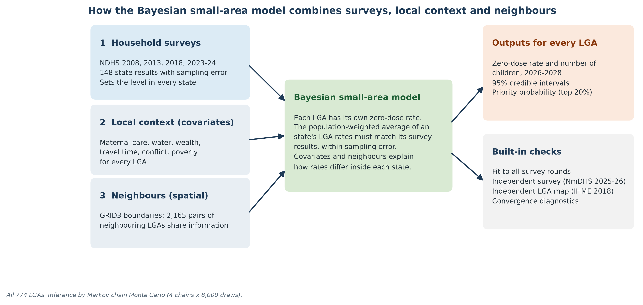
Method 2: Bayesian small-area estimation (SAE)
A second, survey-anchored model that estimates zero-dose directly for every one of the 774 LGAs.
1
Anchored to the surveys. Each state's LGA estimates must add up to that state's NDHS zero-dose level (2008, 2013, 2018, 2023-24), allowing for survey sampling error.
2
Local conditions. Six LGA measures shape differences within a state: maternal care, improved water, wealth, travel time to a facility, conflict and poverty.
3
Neighbours. A spatial term (BYM2) lets neighbouring LGAs share information, so sparse areas borrow strength from their surroundings.
Why a second method. Method 1 distributes each state's estimate to its LGAs using routine DHIS2 Penta1 reporting. Method 2 does not use routine coverage at all: it combines survey levels with local conditions and geography, and gives every LGA its own 95% credible interval and a probability of being a priority. Reading both together shows which priorities are robust.
Model estimate. NDHS = Nigeria Demographic and Health Survey; BYM2 = Besag-York-Mollie spatial model, version 2. Fitted in PyMC (4 chains x 8,000 draws). Covariates: DHS spatial surfaces 2018, Meta Relative Wealth Index, travel time to healthcare, ACLED, poverty.

Slide 30
Method 2: zero-dose rate and its uncertainty, all 774 LGAs
Every LGA has its own estimate and its own 95% credible interval.
30.6%
national zero-dose rate, 2026 (95% CrI 26.5 to 35.0%)
50.6%
North-West zone rate, the highest of the six zones
How to read the right-hand map. Wider intervals mark LGAs where survey anchors and local measures leave more room for error. These LGAs are the first candidates for local verification, for example a rapid coverage assessment, before large investments.
Model estimate. Method 2: Bayesian small-area estimation (SAE), 2026. CrI = credible interval. Sources: NDHS 2008-2024; NPC 2022; GRID3 boundaries; covariates as listed on the method slide.

Slide 31
Method 2: zero-dose burden and priority probability
Burden combines rate and child numbers; the probability shows how stable each priority is.
2.15 million
zero-dose children in 2026 (95% CrI 1.86 to 2.46 million)
54%
of the burden is in the top 20% of LGAs (155 LGAs)
Priority probability. For each LGA, the share of 4,000 model simulations in which it ranks among the 155 highest-burden LGAs. 40 LGAs are priorities in at least 90% of simulations; LGAs between 0.1 and 0.9 are borderline and should be confirmed with local data.
Model estimate. Method 2: Bayesian small-area estimation (SAE), 2026. Children aged 12-23 months from the 2024 under-five projection divided by five, shared by NPC 2022 LGA population.

Slide 32
Method 2: the 20 highest-burden LGAs
Each bar shows the 95% credible interval; P is the probability of being among the top 155.
19 of 20
are in the North-West zone
19 of 20
are priorities in at least 90% of simulations
Concentration. Zamfara 8, Kebbi 5, Sokoto 3, Katsina 1, FCT 1, Jigawa 1, Kano 1. These LGAs combine high rates with large child populations.
Model estimate. Method 2: Bayesian small-area estimation (SAE), 2026. Ranks from 4,000 posterior draws.

Slide 33
Method 2: model performance and diagnostics
The model fits every survey round, passes an independent survey check, and its sampler converged cleanly.
1.003
2,549
0
98%
rho 0.87
maximum R-hat (target below 1.01)
minimum effective sample size (target above 400)
divergent transitions
of NDHS state-round values inside the 95% predictive interval
against NmDHS 2025-26 (37 states); mean absolute error 5.9 points
Method 2: Bayesian small-area estimation (SAE). 1,649 parameters; 4 chains x 8,000 draws after 3,000 tuning steps. NmDHS = Nigeria mini Demographic and Health Survey, not used in fitting.

Slide 34
Method 2: what explains differences between LGAs
Maternal care is the strongest and most certain predictor of zero-dose within states.
Local measure | Effect (95% CrI) | Odds ratio
Maternal care | -0.83 (-1.29 to -0.37) | 0.44
Improved water | -0.42 (-0.88 to -0.00) | 0.65
Relative wealth | -0.31 (-0.77 to +0.16) | 0.73
Travel time to facility | -0.06 (-0.58 to +0.46) | 0.95
Conflict events | -0.11 (-0.39 to +0.16) | 0.89
Poverty rate | -0.28 (-0.60 to +0.02) | 0.75
Reading the table. Effects are on the log-odds scale per standard deviation; below zero means lower zero-dose. An odds ratio of 0.44 means one standard deviation better maternal care is linked with about 56% lower odds of a child being zero-dose.
Associations, not causes. These are partial associations used to distribute survey levels within states, not causal effects.
Model estimate. Method 2: Bayesian small-area estimation (SAE). Maternal care = mean of standardised ANC4+ and facility delivery (DHS spatial surfaces, 2018).

Slide 35
Routine coverage and survey-anchored estimates
Why Method 2 uses survey levels rather than routine coverage to estimate LGA zero-dose.
81%
of LGAs show Penta1 coverage above 100%
rho 0.18
routine-only zero-dose vs NmDHS 2025-26, 37 states
rho 0.87
Method 2 vs NmDHS 2025-26, 37 states
What this means. Administrative coverage divides doses given by an estimated target population. When the target population is too small, or doses include children from other LGAs, coverage exceeds 100 percent and cannot be read as a rate. Routine data remain essential for monitoring trends and data quality; for the level of zero-dose in each LGA, survey-anchored estimates are more reliable (routine-only state estimates differ from NmDHS by 27 points on average).
DHIS2 Penta1 2023-2025 annual mean over the 2024 cohort projection (state under-five / 5, NPC 2022 shares). Sources: DHIS2; NmDHS 2025-26.

Slide 36
Method 1 and Method 2 compared by zone
About half of zero-dose children are in the North-West under both methods; national totals differ by 2.4%.
Zone | LGAs (M1 / M2) | Children 12-23 months | Method 1 zero-dose children (95% interval) | Method 1 rate % | Method 2 zero-dose children (95% CrI) | Method 2 rate % | Difference M2 vs M1 | NmDHS 2025-26 %
North West | 186 / 186 | 2,269,638 | 1,084,155 (961,608 - 1,201,516) | 47.8 | 1,149,017 (923,311 - 1,371,914) | 50.6 | +6.0% | 48.7
North East | 111 / 112 | 1,073,384 | 336,687 (255,921 - 417,822) | 31.4 | 372,892 (265,189 - 495,882) | 34.7 | +10.8% | 38.7
North Central | 121 / 121 | 1,039,371 | 343,731 (262,802 - 433,604) | 33.1 | 324,138 (228,447 - 421,964) | 31.2 | -5.7% | 34.2
South West | 137 / 137 | 1,068,159 | 154,451 (97,752 - 231,362) | 14.5 | 141,155 (86,336 - 210,104) | 13.2 | -8.6% | 14.4
South South | 123 / 123 | 821,850 | 112,309 (67,941 - 169,284) | 13.7 | 110,354 (65,945 - 169,111) | 13.4 | -1.7% | 8.8
South East | 95 / 95 | 746,305 | 67,871 (36,662 - 111,588) | 9.1 | 52,005 (26,981 - 87,430) | 7.0 | -23.4% | 11.2
Nigeria | 773 / 774 | 7,018,707 | 2,099,204 (1,898,902 - 2,308,432) | 29.9 | 2,149,561 (1,856,459 - 2,455,411) | 30.6 | +2.4% | -
Same national picture. 2.10 million (Method 1) and 2.15 million (Method 2); the 95% intervals overlap in every zone.
North-West first. 52% of zero-dose children under Method 1 and 53% under Method 2.
Largest gap: North-East. Method 2 is 11% higher (34.7% vs 31.4%); NmDHS 2025-26 shows 38.7%.
Model estimate, 2026. Method 1: Bayesian hierarchical model with DHIS2-calibrated LGA allocation (773 LGAs); Method 2: Bayesian small-area estimation (SAE) (774 LGAs). NmDHS 2025-26 zone rates for reference (not used in fitting).

Slide 37
Method 1 and Method 2 compared by state
The methods rank the 37 states almost identically (rho = 0.96); ordered by Method 1 burden.
State | Method 1 children | Method 2 children | M1 rate % | M2 rate % | NmDHS %
Kano | 198,101 | 227,157 | 36.8 | 42.4 | 38.7
Katsina | 169,685 | 211,744 | 39.0 | 48.6 | 48.2
Sokoto | 166,648 | 167,720 | 72.7 | 71.4 | 76.5
Kebbi | 153,659 | 162,123 | 69.0 | 71.8 | 72.4
Zamfara | 150,220 | 143,697 | 70.9 | 67.2 | 49.6
Kaduna | 139,578 | 119,060 | 42.0 | 37.3 | 45.2
Bauchi | 111,948 | 118,781 | 33.3 | 36.2 | 45.3
Jigawa | 106,264 | 117,518 | 34.8 | 38.5 | 29.2
Niger | 104,030 | 104,633 | 45.0 | 45.2 | 56.8
Borno | 60,604 | 70,746 | 30.3 | 39.1 | 41.2
Benue | 52,312 | 42,277 | 28.9 | 23.6 | 18.7
Gombe | 50,128 | 57,947 | 34.2 | 39.6 | 29.2
Kogi | 48,476 | 41,779 | 31.3 | 27.5 | 20.2
Kwara | 47,518 | 42,528 | 36.6 | 33.8 | 36.6
Oyo | 45,265 | 42,253 | 19.3 | 18.1 | 28.0
Yobe | 43,282 | 53,059 | 35.3 | 43.8 | 42.1
Plateau | 42,309 | 44,941 | 27.9 | 30.2 | 35.2
Taraba | 35,731 | 34,085 | 29.2 | 27.9 | 38.2
Adamawa | 34,994 | 38,275 | 20.1 | 22.0 | 26.7
State | Method 1 children | Method 2 children | M1 rate % | M2 rate % | NmDHS %
Ogun | 32,123 | 22,819 | 18.9 | 14.7 | 16.2
Rivers | 30,795 | 26,122 | 14.7 | 13.0 | 9.5
Nasarawa | 28,735 | 29,256 | 25.6 | 27.8 | 32.5
Ondo | 28,122 | 32,119 | 18.7 | 21.7 | 10.3
Lagos | 22,095 | 18,709 | 7.1 | 6.2 | 7.1
Delta | 21,940 | 23,510 | 12.9 | 13.9 | 7.4
FCT | 20,351 | 18,725 | 18.5 | 19.3 | 18.6
Akwa Ibom | 19,144 | 13,242 | 13.1 | 10.5 | 11.8
Anambra | 18,507 | 14,459 | 9.8 | 7.9 | 7.3
Edo | 15,905 | 12,516 | 10.0 | 8.5 | 9.0
Enugu | 14,715 | 10,442 | 9.9 | 7.0 | 7.8
Osun | 14,337 | 12,763 | 12.1 | 10.7 | 10.8
Imo | 14,271 | 9,100 | 8.5 | 5.6 | 4.8
Abia | 12,741 | 10,508 | 8.9 | 7.5 | 31.9
Ekiti | 12,509 | 12,492 | 11.2 | 11.2 | 6.6
Bayelsa | 12,434 | 20,938 | 18.0 | 30.3 | 10.9
Cross River | 12,091 | 14,026 | 11.2 | 13.0 | 5.3
Ebonyi | 7,637 | 7,496 | 6.7 | 6.6 | 10.8
Model estimate, 2026. Method 1: Bayesian hierarchical model with DHIS2-calibrated LGA allocation; Method 2: Bayesian small-area estimation (SAE). Children = modelled zero-dose children aged 12-23 months. NmDHS 2025-26 for reference.

Slide 38
National comparison and agreement with independent data
Both methods match the new national survey; Method 2 agrees more closely with the independent IHME LGA map.
Measure | Method 1 | Method 2 (SAE)
LGAs estimated | 773 | 774
Zero-dose children, 2026 (95% interval) | 2.10 million (1.90 - 2.31) | 2.15 million (1.86 - 2.46)
National zero-dose rate | 29.9% | 30.6%
NmDHS 2025-26, 37 states: Spearman rho (95% CI) | 0.89 (0.74 to 0.96) | 0.87 (0.71 to 0.95)
NmDHS 2025-26: mean absolute error / bias, points | 6.3 / -0.7 | 5.9 / +0.1
IHME DTP1 2018, 743 LGAs: Spearman rho (95% CI) | 0.65 (0.60 to 0.70) | 0.89 (0.87 to 0.90)
IHME within states: Spearman rho (95% CI) | 0.08 (0.00 to 0.15) | 0.54 (0.48 to 0.59)
States with positive within-state agreement | 22 of 37 | 36 of 37
How to read this. Both methods rank states almost identically against NmDHS 2025-26, which neither model used. At LGA level, Method 2 agrees far more closely with the independent IHME map, above all within states, where Method 1 follows routine reporting patterns. 107 of the top 155 LGAs are shared by both methods.
rho = Spearman rank correlation; 95% CI from 2,000 bootstrap resamples. All p < 0.001 except Method 1 within states (p = 0.03). IHME = Institute for Health Metrics and Evaluation Local Burden of Disease DTP1, 2018 (zero-dose = 100 - DTP1).

Slide 39
LGAs needed to reach 50, 60 and 80 percent of the burden
Burden concentration under both methods, ranking LGAs from highest to lowest modelled burden.
Share of zero-dose children | Method 1 LGAs (% of LGAs) | Method 2 LGAs (% of LGAs)
50% | 151 (20%) | 138 (18%)
60% | 199 (26%) | 181 (23%)
80% | 342 (44%) | 319 (41%)
Held by top 155 (20% of LGAs) | 50.9% (46.9 - 54.7) | 54.2% (49.6 - 58.6)
Planning rule of thumb. About 140 to 150 LGAs reach half of all zero-dose children, about 180 to 200 reach 60 percent, and 320 to 340 reach 80 percent, whichever method is used. Method 2 is slightly more concentrated.
Model estimate, 2026. Method 1: Bayesian hierarchical model with DHIS2-calibrated LGA allocation (773 LGAs); Method 2: Bayesian small-area estimation (SAE) (774 LGAs). Method 2 band = 95% credible interval of the cumulative share.

Slide 40
Where the two methods agree and differ at LGA level
Strong agreement overall; differences where routine reporting is out of line with population.
rho = 0.75
rank agreement in zero-dose children across 773 LGAs
107 of 155
top-20% LGAs shared by both methods: the most robust priorities
Where they differ. Method 1 follows each LGA's share of reported Penta1 doses: very high reported doses push its rate toward the 1% floor (for example Rabah and Goronyo, Sokoto) and low reported doses push it up (for example Sokoto North). Method 2 is not affected by reporting volumes. LGAs with large gaps are priorities for data-quality review.
Model estimate, 2026. Method 1: Bayesian hierarchical model with DHIS2-calibrated LGA allocation; Method 2: Bayesian small-area estimation (SAE). Spearman rank correlation of modelled zero-dose children.

Slide 41
Which estimate for which decision
The two methods answer the same question in different ways; each has a role.
Decision | Recommended estimate | Why
National, zone and state totals | Either; report Method 1 with Method 2 as the sensitivity range | Totals agree within 2.4% nationally; state rank agreement rho = 0.96; both match NmDHS 2025-26
Ranking LGAs within a state | Method 2 (SAE) | Covers all 774 LGAs; full uncertainty for each LGA; within-state agreement with IHME rho = 0.54 vs 0.08
Selecting priority LGAs for funding | The 107 LGAs in the top 155 under both methods first | Robust to the choice of method; then add LGAs with high Method 2 priority probability
Tracking change and early warning | Method 1 | Uses the DHIS2 trend and updates with monthly routine data
Data-quality review | LGAs where the methods differ most | Large gaps flag reported doses out of line with population
Method 1: Bayesian hierarchical model with DHIS2-calibrated LGA allocation; Method 2: Bayesian small-area estimation (SAE). IHME = Institute for Health Metrics and Evaluation; NmDHS = Nigeria mini Demographic and Health Survey.

Slide 42
Method 2 is the most accurate approach tested
Independent state-level check against the NmDHS 2025-26 (37 states); the survey was not used to fit any model.
5.9 points
0.87
+0.4 points
mean absolute error (MAE), lowest of six approaches; bias +0.1
rank correlation with the survey (95% CI 0.73 to 0.95)
Method 1 difference (95% CI -0.8 to 1.6): statistically equivalent
Model estimate. MAE in percentage points; CI = bootstrap confidence interval over states. Comparators: Method 1 (6.3), gradient boosting (7.5), Fay-Herriot area-level model (7.9), latest survey carried forward (8.2), routine data only (26.5).

Slide 43
Honest uncertainty; forecasting ahead is the weak link
Intervals cover the survey as intended; projecting trends forward is harder than describing the present.
Calibrated. With design effect 2, the 95% predictive interval contained the NmDHS value in 37 of 37 states and the 50% interval in 24 of 37, as expected (p = 0.10 and 0.26). Continuous ranked probability score (CRPS) 4.4, against 4.5 for Method 1.
Trend breaks. With survey rounds held out, Method 2 beat carry-forward for 2018 (MAE 10.1 vs 12.0) but not for 2024 (10.9 vs 8.9). In 18 states the projected direction was wrong, with errors nearly twice as large (14.3 vs 7.7).
What it means. Use the intervals, not only the point estimates, and refresh the model with every new survey round: the 2026 estimates carry real trend uncertainty.
Model estimate. Design effect 2 allows for survey sampling error. MAE = mean absolute error, percentage points.

Slide 44
Prioritizing under uncertainty
Fund near-certain priorities first; verify uncertain LGAs through microplanning.
40 LGAs
near-certain to be in the top 155 (probability 0.9 or more)
217 LGAs
uncertain; 102 of them fall outside the ranked list of 155
54%
Capture. Ranking by rate alone captures 48%, and ranking by routine administrative coverage 30-34%. Each model favours its own list, so these are model-based, not observed.
of modelled zero-dose children in the 155 LGAs ranked by Method 2 expected burden
Robust. State MAE stays at 5.86-6.02 across design-effect, prior and spatial choices; the 2025 population projection raises the total by 12.7% but changes only 4 of the 155 priority LGAs.
Model estimate. Method 2: Bayesian small-area estimation (SAE), 4,000 posterior draws. MAE = mean absolute error.

Slide 45
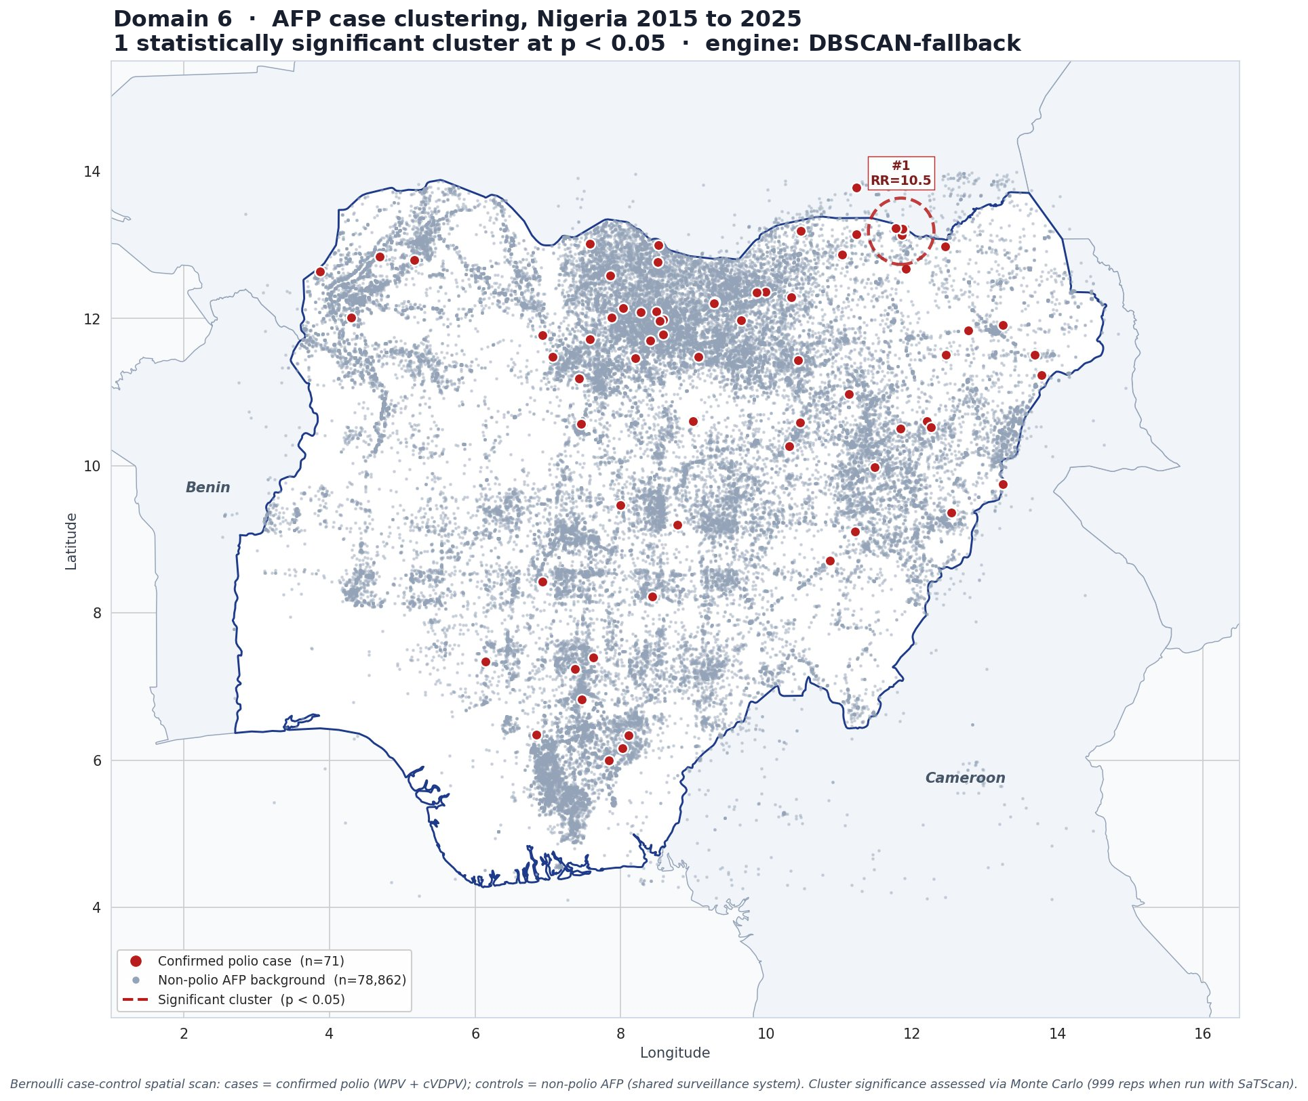
Where is polio-detection risk highest?
One cluster on the north-east border, and six states that have not yet reached the three-year mark.
RR = 10.5
the highlighted border area needs closer surveillance and response
Meaning: the highlighted area should remain a priority for surveillance, investigation and response.
Programme meaning: Taraba, Kogi, Adamawa, Borno, Gombe and Kano require continued attention.
Action: maintain strong campaign quality, AFP surveillance, environmental surveillance and timely investigation.
Model estimate. Source: Domain 6 spatial scan on the national acute flaccid paralysis line list (about 103,000 records, 2015 to 2025); survival analysis against the WHO three-year certification rule.

Slide 46
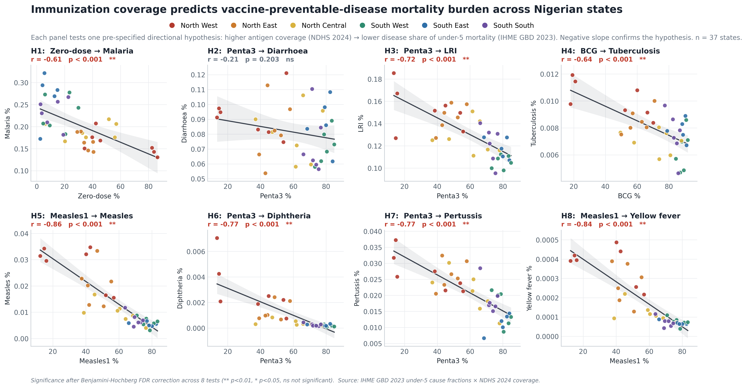
Domain 7: outbreak risk and the link to child deaths
Places with lower vaccination coverage also show higher risk of child deaths from vaccine-preventable diseases.
7 of 8
pre-specified coverage-to-mortality links hold after correction for multiple testing
Strongest for measles. The strongest link was for measles. Improving measles coverage in high-risk areas can protect more children.
Why it matters: reaching missed children is not just about percentages; it is about preventing illness and death.
Model estimate. Source: Domain 7, eight pre-specified false-discovery-rate-corrected tests against IHME Global Burden of Disease 2023 cause fractions, a validated proxy while the national surveillance line-lists are pending.

Slide 47
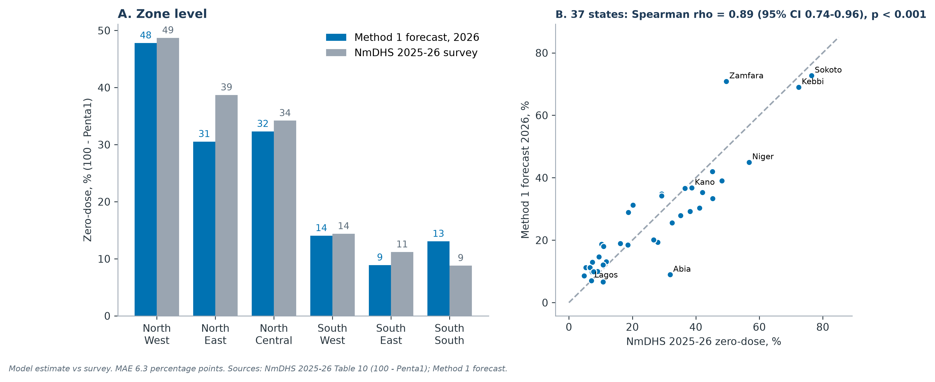
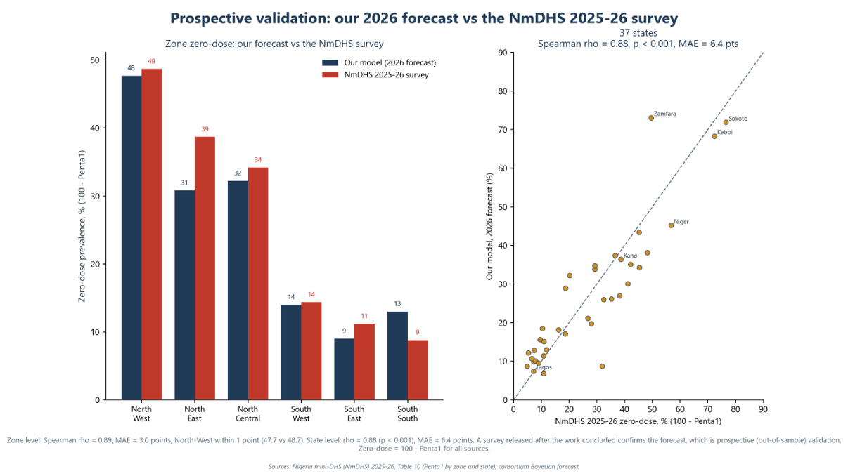
External check, state level
Model estimate against out-of-sample data. The NmDHS 2025-26 survey was released after this work concluded.
rho = 0.89
Our forecast and the new survey rank the 37 states in almost the same order.
48% vs 49%
our North-West forecast against the new survey - within one point
Why this is the strongest evidence. The NmDHS 2025-26 did not exist when the model was built - a true out-of-sample test.
The pattern also matched independent child-death data.
rho = Spearman rank correlation, where 1.00 is a perfect match of the ordering. Sources: Nigeria mini Demographic and Health Survey (NmDHS) 2025-26; consortium forecast; IHME Global Burden of Disease 2023. Out-of-sample check.

Slide 48
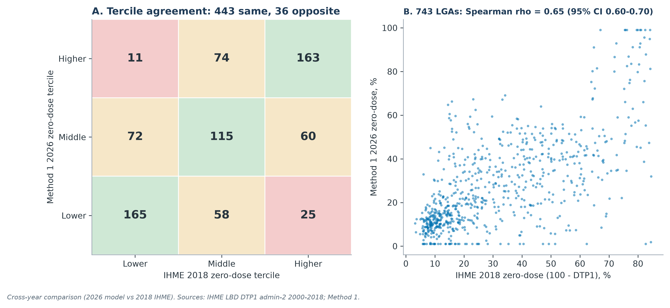
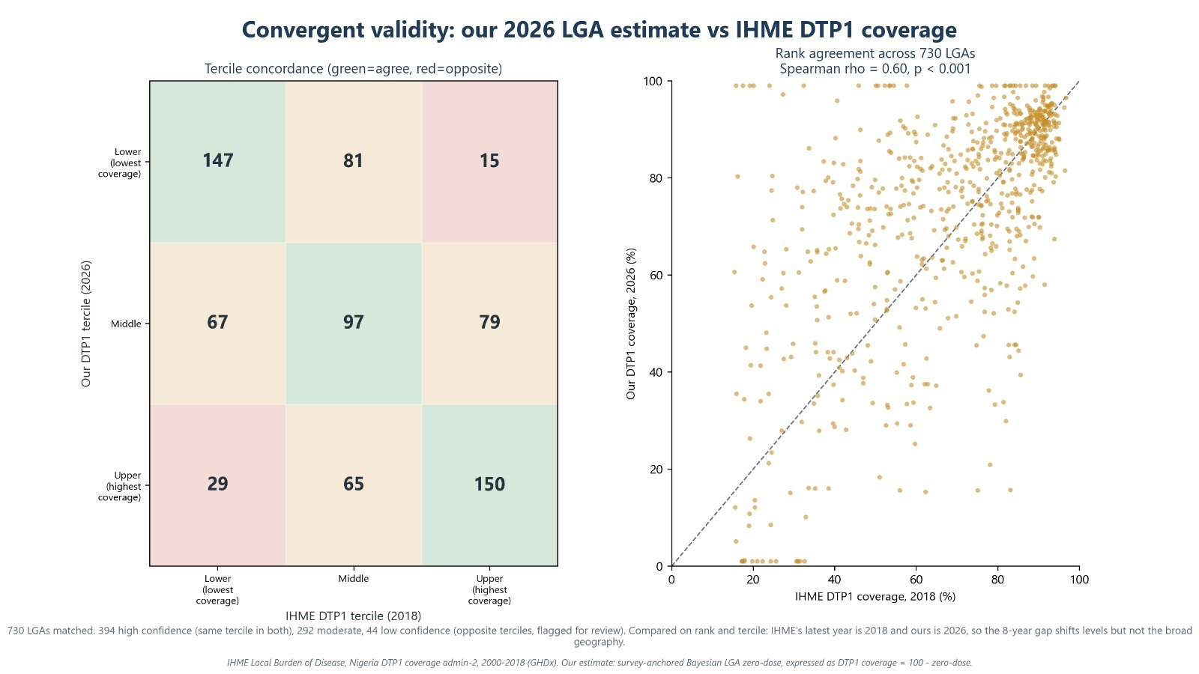
External check, local-government level
Independent data, built another way, puts the same areas in the same order.
rho = 0.65
Our LGA ranking and the independent map show similar priority patterns.
Most LGAs were placed in the same or a neighbouring priority third. Only 36 were in opposite thirds and should be reviewed.
Why the levels differ. The IHME surface ends in 2018 and ours is for 2026. Eight years shift the levels, but the geography still agrees.
Model estimate: Method 1 local-government estimate as DTP1 coverage (100 minus zero-dose), against the IHME Local Burden of Disease DTP1 admin-2 surface, 2000 to 2018. rho = Spearman rank correlation, 743 matched LGAs.
Notes:
The state-level check was the headline. This is the harder test, because agreement always gets noisier the further down you go.
Against the IHME DTP1 surface - an independent product, different team, different method - our local-government ranking agrees at rho of 0.60 across all 730 matched areas. On the tercile grid, 394 areas fall in the same third on both, 292 are one third apart, and only 44 land in opposite thirds; those 44 are flagged for review rather than buried.
Be precise about the claim. IHME's latest year is 2018 and ours is 2026, so the eight-year gap moves the levels but not the broad geography. We are validating the ordering, not asserting an exact district coverage percentage.

Slide 49
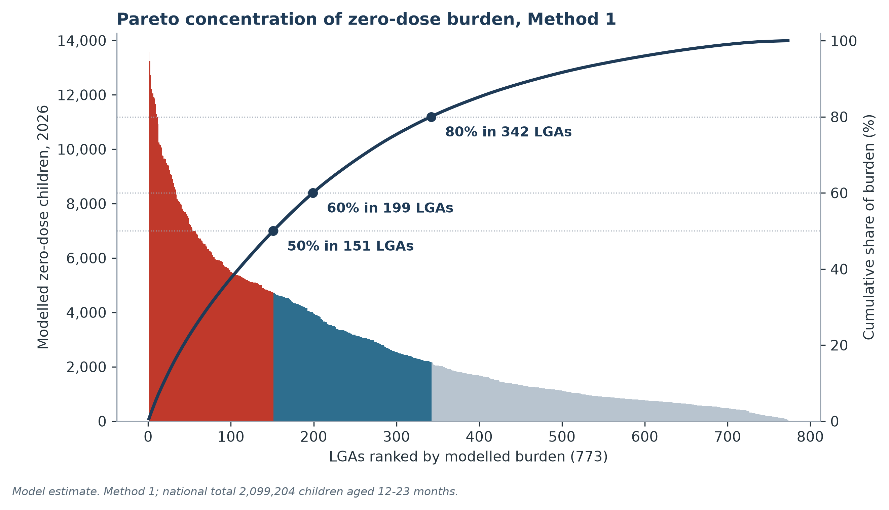
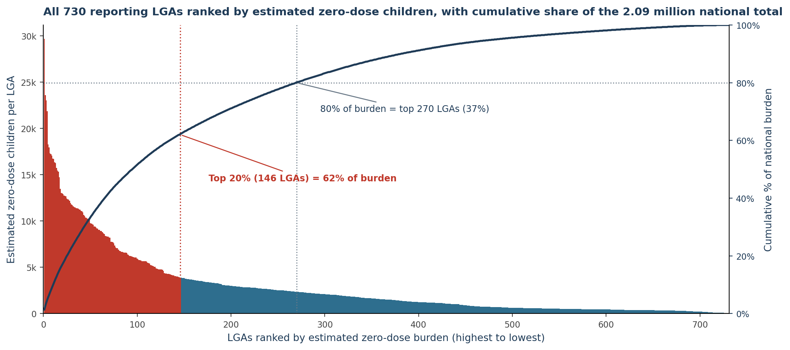
How the RI team uses this
Each output maps to a decision the programme already makes.
1
Microplanning
Use the priority list and vaccine-risk calendar in annual RI workplans.
2
Barrier-matched packages
Use each LGA's measured barriers to choose the package, starting from the state package.
The tool ranks LGAs by estimated missed children and shows how much of the burden each group contains.
3
Campaign and supervision routing
Use hotspot and burden ranking to choose campaign areas and supervision routes.
Sequencing the money. Start with about 151 LGAs to reach half of missed children, expand to about 199 for 60 percent, then toward 342 LGAs to reach 80 percent.
4
Leverage beyond immunization
Many high-risk places also need nutrition and antenatal-care support; one visit can deliver several services.
Model estimate. Source: Domain 5 local-government ranking and Pareto curve (Method 1: Bayesian hierarchical model with DHIS2-calibrated LGA allocation; 773 local government areas; national total 2.10 million).

Slide 50
The platform: a live tool, not a static report
A no-code web application that re-runs every model on uploaded data.
Live, no-code re-runs
The LGA Priority and Archetypes screen
ZARA, the platform's analyst
Upload new DHIS2 or survey files. The app checks the data and updates the results.
Filter by state or LGA to see vaccine risks, estimated missed children, rank and recommended response type. Results export to Excel.
Zero-dose Analytics and Risk Assistant: ZARA answers simple questions in English, Hausa, Yoruba, Igbo, Pidgin and more, using only the results in the platform.
Guardrails, on every view
Each result shows the data date, reporting completeness and whether it is an estimate. This helps users avoid misreading the figures.
Live demonstration: huggingface.co/spaces/amobionovo/nphcda-zerodose

Slide 51
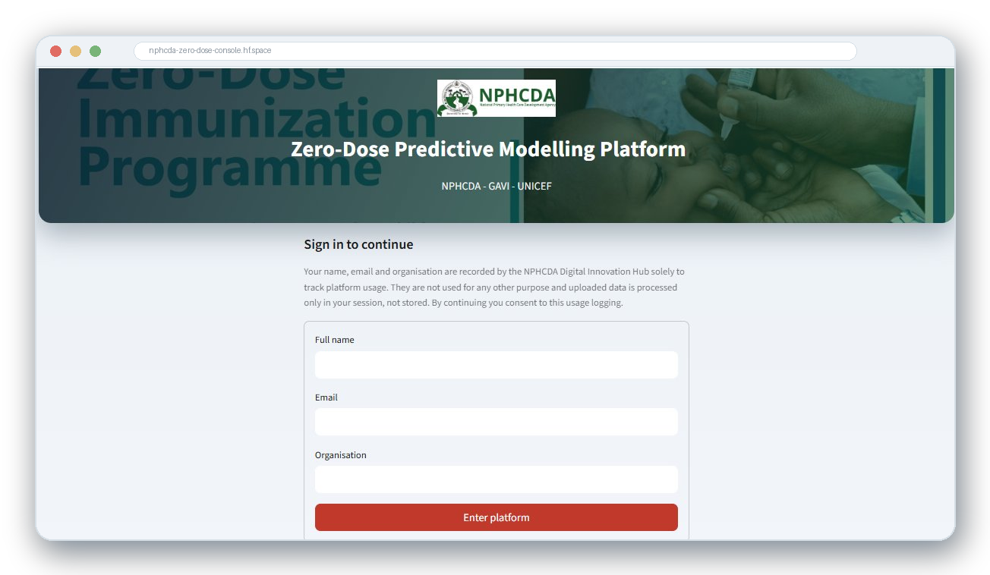
WHAT THE WEB PLATFORM ADDS
From notebooks to a live decision platform the DIH team can operate
Live, real-time modelling
Runs on uploaded data, deployed on Hugging Face Docker.
Reproduces the report
National total within 0.01%; back-tested and wave-validated.
Grounded AI layer
Interpreter on every output, ZARA analyst, page-cited Q&A.
Two coverage lenses
Estimated coverage and the 2024 index, triangulated with NDHS.
Decision-ready outputs
Scorecards, maps, GAVI factsheet, policy brief, this deck.
Governance built in
The live platform on Hugging Face; secure login with usage tracking.
Secure login and usage tracking; data stays in-session.
CIDRE and Quantium Insights LLC · In technical support of NPHCDA · Confidential draft for GAVI and UNICEF review
8

Slide 52
THE HUGGING FACE APPLICATION
How the tool supports programme discussions
It re-runs live, explains itself in plain language, and produces the documents a meeting needs.
Live re-runs on new data. Upload refreshed files; the app validates the structure and recomputes only what changed. No code change is needed.
1
ZARA, a grounded analyst. Plain-language and multilingual Q&A (English, French, Hausa, Yoruba, Igbo, Pidgin, Swahili and more). It reads the live outputs and is instructed never to invent numbers.
2
One-click factsheet and policy brief. A GAVI-style factsheet and a Word policy brief regenerate from the same live outputs, so the documents never drift apart.
3
Governance built in. Secure login, data stays in-session, and the load-validate-run-review-approve-release sign-off cycle for the DIH.
4
ZARA is grounded on the live results and uploaded documents (with page citations). One source of truth feeds the report, factsheet, brief and deck.
CIDRE and Quantium Insights LLC | In technical support of NPHCDA | For GAVI and UNICEF review
26
Notes:
Close the tour on what makes it useful in a room. It re-runs live on new uploads, so a review meeting can work with the latest data. ZARA answers questions in plain language and local languages, locked to the live numbers. And it produces the factsheet and brief in one click, all from the same source of truth, with governance for the DIH.

Slide 53
Recommendations from the modelling team
Act first where burden and deprivation meet
1
Begin with Sokoto, Kebbi, Zamfara and the highest-burden LGAs. About 151 LGAs reach half of missed children; the 107 LGAs ranked in the top 155 by both methods come first.
Match packages to each LGA's measured barriers
2
Start from the state package and add outreach, security-sensitive access, maternal-care or nutrition integration, demand support or defaulter tracing where an LGA's barriers call for it; validate locally.
Adopt the platform for routine microplanning
3
Use monthly DHIS2 data to update the priority list, flag data problems and support Gavi 6.0 targeting.
The Digital Innovation Hub leads from here
4
The DIH should lead routine use of the platform, with continued collaboration for upgrades and expansion to nutrition and child health.
The results have been checked against the newest national survey and can support Gavi 6.0 targeting.

Slide 54
Acronyms and abbreviations (1 of 2)
Every acronym used in this deck, spelled out.
ACLED
Armed Conflict Location and Event Data
DTP1 / Penta1
First dose of the pentavalent vaccine
ACSM
Advocacy, Communication and Social Mobilization
FDR
False discovery rate
AFP
Acute flaccid paralysis
GBD
Global Burden of Disease study (IHME)
ANC
Antenatal care
Getis-Ord Gi*
Local spatial hotspot statistic
BCG
Bacille Calmette-Guerin (tuberculosis vaccine)
GRID3
Geo-Referenced Infrastructure and Demographic Data for Development
CHI
Composite Hesitancy Index
HTR
Hard-to-reach
cVDPV
Circulating vaccine-derived poliovirus
IDSR
Integrated Disease Surveillance and Response
DHIS2
District Health Information System, version 2
IHME
Institute for Health Metrics and Evaluation
DHS
Demographic and Health Survey
ITN
Insecticide-treated net
DIH
Digital Innovation Hub (NPHCDA)
LASSO
Least absolute shrinkage and selection operator
Reference. CIDRE and Quantium Insights LLC, in technical support of NPHCDA.

Slide 55
Acronyms and abbreviations (2 of 2)
Every acronym used in this deck, spelled out.
LGA
Local government area
Penta3
Third dose of the pentavalent vaccine
MCV1 / Measles1
First dose of measles-containing vaccine
R-hat
Gelman-Rubin convergence diagnostic
Measles2
Second dose of measles-containing vaccine
RI
Routine immunization
MGWR
Multiscale geographically weighted regression
RMNCH
Reproductive, maternal, newborn and child health
NCDC
Nigeria Centre for Disease Control
RR
Relative risk
NDHS
Nigeria Demographic and Health Survey
RWI
Relative Wealth Index (Meta)
NmDHS
Nigeria mini Demographic and Health Survey
SIA
Supplementary immunization activity
NPC
National Population Commission
UNICEF
United Nations Children's Fund
NPHCDA
National Primary Health Care Development Agency
VPD
Vaccine-preventable disease
OLS
Ordinary least squares regression
ZARA
Zero-dose Analytics and Risk Assistant
SAE
Small-area estimation
BYM2
Besag-York-Mollie spatial model, version 2
Reference. CIDRE and Quantium Insights LLC, in technical support of NPHCDA.

