Slide 1
NPHCDA · UNICEF · GAVI
Predictive Modelling of Zero-Dose and
Under-Immunized Children for Improved Immunization Decision Making in Nigeria
Findings and programme use for the National Routine Immunization (RI) team
Prepared by the CIDRE and Quantium Insights LLC consortium, in technical support of NPHCDA, with UNICEF and Gavi (the global vaccine partnership).

Slide 2
Outline
1
Project summary: project journey, outputs and handover
2
Key results and programme messages
3
Modelling approach: state estimates down to LGA
4
External benchmarks and an independent Concordant check
5
Practical use and use cases for decision-making
6
Methodological considerations: data quality, model transparency, archetype robustness
7
The Hugging Face application: filtering, outputs, programme support and limits
Recommendations
8
2
Notes:
Outline of the modelling check-in (your portion, after the three project-summary slides). Page references match the numbers printed on each slide. Five main-deck areas plus the Hugging Face application. If you prefer the printed page numbers to match each slide's physical position, the whole deck can be renumbered so this outline becomes slide 4 with content running 5 to 26.

Slide 3
Project journey: inception to handover
One integrated cycle over six months, from assessment to handover.
M1
M1-M2
M3
M4-M5
M6
Inception and governance
Baseline and modelling questions
Capacity building
Applied modelling
Endline, Integration and handover
Self-learning, virtual class, in-person fellowship, tests
Group mentorship, abstracts, model validation, domain outputs
Kickoff, workplan, data inventory, stakeholder alignment
Readiness review, decision-use questions, use-case matrix
No-code app, ZARA, procedures, user guides, endline, closeout
Delivery stream
Evidence of implementation
Baseline assessment - documented status, infrastructure, staff capacity and governance.
Abstract presentations turned model outputs into policy-facing products.
Modelling questions refined into eight domains aligned to NPHCDA decision needs.
Endline assessment - measured uptake, readiness gains and remaining barriers.
The fellowship combined virtual learning, in-person modelling, and supervised group work.
Handover packaged models, documentation, dashboards and recommendations.
Key achievement: from one-off training to a modelling workflow NPHCDA now runs in-house.
Source: consortium project record, January to June 2026. DIH = Digital Innovation Hub, the agency's in-house data team; ZARA = Zero-dose Analytics and Risk Assistant.

Slide 4
The seven research questions
Agreed with NPHCDA as the scope of work. Seven domains, one shared question: who is missed, where, and why.
Domain 1
Domain 5
Which antigens are at risk of falling below the 80 percent coverage target in the next 6 to 12 months?
Where do zero-dose children concentrate, who are they, and where do we act first?
Domain 2
Domain 6
What are the dropout rates across antigen pairs, and what drives incomplete vaccination?
Where is polio-detection and transmission risk highest on the path to certification?
Domain 3
Domain 7
How does zero-dose risk vary by place, wealth, education and access?
Where is outbreak risk highest, and how does it link to child deaths?
Domain 4
Domains 1 to 7 are complete and validated. Domain 8, on campaign design and costing, awaits data from NPHCDA.
How far does vaccine hesitancy explain coverage shortfalls?
Source: scope of work agreed with NPHCDA, 2026. LGA = local government area; RI = routine immunization.

Slide 5
The modelling journey, end to end
We brought many data sources together, checked them, and turned the results into a priority list and simple web tool.
1 · PREPARE
Data retrieval
Harmonization and triangulation
Pre-processing
Feature engineering
Routine immunization records, household surveys, population data, maps, travel-time data and surveillance records
Check missing records, reporting gaps and population figures
Missed children, dropout, child population and local barriers
Make sure state and local government names match across files
2 · ANALYSE
Statistical analysis
Machine learning
Spatial analysis
Time-series forecasting
Bayesian regression
MGWR
Spatial scan statistics
Create five easy-to-use community types
Show where the problem is concentrated
Show why different areas need different responses
LASSO driver selection
Estimate where coverage or completion may fall
Estimate how many children are being missed
Identify where surveillance should remain strong
Seven methods run in parallel on the same engineered features
3 · VALIDATE
AND USE
Convergent validation
Priority list development
Programme use
Compare with newer surveys, independent maps and child-death patterns
Rank local governments and match them with practical response packages
NPHCDA microplanning; the Hugging Face web application and the ZARA analyst
Source: consortium modelling pipeline, 2026. Every acronym is spelled out on the methods, datasets and reference slides.

Slide 6
Methods at a glance
One method per question. Every finding is reproducible from the consortium notebooks.
Domain 1
Showed which vaccines may need attention soon.
Domain 2
Showed where children start vaccination but do not complete it.
Domain 3
Showed where poverty, distance, education and access barriers are strongest.
Domain 4
Checked whether vaccine concerns explain missed children.
Domain 5
Estimated where missed children are and grouped areas by the type of barrier.
Domain 6
Showed where polio surveillance and response should remain strong.
Domain 7
Showed where low coverage is linked with higher child-survival risk.
Validation: Independent testing showed the model was highly accurate (3 to 4% error)
Source: consortium methods, 2026. Model estimates reported with their uncertainty; clean convergence, maximum R-hat = 1.00.

Slide 7
The datasets behind every estimate
Eleven sources, mapped to the domains they feed. Nothing is modelled from a single data stream.
Dataset
What it provides
Domains
DHIS2 routine RI reports
Monthly administrative dose counts, all states, 2021 to 2025
1, 2, 5
NDHS 2008 to 2024 (verified)
Survey DTP1 coverage and zero-dose, 12-to-23-month cohort
1, 3, 4, 5
NmDHS 2025-26
New national survey, released after this work: out-of-sample check
Validation
Zero-dose master dataset
37-state file: survey coverage plus 30+ predictors
2, 3, 4, 5
Equity indicators file
Wealth, education, distance to care, urbanicity, fertility
3, 5
GRID3 admin boundaries
Admin-1 and admin-2 layers for maps and contiguity
3, 5, 6
AFP national line list
Case-level surveillance, about 103,000 records, 2015 to 2025
6
IHME GBD 2023 (Nigeria)
State cause-of-death fractions; independent mortality record
7
NPHCDA ACSM register
2,593 advocacy and social-mobilization activities, 36 states
4
Population: NPC 2022 and WorldPop
Local-government denominators for absolute-burden conversion
1, 4, 5, 7
Meta Relative Wealth Index; Weiss travel time; ACLED
Wealth, remoteness and political-violence covariates
3, 5
All acronyms are spelled out in the reference slides. Domain 8 datasets (programme and expenditure) are pending from NPHCDA.

Slide 8
The 44 local government areas we could not model
LGAs without Penta1 reporting were excluded from the analysis and flagged for data-quality investigation. 730 of the 774 local government areas met the reporting standard.
Every excluded local government area, by state · 23 North-West · 16 North-East · 3 North-Central · 2 South-South
Adamawa
Borno
Jigawa
Kaduna (cont.)
Kano (cont.)
Nasarawa
Fufore
Biu
Birnin Kudu
Kauru
Kiru
Lafia
Hong
Guzamala **
Gwaram
Lere
Kumbotso
Rivers
Yola North
Maiduguri
Kaduna
Sabon Gari
Nasarawa *
Obio/Akpor *
Bauchi
FCT
Birnin Gwari
Soba
Sumaila
Port-Harcourt
Alkaleri
Abuja Municipal *
Chikun
Zaria
Tudun Wada
Ungogo
Taraba
Bauchi *
Bwari
Giwa
Kano
Sardauna
Ganjuwa
Gombe
Igabi
Dala
Ningi
Ikara
Gezawa
Yobe
Akko
Potiskum
Toro
Gombe
Kaduna South
Gwale
Yamaltu/Deba
Kano Municipal
What the data team can fix. Restore the Penta1 data element where other antigens already report, starting with the metropolitan areas: Maiduguri, Kano Municipal, Port-Harcourt.
* Penta1 blank and overall reporting sparse (4 LGAs). ** No data of any kind (1 LGA). Source: DHIS2 routine antigen export by local government area and month, 2021 to 2025.

Slide 9
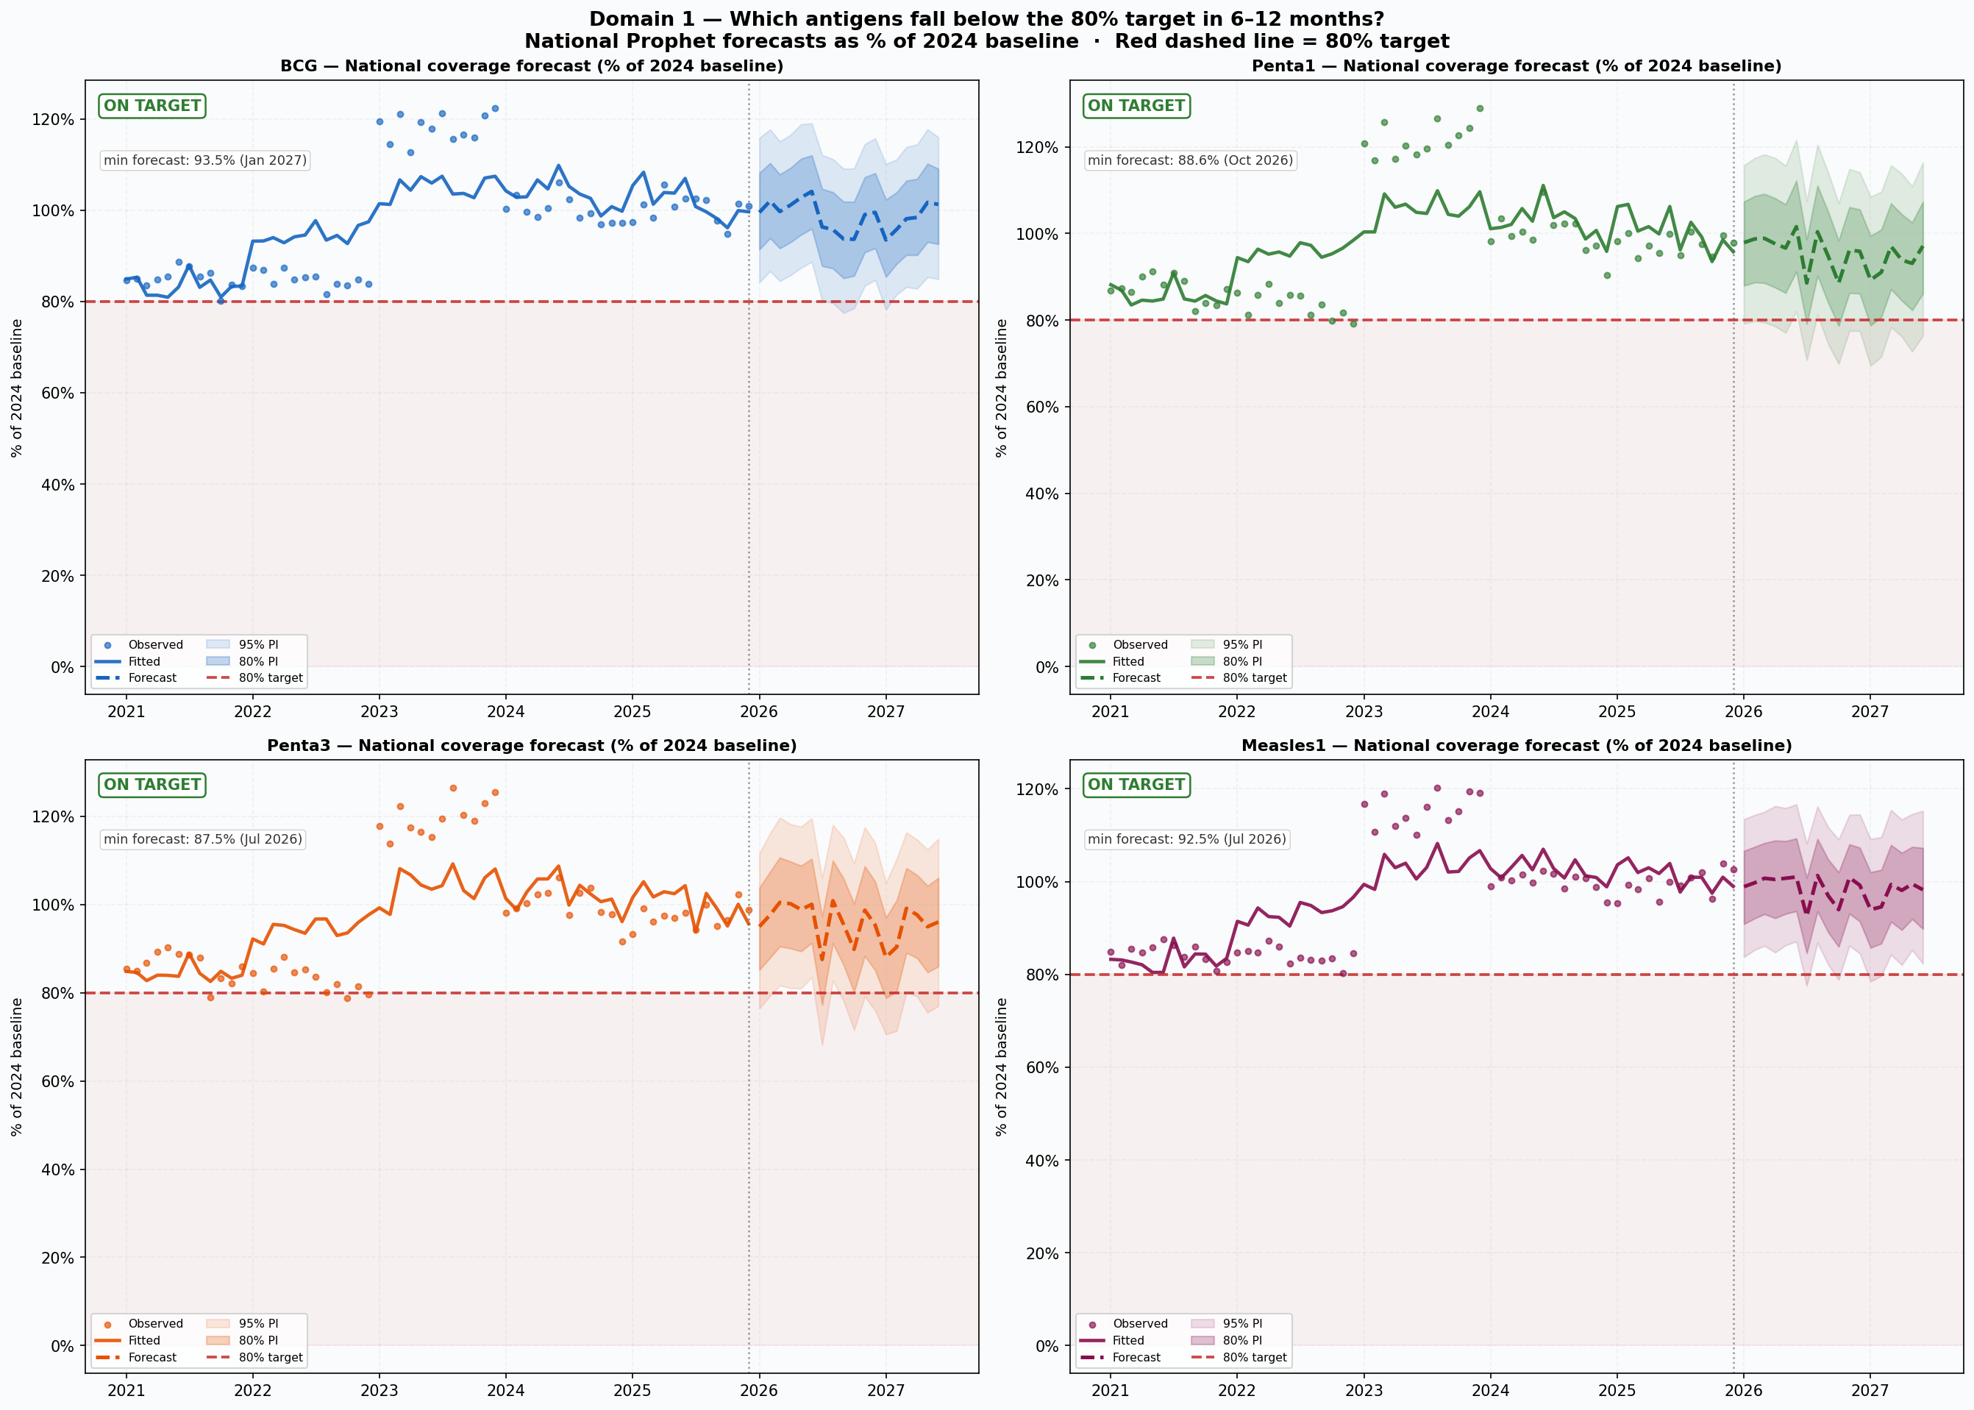
Domain 1: which antigens are at risk of falling below target?
An early-warning signal that delivery is falling. It is not a count of children vaccinated.
1,645
early-warning alerts, in 591 of the 730 reporting areas
Every reporting area has its own forecast for each of the four tracer vaccines. That gives 2,657 forecasts, and 1,645 fall below the mark in the next 6 to 12 months.
What below 80 percent means. Doses delivered have dropped below four-fifths of what that area managed in 2024. It does not mean only 80 percent of children were reached.
What to do. Alert by vaccine and by month, and send supervision to those exact areas.
Model estimate. The 80 percent mark compares each area with its own 2024 level of doses delivered. It is a decline tripwire, not coverage of the eligible child population. Source: Domain 1 Prophet forecasts on DHIS2 routine data, 2021 to 2025.

Slide 10
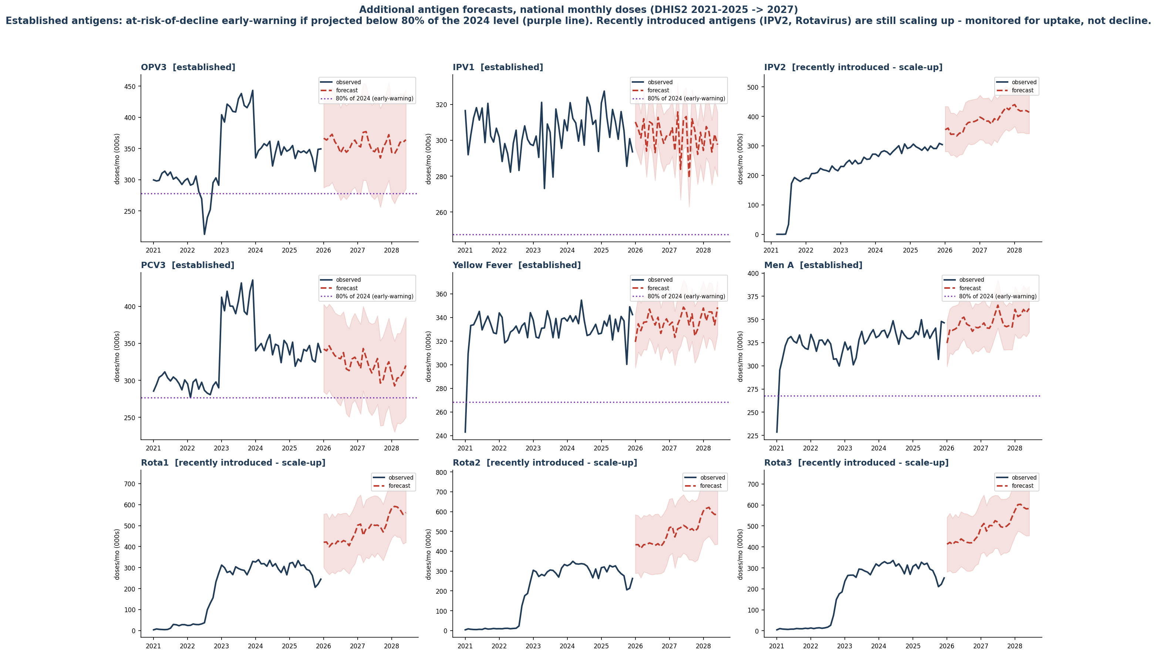
All nine additional antigens show stable, or improving trajectories with no decline warnings
Same method, nine more vaccines. None of them raised a warning, and some are still rising.
5 of 5
established antigens added - OPV3, IPV1, PCV3, Yellow Fever and Meningitis A - are projected to stay above 80 percent of their own 2024 level. None is flagged.
4 of 4
recently introduced series - IPV2 and Rotavirus 1 to 3 - keep rising. They are monitored for uptake, not screened for decline.
How to read the chart
The purple dotted line is 80 percent of that antigen's own 2024 doses - the at-risk-of-decline early-warning mark. Rising series carry no line, because they should not be screened for decline.
Model estimate. Source: Domain 1 Prophet forecasts on DHIS2 (District Health Information System, version 2) routine data, 2021 to 2025, projected to 2027. OPV = oral polio vaccine; IPV = inactivated polio vaccine; PCV3 = third dose of pneumococcal conjugate vaccine.

Slide 11
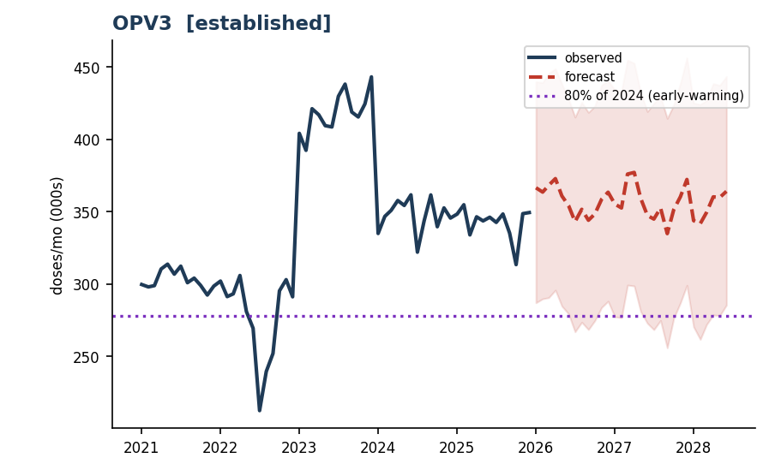
What the at-risk-of-decline early-warning measures
It tells you when delivery is slipping against a settled benchmark. It is not a coverage figure.
THE FLAG, IN FOUR LINES
At-risk-of-decline early-warning
What it measures. Projected monthly doses for an antigen, expressed as a percent of that antigen's own 2024 level.
The mark. Below 80 percent means doses are slipping against the settled 2024 benchmark. That is what raises the flag.
It is denominator-free. It does not say what share of children were reached, because no child population enters the calculation.
What to do with it. Catch the decline early, and route supervision to the exact antigen, month and local government area.
Reading one panel. The purple dotted line is 80 percent of OPV3's 2024 doses; the forecast stays clear of it, so OPV3 is not flagged.
Why the benchmark is 2024, not 2025
Not to be confused with true coverage
2024 is the last complete, fully-reported year, so it holds still. 2025 is partial and keeps shifting as late reports arrive, which would raise alerts that are really reporting lag.
True coverage divides doses by the eligible child population, the 12-to-23-month cohort. It answers a different question and is shown separately in the application as "Estimated coverage (eligible cohort)".
The early-warning tells you when delivery is falling. Coverage tells you how many children you reached. Different questions, different denominators.
Source: Domain 1 methods, consortium documentation, 2026. WHO = World Health Organization; Gavi = the global vaccine partnership. Projected values are model estimates.

Slide 12
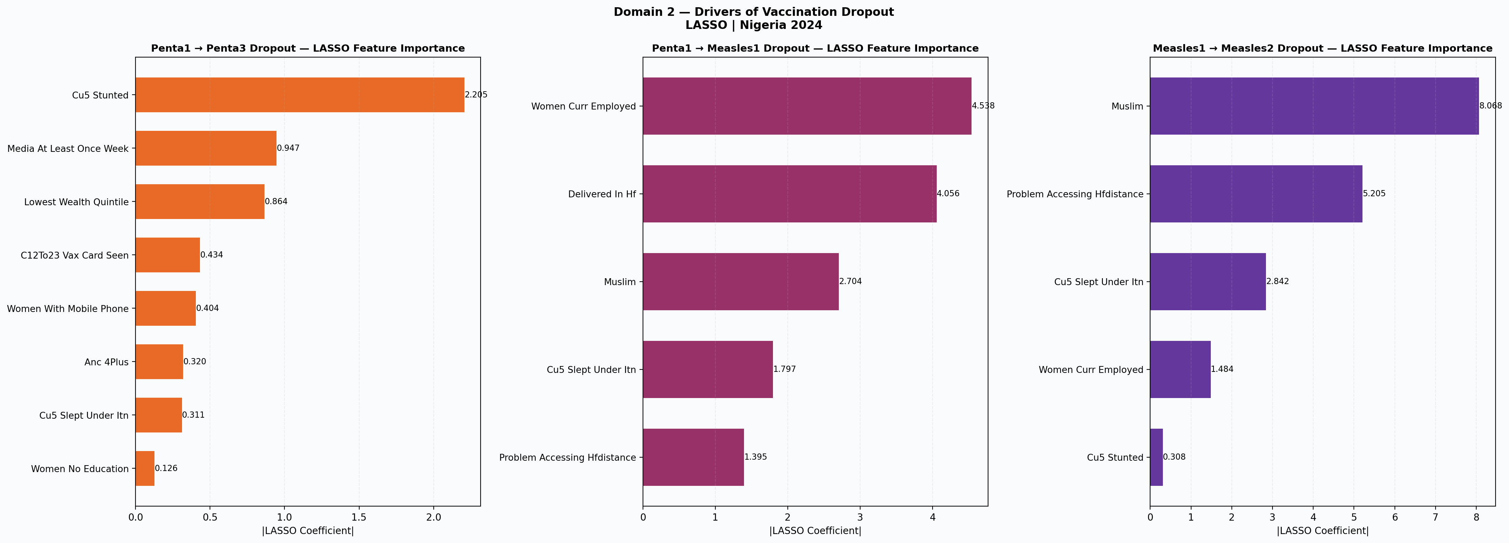
Domain 2: what drives incomplete vaccination?
Each dropout transition has a different driver, so retention needs three tailored responses, not one.
The biggest remaining gap is between Measles1 and Measles2. It has improved but still needs follow-up.
Penta1 to Penta3
Penta1 to Measles1
Measles1 to Measles2
Stunting; media exposure; lowest wealth.
Women employed; facility delivery; religion share.
Religion share; distance to facility; treated-net use.
Defaulter tracing where poverty and undernutrition drive early loss.
Facility-linked, workplace-friendly scheduling.
Outreach and trusted messengers where distance is the barrier.
Model estimate. Bootstrap-stable LASSO selection, then a parsimonious model per transition. Ecological associations across all 37 states: directional, not causal.

Slide 13
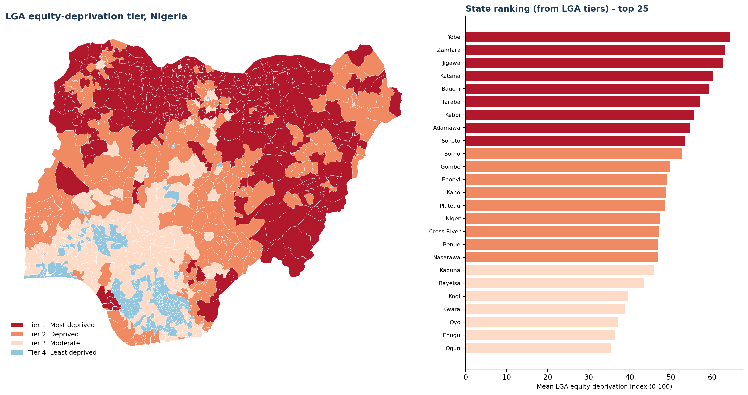
Domain 3: where children are hardest to reach
Model estimate. The index combines travel time, education, poverty and wealth.
Tier 1 Most deprived
Tier 2 Deprived
Tier 3 Moderate
Tier 4 Least deprived
Darker areas have stronger barriers: longer travel, lower education and more poverty.
Many of the hardest-to-reach LGAs are in the North-East and North-West.
Use this with the burden ranking. Burden shows where the most children are; this tier shows where barriers are deepest. Areas with both high burden and high deprivation should be prioritized..
Model estimate. Composite equity-deprivation index (0 to 100) built from Weiss travel time, education, poverty and the Meta Relative Wealth Index, grouped into four equal bands; GRID3 boundaries.

Slide 14
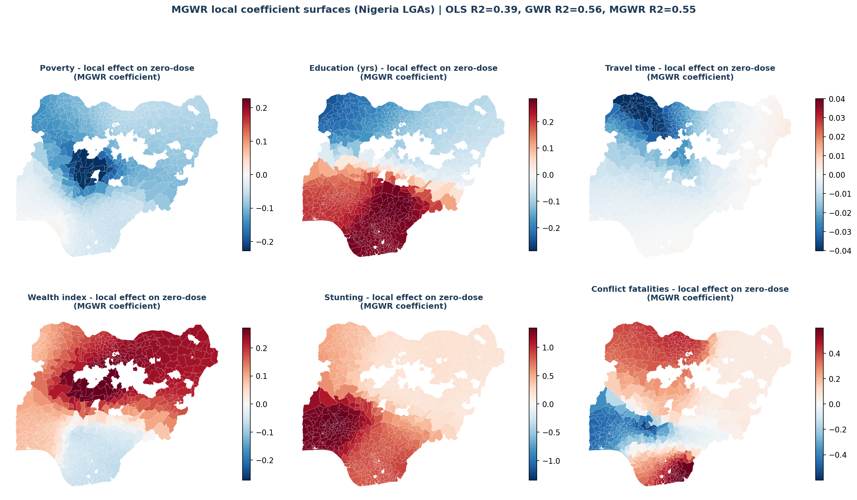
The causes act locally
The previous slide showed where disadvantage is deepest. These maps show which barrier appears strongest in each place.
39% → 55%
of the variation explained, once drivers can act differently in different places
Each map shows one possible barrier to vaccination.
Red means the factor is linked with more zero-dose children. Blue means the opposite. Darker colour means stronger effect.
Model estimate across the 774 local government areas. MGWR = multiscale geographically weighted regression, which lets each driver's effect vary from place to place. These are local, standardised, partial associations, not causal effects. White areas are not modelled because they have no DTP1 reporting, so they carry no estimate rather than a zero.

Slide 15
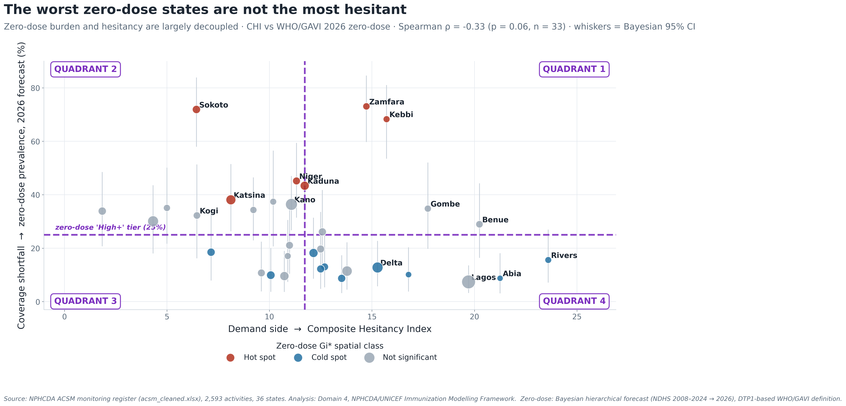
Domain 4: does hesitancy explain the shortfall?
Hesitancy is real, but it does not sit where the missed children are.
rho = -0.33
The states with the most recorded doubt are not the states missing the most children.
Each bubble is a state. Bubble size is the under-five population.
What to do. In high zero-dose but low-hesitancy areas, focus on access, outreach and service availability. Use trust-building where hesitancy is actually high.
Model estimate. Domain 4 Composite Hesitancy Index against the Domain 5 zero-dose forecast. rho = Spearman rank correlation; full provenance on the figure.

Slide 16
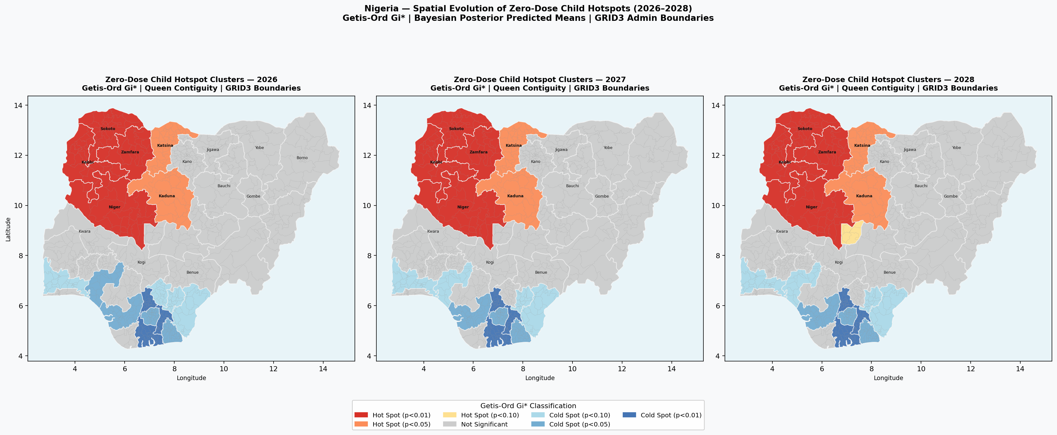
Domain 5: where do zero-dose children concentrate?
A North-West hotspot that stays fixed from 2026 to 2028, held in place by structural conditions.
2.08 million
zero-dose children in 2026, across the 730 modelled local government areas
62%
of the burden is in the top 20% of LGAs
The maps show the modelled zero-dose surface for 2026, 2027 and 2028. The hot area sits over the North-West in every year.
Sokoto, Kebbi and Zamfara remain high-priority throughout the forecast period. They require a multi-year plan, not a one-off activity.
270 local government areas hold 80 percent - concentrated, but not the textbook 80/20.
Model estimate. Source: Domain 5 Bayesian hierarchical Beta regression on NDHS 2008 to 2024, calibrated to local government areas on GRID3 boundaries; Getis-Ord Gi* hotspots.

Slide 17
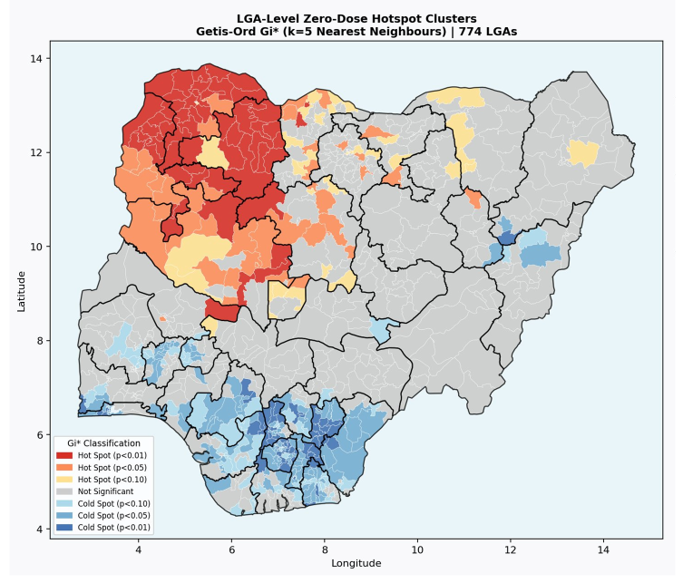
Every local government area, ranked by burden
The top 150 reach 62 percent of zero-dose children; the top 270 reach 80 percent.
Rank
State
LGA
Zone
Burden
Rate %
1
Kaduna
Kaduna North
North West
29,585
78.9
2
Kaduna
Kubau
North West
23,524
81.4
3
Kaduna
Zangon Kataf
North West
22,943
69.9
4
Zamfara
Gusau
North West
21,871
99.0
5
Kaduna
Jema'A
North West
18,222
63.6
6
Bauchi
Gamawa
North East
17,943
57.2
7
Kebbi
Birnin Kebbi
North West
17,286
99.0
8
Bauchi
Misau
North East
17,217
59.8
9
Kebbi
Danko/Wasagu
North West
17,071
99.0
10
Zamfara
Zurmi
North West
16,755
99.0
Red marks clusters of high zero-dose burden; blue marks low-burden clusters.
Top 10 shown here. The full list can be filtered by state or priority level in the web app.
Model estimate. Source: Domain 5 zero-dose model, 2026; GRID3 boundaries. Hotspot method: Getis-Ord Gi* (spatial clustering), k = 5 nearest neighbours.

Slide 18
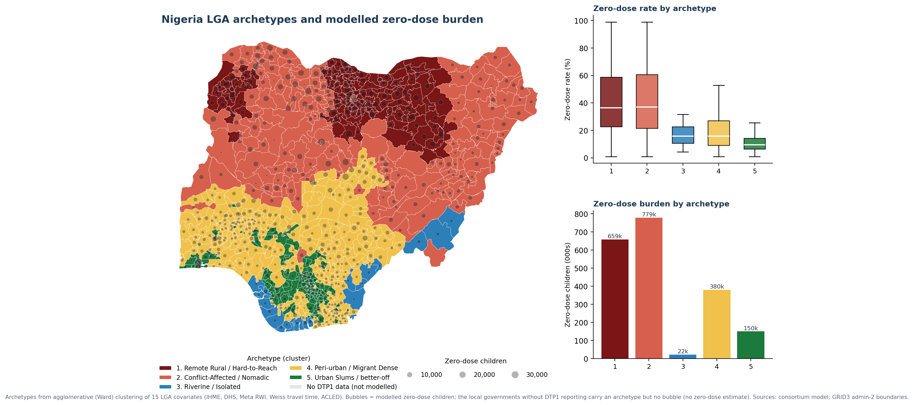
Archetypes and modelled zero-dose burden
Built from social and structural data alone - education, nutrition, poverty, wealth, travel time, antenatal care and conflict - the archetypes used no vaccination data. Yet they reproduce where the children are: Archetypes 1 and 2 hold 1.44 million of 2.08 million zero-dose children (69 percent).
Color shows the type of problem. Bubble size shows how many children are missed. This helps teams decide both where to go and what to do.
Model estimate. Archetypes from agglomerative (Ward) clustering of 15 local-government covariates (IHME, DHS, Meta Relative Wealth Index, Weiss travel time, ACLED); bubbles are modelled zero-dose children; GRID3 admin-2 boundaries.

Slide 19
The five archetypes and the response each one needs
Archetypes 1 and 2 hold about 72 percent of all zero-dose children.
#
Archetype
LGAs
Zero-dose children
Mean rate
Defining signature
Priority intervention
1
Remote Rural /
Hard-to-Reach
136
684,473
(33%)
41.0%
Highest child undernutrition; lowest maternal education (about 2.5 years) and facility delivery (about 10%)
Reaching-Every-Community microplanning, BHCPF outreach and community health workers; co-deliver with nutrition and antenatal care
Kano, Jigawa, Katsina
2
Conflict-Affected /
Nomadic
192
799,656
(39%)
41.9%
Highest political-violence fatalities; high antigen dropout; weak antenatal care and delivery
Security-integrated microplanning, negotiated access, and mobile and transit-point teams
Borno, Niger, Adamawa
3
Riverine /
Geographically Isolated
20
22,425
(1%)
16.6%
Extreme travel time to care (about 108 minutes); low improved-water access
Boat-based outreach, community health worker networks, and multi-antigen bundling per visit
Cross River, Bayelsa, Delta
4
Peri-urban /
Migrant Dense
280
406,045
(20%)
19.3%
Moderate on all fronts; fair care-seeking (antenatal care 72%, delivery 61%)
Ward enumeration, migrant-sensitive scheduling, and Periodic Intensification of Routine Immunization
Osun, Akwa Ibom, Oyo
5
Urban Slums
(better-off core)
146
151,256
(7%)
11.0%
Highest wealth and education (about 9.6 years) and facility delivery (78%); residual informal-settlement gaps
Targeted social mobilisation, a fixed-plus-outreach hybrid, and private-sector last-mile reach
Imo, Anambra, Lagos
Model estimate. Agglomerative (Ward) clustering of 15 covariates across all 774 local government areas; total about 2.06 million zero-dose children. Grey text names example states. BHCPF = Basic Health Care Provision Fund.

Slide 20
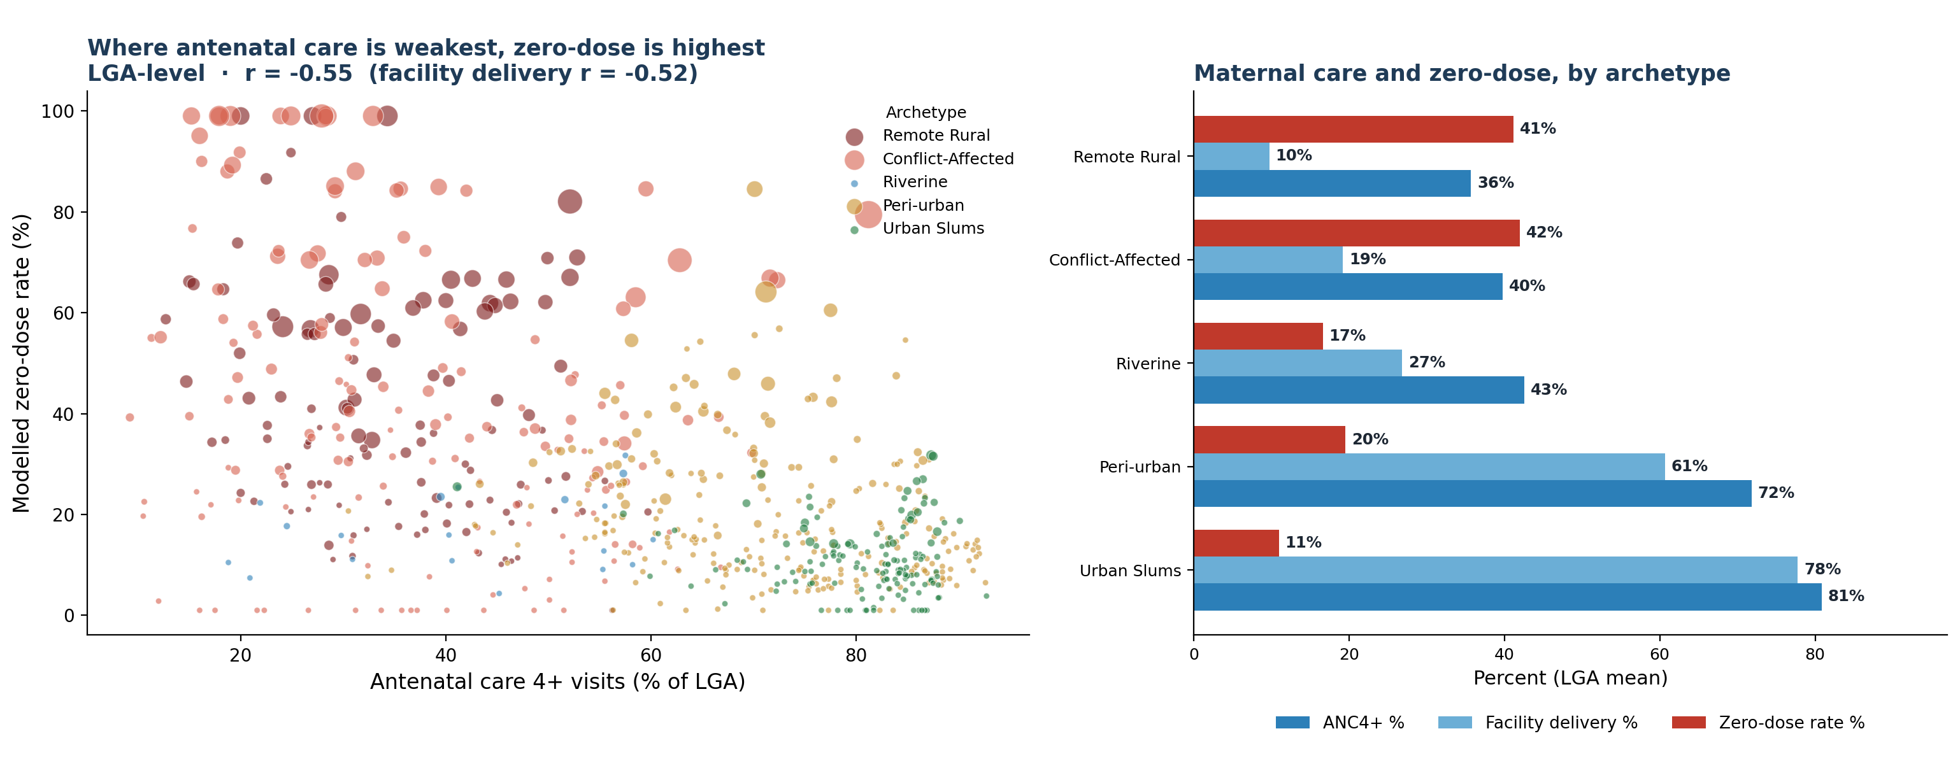
Maternal and immunization gaps sit in the same places
The local governments with the weakest antenatal care and facility delivery are the same ones missing the most zero-dose children, so an existing maternal contact is a ready entry point to reach them.
1.4 million
of the roughly 2.08 million modelled zero-dose children are in the two archetypes with the weakest maternal care.
r = -0.55
antenatal care, four or more visits, against the modelled zero-dose rate across the local governments. Facility delivery is r = -0.52.
The link. Weaker antenatal care goes with higher zero-dose across all 774 local governments (ANC4+ r = -0.55; facility delivery r = -0.52). The link is strong and consistent.
The burden. Remote Rural and Conflict-Affected hold about 1.4 million zero-dose children, on the lowest antenatal care (36 to 40%) and facility delivery (10 to 19%).
The action. Co-deliver immunization with antenatal and delivery contacts in these archetypes - one visit, several services - rather than running immunization outreach on its own.
Model estimate. Source: LGA archetype master (IHME and DHS antenatal-care and facility-delivery covariates; modelled zero-dose). RMNCH = reproductive, maternal, newborn and child health; EPI = Expanded Programme on Immunization; ANC4+ = antenatal care, four or more visits; LGA = local government area. Bubble size = modelled zero-dose children.

Slide 21
From archetype to action: the RMNCH-EPI operational list
Five archetypes, the maternal-care numbers behind each, and the package matched to it.
Archetype
LGAs
ANC4+ (%)
Facility delivery (%)
Zero-dose rate (%)
Zero-dose children
RMNCH-EPI intervention, matched to the archetype
Remote Rural /
Hard-to-Reach
136
35.7
9.8
41.2
658,900
Reaching-Every-Community microplanning, BHCPF outreach and community health workers; co-deliver immunization with antenatal and nutrition contacts
Conflict-Affected /
Nomadic
192
39.8
19.2
42.0
779,131
Security-integrated microplanning, negotiated access, and mobile and transit-point teams delivering immunization and antenatal care together
Riverine /
Geographically Isolated
20
42.6
26.8
16.6
22,425
Boat-based outreach, community health worker networks, and multi-antigen and antenatal bundling per visit
Peri-urban /
Migrant Dense
280
71.8
60.7
19.5
380,154
Ward enumeration, migrant-sensitive scheduling, and Periodic Intensification of Routine Immunization linked to antenatal clinics
Urban Slums
(better-off urban core)
146
80.9
77.8
11.0
150,166
Targeted social mobilization, a fixed-plus-outreach hybrid, and private-sector last-mile reach for immunization and antenatal care
The full list. All 774 local government areas are ranked worst-to-best by modelled zero-dose burden in the operational workbook, each carrying its archetype, antenatal care and facility-delivery figures, and the matched package, ready for microplanning.
Model estimate. Source: LGA archetype master and the RMNCH-EPI operational workbook (IHME and DHS antenatal-care and facility-delivery covariates; modelled zero-dose). BHCPF = Basic Health Care Provision Fund. Facility-level primary health care lists and facility density are not included; those need a GRID3 or National Health Facility Registry dataset.

Slide 22
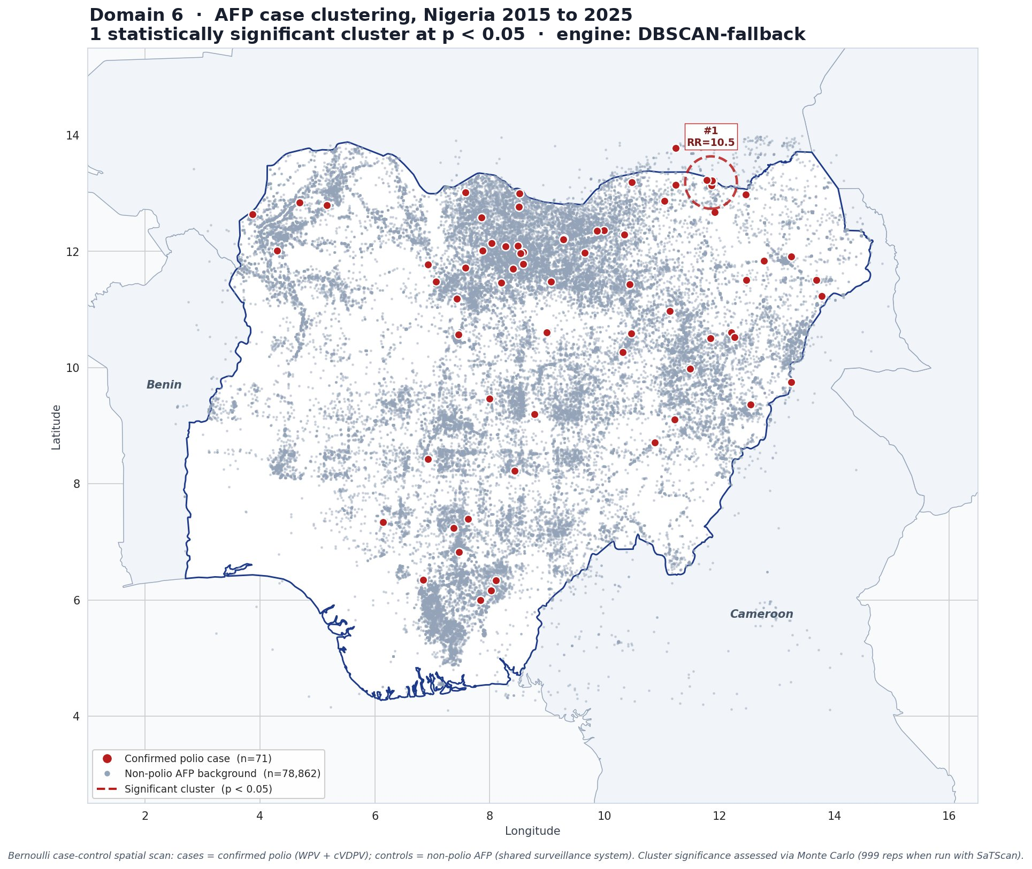
Where is polio-detection risk highest?
One cluster on the north-east border, and six states that have not yet reached the three-year mark.
RR = 10.5
the highlighted border area needs closer surveillance and response
Meaning: the highlighted area should remain a priority for surveillance, investigation and response.
Programme meaning: Taraba, Kogi, Adamawa, Borno, Gombe and Kano require continued attention.
Action: maintain strong campaign quality, AFP surveillance, environmental surveillance and timely investigation.
Model estimate. Source: Domain 6 spatial scan on the national acute flaccid paralysis line list (about 103,000 records, 2015 to 2025); survival analysis against the WHO three-year certification rule.

Slide 23
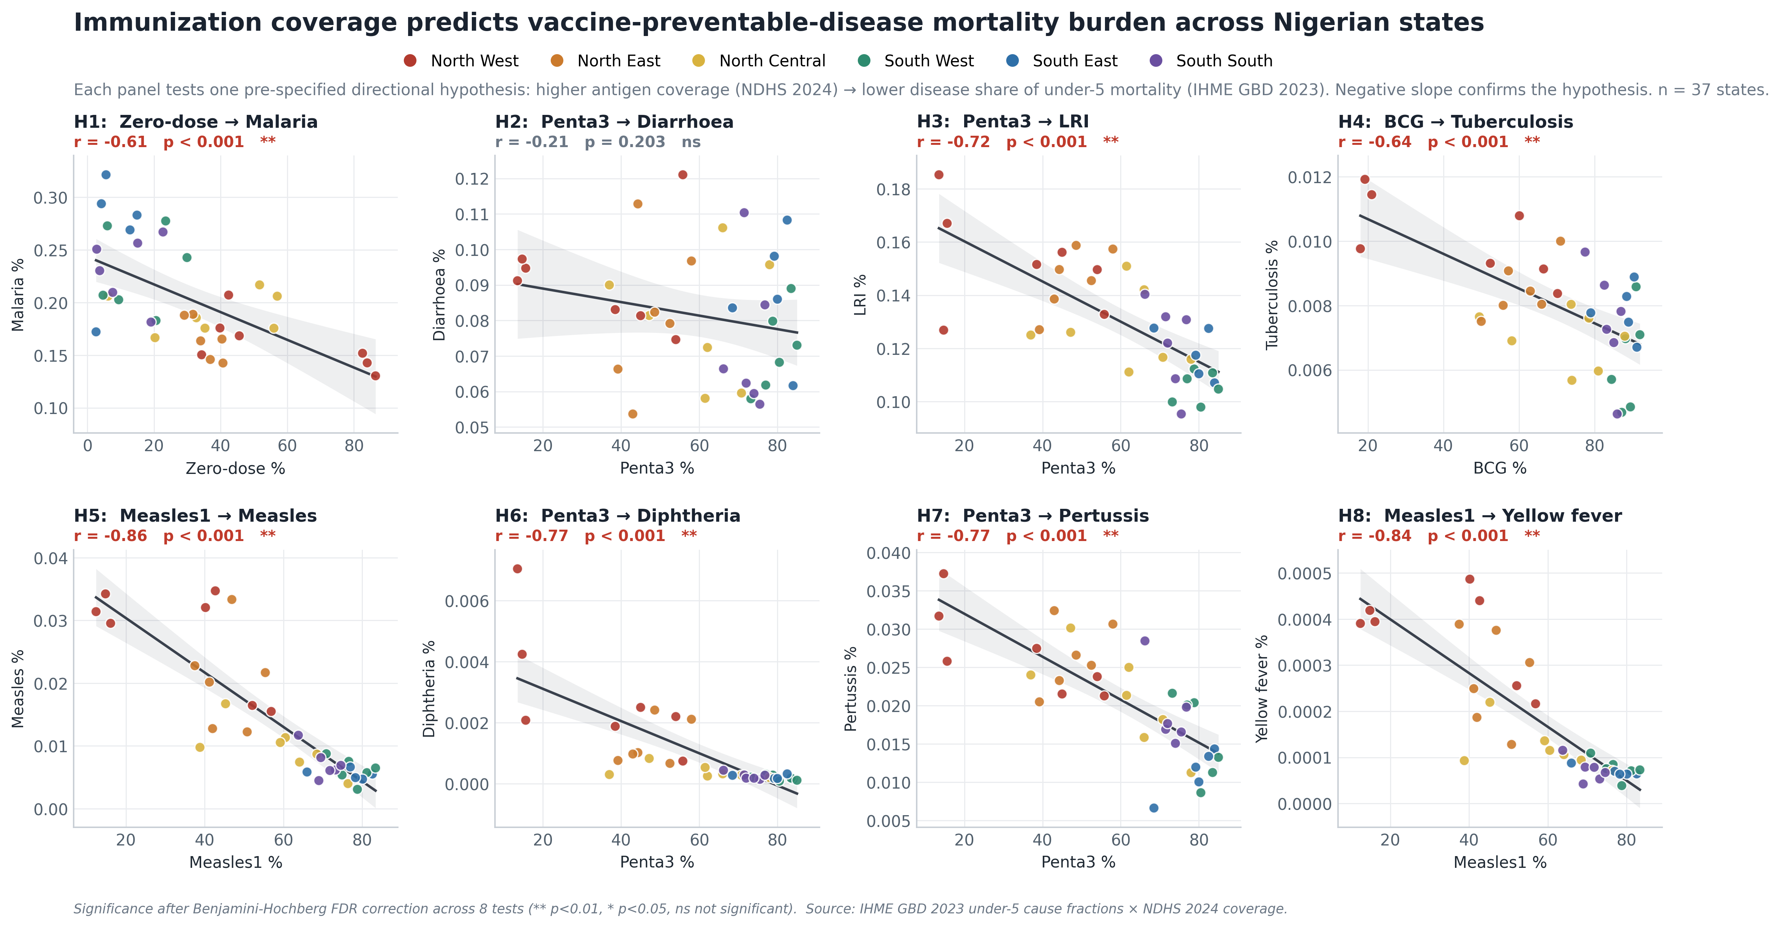
Domain 7: outbreak risk and the link to child deaths
Places with lower vaccination coverage also show higher risk of child deaths from vaccine-preventable diseases.
7 of 8
pre-specified coverage-to-mortality links hold after correction for multiple testing
Strongest for measles. The strongest link was for measles. Improving measles coverage in high-risk areas can protect more children.
Why it matters: reaching missed children is not just about percentages; it is about preventing illness and death.
Model estimate. Source: Domain 7, eight pre-specified false-discovery-rate-corrected tests against IHME Global Burden of Disease 2023 cause fractions, a validated proxy while the national surveillance line-lists are pending.

Slide 24
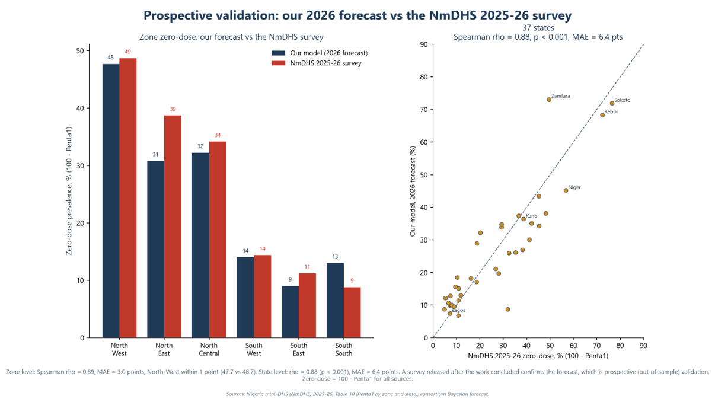
External check, state level
Model estimate against out-of-sample data. The NmDHS 2025-26 survey was released after this work concluded.
rho = 0.88
Our forecast and the new survey rank the 37 states in almost the same order.
48% vs 49%
our North-West forecast against the new survey - within one point
Why this is the strongest evidence. The NmDHS 2025-26 did not exist when the model was built - a true out-of-sample test.
The pattern also matched independent child-death data.
rho = Spearman rank correlation, where 1.00 is a perfect match of the ordering. Sources: Nigeria mini Demographic and Health Survey (NmDHS) 2025-26; consortium forecast; IHME Global Burden of Disease 2023. Out-of-sample check.

Slide 25
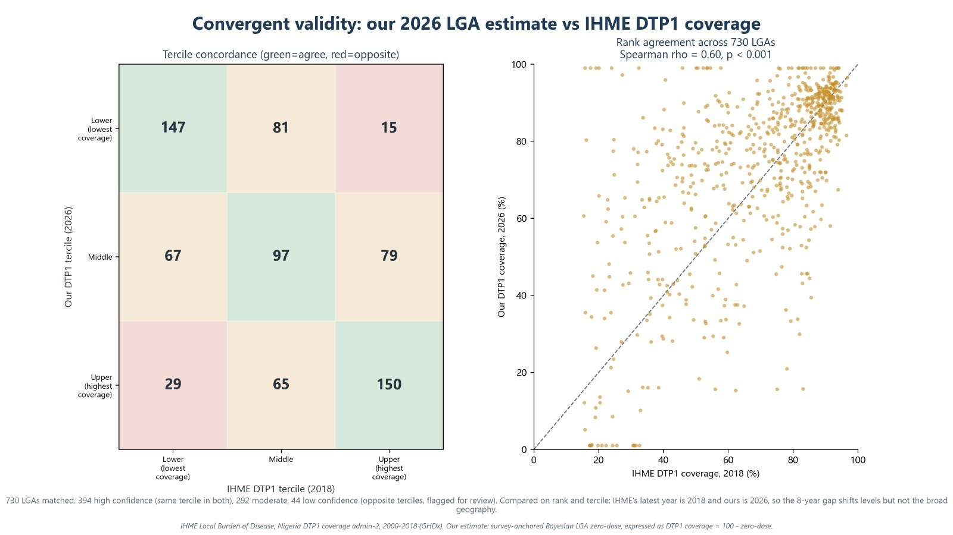
External check, local-government level
Independent data, built another way, puts the same areas in the same order.
rho = 0.60
Our LGA ranking and the independent map show similar priority patterns.
Most LGAs were placed in the same or nearby priority group. Only 44 were far apart and should be reviewed.
Why the levels differ. The IHME surface ends in 2018 and ours is for 2026. Eight years shift the levels, but the geography still agrees.
Model estimate: our Bayesian local-government estimate as DTP1 coverage (100 minus zero-dose), against the IHME Local Burden of Disease DTP1 admin-2 surface, 2000 to 2018. rho = Spearman rank correlation, 730 matched areas.
Notes:
The state-level check was the headline. This is the harder test, because agreement always gets noisier the further down you go.
Against the IHME DTP1 surface - an independent product, different team, different method - our local-government ranking agrees at rho of 0.60 across all 730 matched areas. On the tercile grid, 394 areas fall in the same third on both, 292 are one third apart, and only 44 land in opposite thirds; those 44 are flagged for review rather than buried.
Be precise about the claim. IHME's latest year is 2018 and ours is 2026, so the eight-year gap moves the levels but not the broad geography. We are validating the ordering, not asserting an exact district coverage percentage.

Slide 26
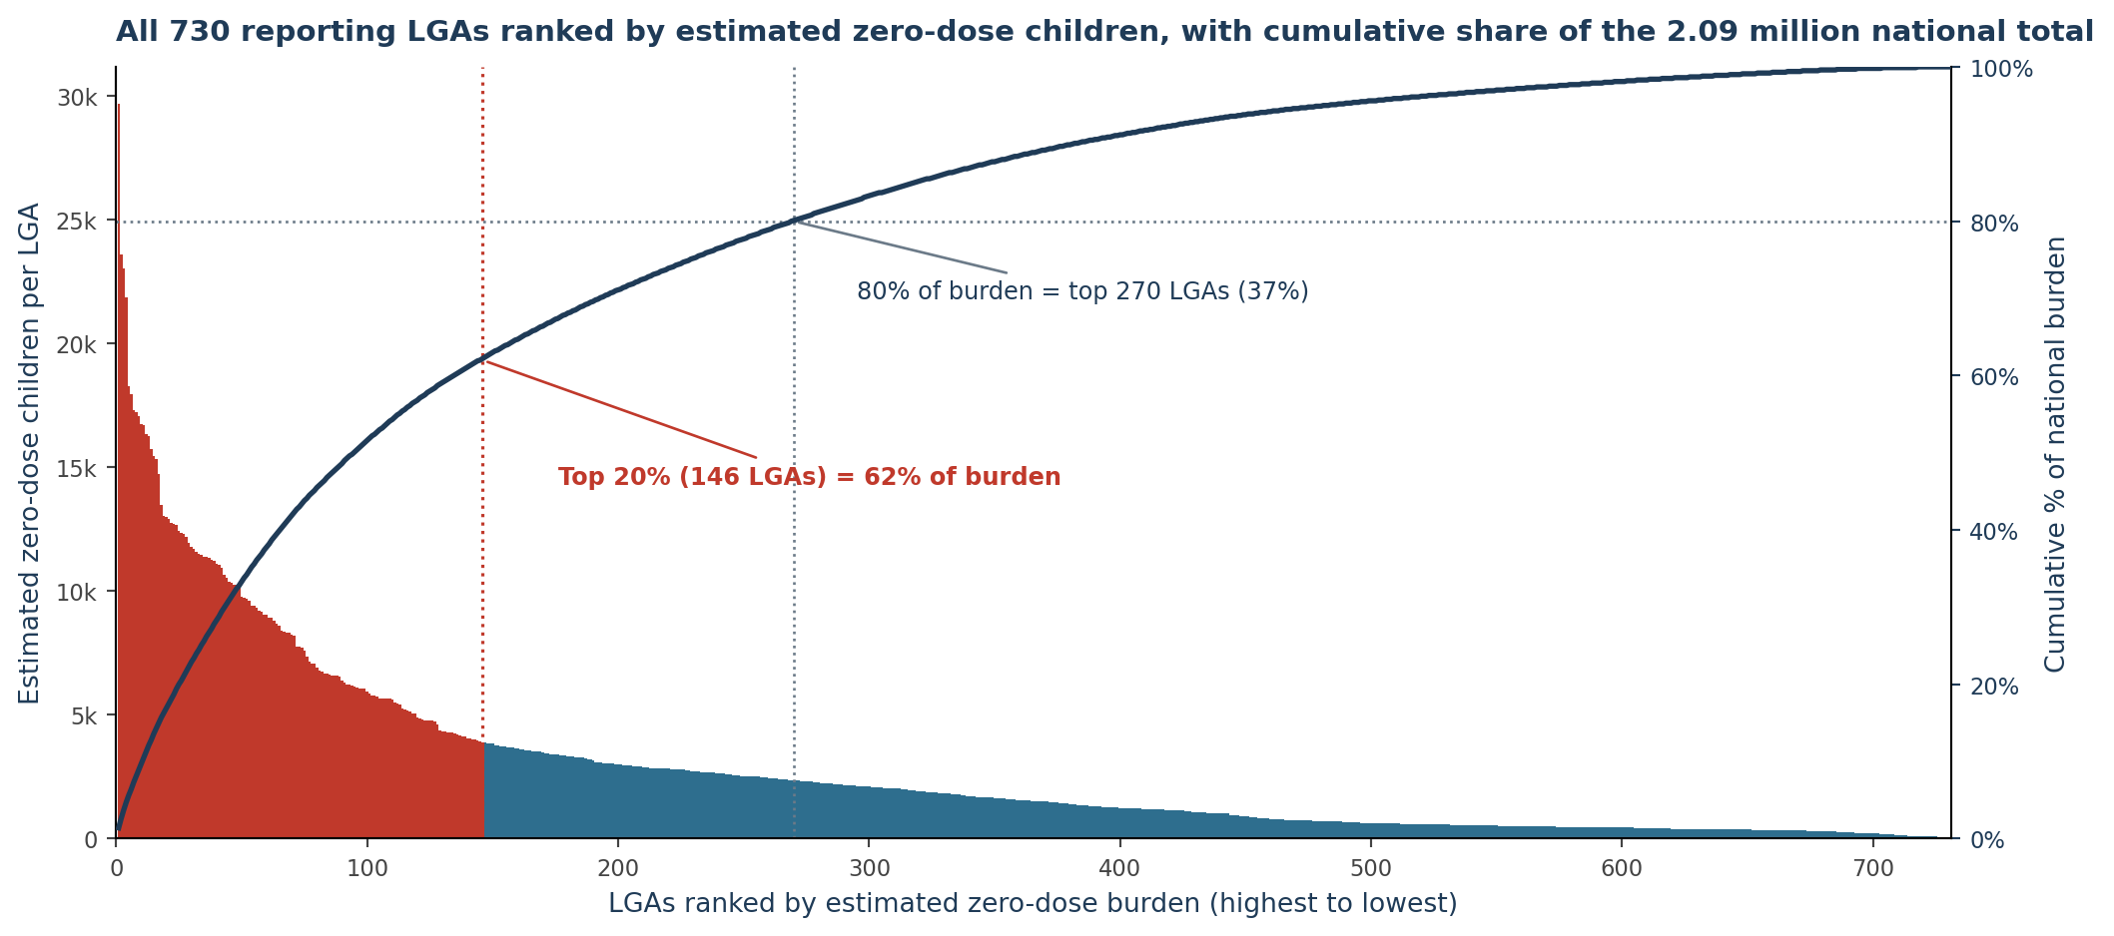
How the RI team uses this
Each output maps to a decision the programme already makes.
1
Microplanning
Use the priority list and vaccine-risk calendar in annual RI workplans.
2
Archetype-matched bundles
Use the right package for each community type.
The tool ranks LGAs by estimated missed children and shows how much of the burden each group contains.
3
Campaign and supervision routing
Use hotspot and burden ranking to choose campaign areas and supervision routes.
Sequencing the money. start with about 150 LGAs to reach roughly 62% of missed children, then expand toward 270 LGAs to reach about 80%.
4
Leverage beyond immunization
Many high-risk places also need nutrition and antenatal-care support; one visit can deliver several services.
Model estimate. Source: Domain 5 local-government ranking and Pareto curve (730 reporting local government areas; national total 2.08 million).

Slide 27
The platform: a live tool, not a static report
A no-code web application that re-runs every model on uploaded data.
Live, no-code re-runs
The LGA Priority and Archetypes screen
ZARA, the platform's analyst
Upload new DHIS2 or survey files. The app checks the data and updates the results.
Filter by state or LGA to see vaccine risks, estimated missed children, rank and recommended response type. Results export to Excel.
Zero-dose Analytics and Risk Assistant: ZARA answers simple questions in English, Hausa, Yoruba, Igbo, Pidgin and more, using only the results in the platform.
Guardrails, on every view
Each result shows the data date, reporting completeness and whether it is an estimate. This helps users avoid misreading the figures.
Live demonstration: huggingface.co/spaces/amobionovo/nphcda-zerodose

Slide 28
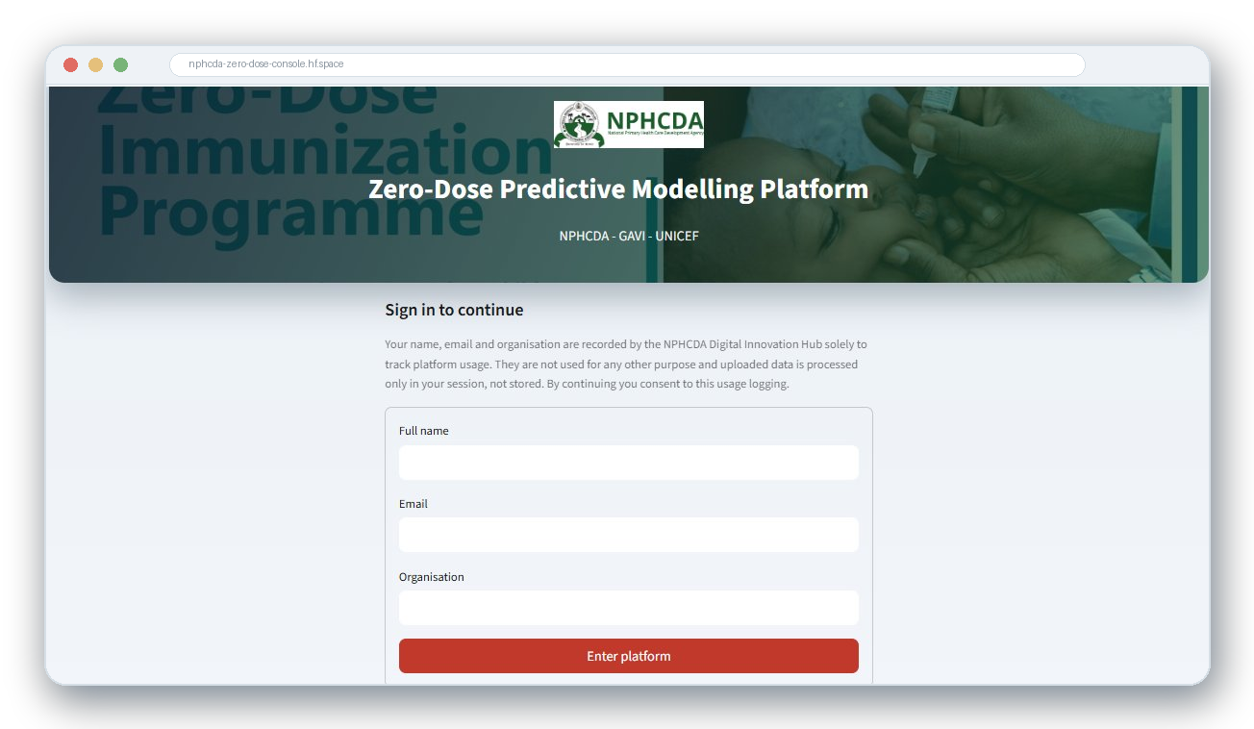
WHAT THE WEB PLATFORM ADDS
From notebooks to a live decision platform the DIH team can operate
Live, real-time modelling
Runs on uploaded data, deployed on Hugging Face Docker.
Reproduces the report
National total within 0.01%; back-tested and wave-validated.
Grounded AI layer
Interpreter on every output, ZARA analyst, page-cited Q&A.
Two coverage lenses
Estimated coverage and the 2024 index, triangulated with NDHS.
Decision-ready outputs
Scorecards, maps, GAVI factsheet, policy brief, this deck.
Governance built in
The live platform on Hugging Face; secure login with usage tracking.
Secure login and usage tracking; data stays in-session.
CIDRE and Quantium Insights LLC · In technical support of NPHCDA · Confidential draft for GAVI and UNICEF review
8

Slide 29
THE HUGGING FACE APPLICATION
How the tool supports programme discussions
It re-runs live, explains itself in plain language, and produces the documents a meeting needs.
Live re-runs on new data. Upload refreshed files; the app validates the structure and recomputes only what changed. No code change is needed.
1
ZARA, a grounded analyst. Plain-language and multilingual Q&A (English, French, Hausa, Yoruba, Igbo, Pidgin, Swahili and more). It reads the live outputs and is instructed never to invent numbers.
2
One-click factsheet and policy brief. A GAVI-style factsheet and a Word policy brief regenerate from the same live outputs, so the documents never drift apart.
3
Governance built in. Secure login, data stays in-session, and the load-validate-run-review-approve-release sign-off cycle for the DIH.
4
ZARA is grounded on the live results and uploaded documents (with page citations). One source of truth feeds the report, factsheet, brief and deck.
CIDRE and Quantium Insights LLC | In technical support of NPHCDA | For GAVI and UNICEF review
26
Notes:
Close the tour on what makes it useful in a room. It re-runs live on new uploads, so a review meeting can work with the latest data. ZARA answers questions in plain language and local languages, locked to the live numbers. And it produces the factsheet and brief in one click, all from the same source of truth, with governance for the DIH.

Slide 30
Recommendations from the modelling team
Act first where burden and deprivation meet
1
Begin with Sokoto, Kebbi, Zamfara and the highest-burden LGAs. About 150 LGAs reach roughly 62% of missed children.
Deploy the archetype-matched bundles
2
Different places need different responses: outreach, mobile teams, trusted messengers, reminders or maintenance.
Adopt the platform for routine microplanning
3
Use monthly DHIS2 data to update the priority list, flag data problems and support Gavi 6.0 targeting.
The Digital Innovation Hub leads from here
4
The DIH should lead routine use of the platform, with continued collaboration for upgrades and expansion to nutrition and child health.
The results have been checked against the newest national survey and can support Gavi 6.0 targeting.

Slide 31
Acronyms and abbreviations (1 of 2)
Every acronym used in this deck, spelled out.
ACLED
Armed Conflict Location and Event Data
DTP1 / Penta1
First dose of the pentavalent vaccine
ACSM
Advocacy, Communication and Social Mobilization
FDR
False discovery rate
AFP
Acute flaccid paralysis
GBD
Global Burden of Disease study (IHME)
ANC
Antenatal care
Getis-Ord Gi*
Local spatial hotspot statistic
BCG
Bacille Calmette-Guerin (tuberculosis vaccine)
GRID3
Geo-Referenced Infrastructure and Demographic Data for Development
CHI
Composite Hesitancy Index
HTR
Hard-to-reach
cVDPV
Circulating vaccine-derived poliovirus
IDSR
Integrated Disease Surveillance and Response
DHIS2
District Health Information System, version 2
IHME
Institute for Health Metrics and Evaluation
DHS
Demographic and Health Survey
ITN
Insecticide-treated net
DIH
Digital Innovation Hub (NPHCDA)
LASSO
Least absolute shrinkage and selection operator
Reference. CIDRE and Quantium Insights LLC, in technical support of NPHCDA.

Slide 32
Acronyms and abbreviations (2 of 2)
Every acronym used in this deck, spelled out.
LGA
Local government area
Penta3
Third dose of the pentavalent vaccine
MCV1 / Measles1
First dose of measles-containing vaccine
R-hat
Gelman-Rubin convergence diagnostic
Measles2
Second dose of measles-containing vaccine
RI
Routine immunization
MGWR
Multiscale geographically weighted regression
RMNCH
Reproductive, maternal, newborn and child health
NCDC
Nigeria Centre for Disease Control
RR
Relative risk
NDHS
Nigeria Demographic and Health Survey
RWI
Relative Wealth Index (Meta)
NmDHS
Nigeria mini Demographic and Health Survey
SIA
Supplementary immunization activity
NPC
National Population Commission
UNICEF
United Nations Children's Fund
NPHCDA
National Primary Health Care Development Agency
VPD
Vaccine-preventable disease
OLS
Ordinary least squares regression
ZARA
Zero-dose Analytics and Risk Assistant
Reference. CIDRE and Quantium Insights LLC, in technical support of NPHCDA.

