Slide 1
.NET Core / ASP.NET Core Introduction
April 9th
Ondřej Pajgrt
Notes:
Preparations:
Solution CoreIntro
Solution Ori.Common.Exceptions (ServiceCollectionExtensions, ExceptionHandlingMiddleware)

Slide 2
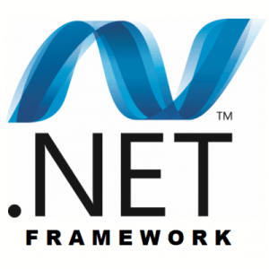

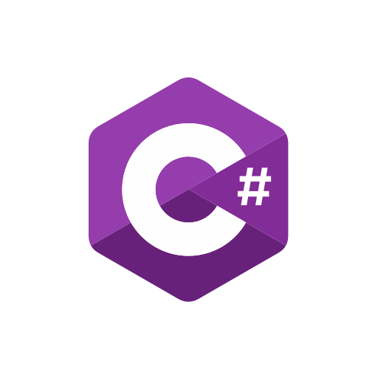


Agenda
Runtime / Framework / Standard
.NET Core vs .NET Framework
Tooling
ASP.NET Core vs ASP.NET 4.x
Startup
Hosting
Configuration
Logging
DI

Slide 3
.NET …
Runtime
Assembly loading
GC
Native interop
Managed code execution
Platform
Framework / Core / Mono /…
Library
Classes
Namespace
Assemblies
Standard
API definition
Contract, no implementation
Defines compatibility
Replaces PCL
Notes:
System.Generics, System.IO, System.Linq, …

Slide 4
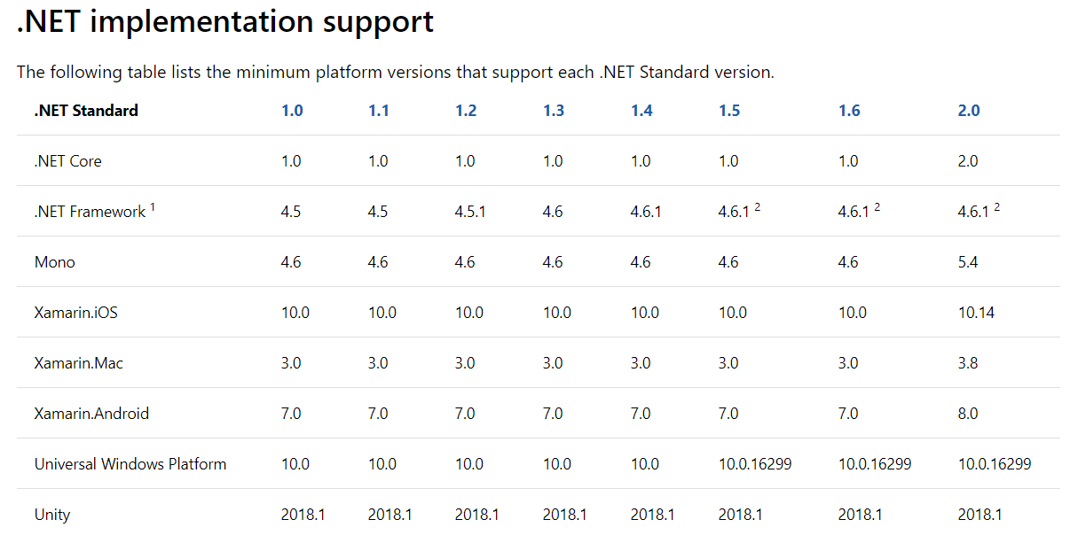
.NET standard
Class library
Use .NET standard if possible
Lower is better
Less components to work with
More possible consumers
Application / test projects
Specific platform
Higher version possible
More libs to consume
https://docs.microsoft.com/cs-cz/dotnet/standard/net-standard
Notes:
Otazka: Proc nemuzu .net standard konzolovku?
Test project – mely by byt na vsechny platformy, ktery me zajimaj

Slide 5
.NET Framework vs .NET Core
Heavy
Monolith
Most in framework
Windows dependent
First release ~2002
Lightweight
Modular
Most in NuGet packages
Multiplatform
Faster
OpenSource

Slide 6
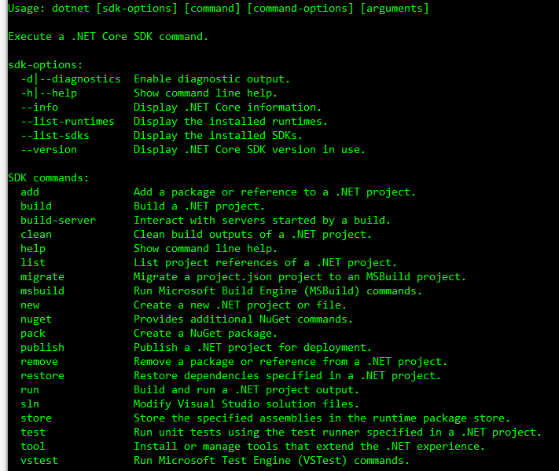
Tooling – CLI
New dotnet command
.NET Core port of MSBUILD
Multiplatform
One tool to handle “everything” and replace
MSBUILD (build, test, publish, …)
can still use “dotnet msbuild”
NuGet (restore, pack, nuget push, …)
Global tools
dotnet tool xxx

Slide 7
Tooling – project
All files in folder included by default
Contains package references
No packages.config
Automatic binding redirect
Partially merged with AssemblyInfo
Version, description, author, …
Build output
Target framework (net461, netstandard2.0, …)
Deployment mode (framework-dependent vs self-hosted)
Directory.Build.props & targets
Notes:
Demo packages.config
01-Tooling
Dependencies v packages config, ruzne verze
Hierarchicke dependencies (ne komplet blast, ale jenom to, co chci
Pouze jedino DLLko v output
Demo na self-hosted
<RuntimeIdentifier>win7-x64</RuntimeIdentifier>
Demo na Directory.Build.props
- Version pryc z projectu

Slide 8
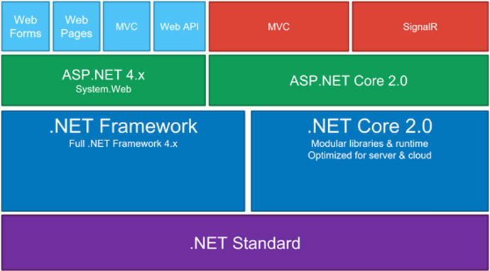
ASP.NET Core
Notes:
ASP.Net based on System.Web and IIS, ASP.NET Core based on OWIN
~ Katana

Slide 9
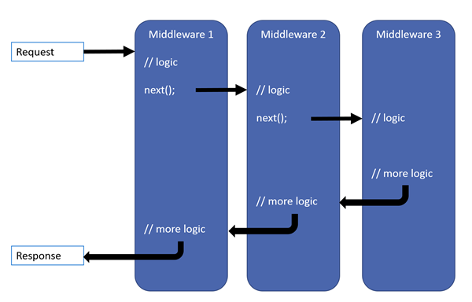
ASP.NET Core – Request pipeline
Set of chained components = Middlewares
DoWork(); => Next(); => DoAnotherWork();
applicationBuilder.Use()
Order matters
HTTPS
Static files
Auth
MVC
Ori.Common.ExceptionHandlingMiddleware
Notes:
Demo na middleware pipelines
02-Middlewares
Pridat Ori.Common.Exceptions -> app.UseExceptionHandlingMiddleware -> podivat se dovnitr
Proc to musim dat az za UseMVC?
https://oriflame.visualstudio.com/Ori.Common/_git/Ori.Common.Exceptions?path=%2Fsrc%2FInfrastructure%2FExceptionHandlingMiddleware.cs&version=GBdevelop

Slide 10
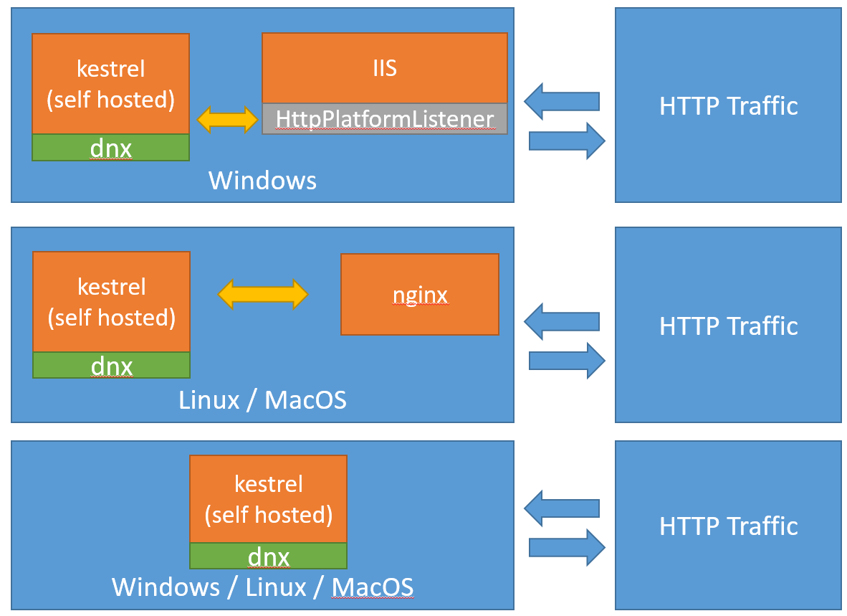
ASP.NET Core – Hosting
Kestrel
Cross platform web server
Preferred for ASP.NET Core projects
Lightweight, build for speed
Less features then IIS
Should be run behind full-featured web server (IIS, nginx) in production
Open source
Properties/launchSettings.json

Slide 11
ASP.NET Core – Startup
Main()
WebHostBuilder (=> HostBuilder in 3.0)
Environment setup
One build for multiple environments
BuildIn: Development, Staging, Production
Logging
Settings (config, connection strings, ..)
Startup class to use
Startup class
ConfigureServices()
Composition root (DI setup)
Configure()
Pipeline setup
App initialization?
Convention based
ConfigureDevelopmentServices()
Notes:
Demo
03-Hosting
Properties->Debug->Profile
https://oriflame.visualstudio.com/_git/ReportingService?path=%2Fsrc%2FReporting%2Fsrc%2FOri.Reporting.UI%2FProperties%2FlaunchSettings.json&version=Gbmaster
launchSettings.json

Slide 12
ASP.NET Core – Logging
Logging
Microsoft.Extensions.Logging.xxx
HostBuilder.ConfigureLogging()
AddConsole
AddDebug
AddFile
AddApplicationInsights()
AddXxx
Inject ILoggerFactory, ILogger<T>
Application Insights logging
Named placeholders
No structured logging
Notes:
Demo na logovani a named placeholders
04-Logging
Program.cs -> ConfigureLogging
Different sources
Logger inject + example
Add AI SDK + Update!
Addnamed placeholders for logging

Slide 13
ASP.NET Core – Settings
Settings
Microsoft.Extensions.Configuration
Key – value pairs
Nested, separated by “:” (Group1:Name)
HostBuilder.ConfigureAppConfiguration()
Addxxx()
json, xml, CLI, KeyVault, Environment, …
Last value wins
UserSecrets
KeyVault
dotnet user-secrets
IConfiguration
GetSection(<path>).GetValue<T>()
Options
Lazy configuration access
Update on change
services.Configure<T>(Configuration);
Inject IOptionsMonitor<T>
Notes:
Demo
05-Settings
Program -> ConfigurAppConfiguration
StartUp -> ConfigureServices -> DirectInject + Options
/api/settings and /api/options
Change PublicValue for options
UserSecretsId in proj file
dotnet user-secrets set "SettingsClass:SecretPhrase" "bubak" --project D:\Work\Oriflame\ArchSync\coreintro\src\Settings
Ori.Configuration.Manager (https://oriflame.visualstudio.com/Configuration%20Manager/_wiki/wikis/Configuration%20manager?wikiVersion=GBdevelop&pageId=60&pagePath=%2FConfigurationManager)

Slide 14
ASP.NET Core – DI
Build-in DI container
Microsoft.Extensions.DependencyInjection
Lightweight, fast
IServiceCollection for registration
IServiceProvider for resolving
Missing some advanced features
Convention based registration
Interception (AOP)
Custom lifestyles
3rd party containers
Implement IServiceProvider
Autofaq
SimpleInjector
Castle.Windsor
Return IServiceProvider from Startup.ConfigureServices()
Some manual wiring required
Scrutor NuGet package
Conventions, discovery
Decorator pattern (AOP)
Notes:
Demo
06-DI
How to register
Register collections
Manual resolve (service locator)
Scrutor Scan + Decorators
Custom DI container – return IServiceProvider from Configure

Slide 15
ASP.NET Core - API
Controllers
No convention or base class required
Controller should be marked with [ApiController] attribute
Routing defined with [Route] attribute
Method names mapped by [HttpXXX] attribute, no convention mapping required
FromBody, FromHeader, FromRoute, …
Results
More return options possible
Specific type
IActionResult
ActionResult<T>
Async support
ProducesResponseType
Notes:
Demo
07-API
Plain and derived controller – base class
Different routes in RouteController
Swagger?

Slide 16
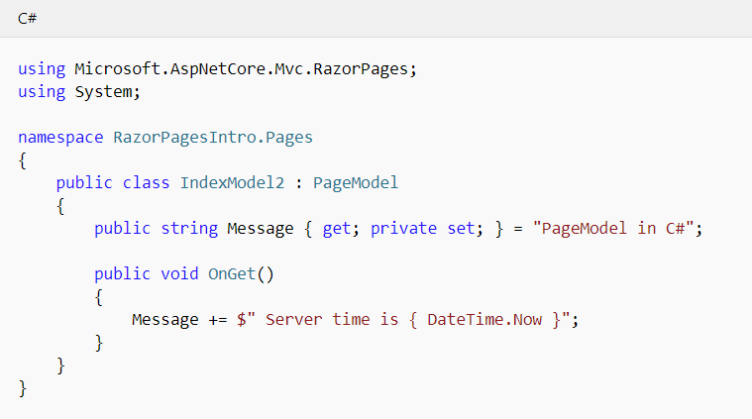
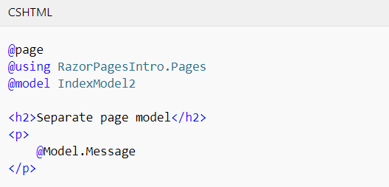
ASP.NET Core - Razor
Razor pages
Lightweight MVC
Convention based
PageModel derived class
Controller+Model
OnGet(), OnPost(), OnGetAsync(), …

Slide 17
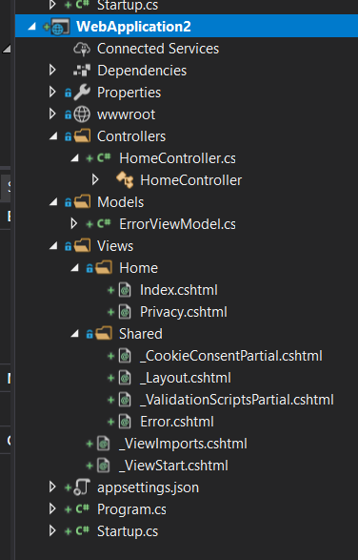
ASP.NET Core – MVC, SPA
MVC
Convention based
Controllers should derive from Controller class
App.UseMvc(r => r.MapRoutes())
SPA
React / Angular template
Server side loading + API

Slide 18

Q&A

