Slide 1
.NET Core / ASP.NET Core Introduction
April 9th
Ondřej Pajgrt

Slide 2


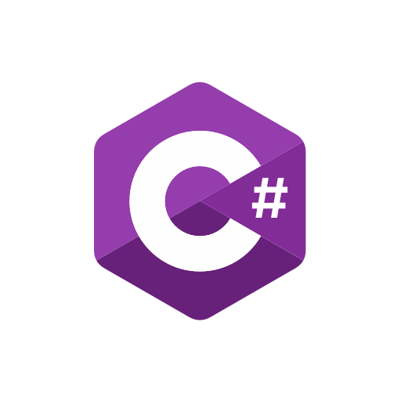


Agenda
Runtime / Framework / Standard
.NET Core vs .NET Framework
Tooling
ASP.NET Core vs ASP.NET 4.x
Startup
Hosting
Configuration
Logging
DI

Slide 3
.NET …
Runtime
Assembly loading
GC
Native interop
Managed code execution
Platform
Library
Classes
Namespace
Assemblies
Standard
API definition
Contract, no implementation
Defines compatibility
Replaces PCL

Slide 4
.NET Framework vs .NET Core
Heavy
Monolith
Most in framework
Windows dependent
Lightweight
Modular
Most in NuGet packages
Multiplatform
Faster
OpenSource

Slide 5
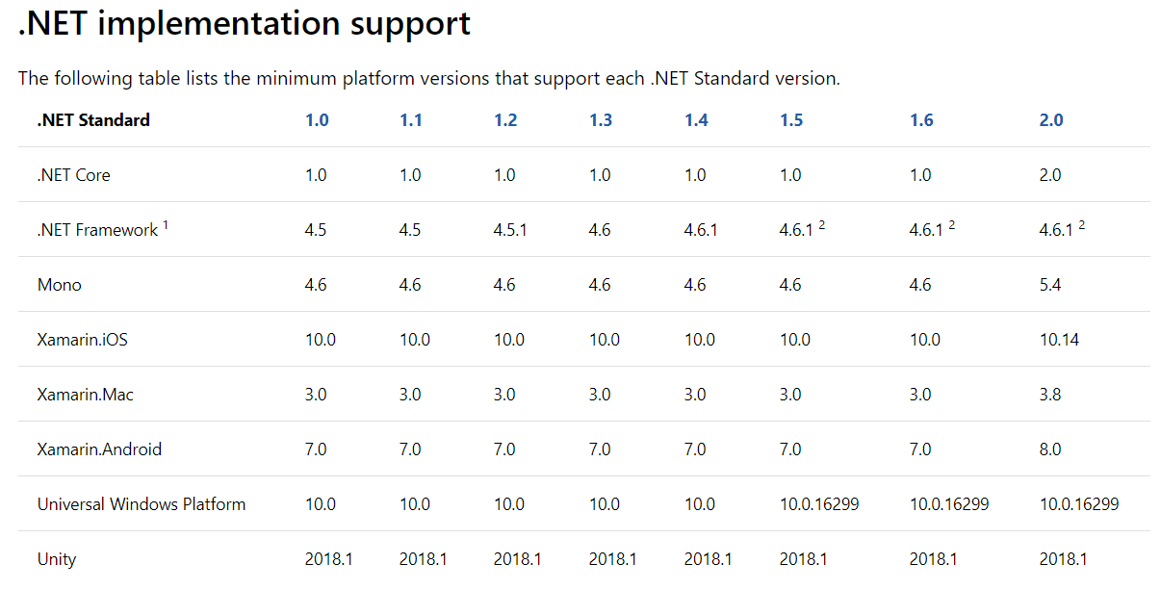
.NET version
Class library
Use .NET standard if possible
Lower is better
Less components to work with
More possible consumers
Application / test projects
Core of framework
Higher version possible
More libs to consume
https://docs.microsoft.com/cs-cz/dotnet/standard/net-standard

Slide 6
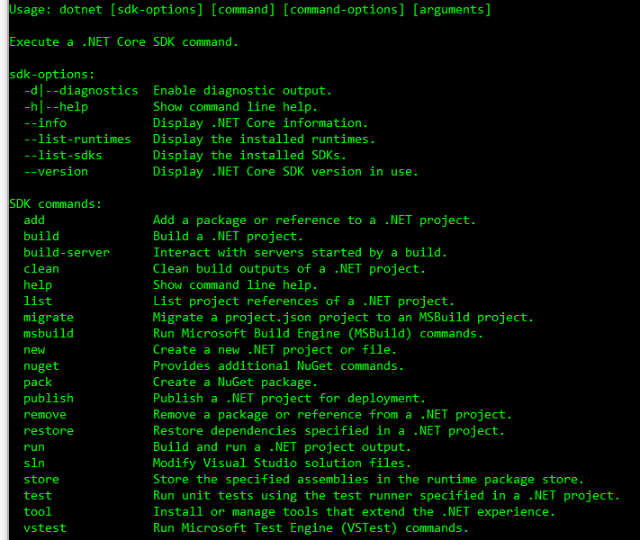
Tooling - CLI
New dotnet command
.NET Core port of MSBUILD
Multiplatform
One tool to handle “everything” and replace
MSBUILD (build, test, publish, …)
can still use “dotnet msbuild”
NuGet (restore, pack, nuget push, …)
Notes:
Demo

Slide 7
Tooling – project
Contains package references
No packages.config
Automatic binding redirect
Partially merged with AssemblyInfo
Version, description, author, …
Build output
Target framework (net461, netstandard2.0, …)
Deployment mode (framework-dependent vs self-hosted)
Directory.Build.props & targets
Notes:
Demo na selfhosted
Demo na Directory.Build.props

Slide 8
ASP.NET Core

Slide 9

Q&A

Slide 10
References

