Slide 1
SneakySalesman Demo
By Ons Bouarada

Slide 2
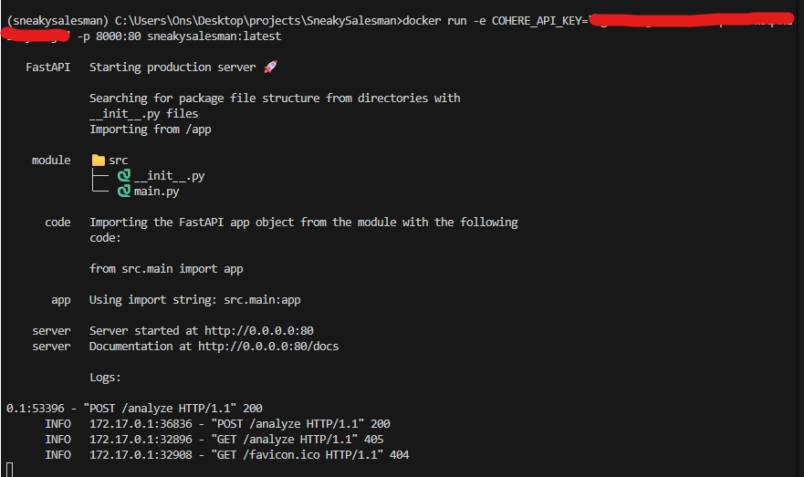
1- Running Docker image
Building: docker build -t sneakysalesman:latest .

Slide 3
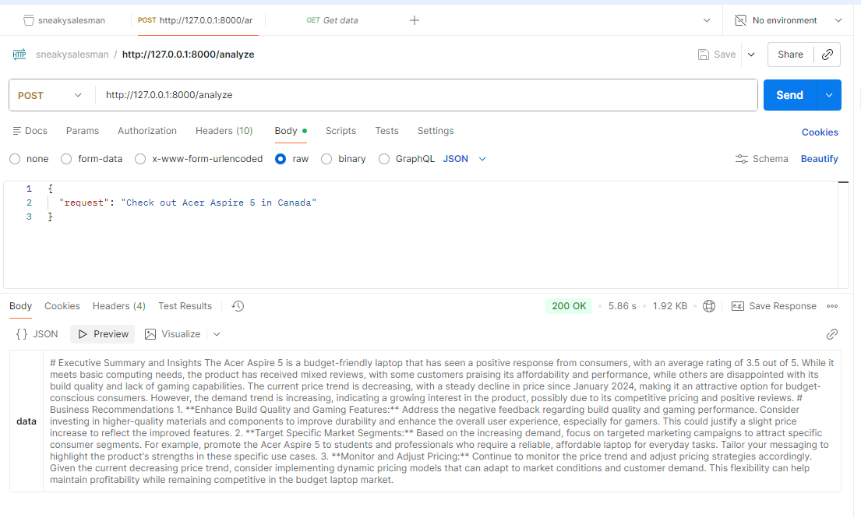
2- testing the app with Postman

Slide 4
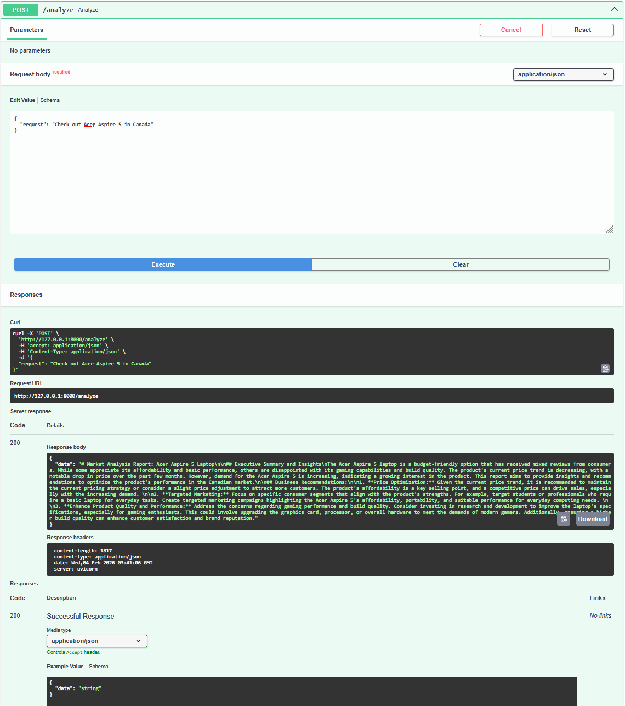
3- Testing the app with Swagger documentation

Slide 5
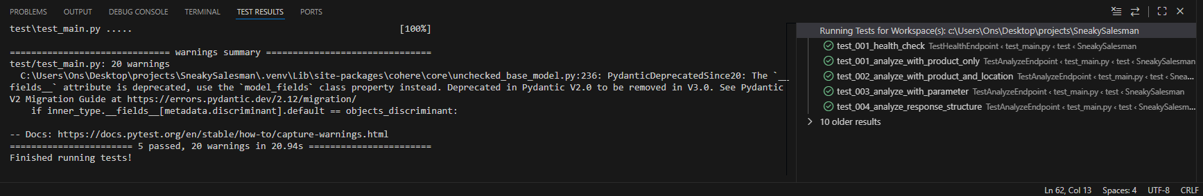
4- Pytest (local)

