Slide 1
2048 Game Design with Java Swing
Aaron Smith
November 23, 2019

Slide 2
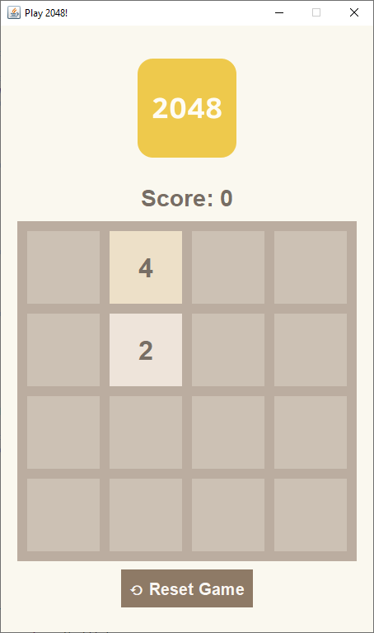
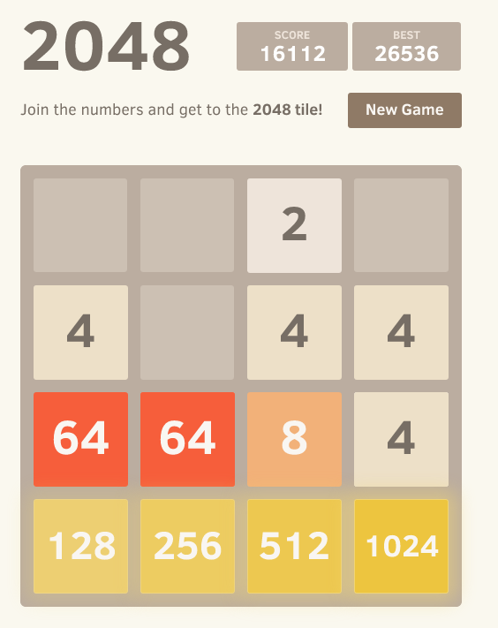
play2048.co
Our version!

Slide 3
How should we represent the board?
private int[][] board;
[
[ 0, 0, 2, 0],
[ 4, 0, 4, 4],
[ 64, 64, 8, 4],
[128, 256, 512, 1024]
]

Slide 4
What else do we need to represent?
private int[][] board;
private int score;
private int size;
4 x 4

Slide 5
Model-View Design Pattern
Notify when
the underlying data
is changed
Model
View
Application Data
User Interface
Notify when the user interacts with the
UI components
Data Manipulation
This is the observer design pattern

Slide 6
The model exposes methods to the data
Model
The purpose of the model is to…
Store the data
Provide methods for data access and manipulation
Application Data
Data Manipulation

Slide 7
Model
View
public int getSize()
public int getScore()
public int getTile(int r, int c)
private int[][] board;
public boolean move(Direction dir)
private int size;
public void addRandomTile()
private int score;
public void reset()
public boolean canMove(Direction dir)
public boolean isOver()

Slide 8
Workshop Resources
github.com/onsmith/comp401-2048
Eclipse Java project code
“master” branch: starter code
“solution” branch: completed code
Slides

Slide 9
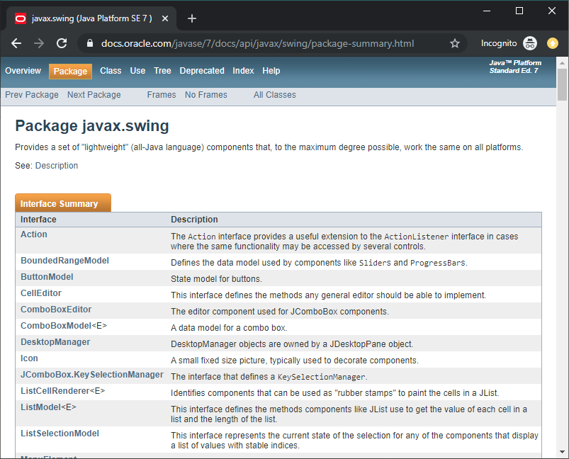
Swing Documentation
Lists Swing’s interfaces and classes
Provides descriptions of each
More details accessible by clicking the links

Slide 10
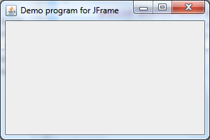
JFrame
Represents a window
JFrame
my_frame.setTitle("Window title");
– Sets the title of the window (shown on tab)
my_frame.setDefaultCloseOperation(JFrame.EXIT_ON_CLOSE);
– Makes the window close when you press X
my_frame.setResizable(false);
– Makes the window so you can’t resize it

Slide 11
JPanel
Represents a grouping of multiple Components
JPanel
my_panel.add( );
– Adds a component to the group
my_panel.setLayout( );
– Specifies how the components should be arranged

Slide 12
JPanel
Represents a grouping of multiple Components
JPanel
my_panel.removeAll( );
– Removes all components from the group
my_panel.reval idate( );
– Refreshes the component after you change it
This will come in handy when we update
the UI components!

Slide 13
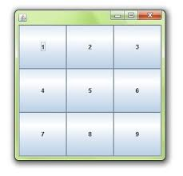
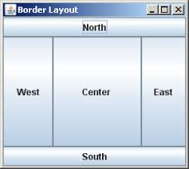
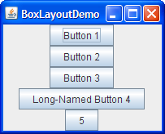
JPanel Layouts
BorderLayout
GridLayout
BoxLayout
my_panel.setLayout( );
What goes here?

Slide 14
BorderLayout
new BorderLayout()
– Creates a new BorderLayout object
– Pass this into my_panel.setLayout()
SOUTH, NORTH, WEST, CENTER, EAST
my_panel.add(my_component, BorderLayout.SOUTH);
Extra argument required when adding components to the panel

Slide 15
GridLayout
Rows
Columns
Either “rows” or “columns” can be 0, indicating that it should be automatically calculated—but not both!
new GridLayout(3, 3)
– Creates a new GridLayout object
– Pass this into my_panel.setLayout()
Components will be added left-to-right, top-to-bottom

Slide 16
BoxLayout
The JPanel object
Dimension for insertion
new BoxLayout(my_panel, BoxLayout.Y_AXIS)
Y_AXIS aligns objects vertically; X_AXIS aligns them horizontally
– Creates a new BoxLayout object
– Pass this into my_panel.setLayout()
my_component.setAlignmentX(Component.CENTER_ALIGNMENT);
my_panel.add(my_component);
Also supported: RIGHT_ALIGNMENT and LEFT_ALIGNMENT
– Must call setAlignmentX or setAlignmentY on every component added to the JPanel

Slide 17
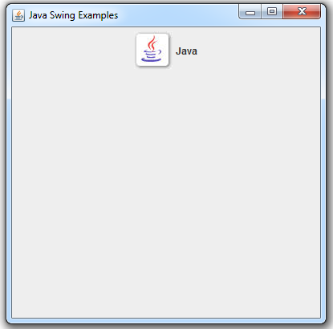
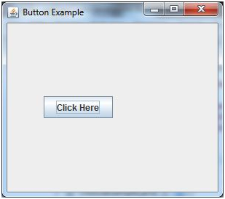
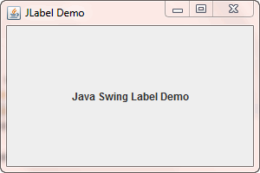
Components
JLabel
setText()
JButton
addActionListener()
setActionCommand()
ImageIcon

Slide 18
Changing the color of a component
What goes in here?
my_component.setForeground( );
my_component.setBackground( );
Background color (yellow)
Foreground color (white)
For JLabels, the text color is the foreground color!

Slide 19
Colors
Red component
(0-255)
Blue component
(0-255)
new Color(187, 173, 160)
Green component
(0-255)
Tools to help you pick colors:
coolors.co
colorhunt.co
Google “color picker”
The one we made in COMP 401!

Slide 20
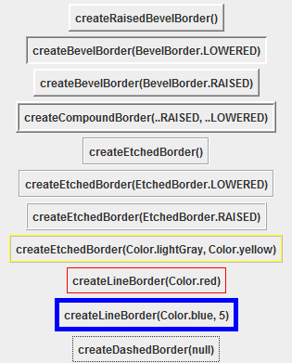
Adding a border to a component
my_component.setBorder( );
What goes in here?
There are lots of border choices/styles to choose from! Google “Java BorderFactory” for a list!

Slide 21
EmptyBorder
Adds a border with the same color as the background
my_component.setBorder( );
Size of
top, left, bottom, right
BorderFactory.createEmptyBorder(20, 20, 20, 20)

Slide 22
LineBorder
Lets you specify the color of the border
my_component.setBorder( );
BorderFactory.createLineBorder(
new Color(187, 173, 160), // border color
6 // border size
)

Slide 23
CompoundBorder
Lets you combine two borders!
my_component.setBorder( );
BorderFactory.createCompoundBorder(
BorderFactory.createLineBorder( … ),
BorderFactory.createEmptyBorder( … )
)

Slide 24
Changing the font
What goes in here?
my_component.setFont( );
new Font("Dialog", Font.BOLD, 28)
A Java Font object

Slide 25
Changing the font
What goes in here?
my_component.setFont( );
new Font("Dialog", Font.BOLD, 28)
font family
(Google search “Java fonts”)
font style
(BOLD, ITALIC, PLAIN)
font size

Slide 26
Specifying the size of a component
my_component.setMinimumSize(new Dimension(100, 100));
my_component.setPreferredSize(new Dimension(100, 100));
my_component.setMaximumSize(new Dimension(100, 100));
width
height

Slide 27
Text alignment
my_jlabel.setHorizontalAlignment(SwingConstants.CENTER);
my_jlabel.setVerticalAlignment(SwingConstants.CENTER);
Can set alignment to LEFT, CENTER, or RIGHT

Slide 28
UI Organization
JFrame
JPanel
ImageIcon
JLabel
JPanel
JButton
JLabel

Slide 29
User Events
View
When a keyboard arrow key is pressed…
Figure out which arrow key was pressed
Call model.move(DIRECTION)
Repaint UI
When reset is clicked…
Call model.reset()
Repaint UI

