Slide 1
Business Intelligence and Data Warehousing (ANL408)
- By Sabarish Nair

Slide 2
Recap from last week....
Prct
OLAP
OLAP Features
OLAP Architecture
MOLAP
ROLAP
HOLAP
DOLAP
Practical: Update Query
Practical: Creating a temporary table
Practical: Cleansing Text-based values
Practical: Cleansing Numeric Values
Practical: Creating a star-schema

Slide 3

Using a DWH – Common Use Cases
Strategic Decision Making
BI and Reporting
Enable end users to analyze data
Predictive Analytics
Data-Driven Insights

Slide 4
Optimizing a Data Warehouse
What are indexes?
Types of Indices
Practical Guidelines

Slide 5
What are Indexes?
Data structure used to improve the performance of the queries by enabling faster data retrieval.
Created on columns that are more frequently used for:
Filtering
Joining
Sorting
Full table scan is not required.
Slower data writes and additional data storage

Slide 6

Types of Indexes
B-Tree Indexes
Bitmap Indexes

Slide 7
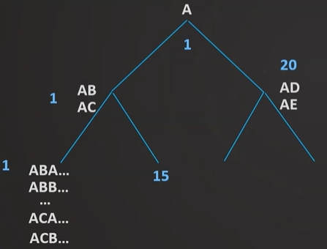
B-Tree Indexes
Standard/Default Index
Multi-level tree structure
Breaks data into pages or blocks
Should be used for high-cardinality
Columns (columns with many distinct
values)
Not entire table (Costly)

Slide 8
Bitmap Indexes
Large amount of data + low cardinality (limited number of distinct values)
Very storage efficient
More optimized for read
Good for many repeating values
Tran_id | Product_id | Product_Type
1 | P001 | Toy
2 | P002 | Toy
3 | P003 | Toy
4 | P004 | Beverage
5 | P005 | Beverage
Row_id | Value
1 | Toy
4 | Beverage
Bit
11100
00011
8

Slide 9

Guidelines for Indexes
Identify Query Patterns
01
Prioritize Columns for Indexing
02
Evaluate Index Types
03
Regularly analyze Index Usage
04
Avoid Over indexing
05
Test and Iterate
06

Slide 10

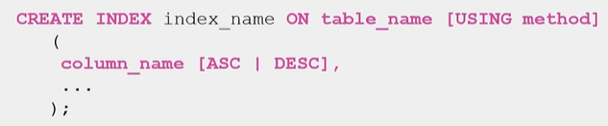
Setting Indexes

Slide 11
Visualization and Reporting
Identify the business needs.
Create reports and dashboards to uncover insights.
Popular Tools:
Power BI
Tableau
Qlik View/Qlik Sense
Google Data Studio
Practical: Connect PostGreSQL to Power BI

Slide 12
Data Mining for Business Intelligence
Uncover hidden patterns, trends and insights from large datasets
Involves applying various statistical, machine learning, and artificial intelligence techniques to analyze data and extract valuable knowledge for decision-making.
Use Cases:
Predictive Analytics
Customer Segmentation
Churn Prediction
Fraud Detection
Sentiment Analysis

Slide 13
Practical: Create tables in Public Schema
Create Dimension Tables
Create Fact Tables

Slide 14
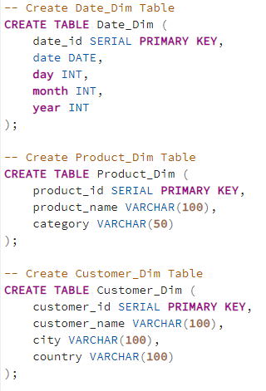
Create Dimension Tables

Slide 15
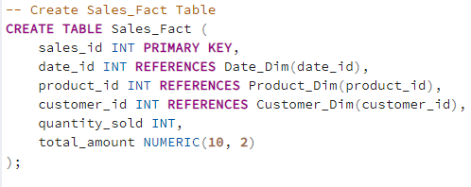
Create Fact Table

Slide 16
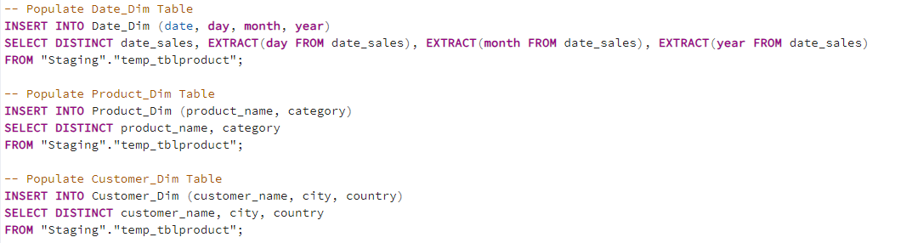
Insert Data in Dimension Table

Slide 17
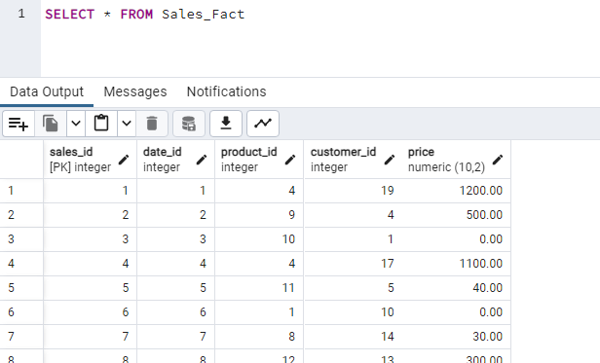
Verify if data exists in Fact Table
Count should match with the total data in the source CSV file.

Slide 18
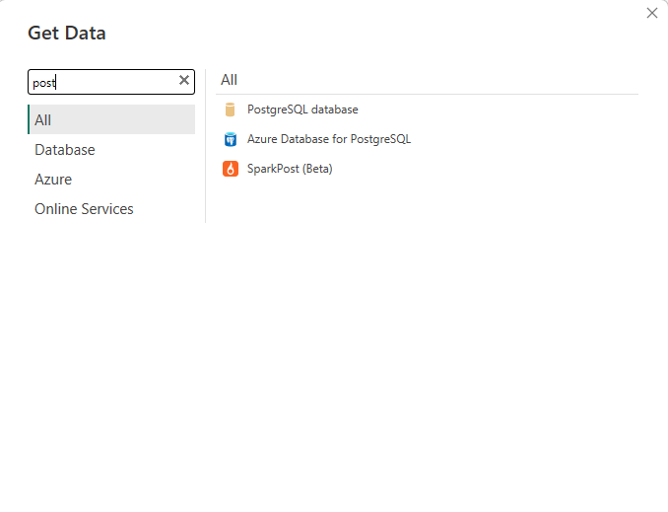
Connect Power BI to PostGreSQL
Select PostGreSQL database from the connections

Slide 19
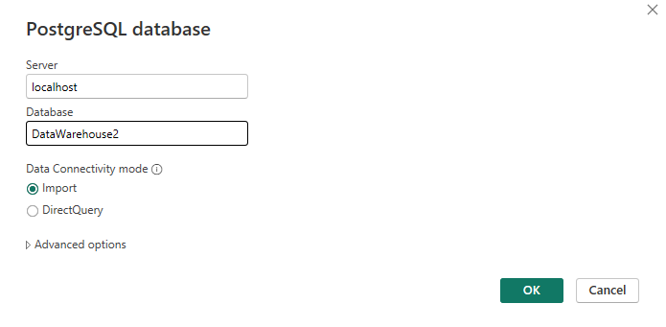
Connect Power BI to PostGreSQL
Add the server and Database name as shown below.

Slide 20
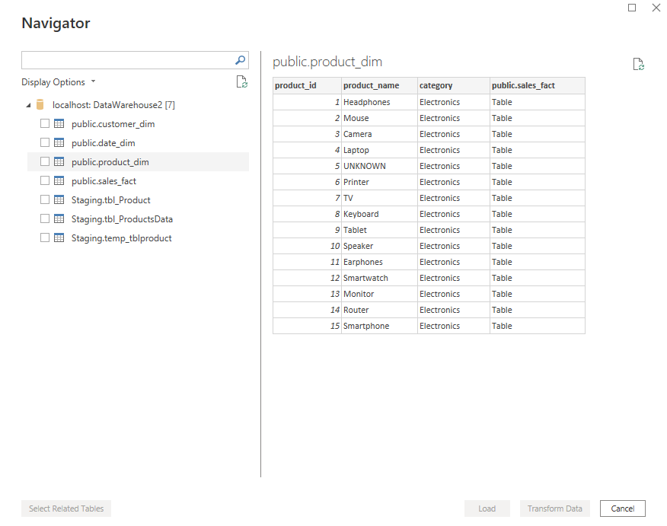
Connect Power BI to PostGreSQL
Add the username and password to get the following view.

Slide 21


