Slide 1
Business Intelligence and Data Warehousing (ANL408)
- By Sabarish Nair

Slide 2
Recap from last week....
Addivity in Fact Tables
Additive Measure
Semi-Additive Measure
Non-Additive Measure
Transactional Fact Table
Periodic Fact Table
Accumulating Snapshot
Factless Fact Table
Natural vs Surrogate Key
Practical: Launch Postgres SQL
Practical: Create a New Database
Practical: Create a Staging Schema

Slide 3
Dimension Tables
Descriptive Attributes
Used to group and filter (slice and dice)
Always has a primary key (can be surrogate)
Related to fact table using a primary key-foreign key relationship

Slide 4

Date Dimensions
Commonly Used Dimension
Contains date related features (year, month, month-name, etc.)
Surrogate Key is usually the date itself (not incremental IDs)
E.g. 2024-09-03 --> 20240903
Handle NULL values (set default date --> 1900-01-01)
Date may have time stamp
Timestamp is usually a separate dimension

Slide 5
Date Features
Can be a combination of numbers and text (01, January, etc.)
Can be a combination of attributes (Q1-2024)
Can be long or abbreviated (Jan, Mon)
Can have flags (Company Holidays, Weekend, etc.)
Date_PK | Year | Month | Day
20240309 | 2024 | 03 | 09
20240307 | 2024 | 03 | 07

Slide 6
Nulls in Dimensions
Recap
Avoid NULLs in Foreign Keys (Replace with dummy values)
NULLs break referential integrity as they don’t appear in JOINS
NULLs can be a part of fact table (e.g. no sales on weekends)
Replace NULLS with descriptive values (e.g. "Unkown", "No description available")
More understandable for business users
Aggregated values appear in Business Tools

Slide 7

Hierarchies in Dimensions
Data is often normalized.
Normalized data suitable for transactional purposes (Write-heavy).
DW is Read-Heavy (Used for analytical purposes)
Snowflake Schema should be avoided (Multiple Hierarchies)
Try to avoid normalization as much as possible (flatten the table)

Slide 8
Conformed Dimensions
Dimensions shared by multiple fact tables/stars
For example: Region, Date, etc.
Drill Across
Sales Fact
Cost Fact
Dimension 1
Dimension 2
Dimension 3
8

Slide 9

Degenerate Dimensions
Dimensions that are derived from fact table columns rather than being stored in separate dimension tables.
They do not have their own dedicated dimension tables.
No additional attributes or relationship.
Mainly used for reporting and analysis purposes
For example: Transaction number, order number or any other unique identifier, etc.

Slide 10
Example: Degenerate Dimension
Transaction_PK | Amount | Payment_FK
1 | 200 | 203-111
2 | 300 | 203-112
3 | 400 | 204-116
Transactional Fact Table
10

Slide 11
Junk Dimension
Dimensions with various flags/indicators with low cardinality (not many value, e.g. Yes/No, etc.)
E.g. A box where we store items, but no separate storing location.
Terminology is used internally. To business users its "transactional indicator dimension".
Simplifies reporting and analysis.
Avoids cluttering of main dimension tables.

Slide 12
Junk Dimension: Example
Transaction_PK | Amount | Payment_Type | Incoming/Outbound | Is Bonus
1 | 200 | Credit Card | Incoming | Yes
2 | 200 | Debit Card | Outbound | No
3 | 400 | Cash | Incoming | Yes
Transaction_PK | Amount | Payment_Flag_FK
1 | 200 | 1
2 | 200 | 2
3 | 400 | 3
Flag_PK | Payment_Type | Incoming/Outbound | Is Bonus
1 | Credit Card | Incoming | Yes
2 | Debit Card | Outbound | No
3 | Cash | Incoming | Yes
12

Slide 13

Role Playing Dimension
Referenced multiple times by Fact Table
Dimensions that serve multiple roles within single fact table.
Represents different perspectives or viewpoints of data.
Each instance of the dimension table in the fact table is referred to as a "role."
Example: Order Date, Ship Date, Delivery Date

Slide 14
Example: Role Playing Dimension
Order_id | Order_date_FK | Production_Date_FK
1 | 20240901 | 20240804
2 | 20240902 | 20240901
Date_PK | Year | Month | Day
20240309 | 2024 | 03 | 09
20240307 | 2024 | 03 | 07
14

Slide 15
Practical
Please download the ProductsData.csv file from Moodle (present under week 6)
Please have Postgres installed in your laptops.
Create a new database named "DataWarehouse".
Create a new schema named "Staging" within the database.

Slide 16
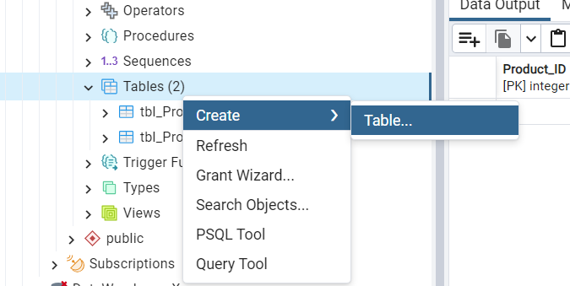
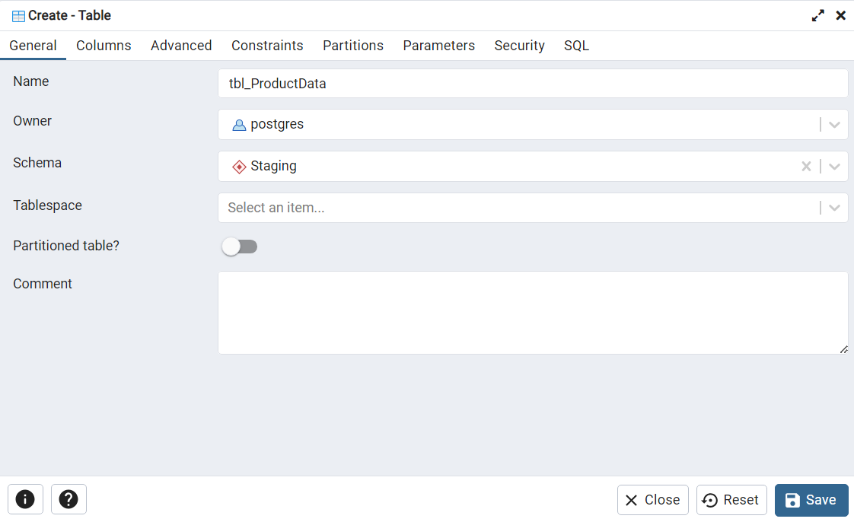
Create the staging table
Create a new table using the table creation wizard.
Right click on the tables section.
Fill in the required details.

Slide 17
Table Creation Script
CREATE TABLE "Staging"."tbl_ProductsData"
(
sales_id integer,
date_sales date,
product_id integer,
product_name character varying,
category character varying,
price numeric,
customer_id integer,
customer_name character varying,
city character varying,
country character varying,
PRIMARY KEY (sales_id)
);

Slide 18
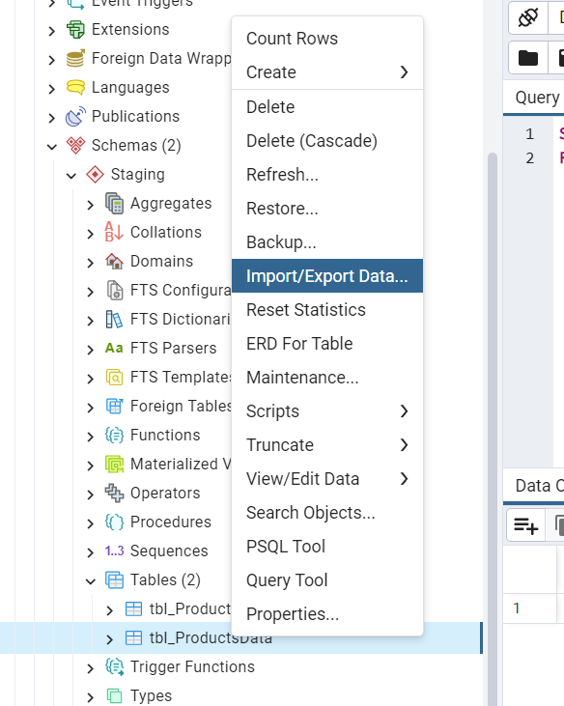
Import the CSV data to the staging table
Right click on the table name and select the option "Import/Export Data."

Slide 19
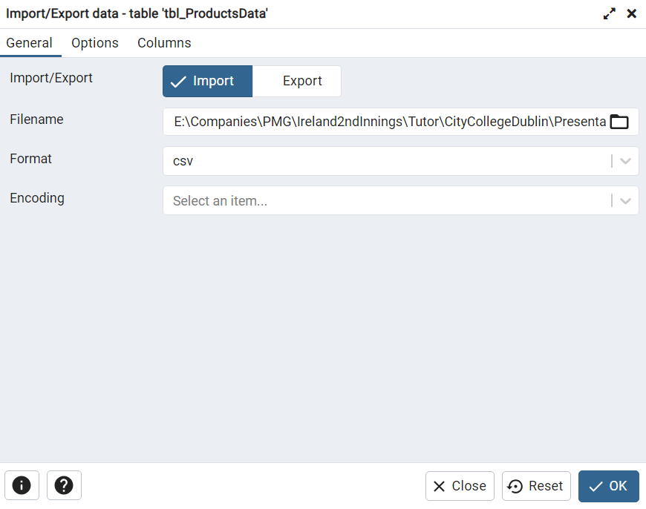
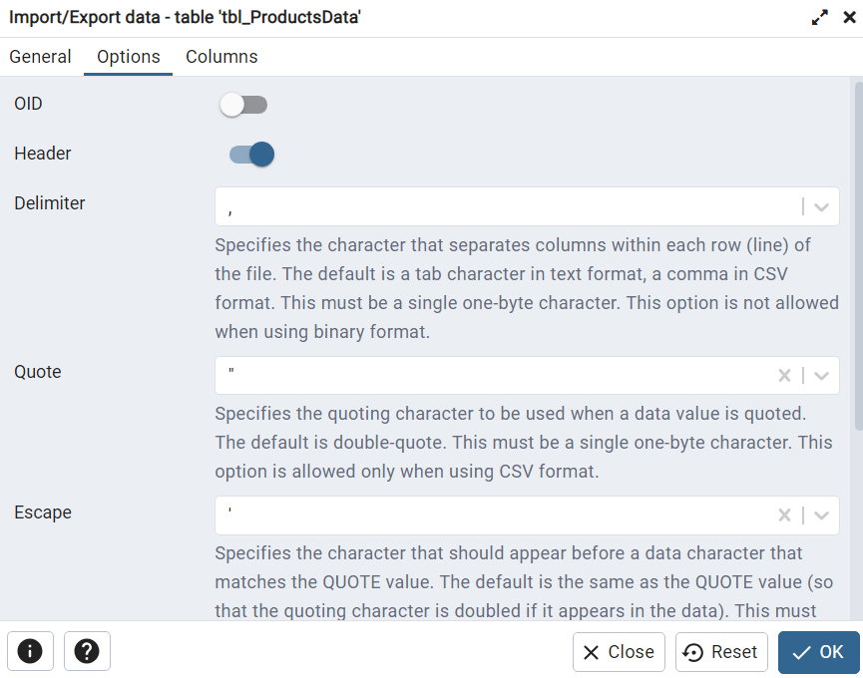
Select the required options
File path, Header, Delimiter, Etc.

Slide 20
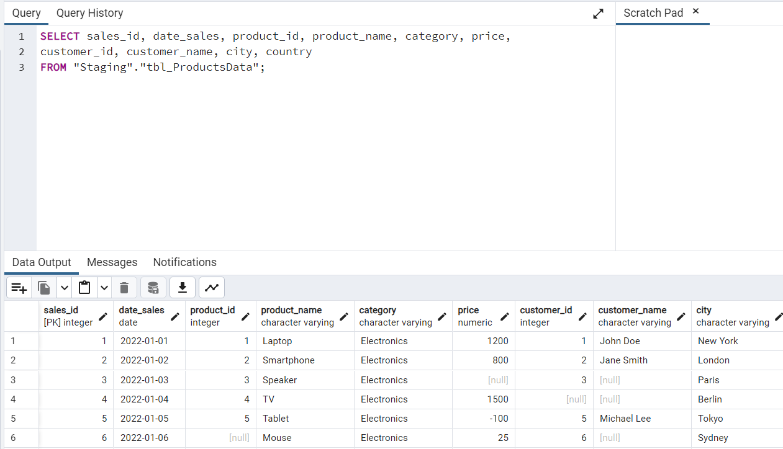
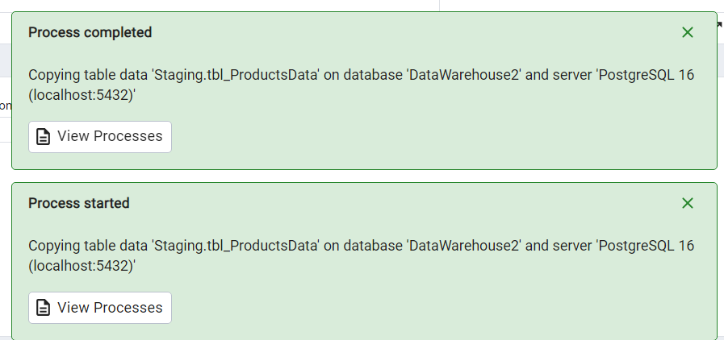
Verify the data

Slide 21


