Slide 1
Business Intelligence and Data Warehousing (ANL408)
- By Sabarish Nair

Slide 2
Recap from last week....
Prct
Dimension Tables
Date Dimensions
NULLs in Dimensions
Hierarchies in Dimensions
Conformed Dimensions
Degenerate Dimensions
Junk Dimension
Role Playing Dimension
Practical: Create a staging schema
Practical: Populate data into staging table from CSV file

Slide 3

Slowly Changing Dimensions (SCD)
Data does change!
Need to capture and track historical changes over time.
Used for historical reporting and analysis
Introduced by Kimball in 1995
Example: Customer Data (changes in demographics)

Slide 4
Slowly Changing Dimensions
Ask proactively about potential changes
Connect with business and technical teams
Define a strategy for each changing attribute

Slide 5
Type 0 - Original
No changes tracked
No historical information is preserved
Most Recent data is available
Very simple and easy to maintain
Example: Data Table (Except for holidays)

Slide 6
Type 1 - Overwrite
Old Data is overwritten with the new data
Only current state is reflected
Most Recent data is available
Historical Information is not preserved
History is lost!
Might break/affect existing queries

Slide 7
Example: Type 1
Product_ID | Name | Category
1 | Bat | Toy
2 | Milk | Beverage
3 | Ball | Toy
Update
Product_ID | Name | Category
1 | Bat | Toy
2 | Almond Milk | Liquid
3 | Ball | Toy
7
Not significant
Significant

Slide 8
Type 2 - New Row
Introduce a new row for the change
Historical Data is available
Perfectly partitions history

Slide 9
Example: Type 2
Fact Table starts pointing to the new product_ID (i.e. 4 ) as foreign key
Dimension Table will have an additional entry
COUNT (products) from dimension table will give accurate results?
Product_ID | Name | Category
1 | Bat | Toy
2 | Milk | Beverage
3 | Ball | Toy
4 | Almond Milk | Liquid
9

Slide 10
Administering Type 2 Dimensions
Introduce 2 date columns, effective date and expiration date.
Add a new column (IsActive)
Product_PK | Product_ID | Name | Category | Effective_Date | Expiry_Date | Is_Active
1 | PR_001 | Bat | Toy | 2022-01-02 | 2100-01-01 | Yes
2 | PR_002 | Milk | Beverage | 2022-01-02 | 2022-06-01 | No
3 | PR_004 | Ball | Toy | 2022-01-02 | 2100-01-01 | Yes
4 | PR_004 | Almond Milk | Liquid | 2022-06-02 | 2100-01-01 | Yes

Slide 11

Type 2 SCD Steps
Add a new row in the dimensions
Fact Table: Lookup in the dimension with the Natural Key + Ef/Ex Date
Add Is_Current/Is_Active Flag

Slide 12
Type 1 + Type 2
Can use Type 1 or 2 depending on the attributes
Use Type 1 for low significant changes
Use Type 2 for high significant changes
Not a technical, but a business decision
No set in stone rules

Slide 13
Type 3: Additional Attribute
Type 1- Static
Type 2: Default strategy to maintain history
Type 3: Switching back and forth between versions

Slide 14
Type 3 – Add a new attribute
Typically used for significant changes at a time (e.g. restructurings in organizations)
Switching between historic and current view
Introduce additional columns to keep tracking multiple changes
Not suitable for frequent or unpredictable changes
Product_ID | Name | Prev category | Category
1 | Bat | Toy | Toy
2 | Milk | Beverage | Liquid
3 | Ball | Toy | Toy

Slide 15
Practical: Exploratory Data Analysis (EDA)
Check the data quality
Check for missing/ NULL values in the dataset
Write queries for finding such records
Get the overall record count
Understand the data!!!

Slide 16
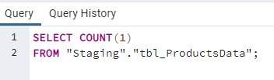
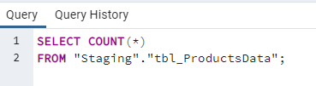
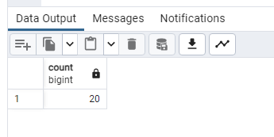
Get the record count

Slide 17
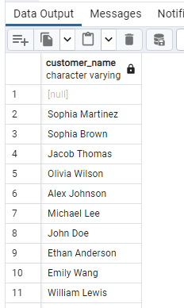
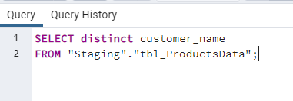
Get Distinct Records in a column

Slide 18
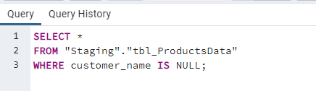
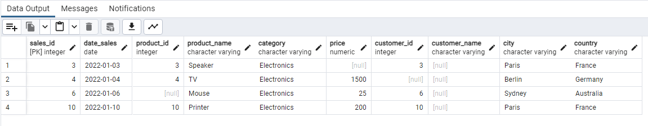
Check for NULL values in columns

Slide 19
Questions
Total Rows?
Total Distinct Products?
Total Distinct Category?
Maximum Price?
Total Distinct Cities?
Count of countries with blank values?

Slide 20


