Slide 1
Business Intelligence and Data Warehousing (ANL408)
- By Sabarish Nair

Slide 2
Recap from last week....
Prct
ELT Basics
Extract
Extracting Types
Full Load
Incremental Load
Transform
Consolidate Data
Reshape Data
Different Transformations
UPDATE/INSERT/DELETE
Vendor ETL Tools
Choosing ETL Tools
ETL Tools Evaluation Matrix
ETL vs ELT

Slide 3

Online Analytical Processing (OLAP)
Technology used in Business Intelligence (BI) to enable interactive analysis of large volumes of data from multiple perspectives.
Category of technology that enables users to gain insight into their data in a fast, interactive and easy to use manner.

Slide 4
OLAP features
Multidimensional Information viewing capabilities – Browse and Navigation (Slice and Dice)
Calculation Intensive Capabilities
Time Intelligence – Time Series Analysis
OLAP Cube
Products
Time
Geography
4

Slide 5
OLAP Architecture
MOLAP
ROLAP
HOLAP
DOLAP

Slide 6
MOLAP
Multidimensional OLAP
Data stored in multidimensional cubes or arrays
Data is pre-aggregated and stored in a proprietary format
Provide fast query performance for multidimensional analysis due to pre-computed aggregations
Example: Microsoft Analysis Services

Slide 7
ROLAP
Relational OLAP.
Stores data in relational databases, typically using a star or snowflake schema.
Extended DBMS to store and manage warehouse data.
Can leverage functionalities inherent in the relational database.
Example: IBM Cognos

Slide 8
HOLAP
Hybrid OLAP
MOLAP + ROLAP
MOLAP = Store summary data in Multidimensional format
ROLAP = Store detailed data in relational format
Example : Microsoft SQL Server Analysis Services

Slide 9
DOLAP
Desktop OLAP
Lightweight OLAP tools designed for individual users or small workgroups.
They typically run on desktop computers and do not require a dedicated server.
Low-cost tools.
Extract Relational data into local (or server) Multidimensional cubes
Example : Tableau Desktop

Slide 10
Practical
Data cleansing
Define fact and dimension tables

Slide 11
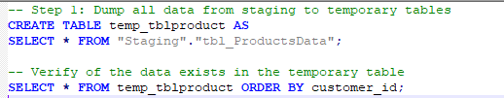
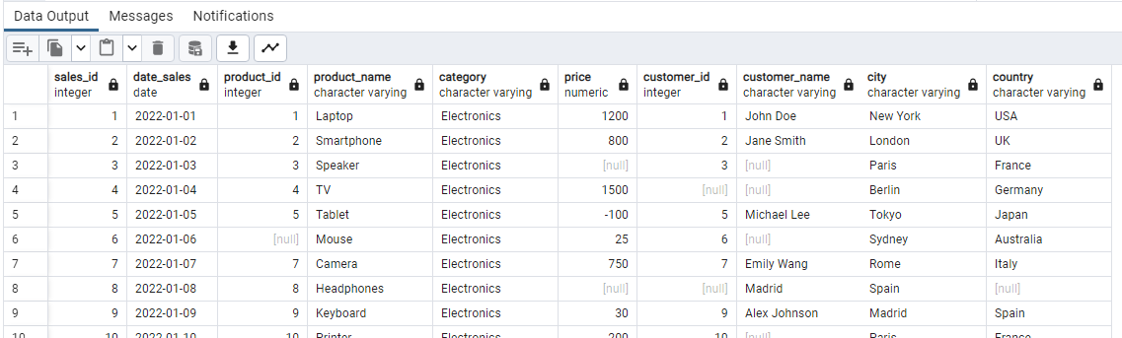
Create a Temporary Table
Query 2: Result

Slide 12

UPDATE Query
UPDATE <table_name>
SET <column_name> = <value>
WHERE <column_name> = <value>

Slide 13
Example: Update Query
Emp_ID | Emp_Name | Emp_City
1 | Sab | Dublin
2 | Viv | Cork
Emp_ID | Emp_Name | Emp_City
1 | Sab | Limerick
2 | Viv | Cork
UPDATE tbl_Employee
SET Emp_City = 'Limerick'
WHERE Emp_ID = 1
13

Slide 14
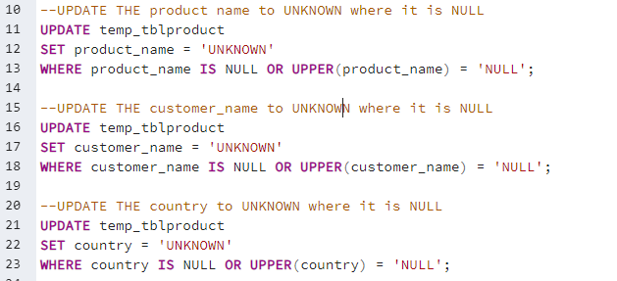
Cleansing the textual data

Slide 15
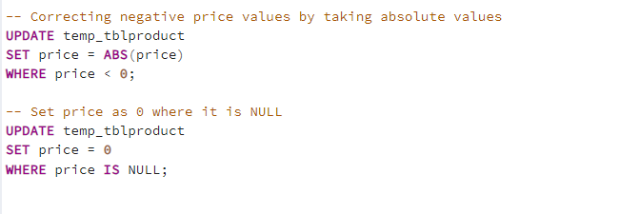
Cleansing the numerical data

Slide 16
Identify the fact and dimension tables
Customer_Dim_Table
Customer_id
Customer_Name
City
Country
Sales_Fact_Table
Sales_id
Date_id
Product_id
Customer_id
Price
Date_Dim_Table
Date_id
Date
Day
month
Year
Product_Dim_Table
Product_id
Product_Name
Category

Slide 17


