Slide 1
Abstract Factory Pattern
- By Sabarish Nair

Slide 2
What is Abstract Factory Pattern?
Creational Design Pattern that encapsulates a group of individual factories that have a common theme.
Super Factory that creates other factories (factory of factories)
Used mainly for:
App Needs to support multiple data types (SQL Server, Oracle, MySQL)
Need to create different types (PDF, Word, etc.)

Slide 3
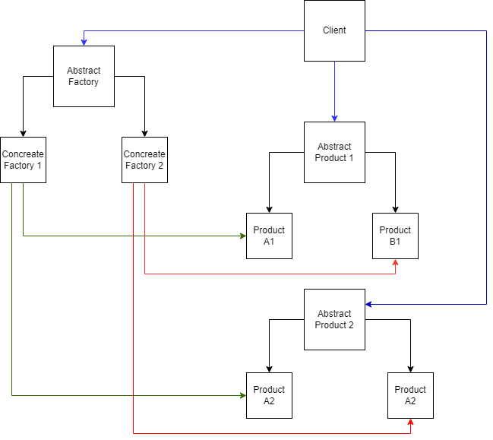
Basic Structure of Abstract Factory

Slide 4
Example
Application showing coding course details
Course can be of 2 types: Frontend and backend
Course can have 2 sources: Offline and Online

Slide 5
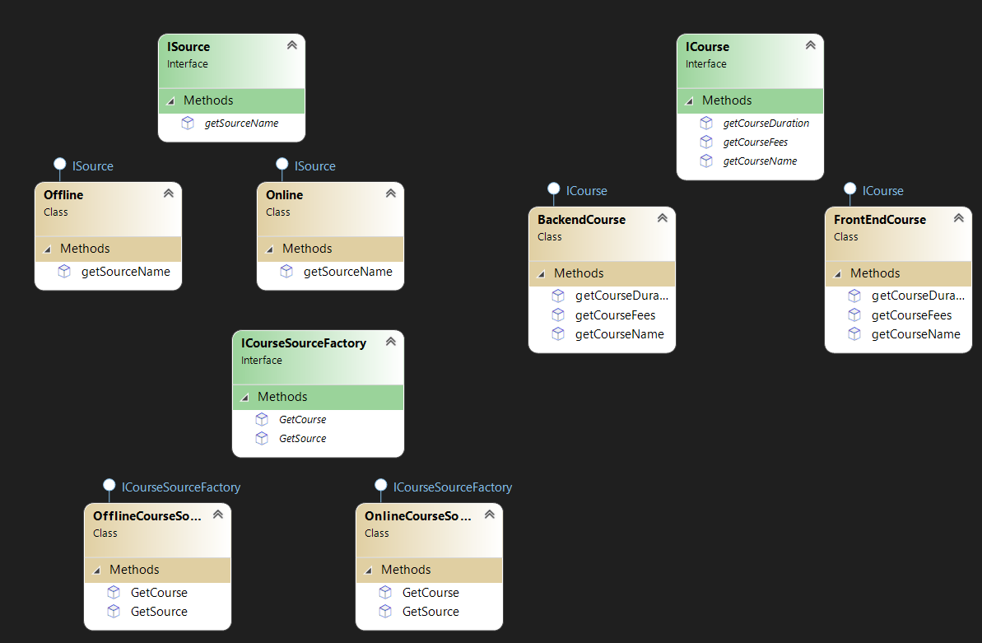
Code Structure

