Slide 1
FactORY Pattern
- By Sabarish Nair

Slide 2
What is Factory Pattern?
Creational Design Pattern
Factory: Class with a method
Method that will create and return objects based on the received input parameter.
Use cases: Same as abstract factory pattern

Slide 3
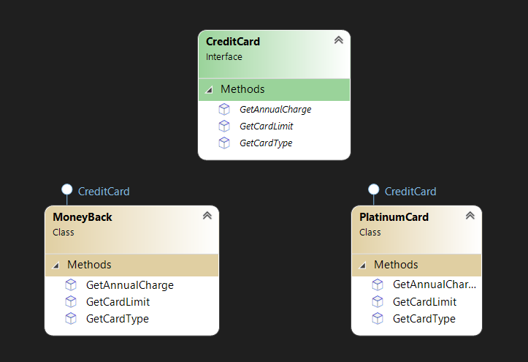
Example: 2 CREDIT card TYPES

