Slide 1
Singleton Pattern
- BY Sabarish NAIR

Slide 2
What is Singleton pattern
Create a single object of a class
It is a part of the creational design pattern
Use cases: Error Logging, Configuration settings etc.
Steps involved in creating a singleton class:
Create a sealed class (Stop creation of subclasses)
Create a parameterless and private constructor (Stop instantiation from outside the class)
Create a private static variable referencing the class’s singleton instance.
Create a public static property that will return the singleton instance.

Slide 3
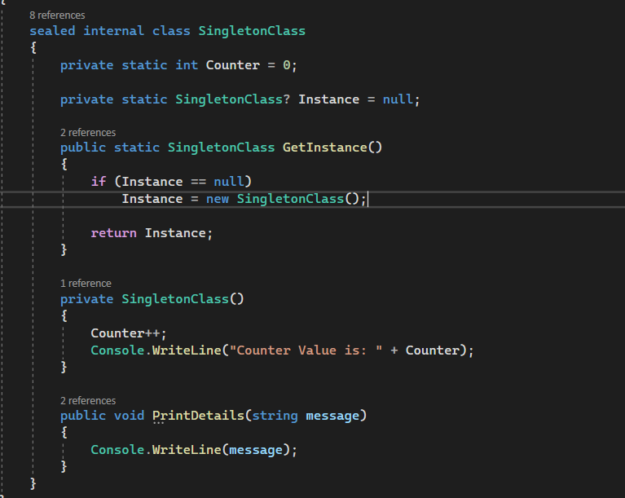
Sample Code

Slide 4
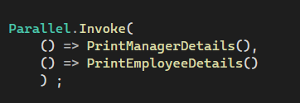
Issue with this approach
Doesn’t work with parallel threads
Multiple instances get created if we follow this approach
Solution: Implement a type-safe singleton class.

Slide 5
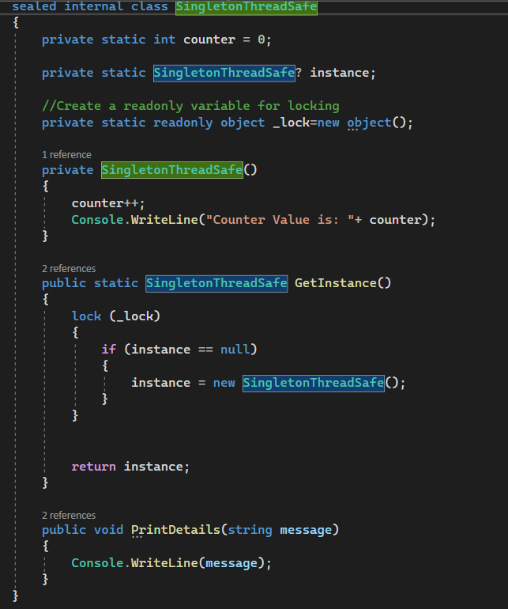
Type-Safe Singleton Class

Slide 6
Thank You!

