Slide 1
Builder Pattern
-By Sabarish Nair

Slide 2
What is Builder Pattern?
Helps in the complex generation of objects
Make the construction of the object generic
Separate construction process from representation
Example: Create a Laptop (plug the memory, plug the hard drive, plug the battery, etc.). Laptops can be of multiple types.
Example Make coffee (add sugar, milk, etc.)

Slide 3
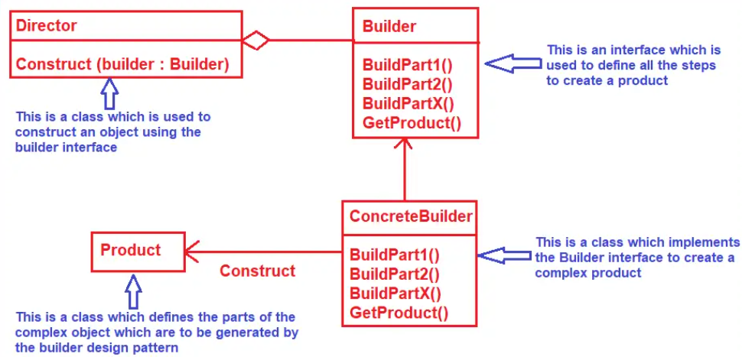
Block Diagram

Slide 4
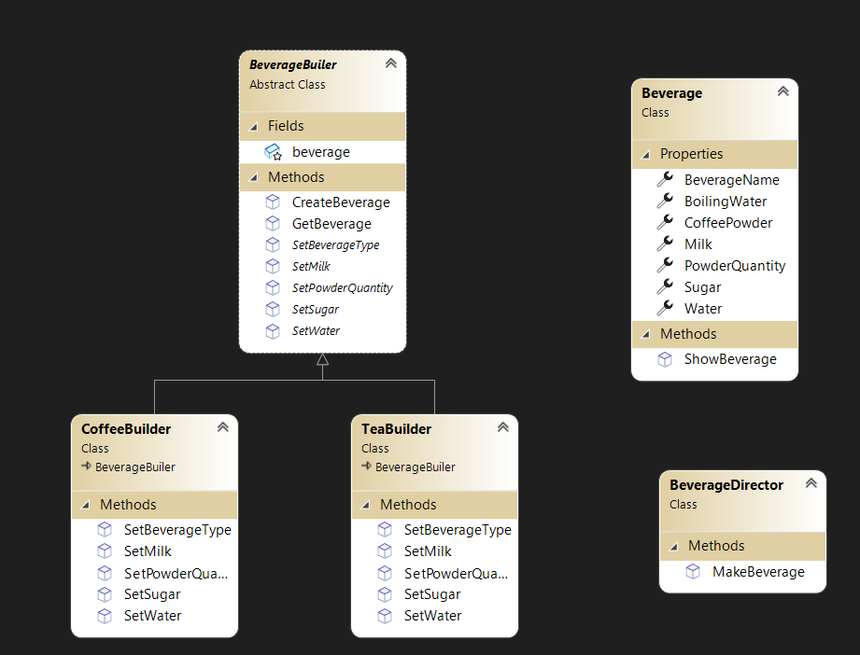
Example: Beverage Maker (Tea and Coffee)

