Slide 1
Chain of Responsibility
- By Sabarish Nair

Slide 2
Introduction
Type of behavioural pattern
Chain the receiving objects and pass the request along until an object handles it
The Chain of Responsibility Design Pattern is a Behavioral Design Pattern that allows passing requests along a chain of handlers.
Instead of sending a request directly to a specific receiver, a chain of potential receivers is formed, and each handler either processes the request or passes it to the next handler in the chain.

Slide 3
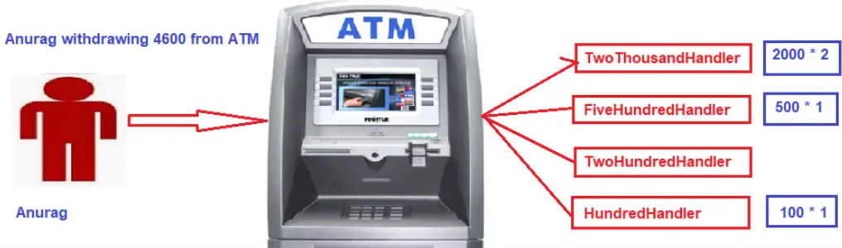
Example: ATM Withdrawal

Slide 4
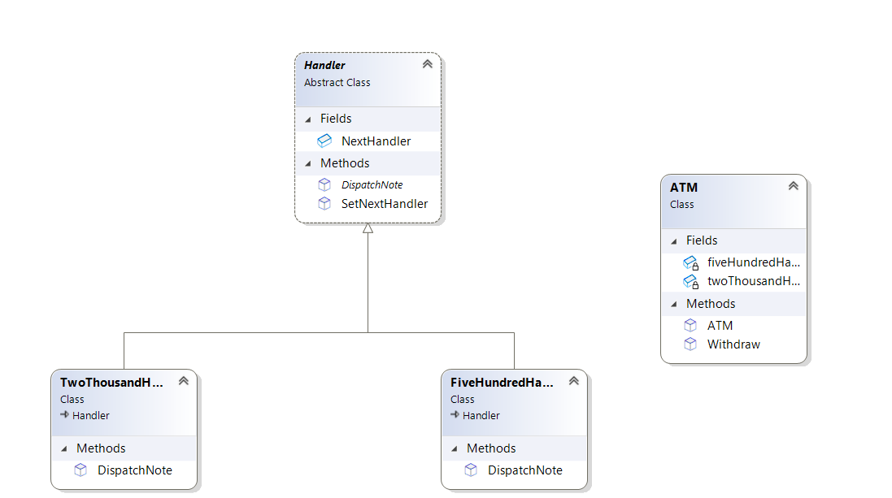
CLASS Diagram

