Slide 1
Visitor Pattern
- By Sabarish Nair

Slide 2
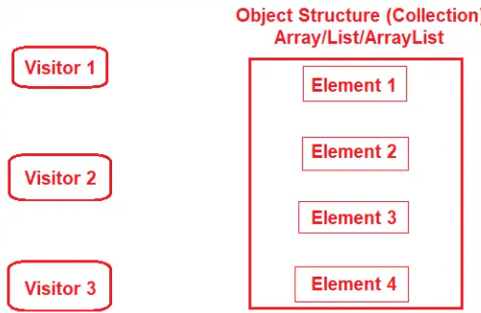
Introduction
Type of behavioural pattern
A Visitor object that changes an element object’s executing algorithm.
The Visitor Design Pattern should be used when you have distinct and unrelated operations to perform across a structure of objects (element objects).
That means the Visitor Design is used to create and perform new operations on a set of objects without changing the object structure or classes.

Slide 3
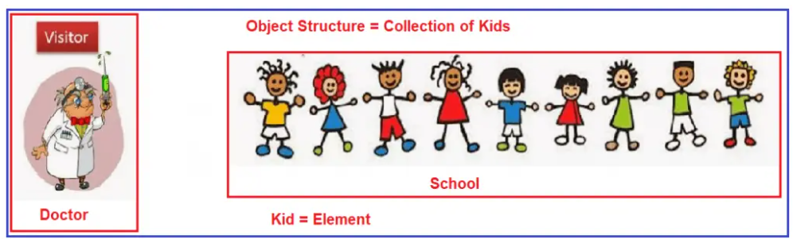
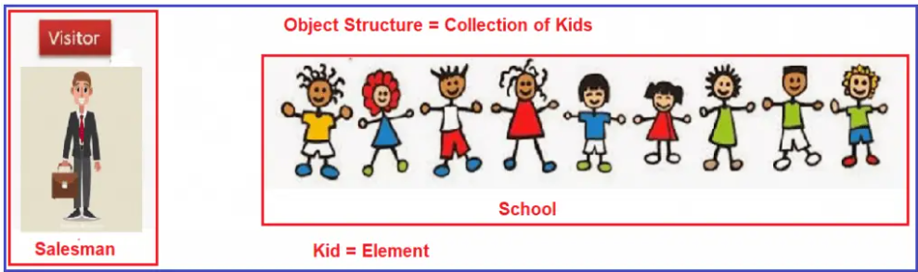
Example
School management decides to do a health checkup on all its students.
A doctor is invited (who is a visitor)
The doctor will check every student
Post that the doctor will submit the report.
Also, the school management decides to give a bag to each student as a Christmas gift.
Now the visitor will be a salesman and the element will remain a kid.

Slide 4
Implementation Example
Example is a Zoo, where each animal behaves differently when a visitor visits them.
Animals:
Lion
Dolphin
Bird
Visitors
Veterinarin
Caretaker
ZooVisitor

Slide 5
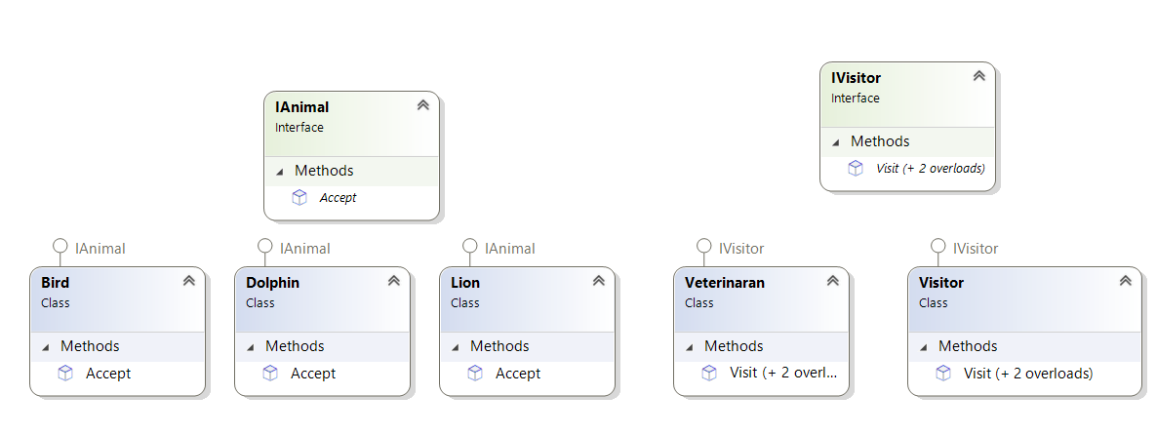
Class Diagram

