Slide 1
Memento Design Pattern
- By Sabarish Nair

Slide 2
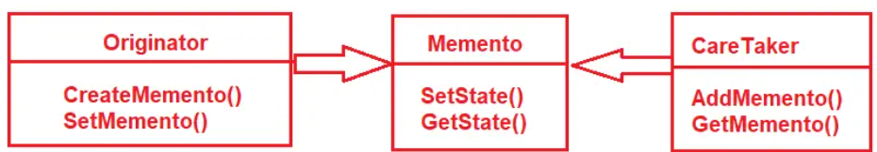
Introduction
Saves the state of an object
Used mainly for undo and rollback operations.
Contains 3 aspects:
Originator: A class that creates a memento object containing a snapshot of the Originator’s current state. CreateMemento(create a snapshot of the current state of the originator). SetMemento(Accepts the memento object, and this method changes the Internal State of the Originator to one of its Previous States).
Caretaker: Stores the memento for later use.
Memento: Sets the internal state and gets the internal state of the Originator object.

Slide 3
EXAMPLE
Users add items to their shopping carts.
They might want a snapshot at various stages.
For instance, before they add a promotional code, they might save a snapshot to compare prices later. If they find that the promotional code didn’t give a good discount or added unwanted items, they can revert to a previous snapshot.

Slide 4
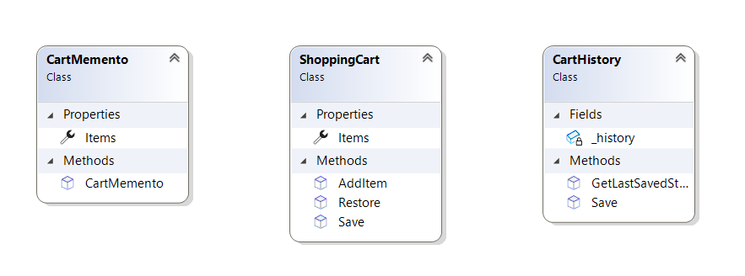
Class Diagram

