Slide 1
Adapter Pattern
- By Sabarish Nair

Slide 2
What is AN Adapter pattern?
Converts an interface to another interface that the client expects.
Allows incompatible interfaces to work together.
Example: Foreign socket to adapt to your phone charger’s plug shape.
Types: Object Adapter Pattern, Class Adapter Pattern

Slide 3
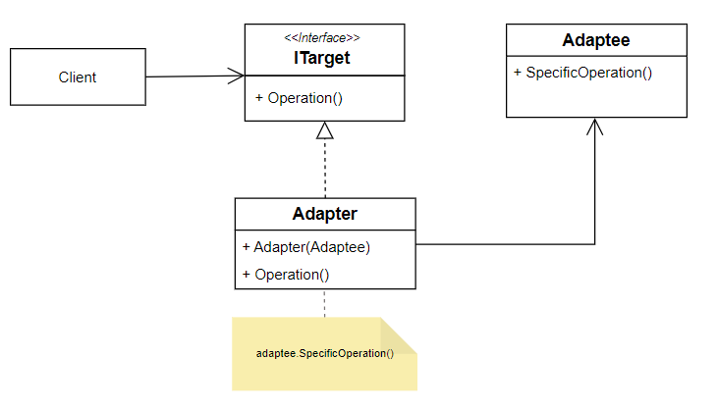
UML diagram: OBJECT adapter pattern

Slide 4
Example: Adapter pattern
Suppose we need to implement a payment feature in an application
We need to use a third-party class
The structure of the application payment class is different from the third party class.

Slide 5
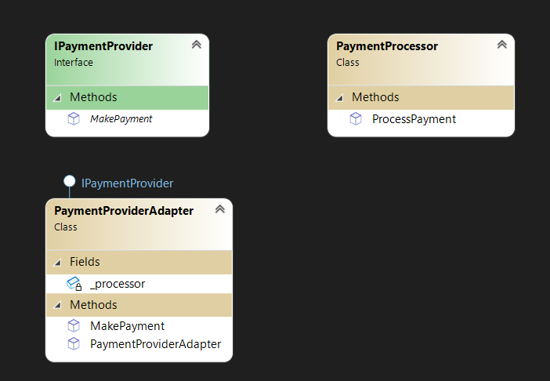
Class diagram: OBJECT ADAPTER PATTERN

Slide 6
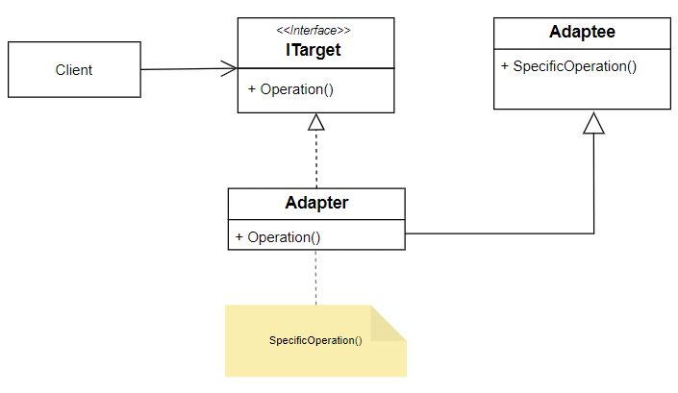
UML diagram: CLASS ADAPTER PATTERN

Slide 7
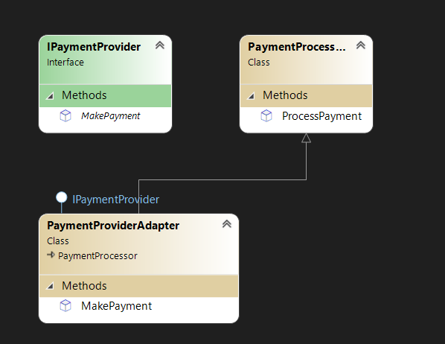
CLASS diagram: CLASS ADAPTER PATTERN

