Slide 1
Mediator Pattern
- By Sabarish Nair

Slide 2
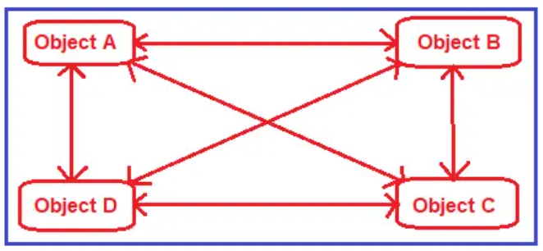
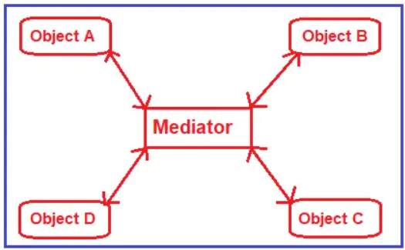
Introduction
Type of behavioral design pattern.
Acts as a mediator for communication between objects.
Objects cannot communicate directly, instead they communicate through a mediator.
Example. 2 users using a Facebook group. One user posts information to the group and other users get the information. Here, the Facebook group acts as a mediator for passing information between 2 people. They are not directly communicating with each other.

Slide 3
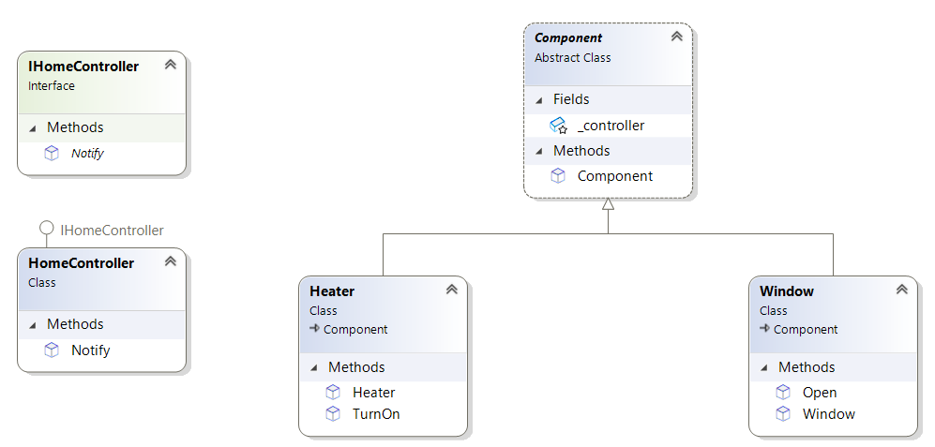
Example: Smart Home System
Different components like lights, windows, curtains, and heaters interact with each other through the central hub or controller.
Here the controller is the mediator

