Slide 1
Strategy Pattern
- By Sabarish Nair

Slide 2
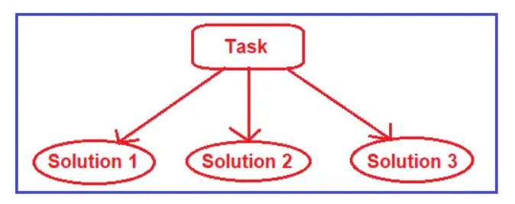
Introduction
Type of behavioural pattern
Enables selecting an algorithm’s behavior at run time.
Ideal when you need to switch between different algorithms or actions in an object dynamically.

Slide 3
Example
User can go to the airport by:
Bus
Train
Taxi
We can let the user decide at run time which approach to take.

Slide 4
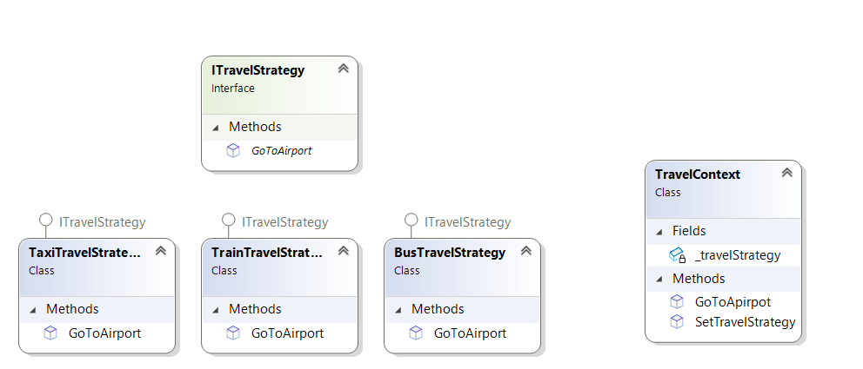
Class diagram

