Slide 1
Proxy Design Pattern
- By Sabarish Nair

Slide 2
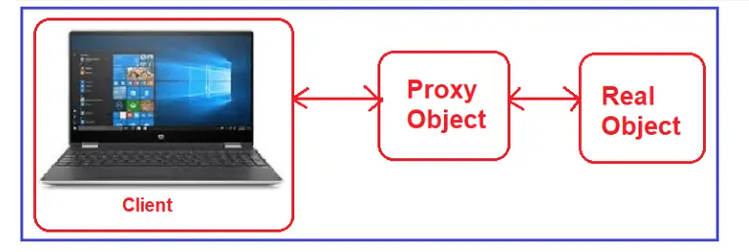
Proxy Design Pattern
Type of structural design pattern.
Proxy = On behalf of
A class that represents the functionality of another class

Slide 3
Types of Proxies
Virtual Proxy: Placeholder for “expensive to create” objects. The real object is only created when a client first requests or accesses the object.
Remote Proxy: A remote proxy provides local representation for an object that resides in a different address space.
Protection Proxy: A protection proxy controls access to a sensitive master object. The surrogate object checks that the caller has the access permissions required before forwarding the request

Slide 4
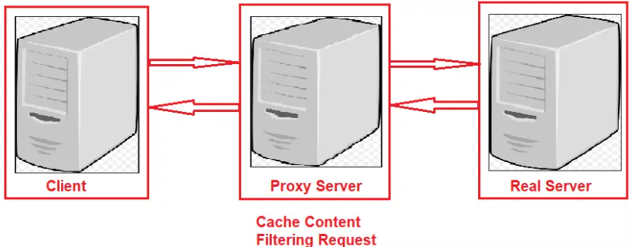
Example: UML Diagram

Slide 5
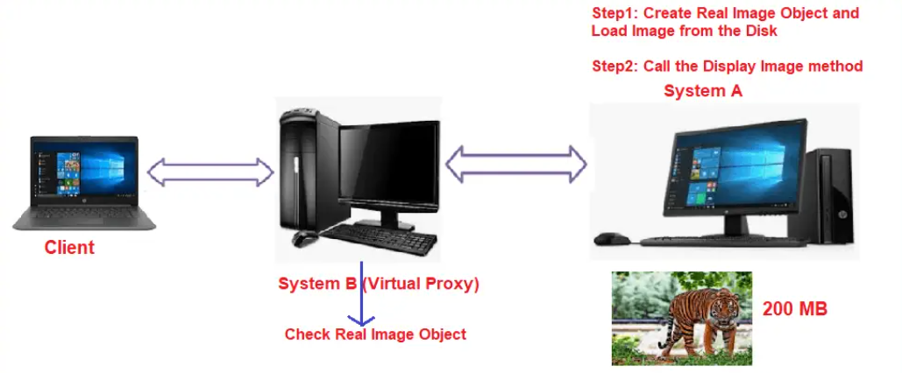
Example
Load image from a server only if it is not loaded earlier.
Check if image exists in Virtual Proxy. If it exists, load them, else load from server (disk)

Slide 6
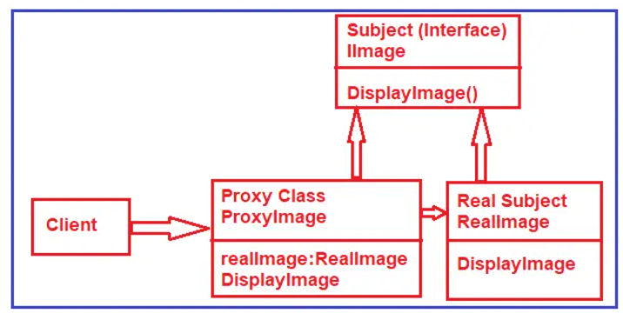
Example

Slide 7
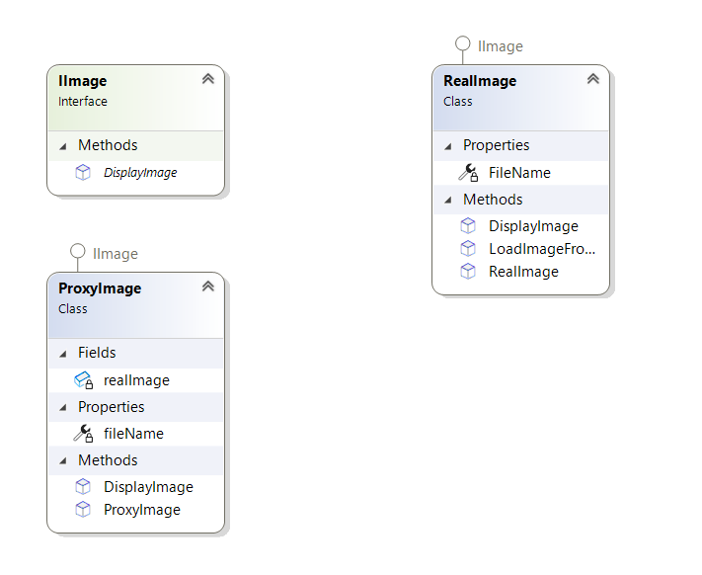
Class Diagram

