Slide 1
Flyweight Design Pattern
- By Sabarish Nair

Slide 2
What is Flyweight design pattern?
Type of structural design pattern
Reduces the need to create objects, decreases memory footprint and increases performance.
States:
Intrinsic: Constants and stored in-memory
Extrinsic: Not constants and need to be calculated on fly

Slide 3
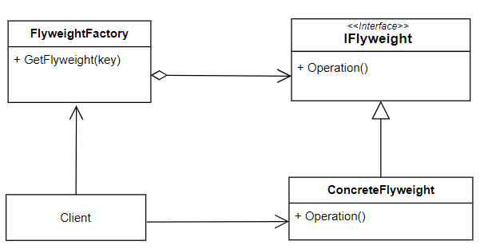
UML: Flyweight pattern

Slide 4
Example: Rich-Text Editor
Manage Large number of characters to create text
Each character has a font, size and colour property.
Create a pool of flyweights to manage font, size and colour property shared among many characters.
Each character object then contains a reference to the corresponding flyweight object, rather than duplicating the same data.

Slide 5
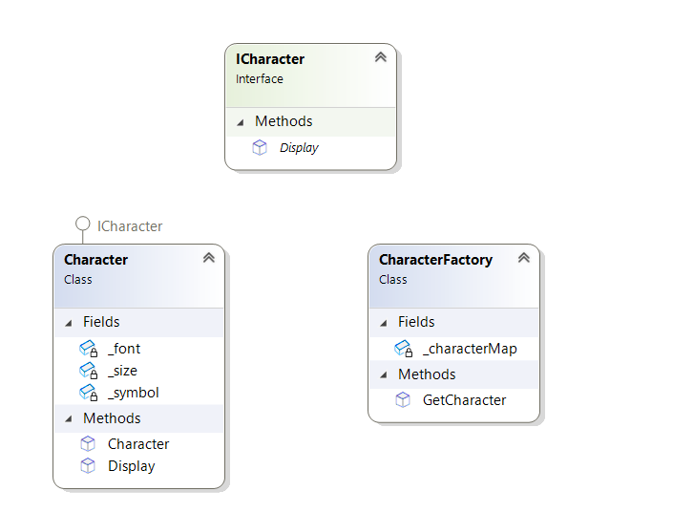
Class Diagram

