Slide 1
Decorator Pattern
- By Sabarish Nair

Slide 2
What is a Decorator Pattern?
Type of Structural Design Pattern
Add functionalities to an existing object without altering its structure.
Components:
Component (Interface)
Concrete Component (Concrete class implementing the interface)
Decorator (Abstract class that contains a reference to a component interface. It acts as a base class for all the decorators. We need to pass the component object to the constructor of this class).
Concrete Decorator: Concrete implementations of decorator class. Override the methods of the decorator class.

Slide 3
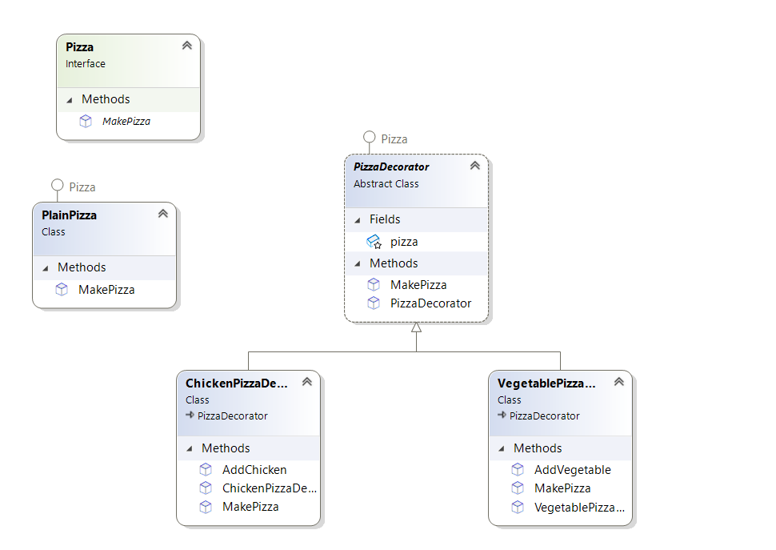
Example: Pizza
Create vegetable and chicken pizza based on plain pizza.

