Slide 1
Interpreter Design Pattern
- By Sabarish Nair

Slide 2
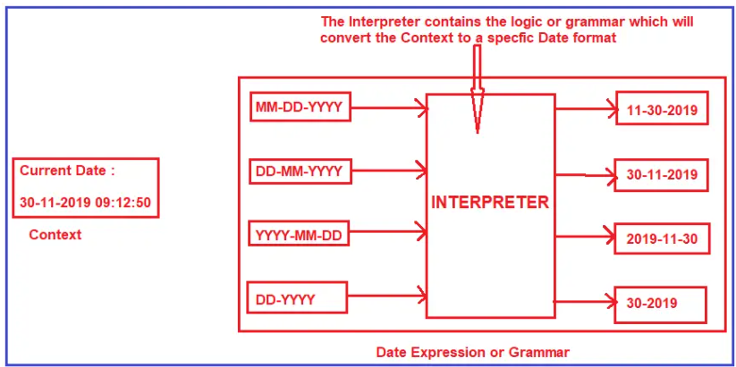
Introduction
Type of behavioral design pattern
Mainly used in the interpretation of language
Provides a grammatical representation of the language and an interpreter to deal with this grammar
It provides a way to evaluate language grammar and its expression.
Example: Interpret date expression

Slide 3
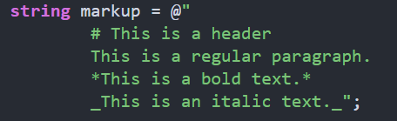
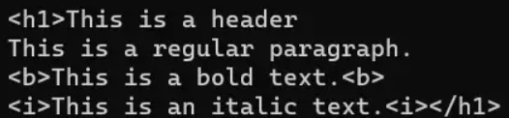
Example
Define document structures in a simple markup language
This language might define headers, paragraphs, and bold or italic text.
Example:
Input: Output:

Slide 4
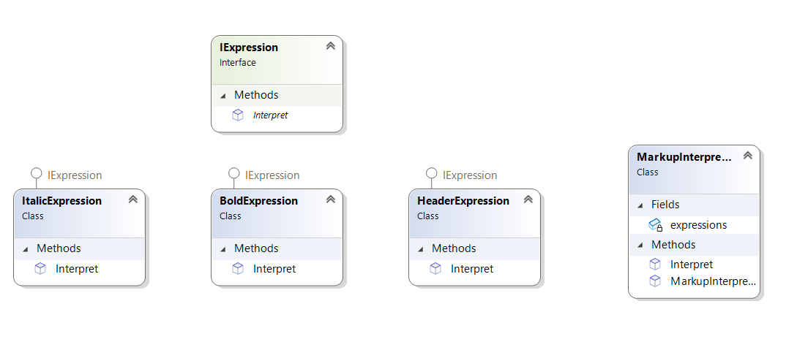
Class Diagram

