Slide 1
Command Pattern
- By Sabarish Nair

Slide 2
Introduction
Type of behavioral pattern.
Turns a request into an object (i.e. command)
Invoker does not know how to serve the request but uses the encapsulated command to perform an action.
Example: Waiter takes an order from the customer and passes it to the cook. The cook will prepare the food and give it back to the waiter.

Slide 3
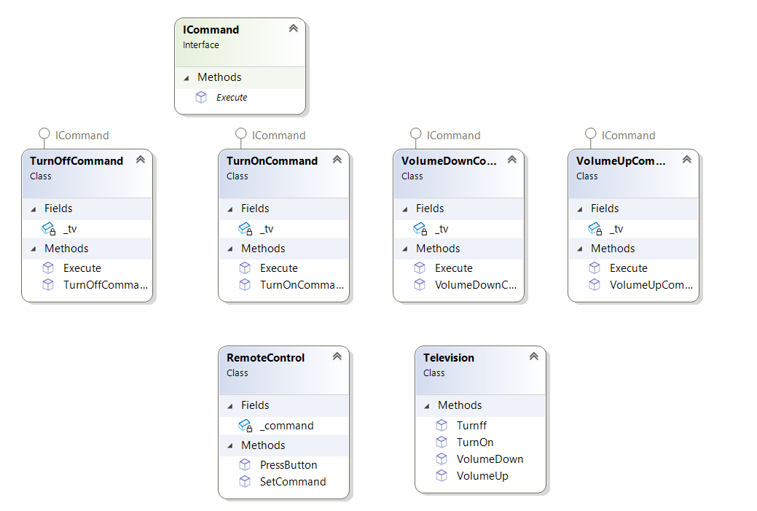
Example: TV Remote
Suppose you have a remote control with buttons for turning the TV on, turning it off, increasing the volume, and decreasing the volume. Each button press is a command the TV (the receiver) must execute.

