Slide 1
Composite Pattern
- By Sabarish Nair

Slide 2
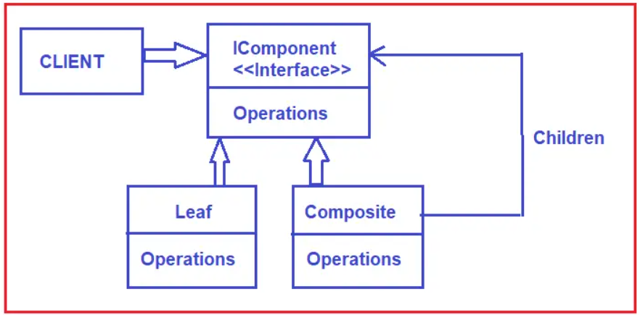
What is composite pattern?
Type of structural design pattern
Compose objects into tree structures
Treats objects and composition of objects uniformly
Useful for representing hierarchical structures such as file systems, UI components, or organizational structures.

Slide 3
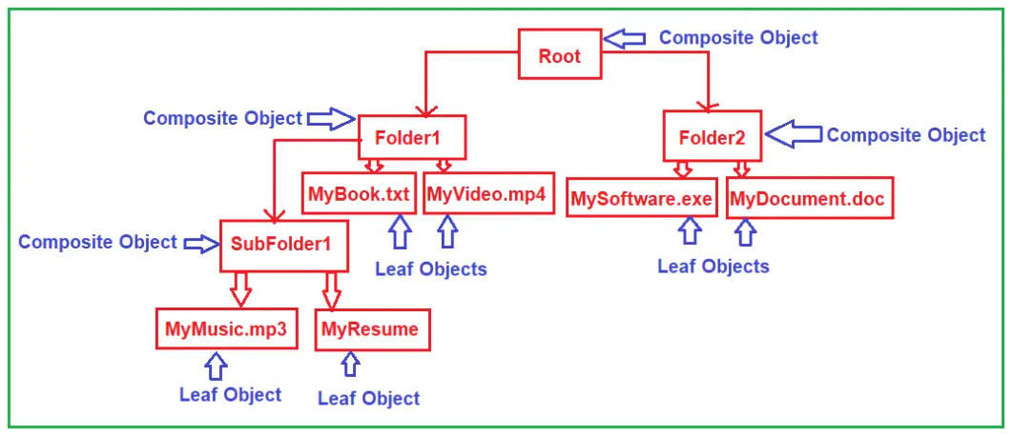
Example

Slide 4
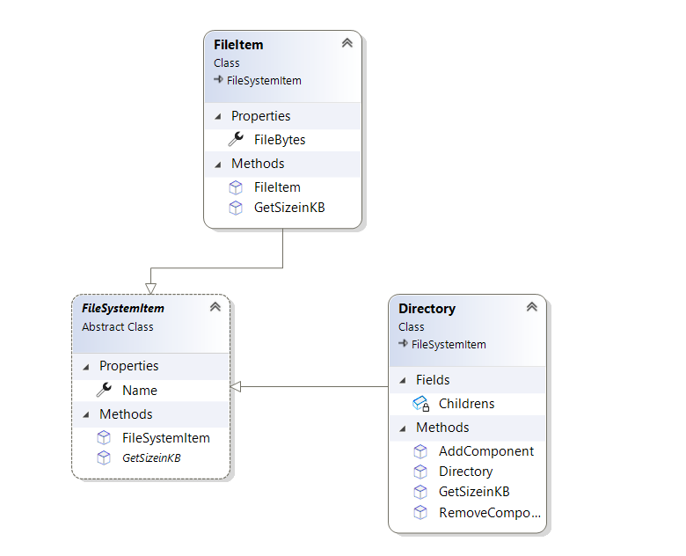
Class Diagram

