Slide 1
State Design Pattern
- By Sabarish Nair

Slide 2
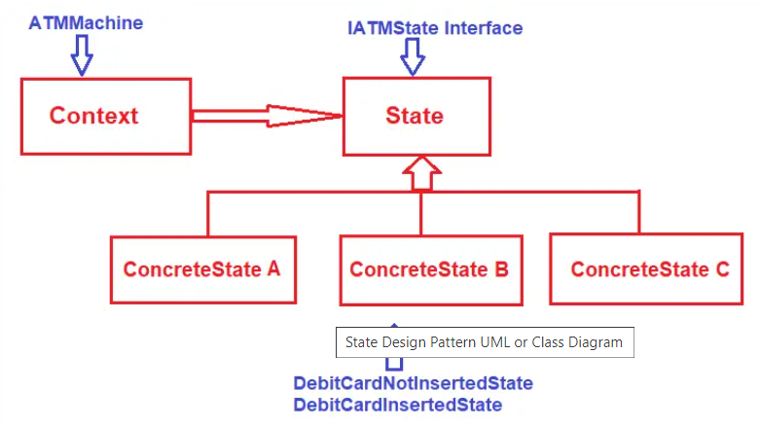
Introduction
Type of structural design pattern
Allows an object to alter its behavior when its internal state changes.
This pattern is useful when an object needs to go through several states, and its behavior differs for each state. Instead of having conditional statements throughout a class to handle state-specific behaviors, the State Design Pattern delegates this responsibility to individual state classes.

Slide 3
Example
Mobile Phone Ringer
Different Ringer Modes: Silent, Vibration and Ringing
State Interface: Defines the behavior when there is an incoming call.
Concrete State Class: Implement the state interface for Silent, Vibration and Ringing
Context: Represents the mobile phone

Slide 4
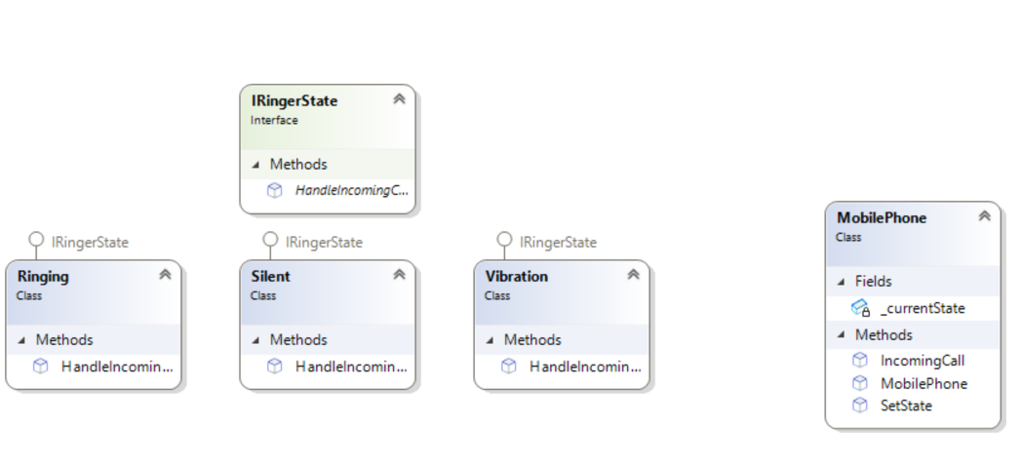
Class diagram

