Slide 1
Facade Pattern
- By Sabarish Nair

Slide 2
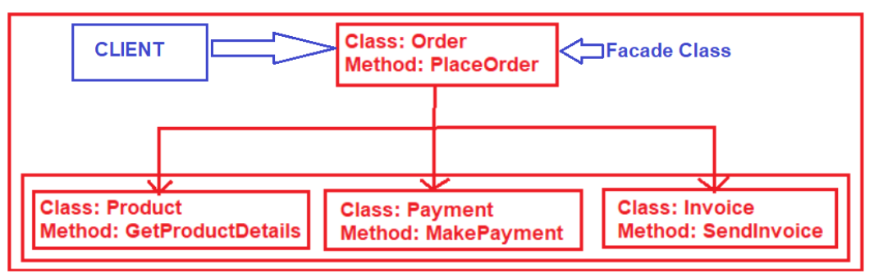
What is a Facade Pattern?
Type of structural pattern.
Provides a unified interface to a set of interfaces.
Example: PlaceOrder internally calls the 3 methods defined below.

Slide 3
Example
To place an order, we need to perform:
Get Product Details (Product.cs class)
Make Payment (Payment.cs class)
Send Invoice(Invoice.cs class)
Create a Façade/Wrapper calls, place order that will do all the steps mentioned above

Slide 4
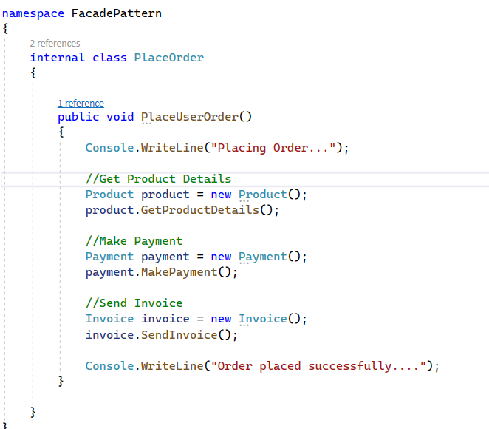
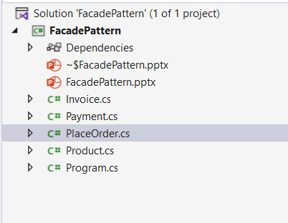
Example

