Slide 1
Template Design Pattern
- By Sabarish Nair

Slide 2
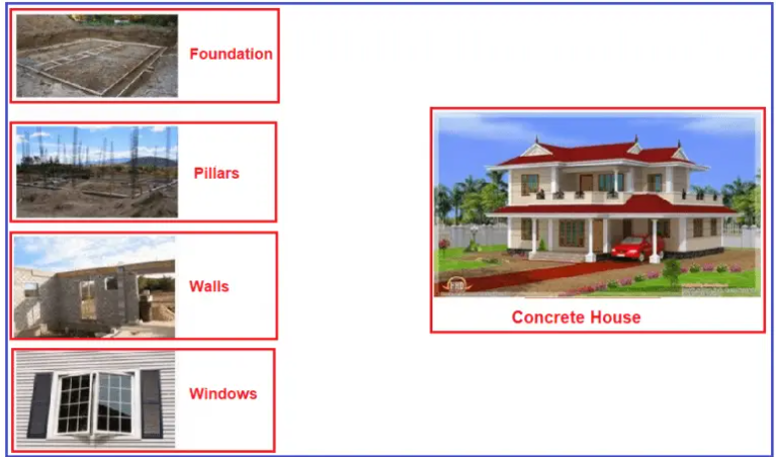
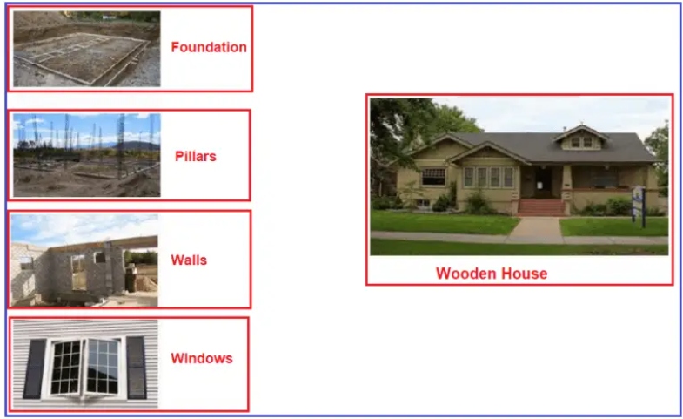
Introduction
Type of behavioral design patterns.
Create an abstract class with virtual methods.
Create concrete implementations
Example: For building concrete houses and wooden houses, steps remain the same, only the materials differ

Slide 3
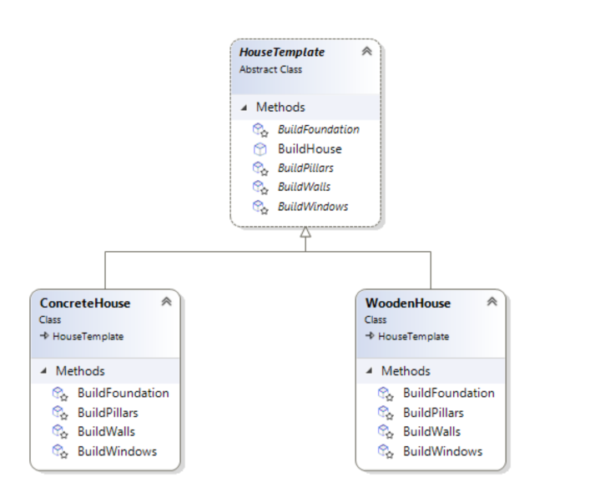
Example

