Slide 1
Observer Pattern
- By Sabarish Nair

Slide 2
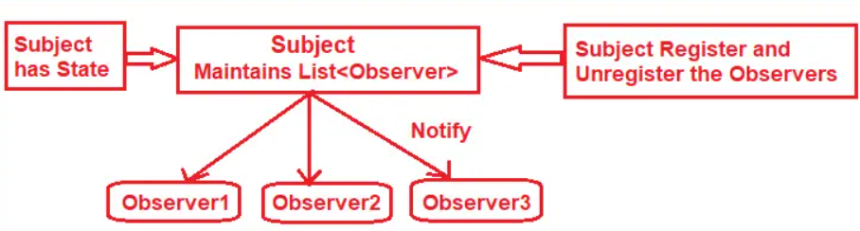
Introduction
Type of behavioural pattern
All dependent objects are notified automatically when one object changes
Subject: One who notifies about the change
Observers: Subscribers listening to change
Also called publish-subscribe and producer-consumer

Slide 3
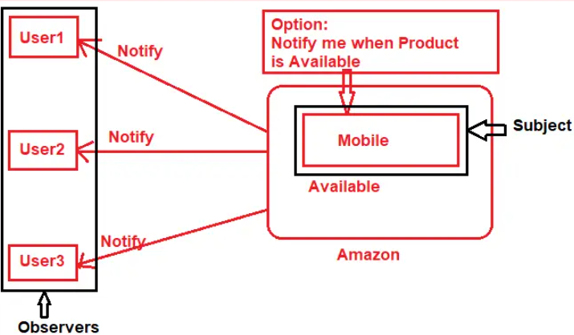
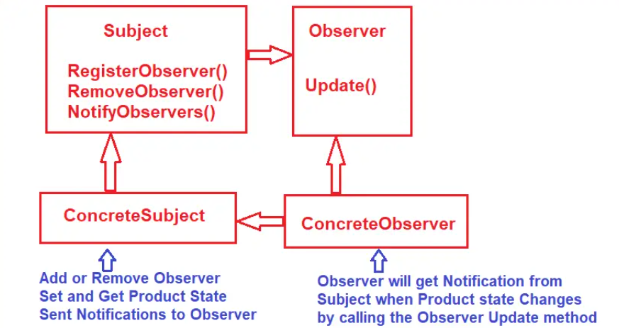
Example

Slide 4
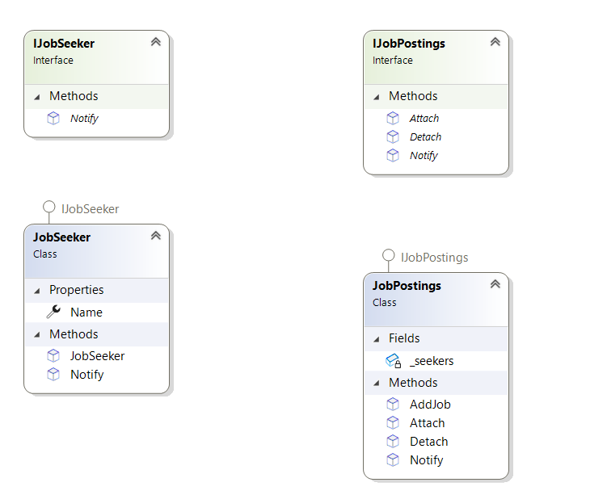
Notify subscribers about new job

