Slide 1
Iterator Pattern
- By Sabarish Nair

Slide 2
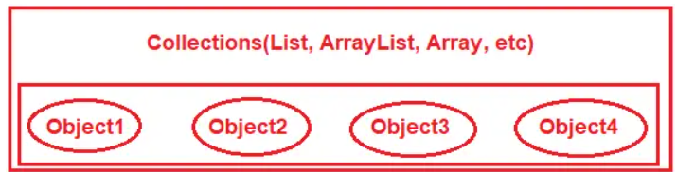
Introduction
Type of Behavioral Pattern
Access the elements of a collection object sequentially without exposing its underlying representation
Provides a uniform interface to traverse data structures

Slide 3
Examples
Browsing Music Playlist
Bookshelf
Radio Station
Social Media Feed
Restaurant Menu

Slide 4
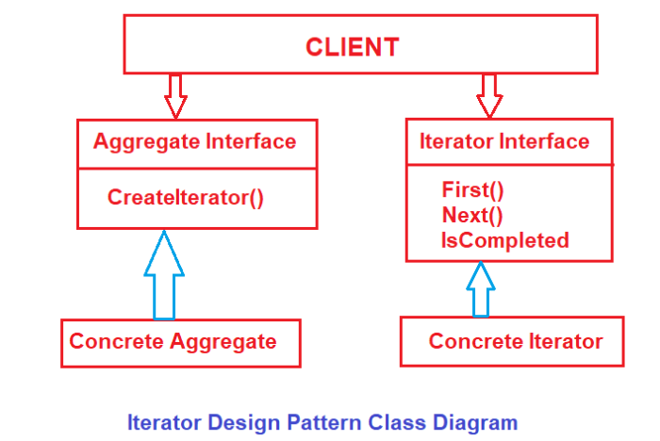
Components

Slide 5
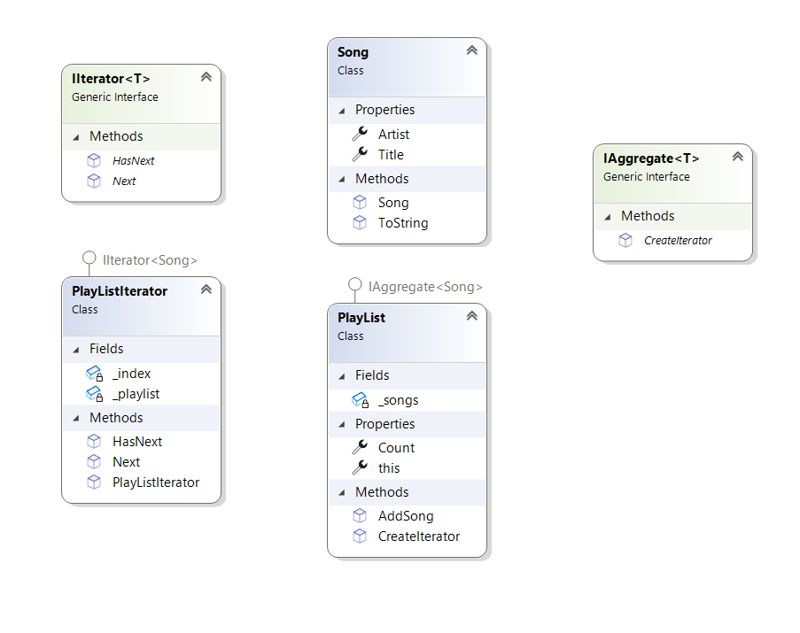
Example: Play List

