Slide 1
Bridge Pattern
- By Sabarish Nair

Slide 2
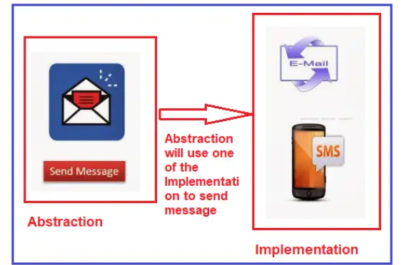
What is Bridge Pattern
Type of structural design pattern.
Has 2 layers: Abstraction and Implementation
Both the layers can evolve independently
Example: Send messages using email or SMS

Slide 3
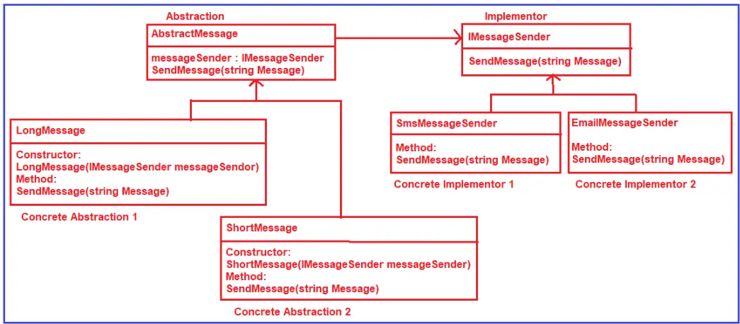
Example

Slide 4
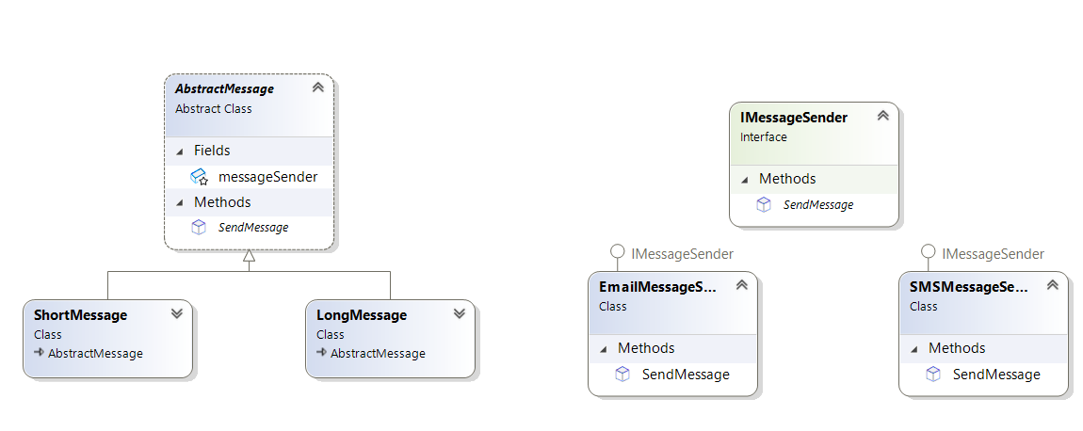
Class Diagram

