Slide 1
Prototype pattern
Sabarish Nair

Slide 2
What is Prototype pattern?
It’s a creational design pattern
Used for creating objects by copying an object (known as a prototype)
Clones an existing object without changing the values of the original object
Use MemberwiseClone() [From System.Object] method to do this
Helps clone complex object

Slide 3
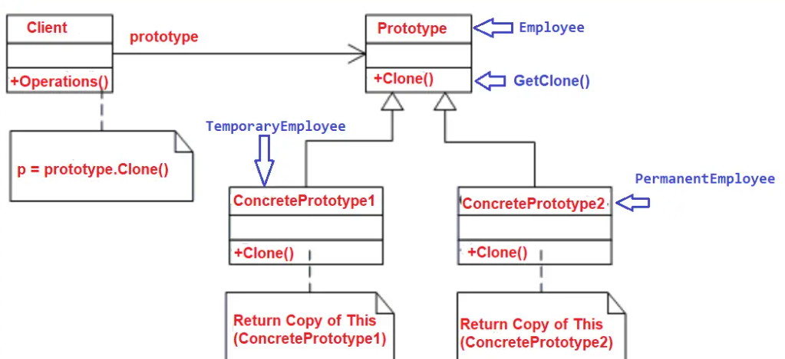
UML Diagram

Slide 4
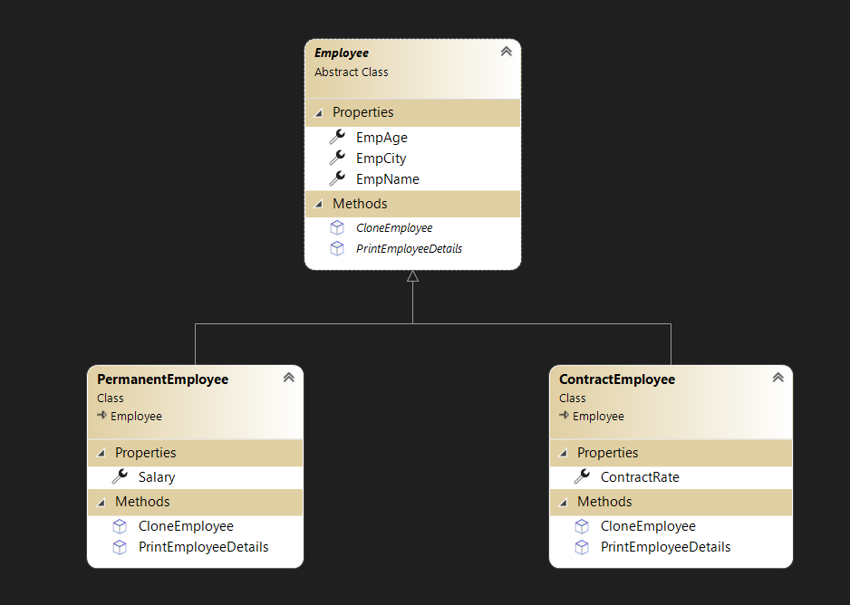
Example
Create objects of permanent and contract employee

