Slide 1
System Design – URL Shortening Service
By Sabarish Nair

Slide 2
Functional Requirements
Short URL generation
Redirection
Custom Short Links
Deletion
Update
Expire the URL generated

Slide 3
Non-Functional Requirements
Highly Available
Horizontally Scalable
URLs easily readable
Low Latency
Unpredictable

Slide 4
Resource Estimation Assumptions
Shortening to Redirection Requests ratio is 1:100
200 Million URL shortening requests per month
A single URL requires 500 Bytes of Storage
Expiry Time: 5 years (unless explicitly deleted)
Daily Active Users (DAU) = 100 Million users

Slide 5
Resource Estimations
Storage Estimation = 200 Million/month * 12 months/year * 5 years * 500 Bytes = 6 TB
Query Rate Estimation (per second) = 200 Million * 100 / (30 * 24 * 60 * 60) = 76 * 100 = 7.6 K URLs/s
Bandwidth Estimation = 7.6K * 500 Bytes * 8 Bits = 30.4 Mbps
Memory Estimation = 0.2 (Considering caching) * 7.68 * 3600 Seconds * 24 Hours * 500 Bytes = 66 GB
Number of Servers = 100 M (DAU) / 8000 = 12500 servers

Slide 6
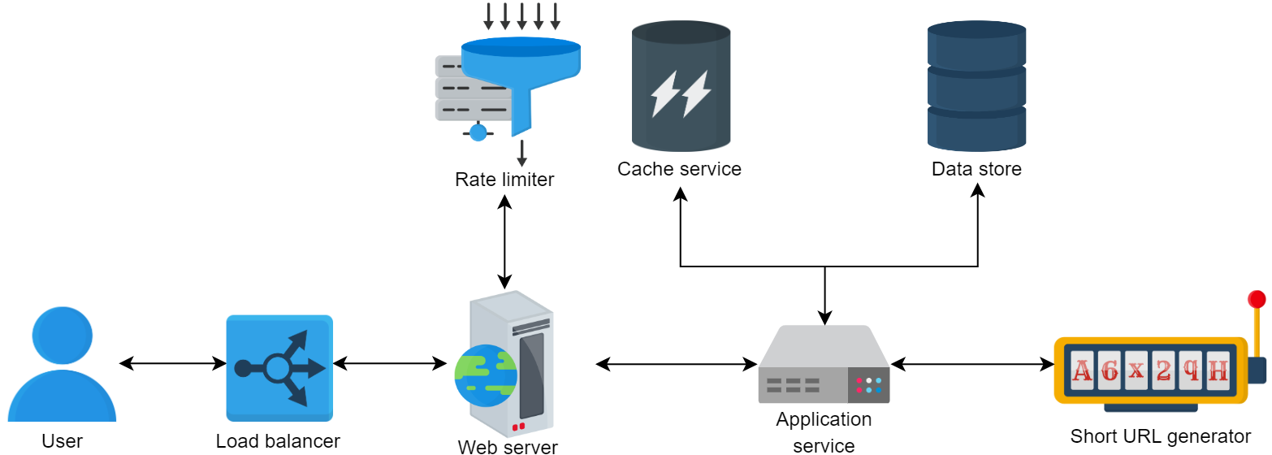
High-Level Design

Slide 7
Database Selection
Not a lot of data to store, read-heavy application.
NoSQL is a good choice
Mongo DB?

Slide 8
System APIs
Shortening a URL
Redirecting a short URL
Deleting a URL
** Every API will have a secure API key for the user account's unique identifier.

Slide 9
Fulfilling Non-Functional Requirements (NFR)
NFR | Technique
Availability | Load Balancer
Scalability | Horizontal Sharding
Readibility | Remove non-alphanumeric characters Remove look-alike characters
Latency | Caching
Unpredictability | Random number allocation instead of going by sequence

Slide 10
THANK YOU!

