Slide 1
Notes:
The EH Team
Anirudh Mungre, Brent Myers, Ethan Elliott

Slide 2

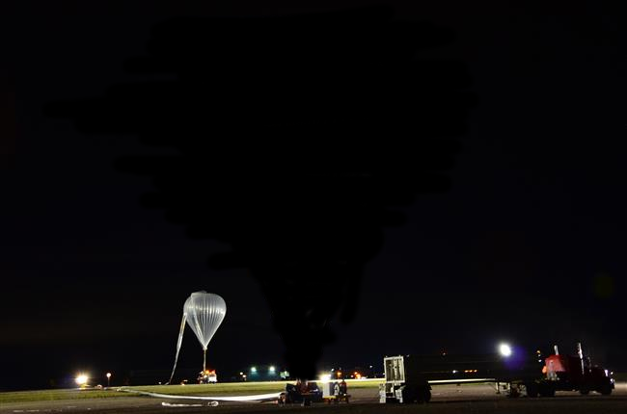
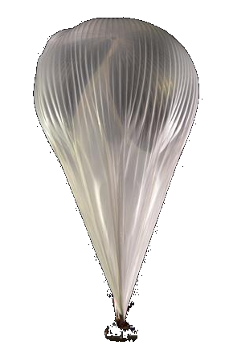


STRATOSPHERE
Notes:
The EH Team
Anirudh Mungre, Brent Myers, Ethan Elliott

Slide 3
Challenge
Create a Web-based Dashboard tool
Allow scientists, students and general public to easily view images and data captured from stratospheric balloons
Notes:
Your challenge
The objective of this challenge is to create a Web-based Dashboard tool that will allow scientists involved in research projects, as well as the general public, to consult, visualize and/or easily interpret images and telemetry captured from stratospheric balloons during the Austral 2017 and Strato-Science 2018 campaigns.
Find details about the challenge and related documents
ftp://ftp.asc-csa.gc.ca/users/OpenData_DonneesOuvertes/pub/Space%20Apps%20Challenge%202019/
Challenge Registration form
http://asc-csa.gc.ca/eng/forms/space-apps-2019-form.asp

Slide 4
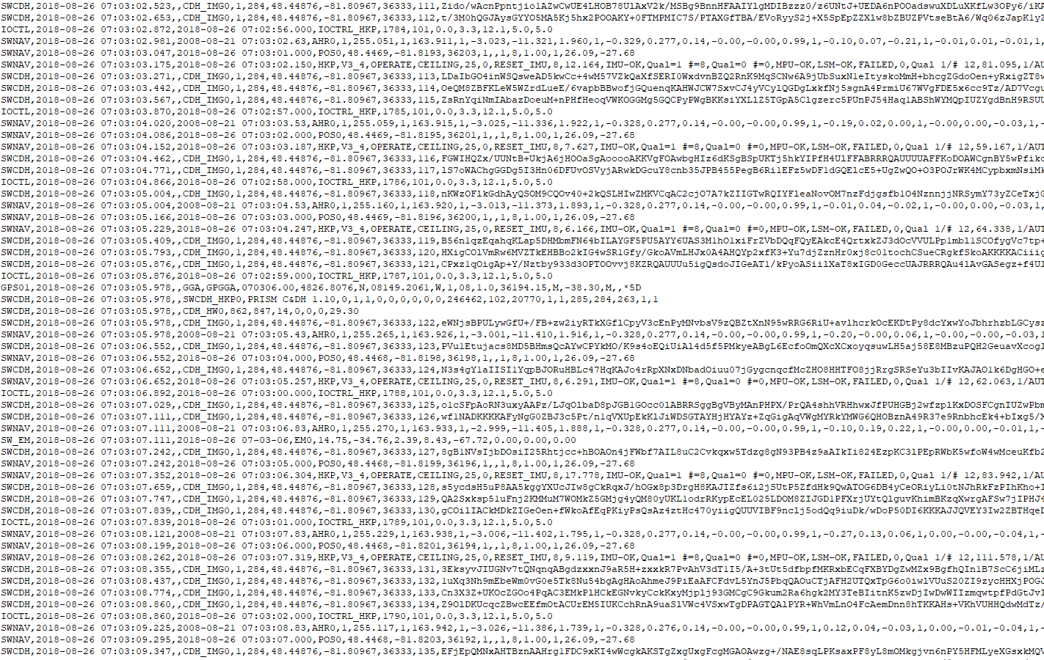
Data Statistics
92,441,728 total characters
88.1MB
212,254 lines of data
339 images
Over 137 processes and packet types

Slide 5
FIX_TIME
LONG
DC12V_OUT
MOON_VECT_Y
SUN_VECT_Z
TRACK_ANG
NB_CMD_EXEC
DEW_POINT
ALT_MSL
MOON_VECT_X
LOOP_DELAY_MAX
LINEAR_ACCEL_X/Y/Z
FIX_QUAL
Source
ATT_Q1
NMEA_ID
COUNTER
LAT
GEOID_SEP_UNIT
SWEM_STATUS
SUN_AZIM
PKT_ID
EMPTY_1
MEM_USED
NDX_IMG_TO_TAKE
MOON_VISIB
NB_TC_REJ
NAVIO_TEMP
VELO_ N/E/D
DERIVED_ALT
ALT_UNIT
CAM_ID
NAVIO_BARO_STATUS
M_TIME
TC_REJ
NAVIO_MPU_STATUS
LAST_CMD_ID
SW_VER
SWEM_VERSION
IMG_LAT
NAVIO_GPS_STATUS
NSATS
LOOP_AVG_FREQ
GRAV_VECT_X/Y/Z
TRUE_ HEAD
FIX_QUAL
SHOCK_Z
ATT_Q3
NB_CMD_REJECT
GPS_SELECT_MODE
DC5V_1_OUT
GPS_SRC
SUN_VECT_VALID
SS_TIME
TC_RX
HDOP
LOOP_MIN_FREQ
TRACK_ANG_VALID
ATT_Q0
DISK_ USABLE
NAVIO_ PRESSURE
IS_NAVEM_IMG
SWNAV_VERSION
NB_SATS
STATUS_TEXT
MOON_VECT_Z
LINEAR_ACCEL_VALID
SUN_VISIB
GEOID_SEP
RELAT_ HUMID
IS_NETWORK_ERR
LOOP_DELAY
ATT_Q2
TIME_OF_FIX
EVENT_TEXT
NB_IMG
IMG_FILE
MOON_DATA_VALID
NDX_IMG_TO_SEND
IS_CONFIG_PARAM_ERR
IMG_LONG
CHKSUM
IS_IMAGE_OVERWRITE
DISK_FREE
NB_TM_SENT
AHR_DATA_SRC
SHOCK_Y
TRUE_HEAD_VALID
VELO_VALID
SVER
IMG_ID
GX5_EF_STATUS
MEM_FREE
CNT_LAST_CMD
IS_CONFIG_FILE_READ
SUN_ELEVATION
N_S
EVENT_TEXT
NAVIO_LSM_STATUS
DC3V3_OUT
SUN_AZIMUTH
IMG_ALT
ORIENTATION_VALID
EXTERN_TEMP
GRAV_VECT_VALID
ANG_RATES_VALID
E_W
DC5V_2_OUT
SUN_VECT_Y
NOVATEL_GPS_STATUS
INTERN_TEMP
GX5_STATUS
EXTERN_PRESS
DCUPS_OUT
MEM_TOTAL
CPU_TEMP
HDOP
DISK_TOTAL
IMG_DATA
IS_IMAGE_OVERFLOW
MODE
SHOCK_X
IS_LARGE_IMG
IS_AUTO_IMAGE
POS_VALID
NB_TC_RX
IS_FILE_ERR
ROLL/ PITCH
LATITUDE
PKT_NDX
ANG_RATE_X/Y/Z
LONGITUDE
SUN_VECT_X
GX5_GPS_STATUS
SUN_ELEV
GX5_EF_STATUS_FLAGS
ALT

Slide 6
EXTERN_ PRESS
NAVIO_ PRESSURE
M_TIME
ROLL/PITCH
EXTERN_ TEMP
LONG
LAT
DEW_ POINT
DERIVED_ALT
EXTERN_ PRESS
NAVIO_ TEMP
EXTERN_ TEMP
RELAT_ HUMID
INTERN_ TEMP
DEW_ POINT
INTERN_ TEMP
ALT
RELAT_ HUMID

Slide 7
Solution
DEMO

Slide 8

Questions

Slide 10
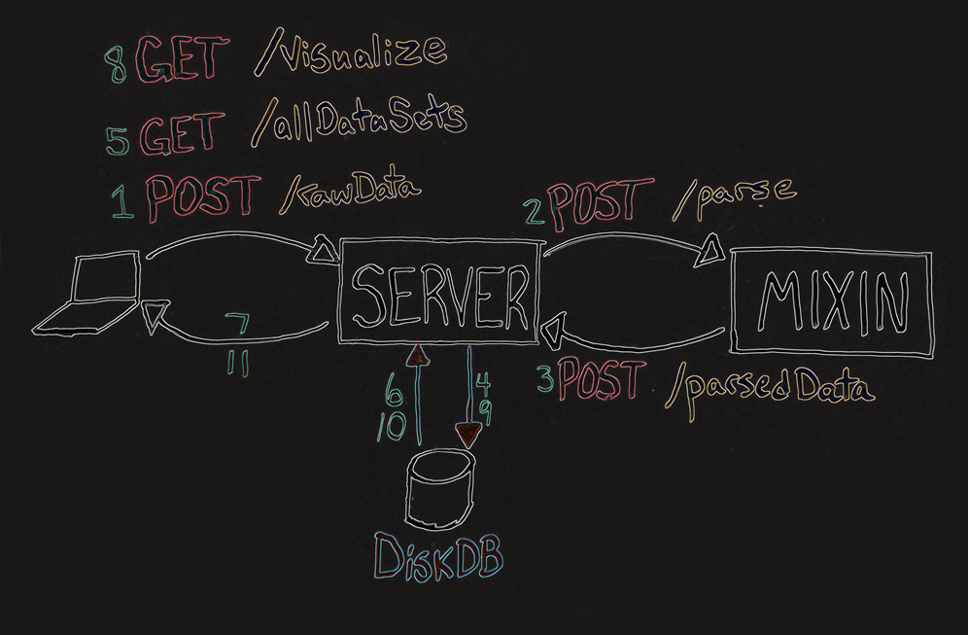

Slide 11
Future Work
Animate effects on the gondola
Yaw, pitch, heading
Different play speeds
Display numerical data
Adapting to different data formats
Australia data
Animate weather predictions based on dew point, relative humidity, and barometric pressure
Data smoothing for a cleaner look
Display critical events on timeline
Start, peak, end, etc…

