Slide 1
Community Support for French Speaking Customers
Jacob H. Marquez

Slide 2



Recommendation
We should hire 20 to 30 more support people to maintain the current average of 2-3 cases assigned per day per person.
Continue to enhance automated support case resolution.
Notes:
Publish

Slide 3
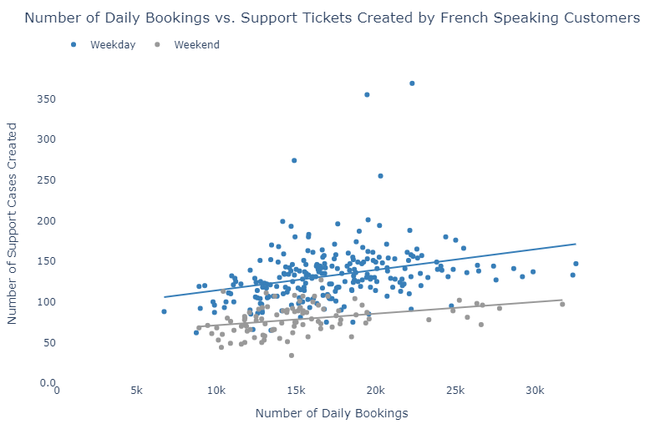
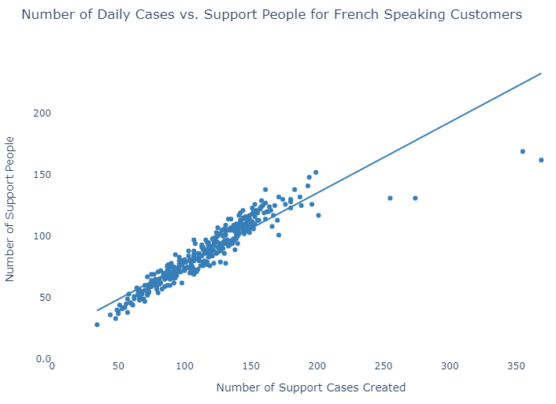
Why?
As bookings increase, so do support cases.
…and more people are needed to support these customers.

Slide 4
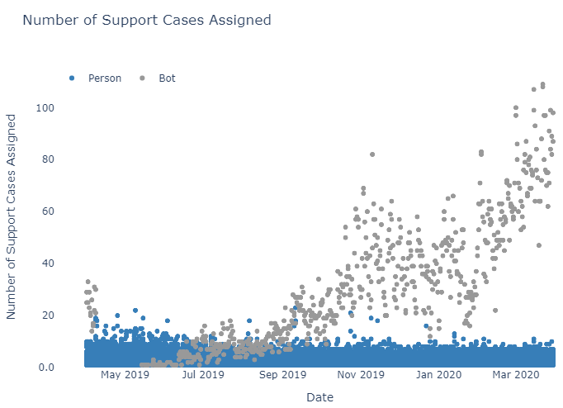
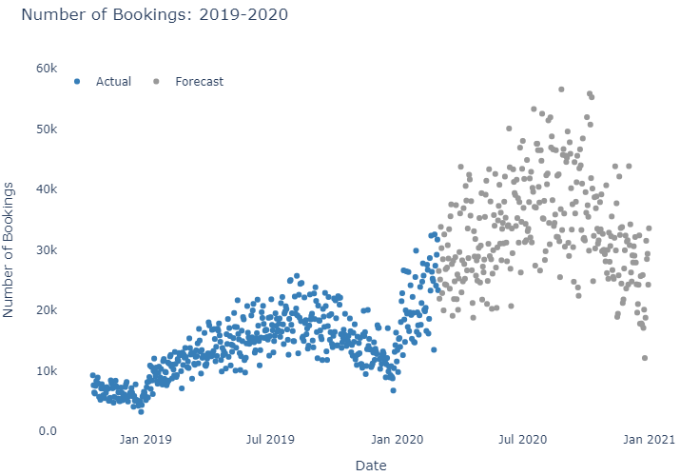
Findings
We are doing well, i.e. manageable number of cases per person, with help from the AI.
But we will require more human power for to meet the forecasted need in 2020.

Slide 5
Appendix
Assumptions
Support cases with a “solved_date” not in 2019 or 2020 were “unsolved”
Support cases assigned to “assignee_id” 0 or 1 were “unassigned”.
Global bookings as an indicator for demand among French-speaking customers. Ideally, we would identify the relationship between bookings by French-speaking customers and support cases by this group.
There were special support people/bots which started handling an increasing number of cases in September 2019. I filtered these cases out of the linear regression model used to understand the rate of support people per booking.
New support cases will be simple enough for the bot to solve.
Tools Used
Excel
Python
pandas
numpy
statsmodels
sklearn
plot.ly
PowerPoint

