Slide 1

Progress Report
Ravi Shankar Prasad – M11202816
Tobias Erik Rosengren – E11302004

Slide 2
Recap
Problem Statement
V2X communications require ultra-low latency, high reliability and high data rates
Traditional ”one-size-fits-all” networks struggle to meet diverse QoS demands
Solution
Network slicing enables dedicated logical networks for different services

Slide 3
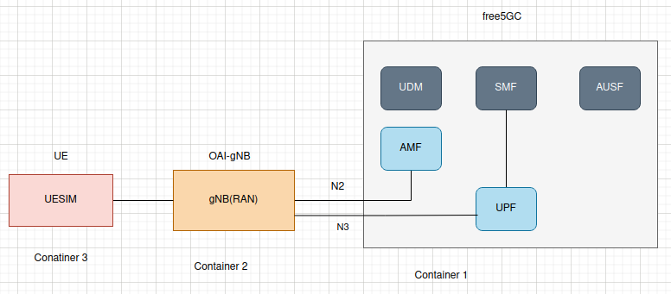
Recap: Simulation Architecture
Client instances(UE/Vehicles)
Base Station gNB
Slice Management

Slide 4
Change from original plan
free5GC
open5GS

Slide 5
Accomplished so far
Built open5GS from source
Successfully connected to core
Started on documentation
Built webUI, set up subscribers

Slide 6
Next steps
Build UESIM for iperf
Benchmarking
Analysis
Simulate traffic
Throughput
Latency
Network Slicing
QoS policies
V2X vs eMBB vs mMTC

Slide 7
Issues
No major issues so far
Minor issues with configuration step
Potential issues with integrating iperf and UESIM

Slide 8
Thank you
References:
https://github.com/ontherays/5G_network_Slice_iiotntust

