Slide 1
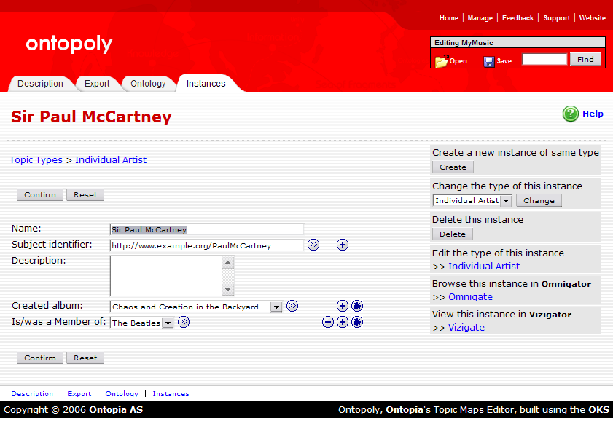
Application
Navigation
Editing
Box
Tabbed
Navigation
Topic
Title
Breadcrumbs
Action
Items
Panel
Edit
Actions
Topic
Fields
Edit
Actions
Tabbed
Navigation

