Slide 1
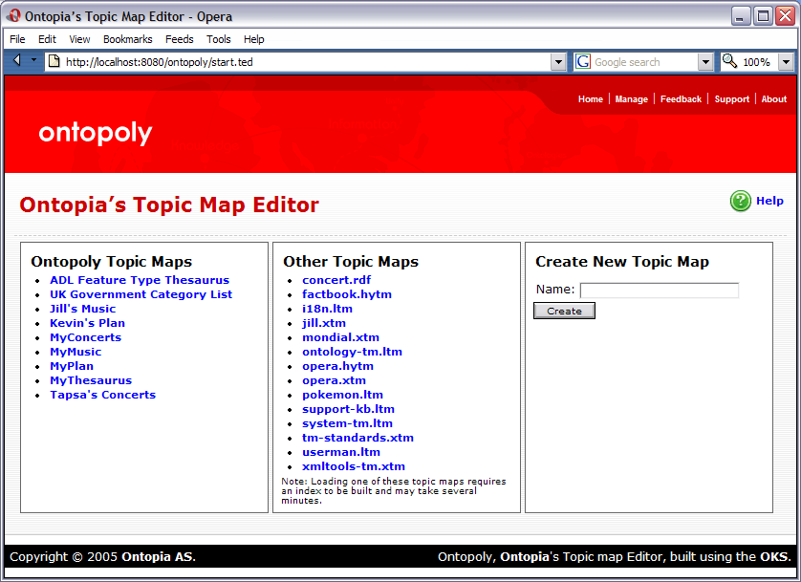
Topic Map
Index Page
Open…
Import
Create
Open
Application
Pages
Instances
Topic Type
Index Page
Import
Page
Ontology
Type
Index Pages
Instance
Index Pages
Description
Export
Type Configuration
Pages
Instance Editing
Pages
Description Page
Delete / Validate
Export Page
LTM / XTM / RDF
Tabbed Navigation

