Slide 1
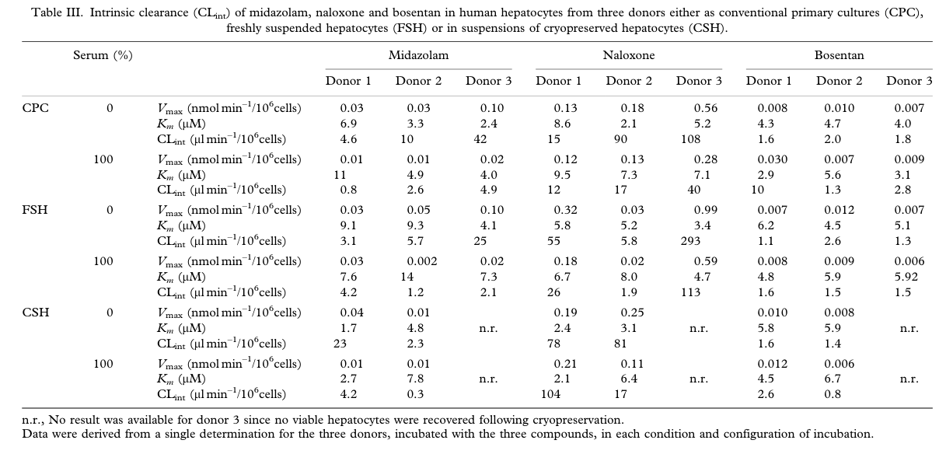
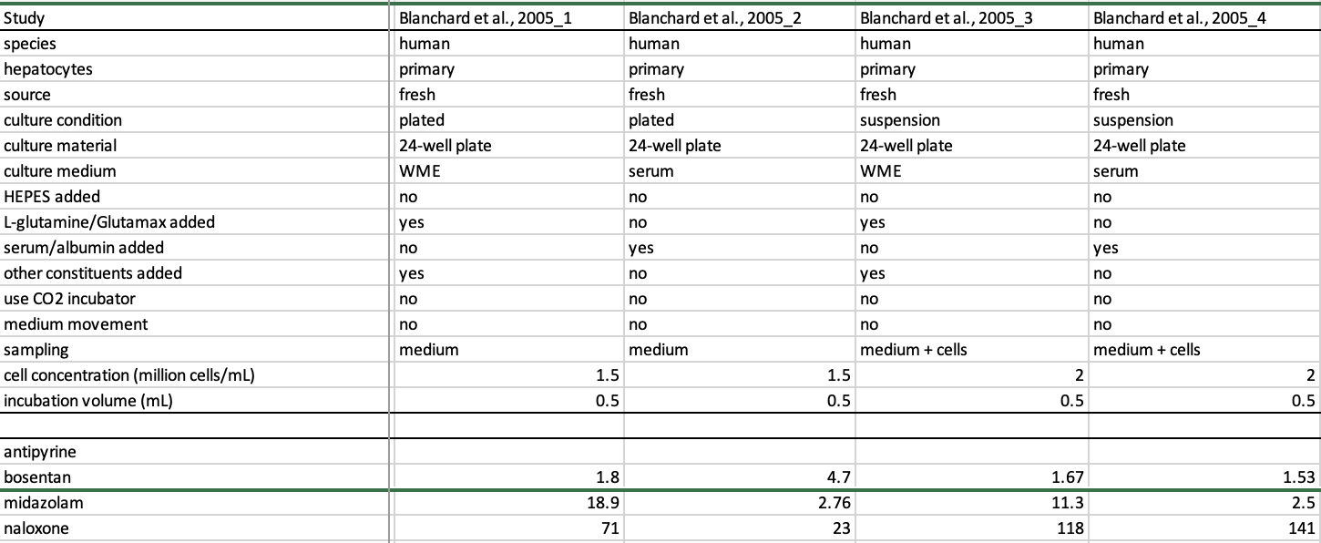
Blanchard et al. 2005
Averaging?

Slide 2
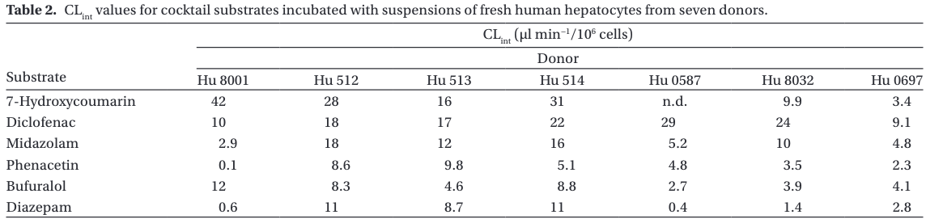
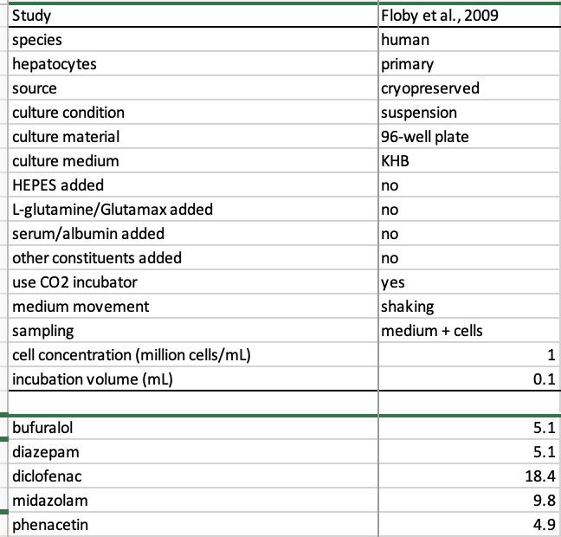
Floby et al., 2009
Averaging?
6.3?

Slide 3
In general
Average CLint when multiple hepatocytes donors?
Could you run multiple PBPK models (with variety of donor input parameters)? ~bayesian approach
CLint only in vitro (here)
Multiple tables/Figures with CLint values, need for careful matching of method / table caption and value
In vivo is usable directly in PBPK modeling, invitro needs qIVIVE (so also extraction of experimental parameters to feed into qIVIVE)

