Slide 1






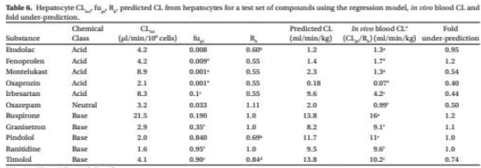
Approach 1
(focus on table extraction)
in the loop
in the loop
Data split
Fine tune
Annotate tables, e.g.:
- triplets: {parameter value(number), row name, column name}
- metadata from table title
=> Table structure recognition
Collect relevant literature
- Segment by page
- Extract tables (annotate bounding boxes)
=> Table detection
pdf
jpg + json
jpg + json
Validate
Notes:
Pending questions: what format when multiple level row/column name => {value, rowLevel1:rowLevel2, column}
Different colors HF model = one table detection model, one table structure model.
We’d need to start from 0 on the last step, so that we don’t get a model that has already seen some of the data.

Slide 2
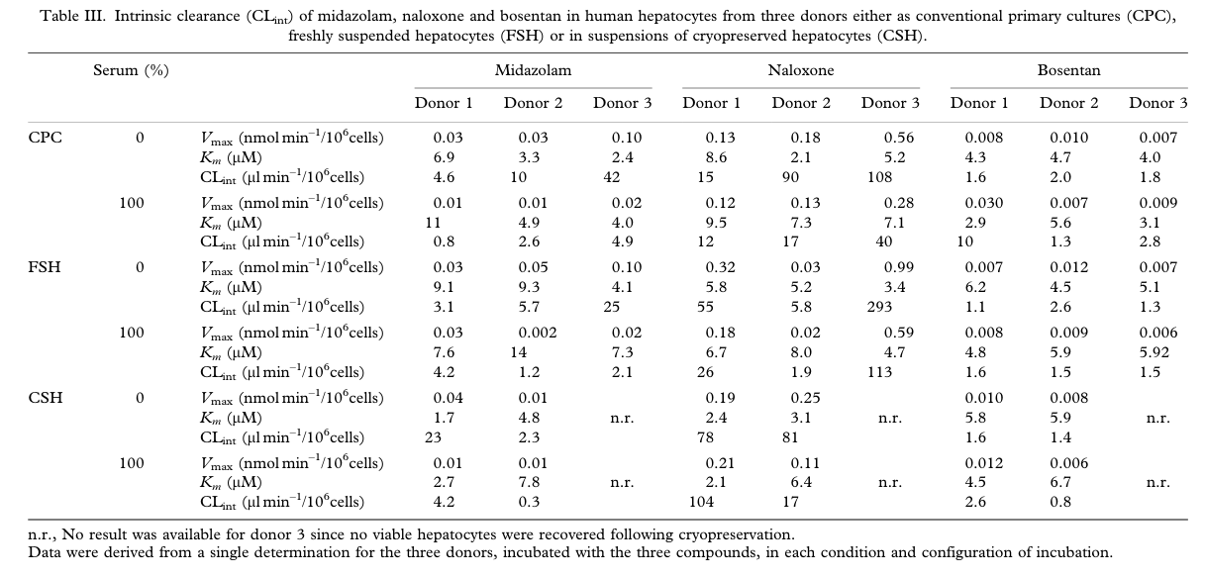
Example output approach 1
{CLint: 4.6,
chemical: midazolam,
species: human,
donor:1,
culture:CPC,
serum_pct:0,
… }

Slide 3



Approach 2 (focus on parameters metadata)
Extract relevant concepts from methods
Return parameters + metadata
Match
text
json
json
Collect relevant literature
Extract text, tables and figures in json format with LlamaParse
Extract relevant concepts from table captions
text
pdf
pdf+ json
Notes:
Pending questions: what format when multiple level row/column name => {value, rowLevel1:rowLevel2, column}
Different colors HF model = one table detection model, one table structure model.
We’d need to start from 0 on the last step, so that we don’t get a model that has already seen some of the data.

Slide 4
Example output approach 2
{CLint: 18.9,
chemical: midazolam,
species: human, hepatocytes:primary,
culture condition:plated,
cell conc_million_mL: 0.1,
… }

Slide 5
Why is such an approach valuable?
Parameters extraction relies on human intervention and parsing:
Assumptions are not* made explicit (ex: calculating averages over donors)
Eventual processing is not* made explicit
Decisions to include/exclude are not* made explicit
Prone to error
*always

