Slide 1
Water And Electricity Tracking App
PIP2001 Capstone Project
Review-4
Batch Number:09
Under the Supervision of,
Ms. Meena Kumari
School of Computer Science and Engineering
Presidency University
Roll Number | Student Name
20211cdv0010 | Deekshitha O
20211cdv0052 | Pavithra P S
20211cdv0063 | Bathini Vasanthe
Name of the Program: CSE(devops)
Name of the HoD: Dr. Pravintha Raja
Name of the Program Project Coordinator:
Name of the School Project Coordinators: Dr. Sampath A K / Dr. Abdul Khadar A / Mr. Md Ziaur Rahman

Slide 2
Introduction
Managing water and electricity efficiently is important for saving money and protecting the environment. Many people struggle to track their daily usage, leading to high bills and unnecessary waste. The Water and Electricity Tracking App helps users monitor their consumption in real time, making it easier to control usage and reduce costs. With simple dashboards and alerts, users can see how much water and electricity they use and get notified about unusual spikes.
The aim of this project is to create a user-friendly and practical tool that encourages people to use resources responsibly, save money on utility bills, and contribute to environmental sustainability. This report explains the need for such an app, the existing solutions, the proposed methodology, system design, implementation, and the expected outcomes of the project.

Slide 3
Literature Review
Title | Year | Drawbacks | Methodology
EnergyHub: Smart Home Energy Management | 2020 | IoT-based smart home energy monitor with integration of mobile apps for real-time data tracking and alerts. | High cost of installation for consumers. Accuracy of data can vary depending on device compatibility.
WaterSmart: Water Conservation through Real-Time Data | 2021 | Smart water meters and cloud integration to track real-time water usage, providing alerts and tips. | Limited to users with compatible water meters; Privacy concerns about data storage and sharing
Sense: Real-Time Home Energy Monitoring | 2022 | Energy monitoring platform that uses machine learning algorithms to track energy consumption by appliance. | Requires installation of dedicated hardware; limited to electricity consumption, no water tracking.

Slide 4
Existing method Drawback
Limited Real-Time Data Access
Manual Data Entry and Errors
Lack of Integration with Smart Technology
High Implementation Costs
Dependence on Stable Internet Connectivity
Limited Customization and Alerts

Slide 5
Proposed Method
Real-Time Monitoring with IoT Integration
Smart Notifications and Alerts
Bill Estimation and Budgeting Tools
Renewable Energy Integration
Cloud-Based Data Storage and Security
Smart Home and IoT Device Compatibility

Slide 6
Objectives
Real-Time Monitoring of Water and Electricity Consumption
Reduce Wastage and Improve Efficiency
Enable Cost Savings Through Smart Insights
Enhance User Engagement and Awareness
Integrate with Smart Home and IoT Devices
Support Households, Businesses, and Communities

Slide 7
Methodology/Modules
System Design and Architecture
Cloud-Based Data Storage and Processing
Smart Notifications and Automation Model
User Feedback and Evaluation
IoT-Based Real-Time Monitoring Model

Slide 8
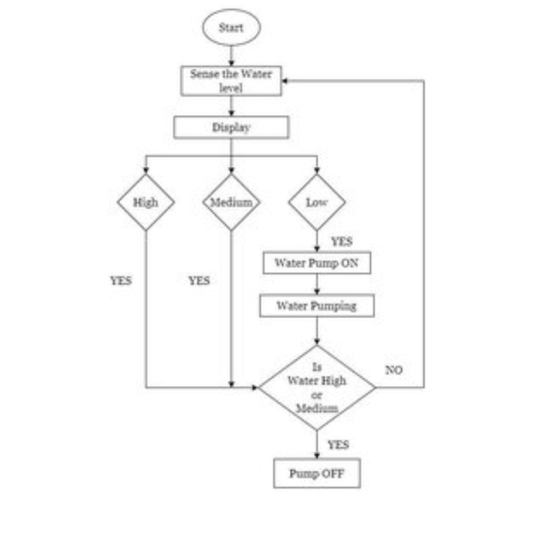
Architecture

Slide 9
Hardware/software components
Software and Hardware Requirements:
Software:
Development: SQL (Backend) ,HTML,CSS,JAVASCRIPT(Frontend)
Cloud: AWS / Google Cloud
Hardware:
Development Workstations:
CPU: Multi-core (Intel i5/i7 or AMD Ryzen)
RAM: 8GB (16GB recommended)
Storage: SSD (256GB or more

Slide 10
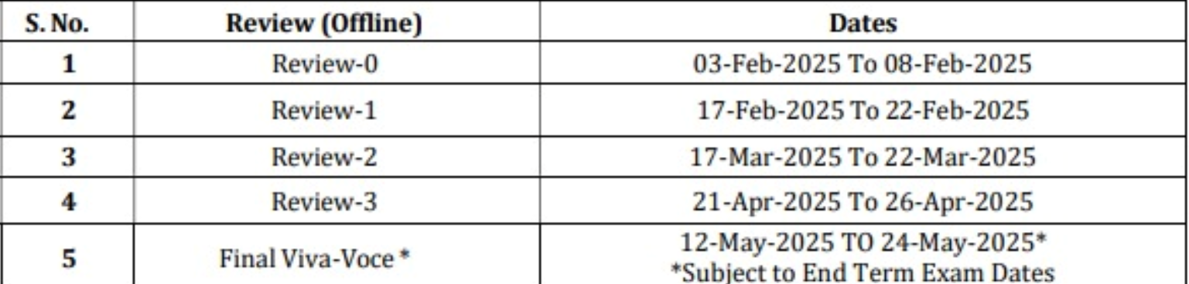
Timeline of Project

Slide 11
Expected Outcomes
Real-Time Resource Monitoring
Reduction in Wastage and Cost Savings
Improved Sustainability and Conservation
Smart Notifications and Automation
Accurate Bill Predictions and Budgeting

Slide 12
Conclusion
The Water and Electricity Tracking App is a smart solution designed to help users monitor, manage, and reduce their resource consumption. By using IoT sensors, AI analytics, and cloud storage, the app provides real-time data, helping users track their water and electricity usage more efficiently.
With features like automated alerts, bill predictions, and smart home integration, the app helps prevent waste, lower costs, and promote sustainable living. Businesses and governments can also use the data for better planning and resource management.
Overall, this app makes it easier for users to save money, conserve resources, and adopt eco-friendly habits. It is a simple, secure, and scalable tool for efficient energy and water management.

Slide 13
Github Link
The Github link provided should have public access permission.
Github Link
https://github.com/ontri/Water-and-Electricity-Tracking-App.git

Slide 14
References
[1] EnergyHub, "Smart Home Energy Management," EnergyHub Official Website, 2020. [Online]. Available: https://www.energyhub.com
[2] WaterSmart Software, "Water Conservation and Customer Engagement Platform," WaterSmart Solutions, 2021. [Online]. Available: https://www.watersmart.com
[3] Sense Labs, "Sense: Intelligent Energy Monitoring," Sense Energy Monitor, 2022. [Online]. Available: https://sense.com

Slide 15

Project work mapping with SDG

Slide 16
Thank You

