Slide 1
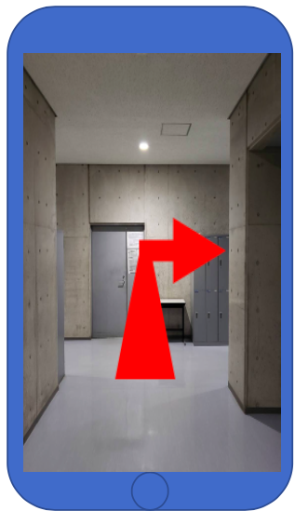
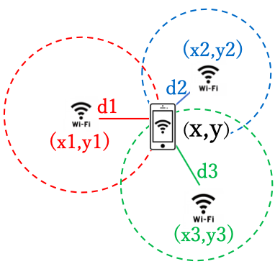
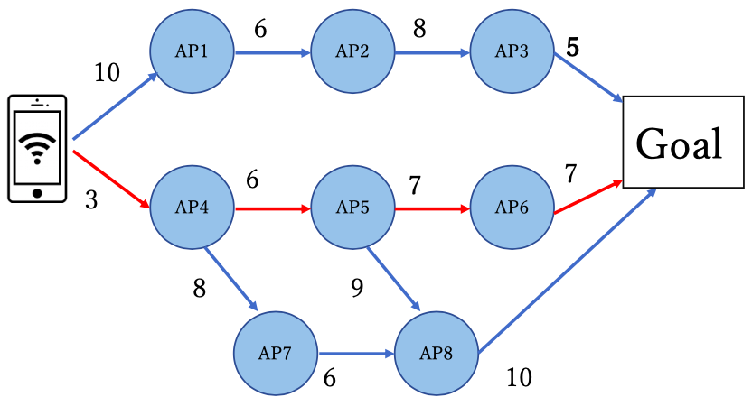
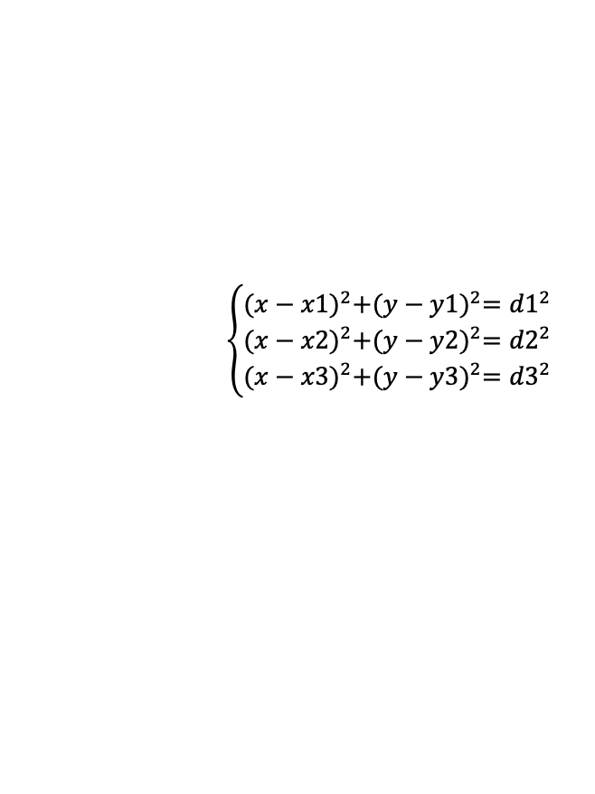
Augmented Reality Approach to Wi-Fi based Indoor Navigation Systems s1260027 Shunsuke Onuki, Supervisor: Kohei Otsuyama
1. Summary of the Research
(Motivation/background and Goal)
2.3 Visual navigation support
Augmented Reality (AR) is the augmentation of the real world by superimposing virtual visual information on the real landscape. The system we took over had a problem with the nature of location information.
a virtual route is shown on the screen using AR (Figure 3). The user can follow that route to the destination.
In this research, we solve this problem by utilizing WiFi-based positioning methods. Calculate the distance between the Access Point (AP) and the terminal from the Received Signal Strength Indicator (RSSI) from the APs, and locate the terminal by Trilateration method.
Figure 3. AR navigation
3. Current Results and Status
2. Approach/Methodology
we are currently developing a method to determine the position based on the distance between the terminal and the APs, and a program to derive the shortest path using the node data of the APs in the Research quadrangle. In the future, we plan to develop and evaluate a program to measure the position of the terminal, and finally show the shortest route on the screen using AR.
2.1 Determining the position
The Trilateration method is used to derive the position of the terminal. The distance between the AP and the terminal is calculated from the RSSI, and a point that is the location of the terminal is derived by solving the simultaneous equations of circles [1] (Figure 1).
4. Remaining Tasks and Tentative Schedule
$$\left\{\begin{aligned}{(x−x1)}^{2}+{(y−y1)}^{2}={d1}^{2} \\ {(x−x2)}^{2}+{(y−y2)}^{2}={d2}^{2} \\ {(x−x3)}^{2}+{(y−y3)}^{2}={d3}^{2}\end{aligned}\right.$$
 | Sep. | Oct. | Nov. | Dec. | Jan. | Feb.
Thesis investigation
Design App
Coding
Test
Data analysis
Write thesis
presentation
Figure 1. Trilateration distance calculation
2.2 Path planning
Dijkstra's method is used for the algorithm. This is a special form of dynamic programming, a breadth-first search algorithm for finding the shortest path from one source vertex to all other vertices [2] (Figure 2).
References
[1] Milad Ghantous,Houssam Shami and Rana Taha, “Augmented Reality Indoor Navigation Based on Wi-Fi Trilateretion”. In IEEE. July 2018.
[2] Kittipong Kasantikul, Chundi Xiu, Dongkai Yang and Meng Yang. “An enhanced technique for indoor navigation system based on WIFI-RSSI”. In IEEE. July 2015.
Figure 2. Dijkstra’s method diagram

