Slide 1
Image Classificaton
종합설계 최종 발표
양승규, 이동건
Notes:
Hello, we’re Yang Seung-gyu and Lee Dong-gun, who chose image classification as the subject of this comprehensive design.

Slide 2
>>
Contents
Part 1
1
Plan
2
Basic Topic
3
Experiment
4
Conclusion
Notes:
And these are the contents of our presentation. We are going to start with the plan of our team, and we introduce about the process of experiment by 4 basic topics. Finally, we’re going to wrap up the presentation with the last, final code and results.

Slide 3
>>
Plan
Part 1
Choose topic,
Basic learning
Choose final model, Experiment
Final workout
23.04-23.05
23.06
23.03-22.4
23.05-23.06
23.06
Improve basic code
Final presentation
Notes:
This is the plan of our team and now we’re in here.

Slide 4
>>
Basic Topic
Part 2
CNN network
Deeper convolutional layer
Batch norm
ResNet
Loss function
Cross entropy
Mixup training
Label smoothing
1
2
Optimizer
SGD
ADAM
3
4
Hyperparameter
Epoch
Batch size
Learning rate
Notes:
We focused on these four basic topics and proceeded with the development.
In the case of network, it is the central part of the code, which has the tendency of accuracy with the deeper and wider the layers. So we start experiment with the deeper layer by using basic code, and finally we use ResNet Network.
For loss function and optimizer, they act as tools to help with image classification accuracy. We tried to use various loss functions and optimizers, finally we use mixup training and label smoothing as loss function and SGD as optimizer.
Finally, we increase epoch to get better accuracy of CNN network.
So, we start with the code of CNN network and hyperparameter, and we explore loss function and optimizer.

Slide 5
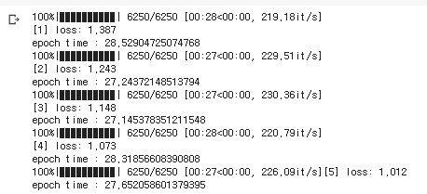
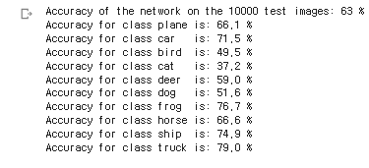
>>
Experiment-Basic Model
Part 3
Structure
Result
Improvement
Deeper Convolutional layer
Hyper parameter
Loss function
Opitimizer
Notes:
Now we introduce about the detail of experiments of our team.
This is the basic model that the class give to us. And you can see that the result is not good to use.
So we should improve the accuracy by develop the code.

Slide 6
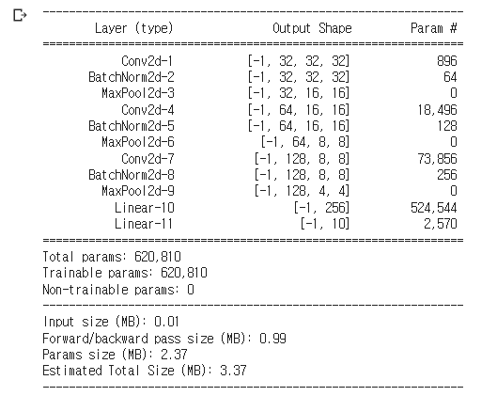
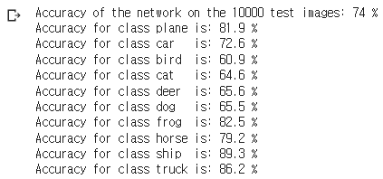

>>
Experiment-Deeper layer + Batch norm
Part 3
Structure
Result
Improvement
Limit of basic model
Use other CNN model
Notes:
Therefore, we implemented the network of the underlying model deeper and used the batch norm that can improve performance further in this process.
And we can see that the accuracy of model has improved up to 74%.
But also we knew that the limitation of basic model, we use various model and function of basic model to improve the accuracy, but we can’t get the better result than this model.
So, we use other CNN model to improve the accuracy

Slide 7
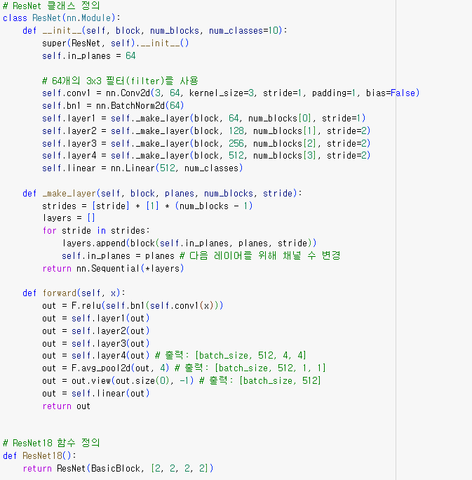
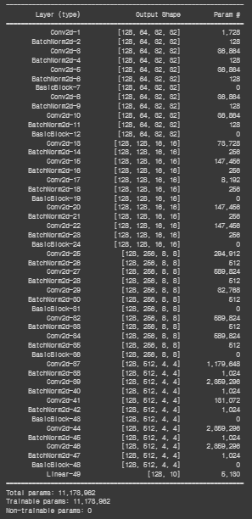
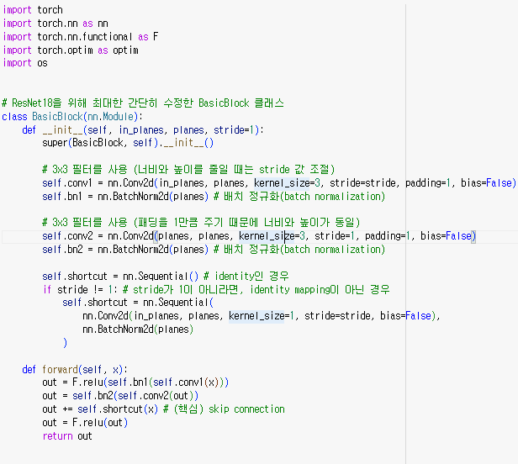


>>
Experiment-ResNet18
Part 3
Code
Code
Structure
Notes:
And this is the model that we use, ResNet-18

Slide 8
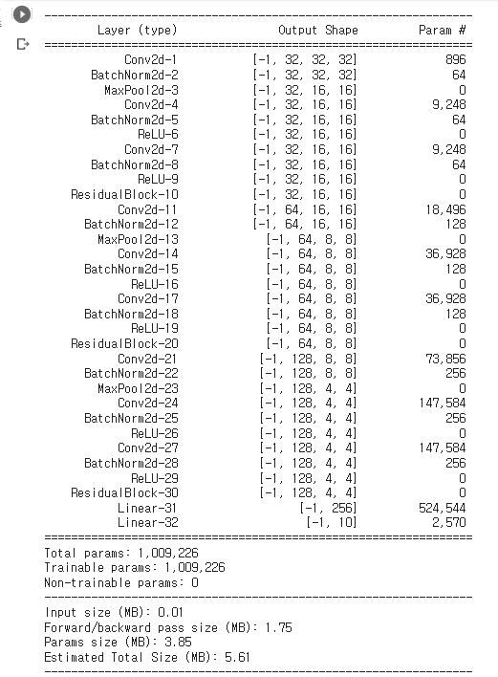
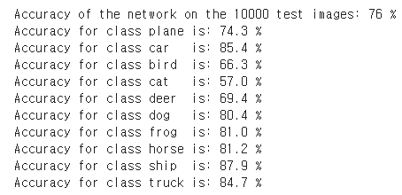
>>
Experiment-ResNet18
Part 3
Structure
Result
Improvement
Solving overfitting
Using Validloader
Doing Valid test
Notes:
And this is the result of ResNet that only change network model. It is pretty good result that only change the network.
So we decide to use this model, and we implement other function and technique to get better accuracy.

Slide 9
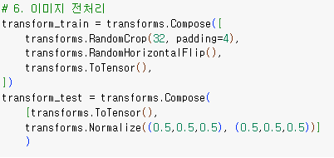
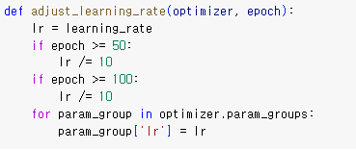
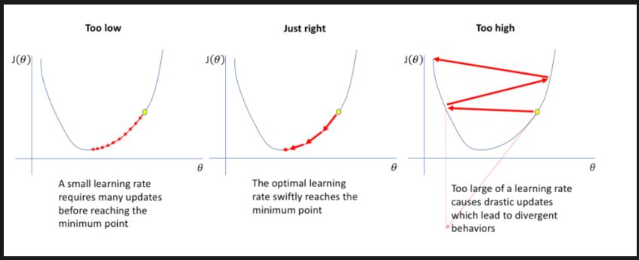
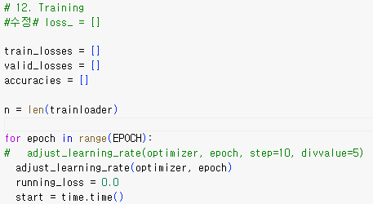
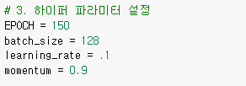
>>
ResNet-Overfitting
Part 3
Image augmentation
Lr-Scheduler
Hyperparameters
Notes:
After decide to use ResNet, we changed some hyperparameter and did several experiments.
We found that the accuracy of training decrease at some point. Through googling, we can know that this is the result of overfitting, so we revised and added two things to solve this problem.
First, we used Image Augmentation.
In the preprocessing part of the image, the train and test part were separated, and the 32x32 image padded in four layers was randomly cut through randomCrop, and the data was enhanced to proceed with the learning.
The second is the learning rate scheduler.
As shown on the right, the learning rate was initially increased and optimized quickly, and then the learning rate decreased as the optimal value approached.
Reflecting this, the first learning_rate was set to 0.1 which is large rate.

Slide 10
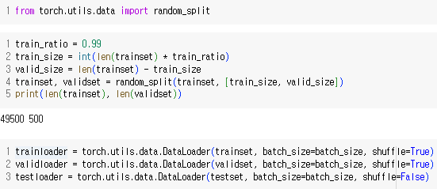
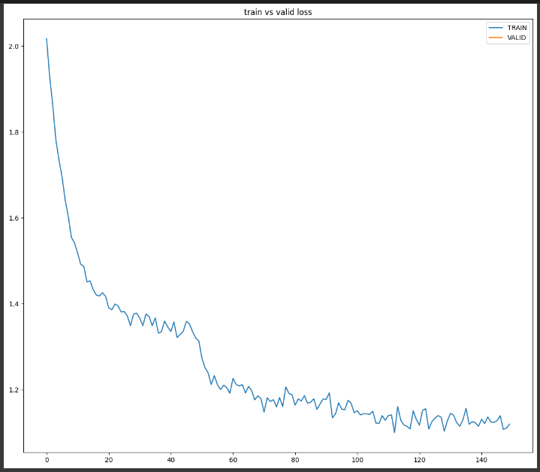
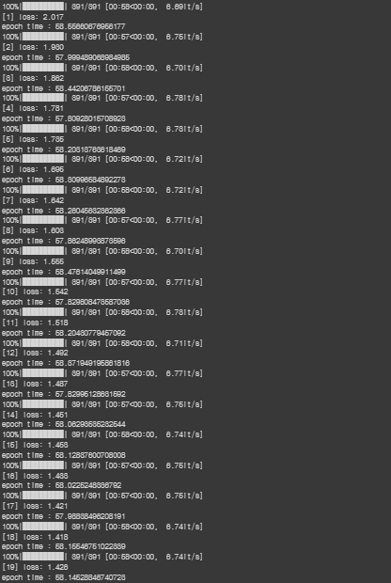
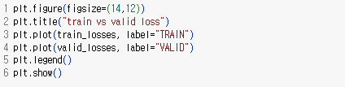
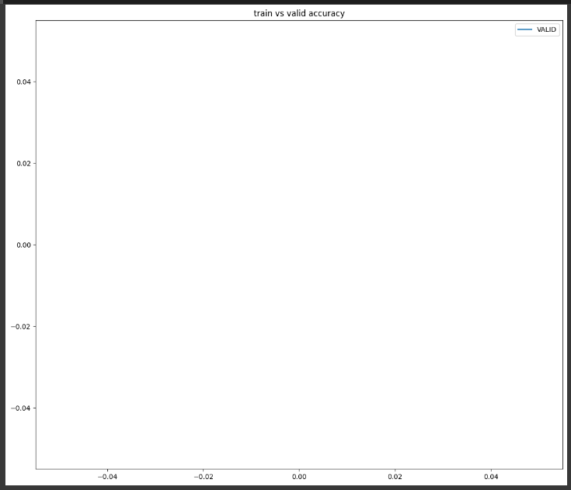

>>
ResNet-Validloader & Graph
Part 3
Structure
Result
Improvement
Notes:
Next is the Validloader.
In the basic code, we checked the accuracy of the test after completing all the training. But The larger the epoch, the longer the experiment time, and we can’t see the change of accuracy.
So we used the valid variable to see how the accuracy changes every time we run an epoch.
The valid variable was divided only 0.01 part of the trainset through random split, trained for each epoch, and then added the valid variable to check the accuracy and overfitting.
In other words, before the test of accuaracy, we added a mock test called valid to check what the result changes every time the epoch progresses.
The graph and results above are the results of not putting the Valid variable in the training process yet.

Slide 11
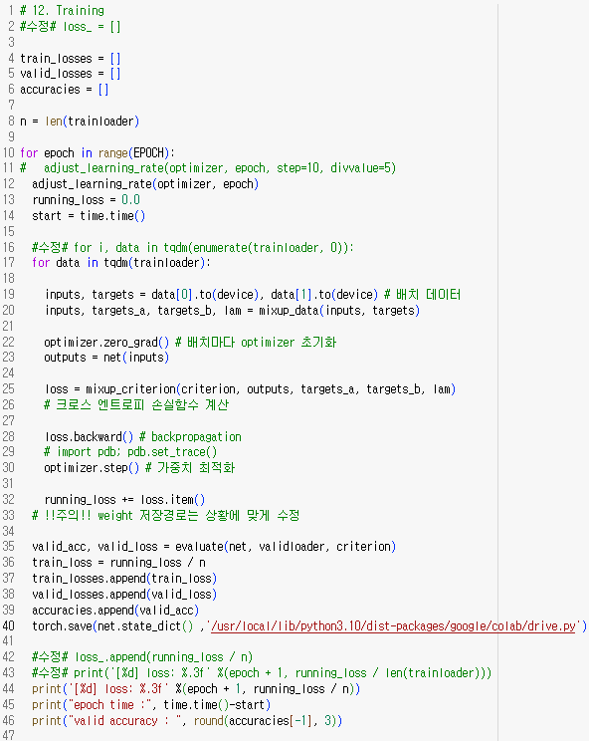
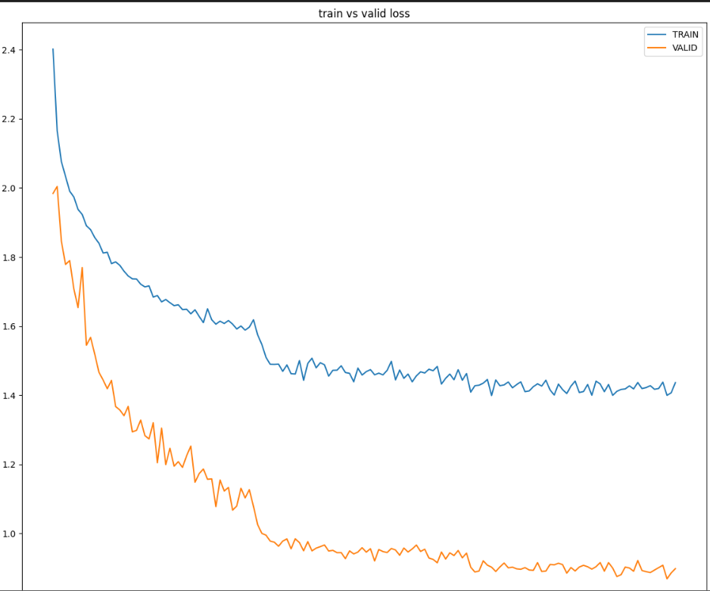
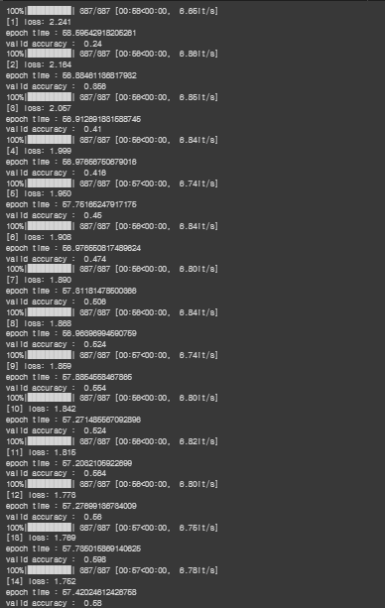
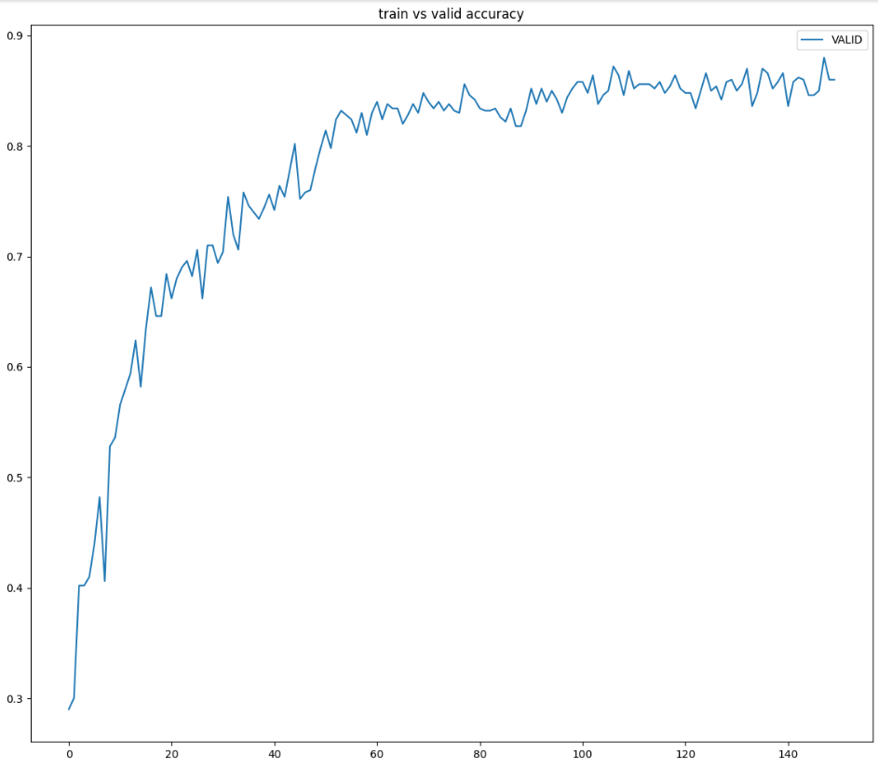
>>
ResNet-Valid Test & Training
Part 3
Structure
Result
Improvement
Notes:
The following is the result of substituting the valid variable into the training process.
The graph above shows the loss change of training and valid, and the graph below shows the accuracy of the valid as the epoch increases.
We can see the change of this page, unlike the previous page, the label 'valid accrual' has been added.
This allowed us to determine when overfitting occurs along with changes in loss and accuracy.

Slide 12
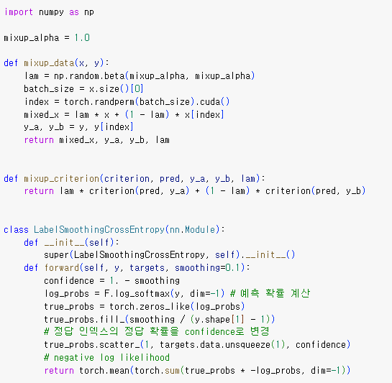
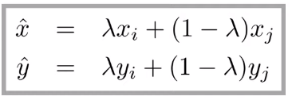
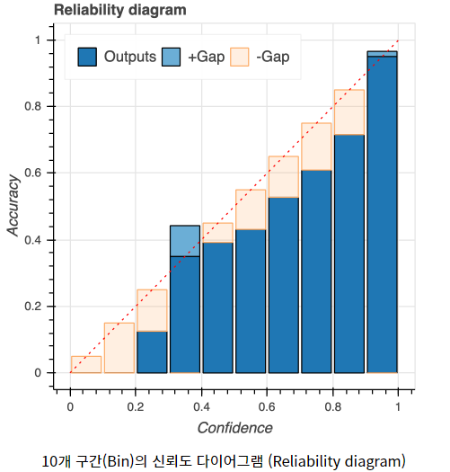
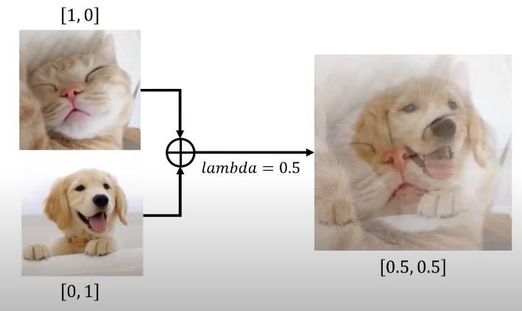
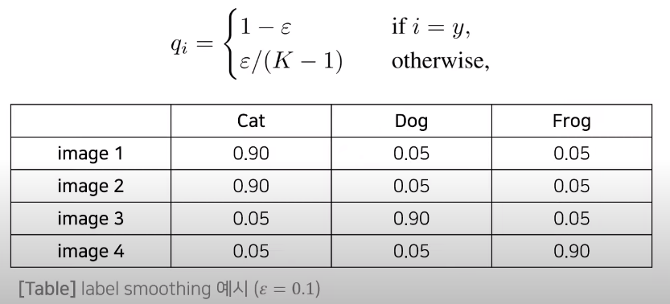

>>
Loss function
Part 3
Structure
Mixup Training
Label Smoothing
Notes:
After selecy the Network and hyper parameter, we search for Loss functions.
Loss functions were used by combining Mixup Training and label smoothing.
First, Mixup training means learning not only images but also labels to enhance data and then learn simple images in a random form every time.
This has the effect of performing some regularization to prevent learning from taking place with overconfidence in a given image.
And, Label smoothing means that the overall distribution is softened by giving a certain lower value to other labels not only the correct answer labels, as shown in the diagram on the right.
This has the effect of normalizing not to overconfident, which is similar with mixup.
To use these two loss functions, we implemented the following form of putting the result of label smoothing into the mixup function.

Slide 13
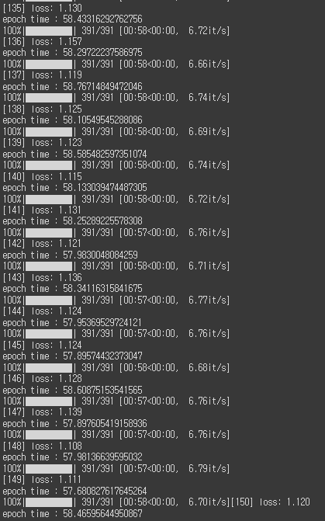
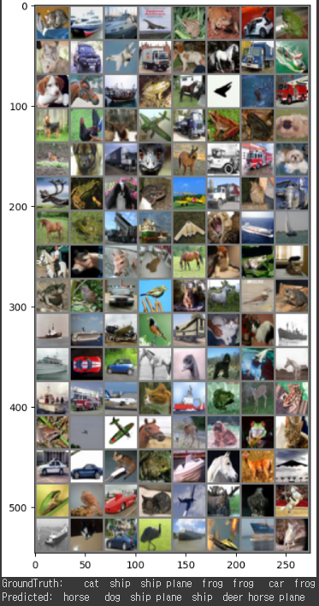
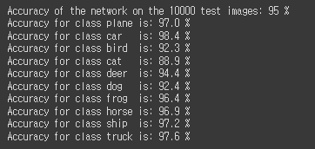
>>
Final Result-Accuracy
Part 3
Graph
Result
Result
<Resnet network & accuracy>
Notes:
The last one is the final accuracy.
The left is the result of putting the valid, setting the epoch to 150, and turning it around. The graph above shows that as the epoch value increases, the loss and accruality improve rapidly and then gradually change to a gentle one.
The result part located in the middle is the loss and accuracy that came out when the cifar-10 was turned after removing the valid for better results. The final accuracy is 95%, which is quite high.

Slide 14
>>
Conclusion
Part 4
ResNet-18
95%
Mixup Training
Lr-shedular

