Slide 1

SpotterAI
AI Personal Health & Fitness Coach
SE 216 — Software Project Management
2025–2026 Spring Semester
Instructor: Dr. Ibrahim ZİNCİR
Team Members
20240601048 Mehmet KAHRAMAN
20230601003 Onur Açar
20240601099 Kerem Güneş
20230601092 Salikh İbragimov
20220601058 Utku Sertkaya
20230601068 İsmail Yiğit Şendur
SPOTTERAI / SE 216 SOFTWARE PROJECT MANAGEMENT
01
Notes:
1

Slide 2
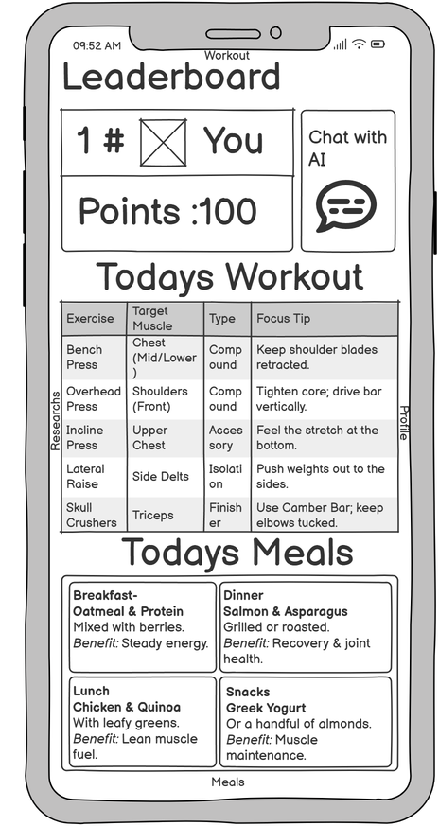
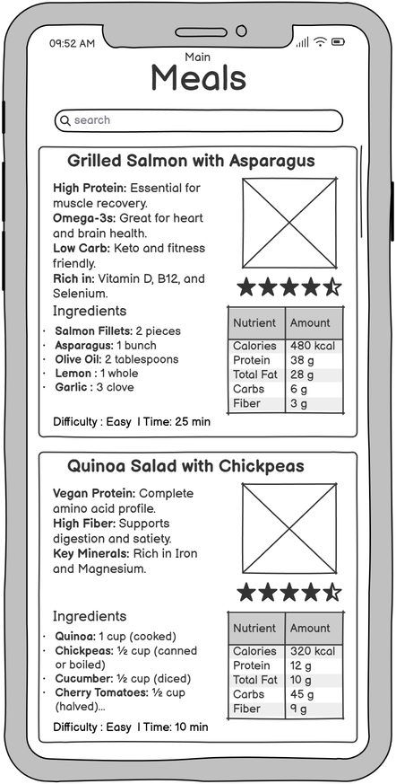
Project Overview
SpotterAI brings AI coaching, meal planning, workouts, and progress tracking into one app.
— Users often struggle to maintain consistent fitness and nutrition habits.
— Existing apps mostly give static plans and generic advice.
— SpotterAI adapts guidance through user profile data, feedback, and activity signals.
Core idea
Main value
A mobile AI coach that updates daily workout and meal guidance based on user behavior.
More personal than static fitness apps and more accessible than personal coaching.
Home dashboard
Meal planning
SPOTTERAI / SE 216 SOFTWARE PROJECT MANAGEMENT
02
Notes:
2

Slide 3


Objectives
What the project is expected to deliver according to the report.
Personalized workout plans
Personalized diet plans
Generate exercise guidancewith sets,
Create diet plans using dietary preferences,
repetitions, intensity, and proper form support through Hugging Face AI.
restrictions, nutritional targets, health goals, and physical characteristics.
Adaptive exercise intensity
Motivation and rewards
Adjust intensity using sleepdata, calorie
Useratings, comments,leaderboard
intake, and previous performance from smartwatch and phone sensors.
ranking, monthly badges, and supplement discounts for top users.
Goal: provide scientifically based recommendations, monitor user behavior, and support sustainable healthy lifestyles.
SPOTTERAI / SE 216 SOFTWARE PROJECT MANAGEMENT
03

Slide 4
Functional Requirements
Main features visible to the user.
Authentication
Daily AI plans
Users can create accounts, log in, log out, and manage their profile.
Home page shows AI-generated meal and exercise plans.
Detailed guidance
Feedback loop
Meals include calories, macros, and allergens; workouts include sets, reps, and intensity.
Ratings and comments are analyzed to improve future recommendations.
Leaderboard
Rewards
Users can filter rankings by region, metric, and time period.
Top users can receive badges or supplement discounts.
SPOTTERAI / SE 216 SOFTWARE PROJECT MANAGEMENT
04
Notes:
4

Slide 5
Non-Functional Requirements
Reliability, security, performance, and platform goals.
Availability
Security & Privacy
Platform support
Maintain 99% uptime availability for reliable use.
OAuth 2.0, Scrypt password hashing, AES-256 encryption, and KVKK compliance.
iOS 13+ and Android 8+ support.
Session safety
API communication
AI response time
User sessions expire after 15 minutes of inactivity.
System components communicate through RESTful APIs.
Feedback analysis should complete within 5 seconds.
Because SpotterAI handles health-related personal data, privacy and reliability are project-critical quality requirements.
SPOTTERAI / SE 216 SOFTWARE PROJECT MANAGEMENT
05
Notes:
5

Slide 6
Software Process Model: Scrum
A flexible model for an AI-based product.
— AI integration requires continuous testing and adaptation.
— Scrum supports incremental delivery through short sprint cycles.
— Sprint reviews help the team collect feedback before the final version.
— Retrospectives help improve team communication and task planning.
Sprint Planning
Sprint Execution
Retrospective
Review
Scrum lets us test assumptions early instead of discovering problems at the end.
SPOTTERAI / SE 216 SOFTWARE PROJECT MANAGEMENT
06
Notes:
6

Slide 7
Product Backlog & Sprint Plan
From infrastructure to intelligent user features.
Sprint 1 (8 days)
Sprint 2 (8 days)
Sprint 3 (15 days)
Sprint 4 (9 days)
Sprint 5 (9 days)
Database planning
User registration
Premium membership
In-app purchase
Profile management
Admin panel
AI infrastructure
Hugging Face API
Scientific summaries
AI fine-tuning
Meal/workout plans
Plan components
Home layouts
Push notifications
Apple Health & Google Fit
Challenge system
Leaderboard algorithm
The sprint plan moves from technical foundation to AI features and user motivation features.
SPOTTERAI / SE 216 SOFTWARE PROJECT MANAGEMENT
07
Notes:
7

Slide 8
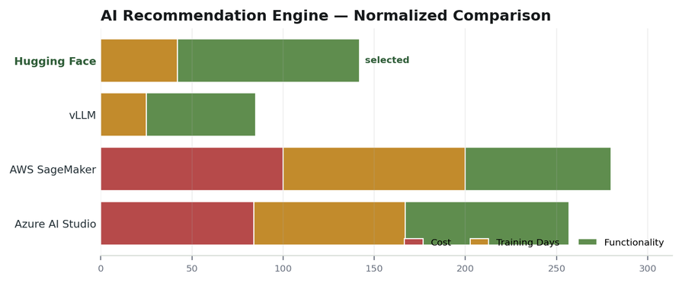
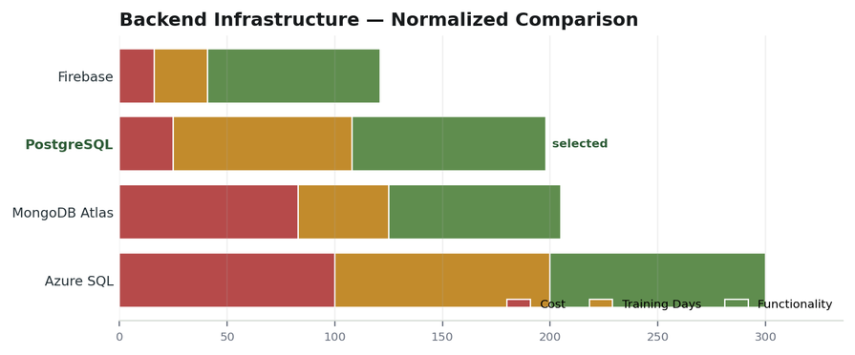
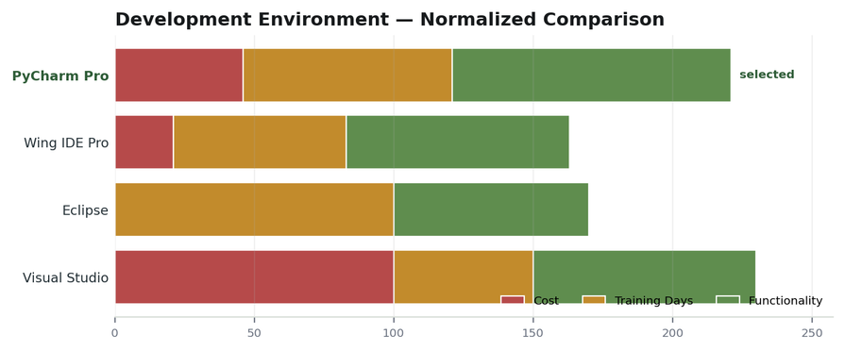
Software Tools
Selected tools and why they fit the project.
Hugging Face
PostgreSQL
PyCharm Professional
Selected for the AI recommendation engine because it supports pre-trained models, fine-tuning, and low initial cost.
Selected for structured health, meal, workout, and user data with reliability, indexing, and complex queries.
Selected for Python AI/backend development with debugging, testing, database tools, and framework integration.
SPOTTERAI / SE 216 SOFTWARE PROJECT MANAGEMENT
08
Notes:
8

Slide 9
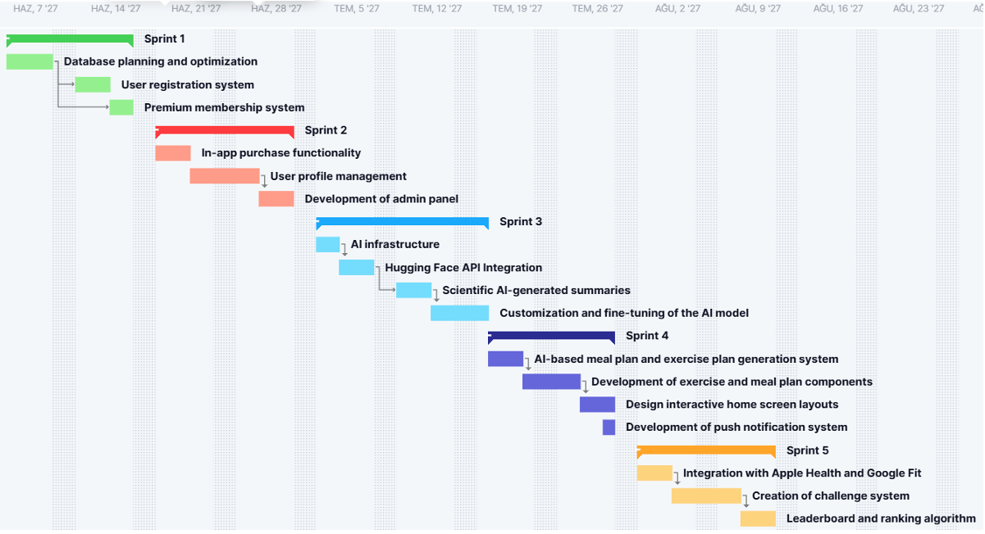
Schedule and Effort
The project is planned as a five-sprint schedule.
SPOTTERAI / SE 216 SOFTWARE PROJECT MANAGEMENT
09
Notes:
9

Slide 10
Stakeholders
Who is affected by project success or failure?
Users
Project Owner
Health & Fitness Experts
Service Providers
Receive personalized coaching and motivation.
Benefits from growth, profit, and recognition.
Support safer, more accurate guidance.
Provide AI APIs, hosting, and infrastructure.
Wearable Companies
Research Centers
Gyms & Nutrition Companies
Competitors
Connect health data with the app.
Provide scientific sources for recommendations.
Potential partners for offers and services.
May react by improving similar products.
SPOTTERAI / SE 216 SOFTWARE PROJECT MANAGEMENT
10
Notes:
10

Slide 11
Project Risks
Main risks that must be controlled.
No real behavior data
Low AI accuracy
Integration issues
Habit prediction is difficult before enough users generate real feedback.
Generated meal or workout plans may be ineffective or unsafe without validation.
AI, backend, database, and wearable data may not work smoothly together.
Compliance risk
Schedule delays
API costs
Improper health data handling may create KVKK/GDPR problems.
AI and backend tasks may take longer than expected.
AI token and service usage may exceed the planned budget.
Highest-priority risks are those with both high likelihood and high impact.
SPOTTERAI / SE 216 SOFTWARE PROJECT MANAGEMENT
11
Notes:
11

Slide 12
Measurements
How we track progress, quality, and product value.
Budget / Team Effort
AI Accuracy
Data Quality / Processing
Defect Density
Budget: actual cost vs. planned budget
Team Effort: story points completed
Correct and helpful AI meal/workout plans divided by total generations
Valid sensor data per MB
Successfully processed rows / collected rows
Accurate, error-free, usable rows divided by total collected rows
Measurements connect software project management with the actual usefulness of the product.
SPOTTERAI / SE 216 SOFTWARE PROJECT MANAGEMENT
12
Notes:
12

Slide 13
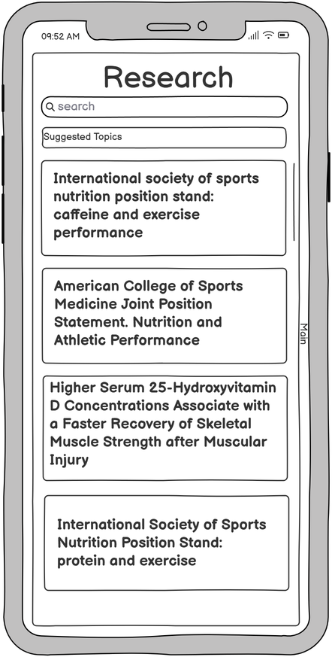
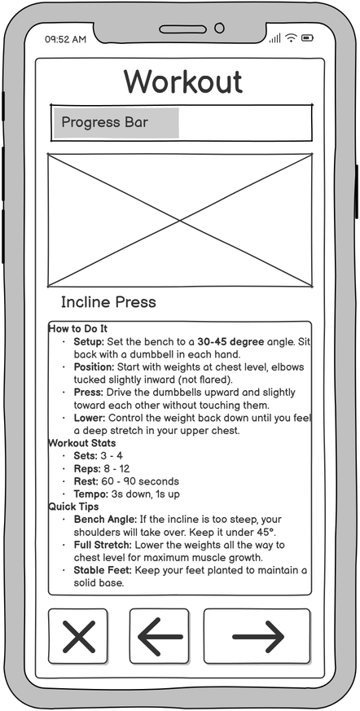
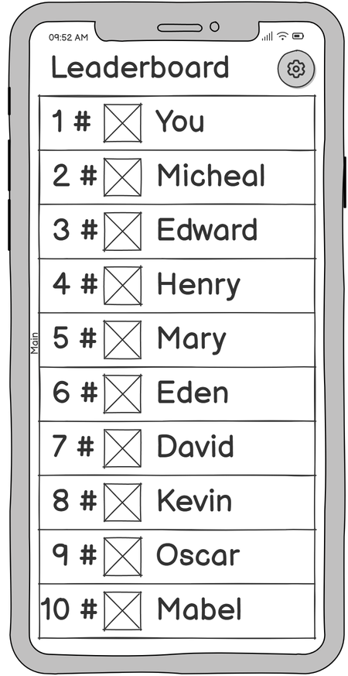
Graphical User Interfaces
Home screen
Meals
Research
Workout
Leaderboard
The screens are concentrated here so they support the app story without distracting every technical slide.
SPOTTERAI / SE 216 SOFTWARE PROJECT MANAGEMENT
13
Notes:
13

Slide 14
Conclusion
SpotterAI aims to make personal health coaching more accessible, adaptive, and motivating.
Questions?
SPOTTERAI / SE 216 SOFTWARE PROJECT MANAGEMENT
14
Notes:
14

