Slide 1
SpotterAI
AI Personal Health C Fitness Coach
SE 216 — Software Project Management
2025–2026 Spring Semester
Instructor: Dr. Ibrahim ZİNCİR
Team Members
20240601048 Mehmet KAHRAMAN
20230601003 Onur Açar
20240601099 Kerem Güneş
20230601092 Salikh İbragimov
20220601058 Utku Sertkaya
20230601068 İsmail Yiğit Şendur
01

Slide 2
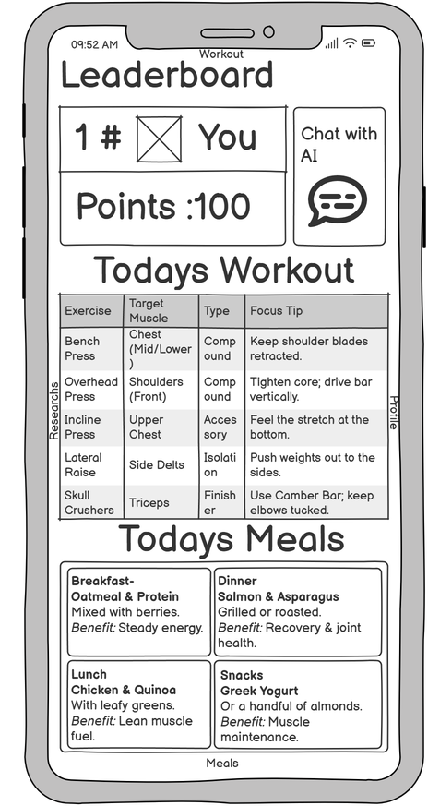
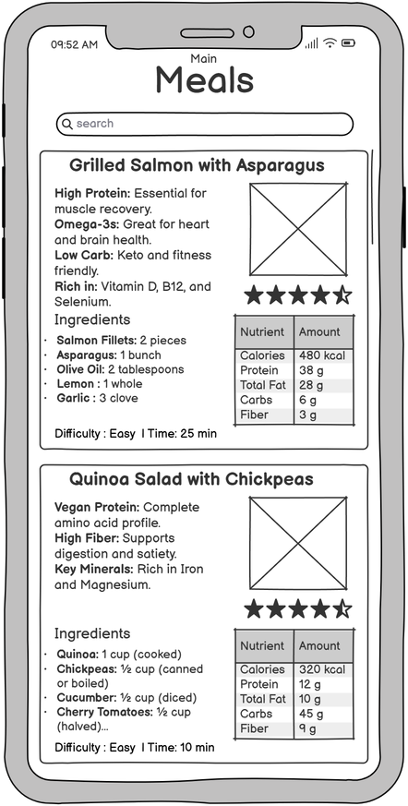
Project Overview
SpotterAI brings AI coaching, meal planning, workouts, and progress tracking into one app.
Users often struggle to maintain consistent fitness and nutrition habits.
Existing apps mostly give static plans and generic advice.
SpotterAI adapts guidance through user profile data, feedback, and activity signals.
Core idea
Main value
A mobile AI coach that updates daily
More personal than static fitness
workout and meal guidance based on user behavior.
apps and more accessible than personal coaching.
Home dashboard
Meal planning
02

Slide 3
Objectives
What the project is expected to deliver according to the report.
Personalized workout plans
Generate exercise guidancewith sets, repetitions, intensity, and proper form support through Hugging Face AI.
Personalized diet plans
Create diet plans using dietary preferences, restrictions, nutritional targets, health goals, and physical characteristics.
Adaptive exercise intensity
Adjust intensity using sleepdata, calorie intake, and previous performance from smartwatch and phone sensors.
Motivation and rewards
Useratings, comments,leaderboard ranking, monthly badges, and supplement discounts for top users.
Goal: provide scientifically based recommendations, monitor user behavior, and support sustainable healthy lifestyles.
03

Slide 4
Functional Requirements
Main features visible to the user.
Authentication
Users can create accounts, log in, log out, and manage their profile.
Daily AI plans
Home page shows AI-generated meal and exercise plans.
Detailed guidance
Meals include calories, macros, and allergens; workouts include sets, reps, and intensity.
Feedback loop
Ratings and comments are analyzed to improve future recommendations.
Leaderboard
Users can filter rankings by region, metric, and time period.
Rewards
Top users can receive badges or supplement discounts.
04

Slide 5
Non-Functional Requirements
Reliability, security, performance, and platform goals.
Availability
Security G Privacy
Platform support
Maintain 99% uptime availability for reliable use.
OAuth 2.0, Scrypt password hashing, AES-256 encryption, and KVKK compliance.
iOS 13+ and Android 8+ support.
Session safety
API communication
AI response time
User sessions expire after 15 minutes of inactivity.
System components communicate through RESTful APIs.
Feedback analysis should complete within 5 seconds.
Because SpotterAI handles health-related personal data, privacy and reliability are project-critical quality requirements.
05

Slide 6
Software Process Model: Scrum
A flexible model for an AI-based product.
— AI integration requires continuous testing and
adaptation.
— Scrum supports incremental delivery through short
Sprint Planning
Sprint Execution
sprint cycles.
Sprint reviews help the team collect feedback before the final version.
Retrospectives help improve team communication and task planning.
Retrospective
Review
Scrum lets us test assumptions early instead of discovering problems at the end.
06

Slide 7
Product Backlog G Sprint Plan
From infrastructure to intelligent user features.
Sprint 1 (8 days)
Sprint 2 (8 days)
Sprint 3 (15 days)
Sprint 4 (G days)
Sprint 5 (G days)
Database planning
In-app purchase
AI infrastructure
Meal/workout plans
Apple Health C Google Fit
User registration Premium membership
Profile management Admin panel
Hugging Face API Scientific summaries
Plan components Home layouts
Challenge system Leaderboard algorithm
AI fine-tuning
Push notifications
The sprint plan moves from technical foundation to AI features and user motivation features.
07

Slide 8
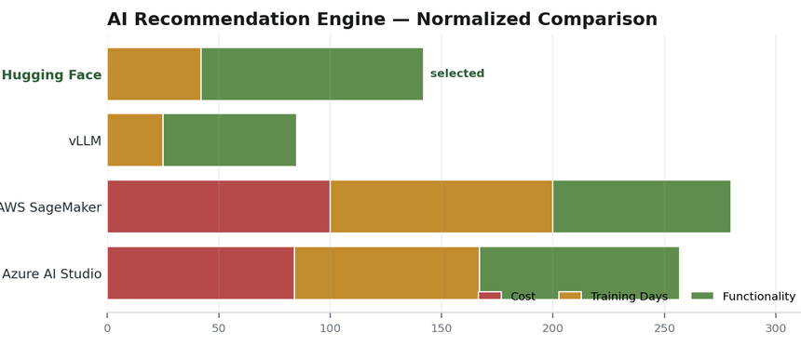
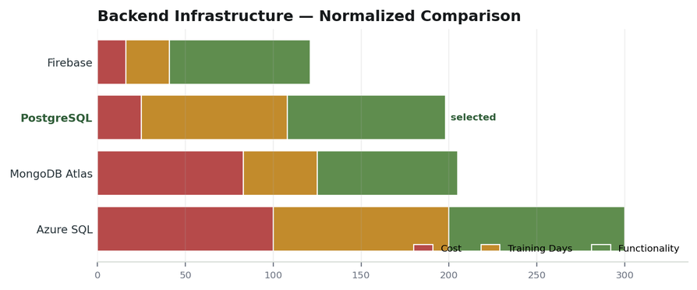
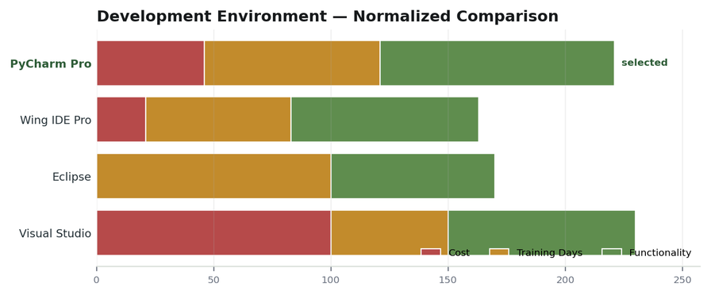
Software Tools
Selected tools and why they fit the project.
Hugging Face
PostgreSǪL
PyCharm Professional
Selected for the AI recommendation engine
Selected for structured health, meal, workout,
Selected for Python AI/backend development
because it supports pre-trained models, fine-tuning, and low initial cost.
and user data with reliability, indexing, and complex queries.
with debugging, testing, database tools, and framework integration.
08

Slide 9
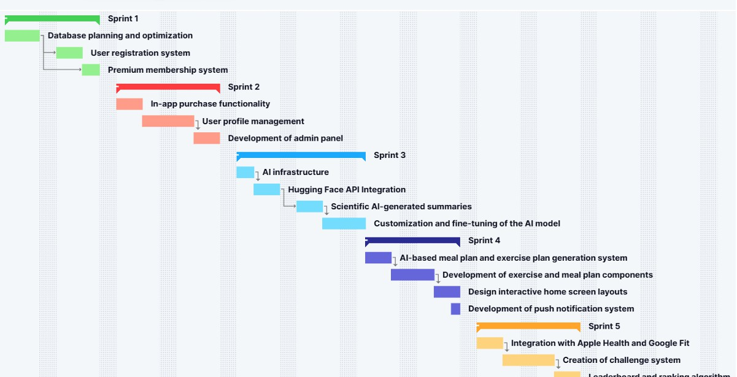
Schedule and Effort
The project is planned as a five-sprint schedule.
0G

Slide 10
Stakeholders
Who is affected by project success or failure?
Users
Project Owner
Health G Fitness Experts
Service Providers
Receive personalized coaching and
Benefits from growth, profit, and
Support safer, more accurate
Provide AI APIs, hosting, and
motivation.
recognition.
guidance.
infrastructure.
Wearable Companies
Research Centers
Gyms G Nutrition Companies
Competitors
May react by improving similar
Connect health data with the app.
Provide scientific sources for recommendations.
Potential partners for offers and services.
products.

Slide 11
Project Risks
Main risks that must be controlled.
No real behavior data
Low AI accuracy
Integration issues
Habit prediction is difficult before enough users generate real feedback.
Generated meal or workout plans may be ineffective or unsafe without validation.
AI, backend, database, and wearable data may not
work smoothly together.
Compliance risk
Schedule delays
API costs
Improper health data handling may create KVKK/GDPR problems.
AI and backend tasks may take longer than expected.
AI token and service usage may exceed the planned budget.
Highest-priority risks are those with both high likelihood and high impact.

Slide 12
Measurements
How we track progress, quality, and product value.
Budget / Team Effort
AI Accuracy
Data Ǫuality / Processing
Defect Density
Budget: actual cost vs. planned budget
Correct and helpful AI meal/workout plans divided by
Valid sensor data per MB Successfully processed rows /
Accurate, error-free, usable rows divided by total collected
Team Effort: story points completed
total generations
collected rows
rows
Measurements connect software project management with the actual usefulness of the product.

Slide 13
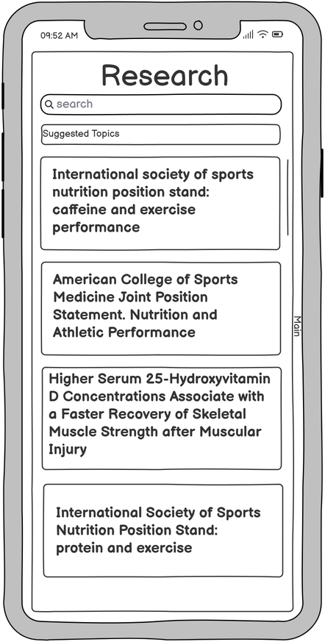
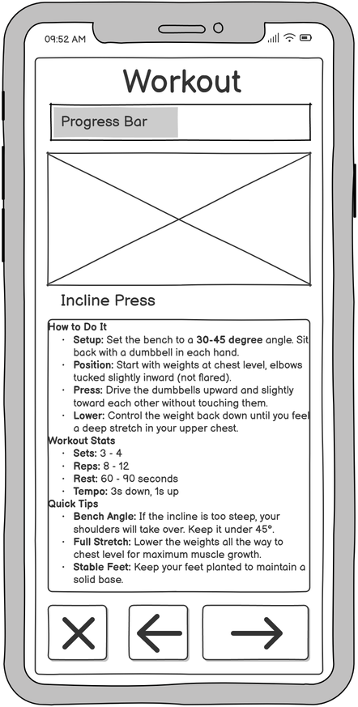
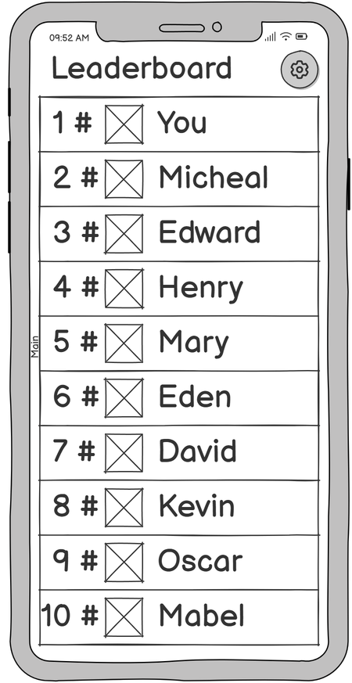
Graphical User Interfaces
Home screen
Meals
Research
Workout
Leaderboard
The screens are concentrated here so they support the app story without distracting every technical slide.

Slide 14
Conclusion
SpotterAI aims to make personal health coaching more accessible, adaptive, and motivating.
Ǫuestions?

