Slide 1
Music Genre Classification on FMA-small
Handcrafted features, mel-spectrogram CNNs, hybrid fusion, and audio-pretrained transfer learning Selected Topics in Music and Acoustic Engineering

Slide 2
Project Motivation
Goal: classify 30-second music tracks into 8 genre labels.
Why it matters:
automatic music tagging supports search, recommendation, cataloguing, and dataset organization;
genre is subjective and acoustically ambiguous, so the task tests both feature design and representation learning.
Main objective:
build a reproducible genre-classification pipeline;
compare handcrafted-feature baselines, from-scratch CNN models, hybrid late fusion, and audio-pretrained transfer learning.

Slide 3
Dataset and Task
Dataset: FMA-small, 8000 Creative Commons tracks.
Classes: Electronic, Experimental, Folk, Hip-Hop, Instrumental, International, Pop, Rock.
Track duration used in code: 29 seconds, avoiding edge artifacts near 30 seconds.
Balanced evaluation: 1000 tracks per class; held-out test set has 200 tracks per class.
Shared split across experiments:
64% train, 16% validation, 20% test;
stratified split, random seed 42.

Slide 4
Methodology Overview
Baseline method:
extract handcrafted timbre, harmony, rhythm, and combined features;
train Random Forest and MLP classifiers;
select models using validation F1-macro.
From-scratch deep pipeline:
convert audio to cached 128-bin mel spectrograms;
compare Plain CNN, regularized CNN, ResNet-style CNN, Multi-shape CNN;
add augmentation and segment-level aggregation.
Selected state-of-the-art method:
AudioSet-pretrained AST embeddings plus MLP classifier;
segment averaging over 10-second crops.

Slide 5
Baseline: Handcrafted Features
Feature extraction:
timbre: MFCC-related descriptors;
harmony: chroma-based descriptors;
rhythm: tempo/tempogram-related descriptors;
combined feature vector for the final baseline comparison.
Models:
Random Forest on each feature group;
MLP on the best handcrafted feature set.
Best handcrafted baseline:
MLP - Combined;
test accuracy 0.529, test F1-macro 0.522.

Slide 6
From-Scratch CNN Pipeline
Input: cached mel spectrograms, shape-normalized for CNN training.
Architecture search:
Plain CNN tests a simple local time-frequency learner;
regularization adds batch normalization, dropout, weight decay, and label smoothing;
ResNet-style CNN tests residual connections;
Multi-shape CNN uses filter shapes for local patterns, broad frequency bands, and longer temporal context.
Model selection criterion:
validation F1-macro selects the best epoch and model.

Slide 7
CNN Optimization Results
Stage | Selected model | Test F1
Handcrafted baseline | MLP - Combined | 0.522
Plain CNN regularized | Plain CNN - Regularisation | 0.567
Music-aware CNN | Multi-shape CNN | 0.589
Augmentation | Multi-shape CNN - Mixup | 0.584
Segment aggregation | Multi-shape CNN - Mixup - Segment Averaging | 0.641
Segment transformer | Multi-shape CNN - Mixup - Segment Transformer | 0.629

Slide 8
Largest gain in the custom pipeline comes from segment-level training and probability averaging.
The Transformer aggregator did not outperform simple averaging in this dataset.

Slide 9
Hybrid Late Fusion
Fusion inputs:
best CNN branch: Multi-shape CNN - Mixup - Segment Averaging;
best handcrafted branch: MLP - Combined.
Validation search over CNN/handcrafted probability weights.
Selected weight:
CNN weight = 1.0;
handcrafted weight = 0.0.
Interpretation:
handcrafted features were useful as a baseline;
once segment-level CNN predictions were available, late fusion did not add validation benefit.

Slide 10
State-of-the-Art Method: AST Transfer Learning
Selected method: Audio Spectrogram Transformer pretrained on AudioSet.
Why AST:
it is trained on large-scale audio data rather than only FMA-small;
Transformer attention models longer-range time-frequency relationships;
frozen embedding extraction is computationally lighter than full fine-tuning.
Implementation:
extract full-track and segment embeddings from 10-second audio crops;
train compact MLP classifiers;
average segment probabilities at track level.

Slide 11
Experimental Setup
Common protocol:
same stratified split for every experiment;
validation F1-macro used for model selection;
final numbers reported only on held-out test set.
Metrics:
accuracy for overall correctness;
F1-macro to treat all 8 genres equally;
confusion matrix and per-class recall for error analysis.
Reproducibility:
features and embeddings cached under features/;
outputs saved as metrics.csv, predictions.csv, reports, and plots under results/.

Slide 12
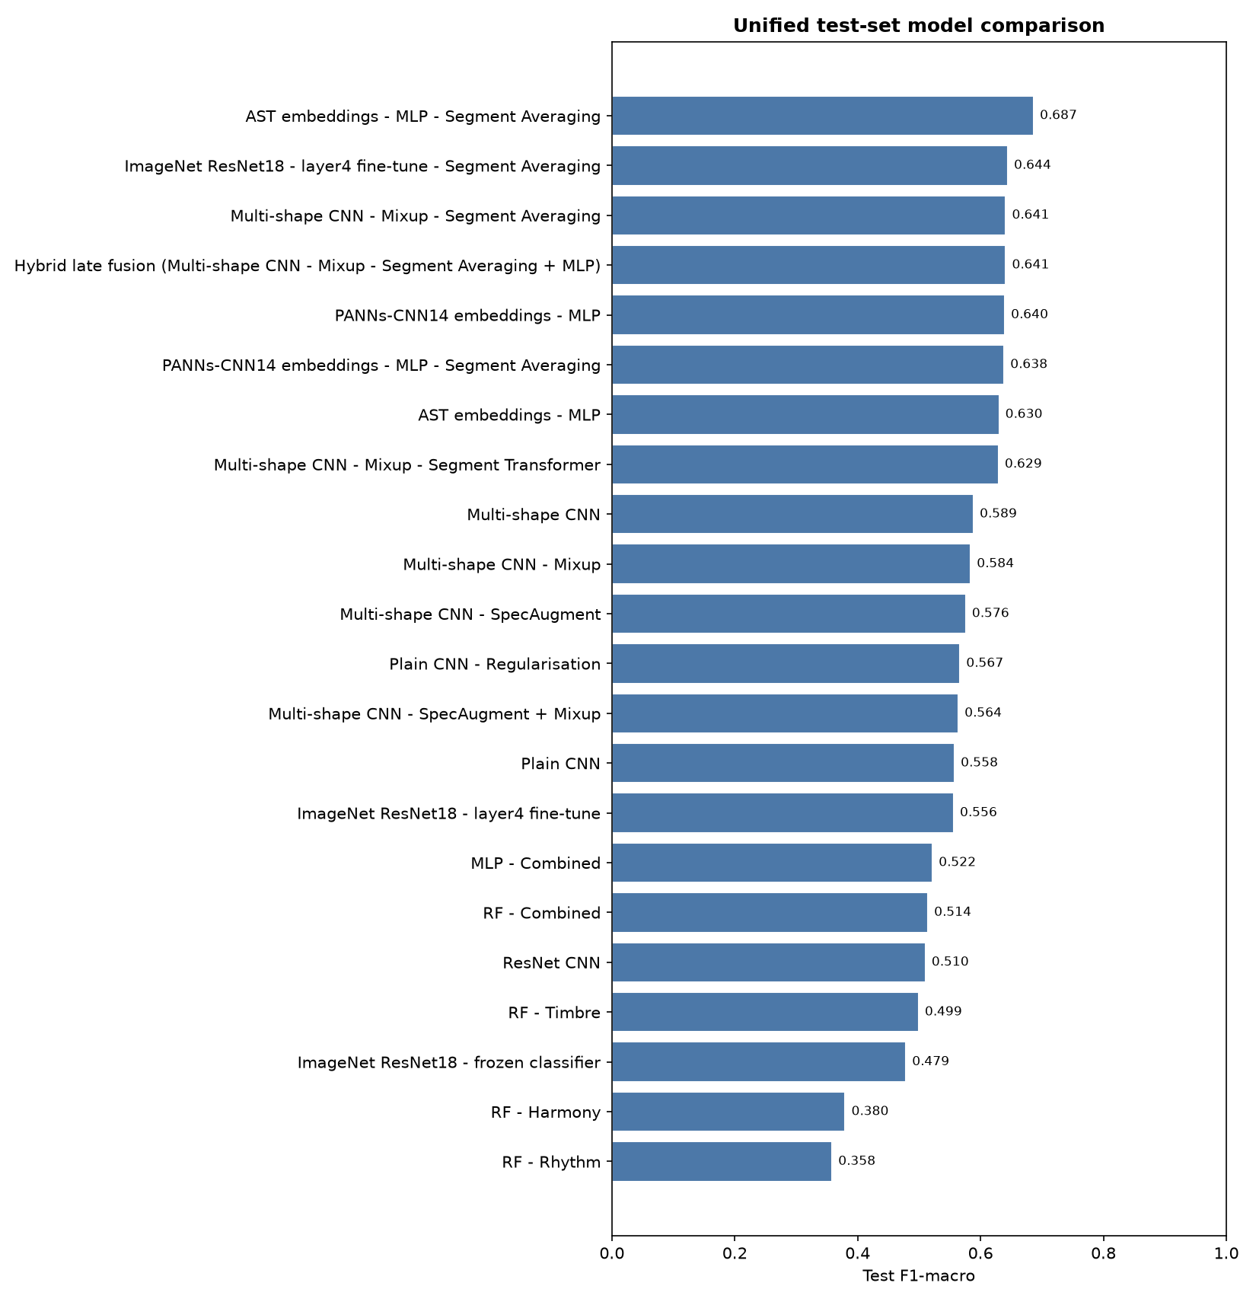
Overall Results

Slide 13
Key Numerical Comparison
Method family | Best model | Test Acc. | Test F1
Handcrafted baseline | MLP - Combined | 0.529 | 0.522
From-scratch CNN | Multi-shape CNN | 0.594 | 0.589
Augmented CNN | Multi-shape CNN - Mixup | 0.591 | 0.584
Segment CNN / Hybrid | Segment Averaging / Hybrid | 0.648 | 0.641
ImageNet transfer | ResNet18 layer4 + segments | 0.645 | 0.644
Audio transfer | PANNs-CNN14 + segments | 0.640 | 0.638
Selected SOTA | AST embeddings + segment averaging | 0.688 | 0.687

Slide 14
AST segment averaging gives the best overall result.
Improvement over the handcrafted baseline: +0.165 F1.
Improvement over the best custom CNN/hybrid pipeline: +0.045 F1.

Slide 15
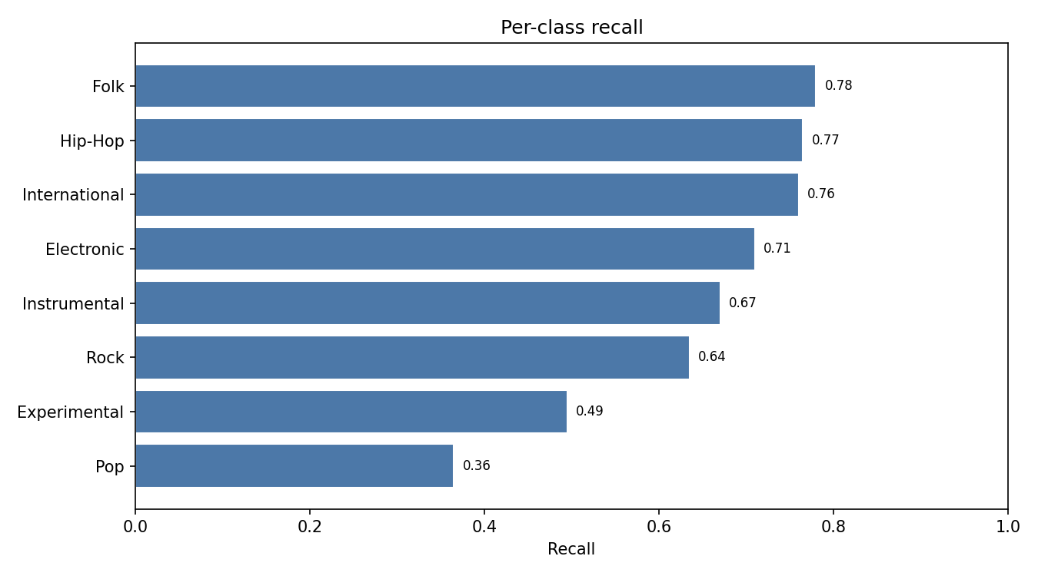
Error Analysis: Custom Pipeline Recall

Slide 16
Best custom pipeline accuracy: 0.648.
Weakest recall classes:
Pop: 0.365;
Experimental: 0.495;
Rock: 0.635.

Slide 17
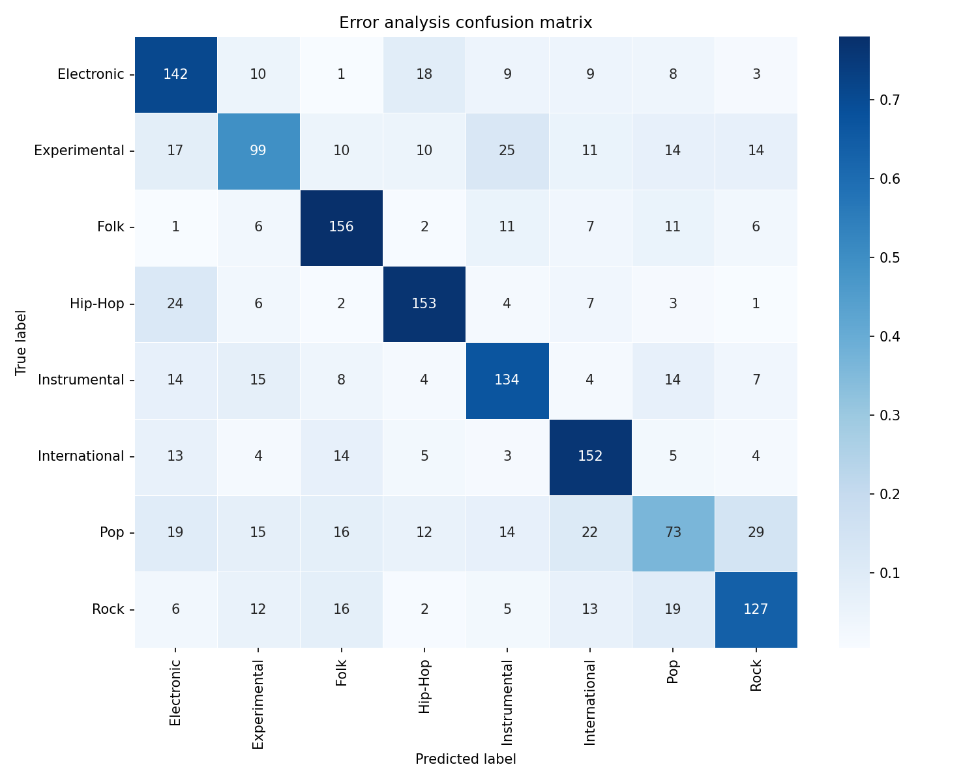
Error Analysis: Custom Pipeline Confusions

Slide 18
Most common confusions:
Pop to Rock;
Experimental to Instrumental;
Hip-Hop to Electronic.

Slide 19
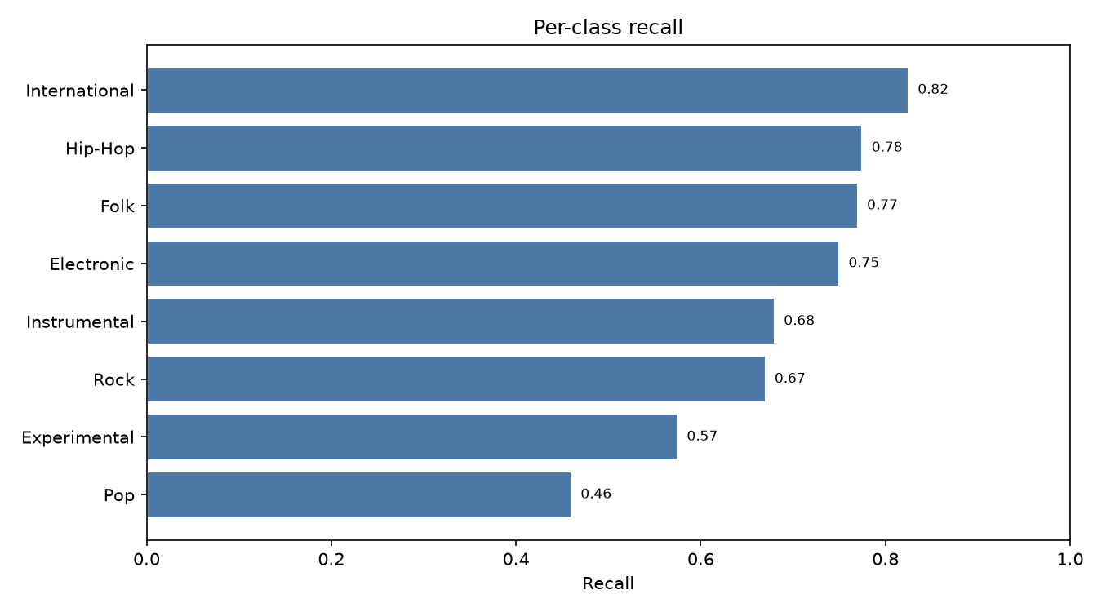
Error Analysis: AST Recall

Slide 20
AST test accuracy: 0.688; test F1-macro: 0.687.
Weakest recall classes remain:
Pop: 0.460;
Experimental: 0.575;
Rock: 0.670.

Slide 21

Error Analysis: AST Confusions

Slide 22
AST improves most weak classes, but does not remove genre ambiguity.

Slide 23
Critical Discussion
What worked:
mel-spectrogram CNNs clearly outperform handcrafted-only features;
segment averaging improves track-level robustness;
AudioSet-pretrained AST provides the strongest representation.
What did not work as expected:
late fusion selected handcrafted weight 0.0, so handcrafted probabilities did not complement the best CNN;
the lightweight segment Transformer underperformed simple probability averaging.
Likely reasons:
FMA-small labels can be broad and subjective;
Pop, Rock, and Experimental overlap strongly with other acoustic styles;
pretrained audio representations transfer better than image-pretrained spectrogram models.

Slide 24
Conclusion
The project builds a full, reproducible music genre classification pipeline.
Baseline MLP on handcrafted features reaches 0.522 test F1-macro.
The best custom pipeline, Multi-shape CNN with Mixup and segment averaging, reaches 0.641 test F1-macro.
The selected state-of-the-art AST segment-averaging model reaches 0.687 test F1-macro.
Main takeaway:
domain-specific audio pretraining plus segment-level aggregation is the most effective strategy for this task.

