Slide 1
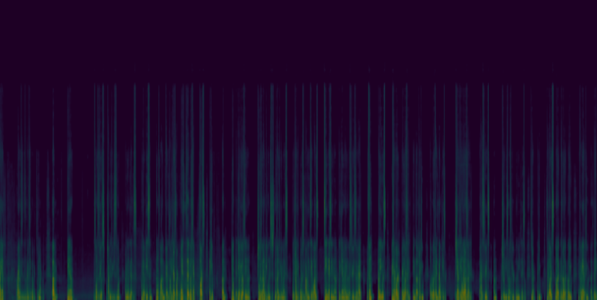
Deep Fake Voice Recognition
Onurcan Ataç
Kutay Şenyiğit
Oğuz Kuyucu
Alperen Utku Yalçın

Slide 2
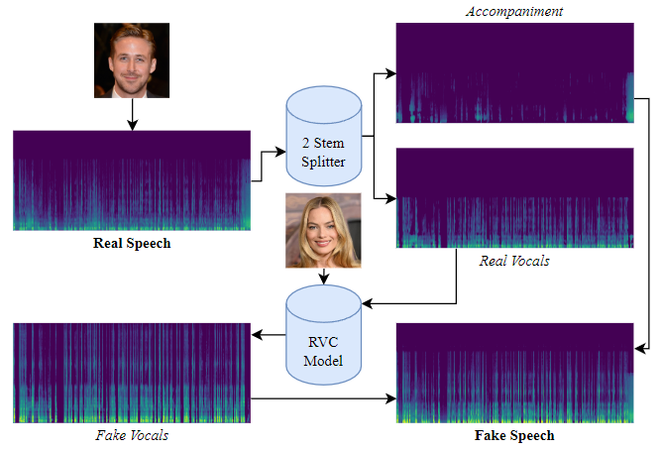
Project and the Dataset
We implemented deep learning models to distinguish
deep-fake audios and original audios.

Slide 3

Project and the Dataset

Slide 4
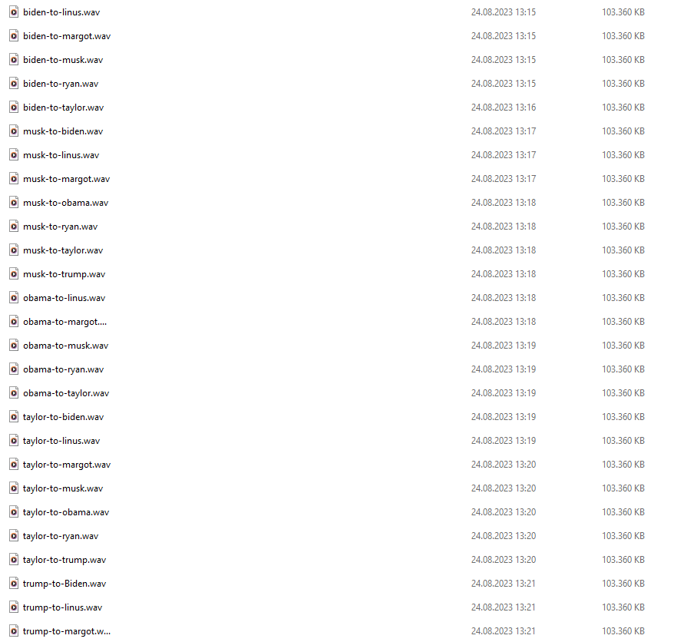

Slide 5
Pre processing
We derived spectrograms of right channels via librosa.

Slide 6
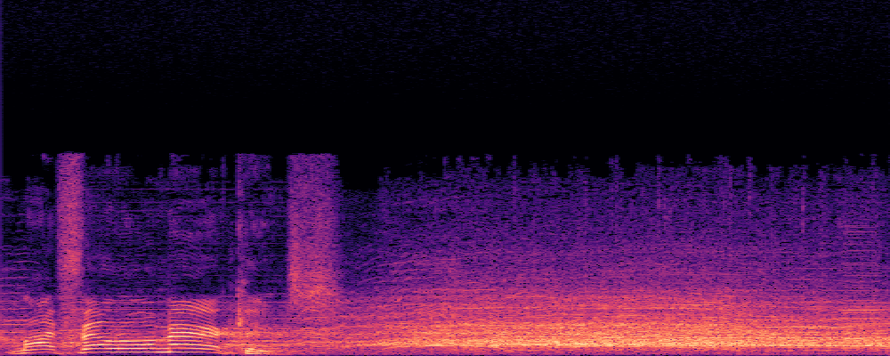
Pre processing

Slide 7
Splitting the Data
Data Split 1
Knowing A Person’s Voice but not the Transcript
DL Models
CNN
ResNet
Data Split 2
Without Knowing A Person’s Voice or the Transcript
DL Models
CNN
ResNet

Slide 8
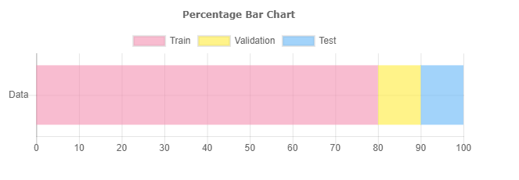
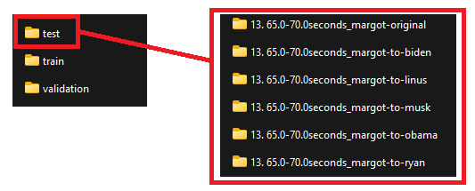
Data Split 1
80% / 10% / 10%
Each audio file is splitted separately
Knowing a person’s voice, but not the transcript

Slide 9

Data Split 2
At first, number of true != number of false
Afterwards, pick the labels
so that no of true are same as false labels.
train length: 697
Validation length: 115
Train length: 124
Train
All data – Trump or Biden
(neither their Voices nor Transcripts)
Validation
Biden’s transcript
Trump’s transcript
Trump’s Voice
Test
Trump’s transcript
Biden’s transcript
Biden’s Voice

Slide 10
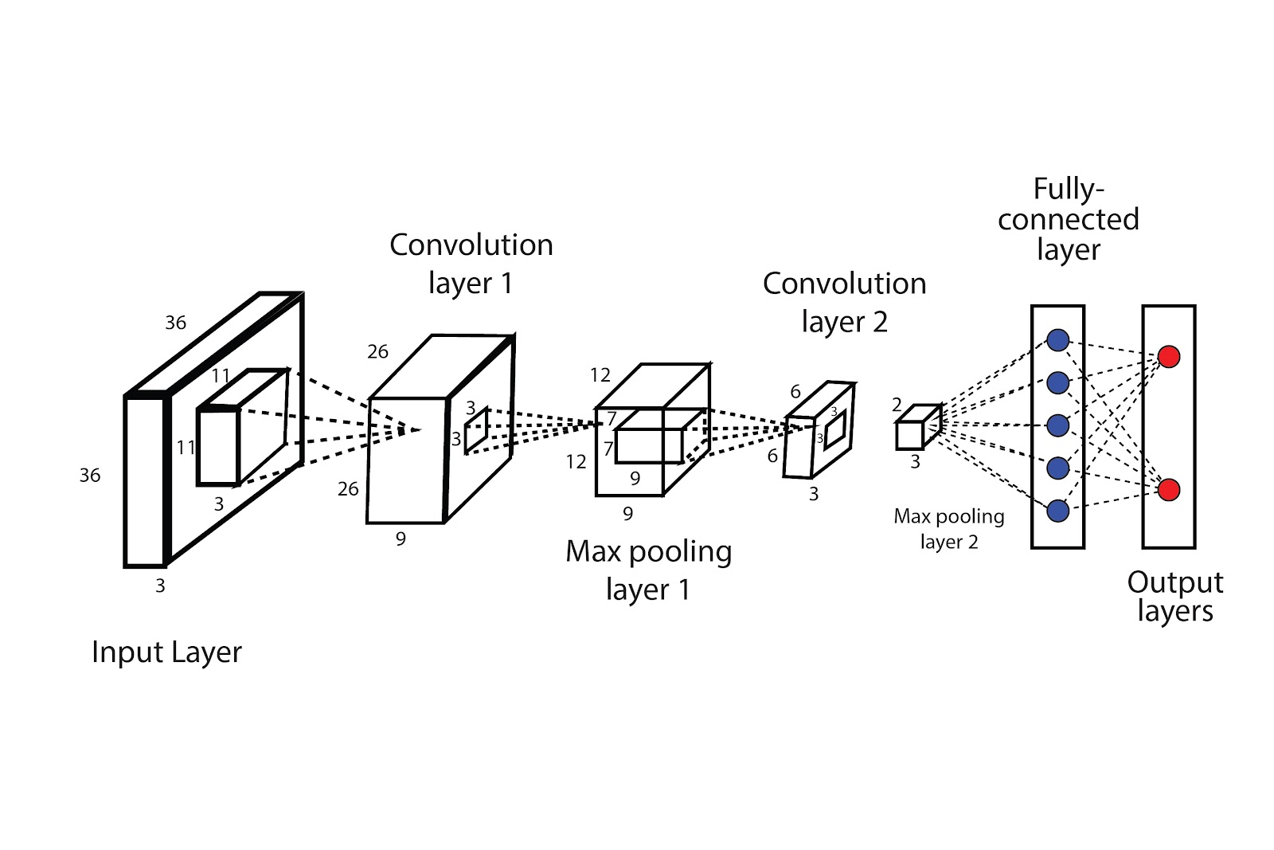
Data Split 1, CNN

Slide 11
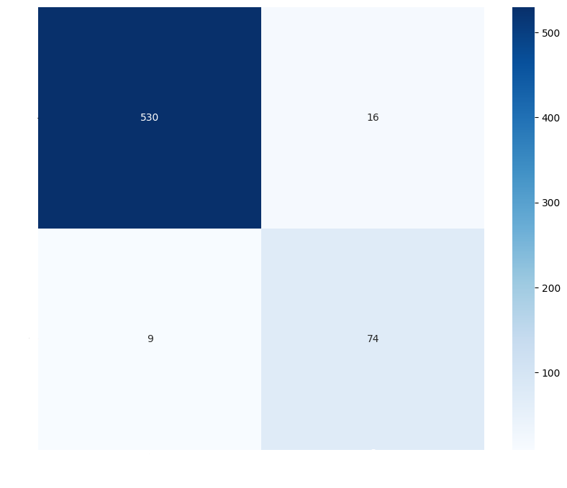
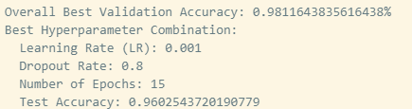
Data Split 1, CNN
Equal classes in train set
Experimented with hyperparameters
Test Accuracy: 94-96% for 15 epochs

Slide 12
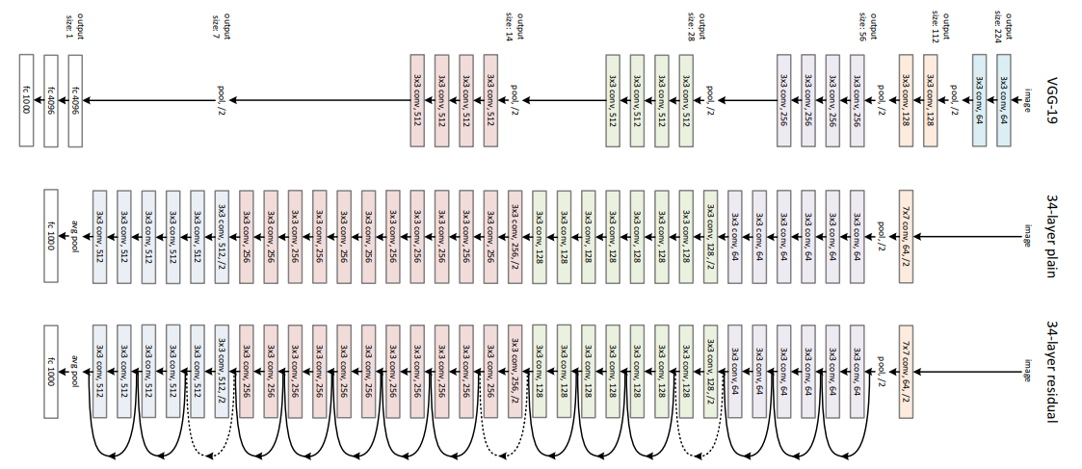
ResNet is a type of deep learning system that uses residual connections to train very deep neural networks, addressing the vanishing gradient issue.
Residual Neural Network

Slide 13
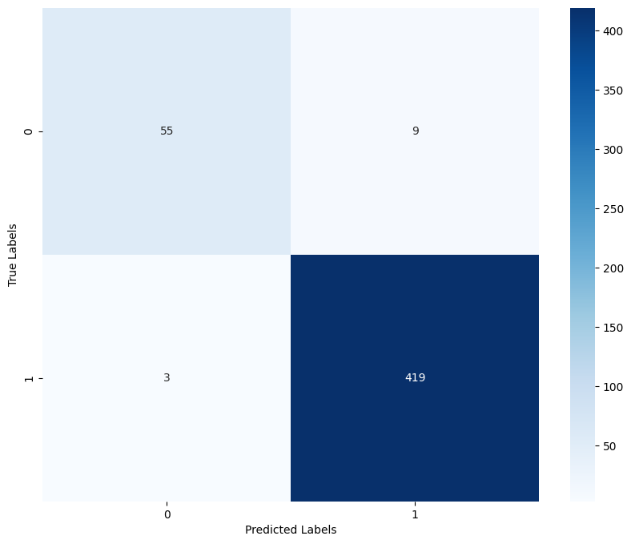
Data Split 1, ResNet
Test Accuracy: 97.53%
Batch size : 32
Learning Rate : 0.001
Number of Epochs: 10

Slide 14
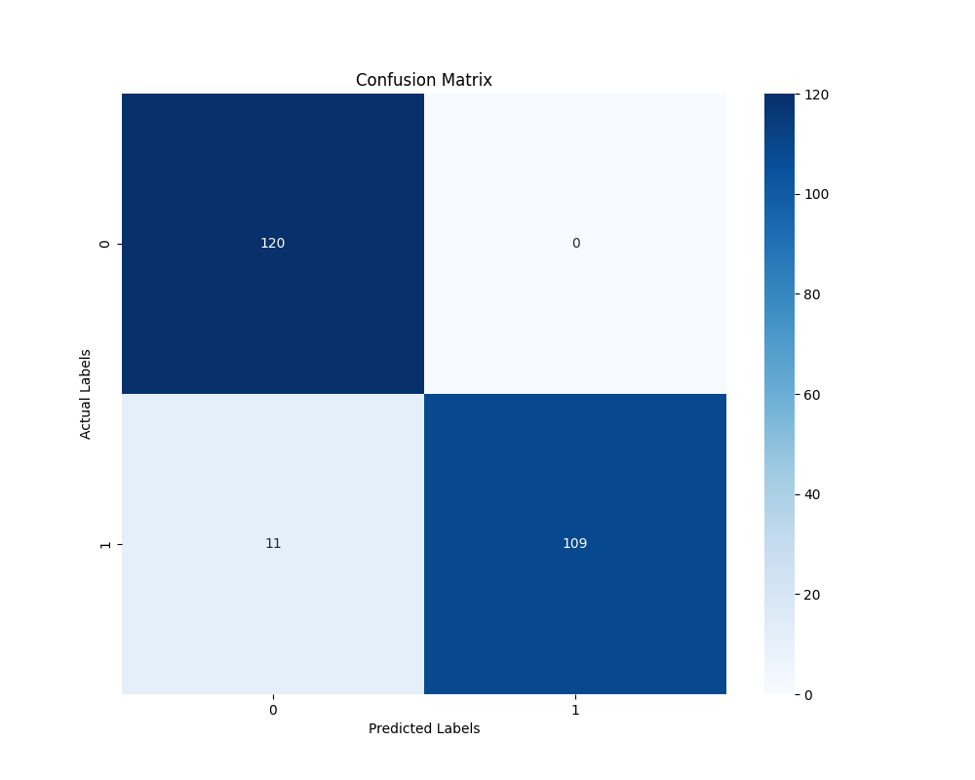
Data Split 2, CNN
Test Accuracy: 91%
Batch size = 32
Learning Rate (LR): 0.001
Dropout Rate: 0.8
Number of Epochs: 10

Slide 15
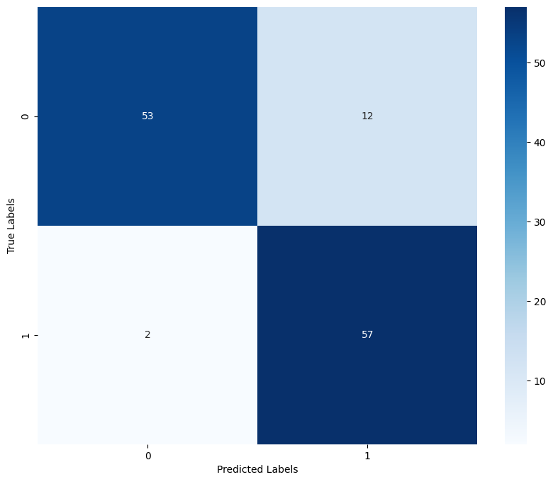
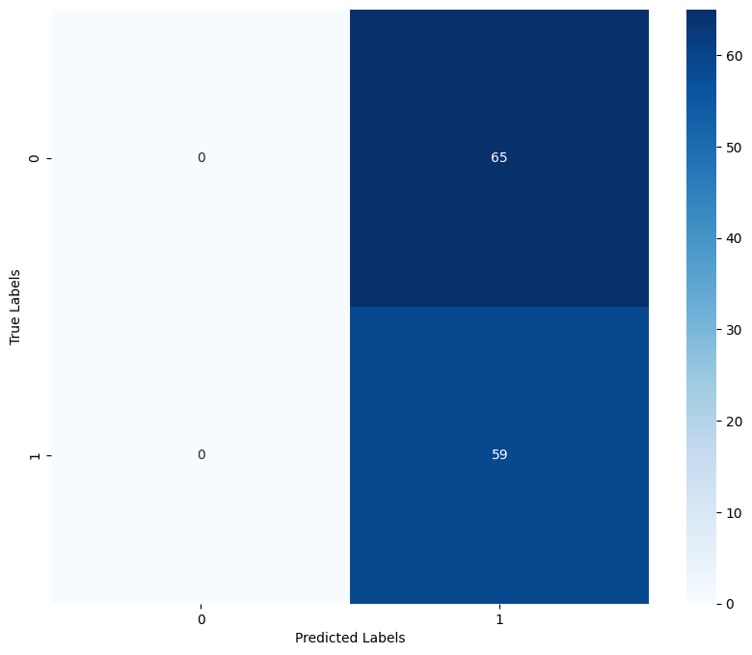
Data Split 2, ResNet
Test Accuracy: 78.23%
Batch size = 32
Learning Rate = 0.001
Number of Epochs: 1 or 2
To Prevent Overfitting!

Slide 16



Result Comparisons
Data Split 1, ResNet: Test Accuracy: 97.53%
Data Split 1, CNN: Test Accuracy: 94-96%
Data Split 2, CNN: Test Accuracy: 91%
Data Split 2, ResNet: Test Accuracy: 78.23%

Slide 17

Thank You For Listening!
Special Thanks to Ahmet Burak Yıldırım

